Slide 1
The Golden 15

Slide 2
What will you learn in this training?
During this training you will learn how to:
Analyze and Qualify the lead
Look for ways we could increase the price per unit of the Quote we send
Check for duplicates
Copy lead into NetSuite
Adding address
Send samples

Slide 3
Receiving a New Web Lead
There are 2 ways to receive leads which are via our Online enquiry form and over the Phone.
It is important we call the customer within the first 15 minutes where possible to beat our competitors and discuss the customer’s enquiry. We strive to have the Quote to the customer within 45 minutes of receiving the enquiry.
Remember the customer is likely to have enquired elsewhere, do you want someone else eating your lunch?

Slide 4
Analyzing and qualifying the lead
Review the Enquiry form in full:
This gives us a better understanding of the customer’s enquiry and what isn’t completed needs to be discussed with the customer on the phone. Questions that need to be considered are:
Do we have the correct contact details for the customer?
What products are they interested in?
How many units do they require?
If applicable, what capacity do they need?
Do we have the customer’s logo? If not, Be proactive and search on Google and customer’s website.
Do we have an Address for Samples? If not can we still send some by discussing with customer on the phone or searching on Google?
Do they have an anticipated delivery date? Can we achieve it?
What size company are they? What do they do?
Can we increase our Quote based on any of the above?

Slide 5
Analyzing and qualifying the lead
All mentioned needs to be considered and if we are missing information, it’s important to discuss this on the phone with the customer.
If we can’t reach the customer, it’s on us to be as proactive as possible and search for what we can.
Always where possible, send a Quote, Price List, Virtual Proof and a Showcase PDF from the product category of interest.
Top Tip:
Review the customer’s website to get a better understanding of the customer and their requirements. It is also handy for building a rapport with the customer over the phone.

Slide 6
Checking for Duplicates
Before we copy the customer across to NetSuite, it’s crucial to check the customer hasn’t made an enquiry with Flashbay before. This must be done before every lead is inputted into NetSuite and you do this by searching for:
Customer’s name
Company name (and different variations just in case it was put in different to what you have received).
Telephone number
Email address
Once these checks have been completed, you are free to input the lead into NetSuite.
If the customer belongs to someone else after checks, email the Enquiry form to the relevant SAM.

Slide 7
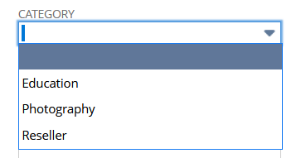
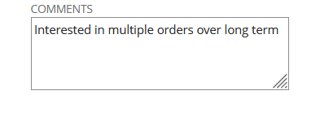
Transferring lead from enquiry form to NetSuite
Now you have completed your checks, it’s time to copy and paste the details on the enquiry form to NetSuite:
Copy and paste (CTRL+C, CTRL+V) the details to ensure accuracy
Make sure EVERYTHING is transferred across
Update the customer’s Category if appropriate. i.e are they a Reseller or Education?
Update the correct Territory
Update the correct Price Levels so if they decide to place an order Online they will see the correct Price Levels
Use the Comments section to help yourself.
Now that you have analyzed the form, checked for Duplicates and copied into NetSuite, It’s time to pick up the Phone and call your customer.

Slide 8
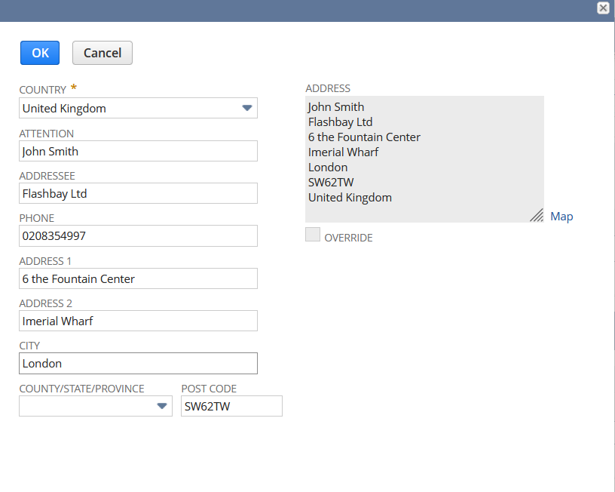
Adding Address for Sending Samples
Sending Samples is one of our biggest assets for winning any deal.
We have a Sample of every product in our Warehouse so the Customer receiving them is a fantastic way of winning your order.
These are also usually delivered to the customer’s address within 48 hours. A lot of our competitors don’t send samples so use this to your advantage and send where appropriate.
Always copy and paste to ensure accuracy.

Slide 9
Adding Address
Sending Samples is one of our biggest assets for winning any deal.
Scroll to the Address Tab on the Customer`s profile and click Edit.
2. In the new pop-up fill out all the details including Attention field and click OK (see on right).

Slide 10
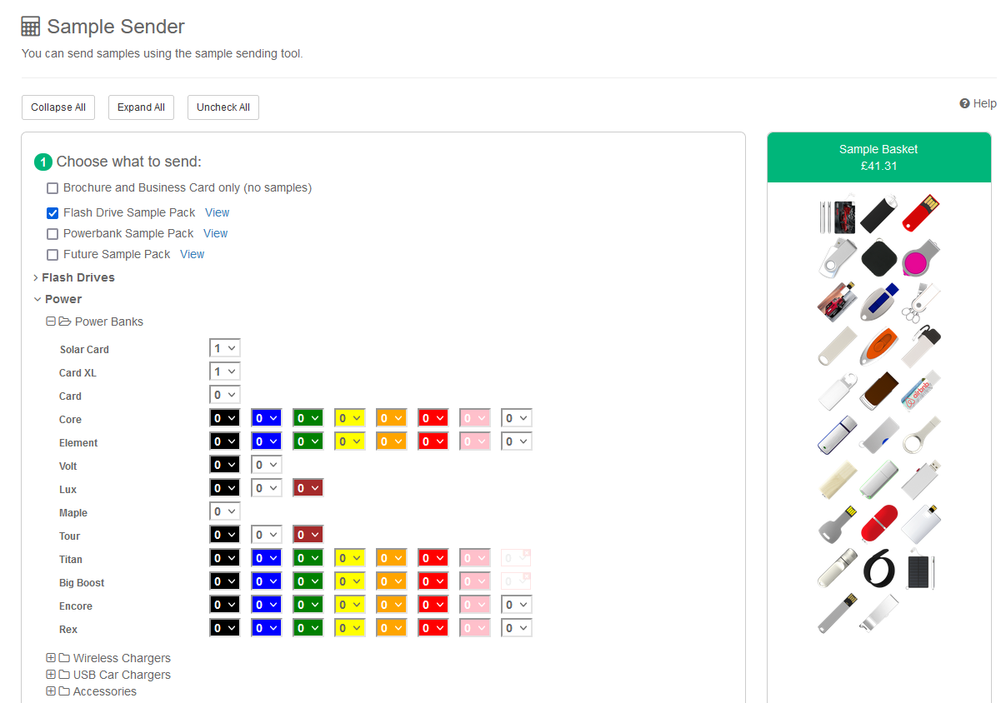
Sending Samples
1. Scroll to VP & Samples on the Customer`s profile and click Send Samples.
2. In the Sample Sender page tick the Samples you want to send

Slide 11
Sending Samples
To send Samples to the Customer, please follow the below process and keep in mind:
• Is the address correct?
• Which Samples do they require?
• Has the Customer mentioned any other Products they are interested in?
• Are there any other products that might be suitable?
• Do you need to send samples?
I.e. If the enquiry is a Photographer and interested in 10 units, do you need to send a full sample pack or a single, loose sample?

