Slide 1
Emails

Slide 2
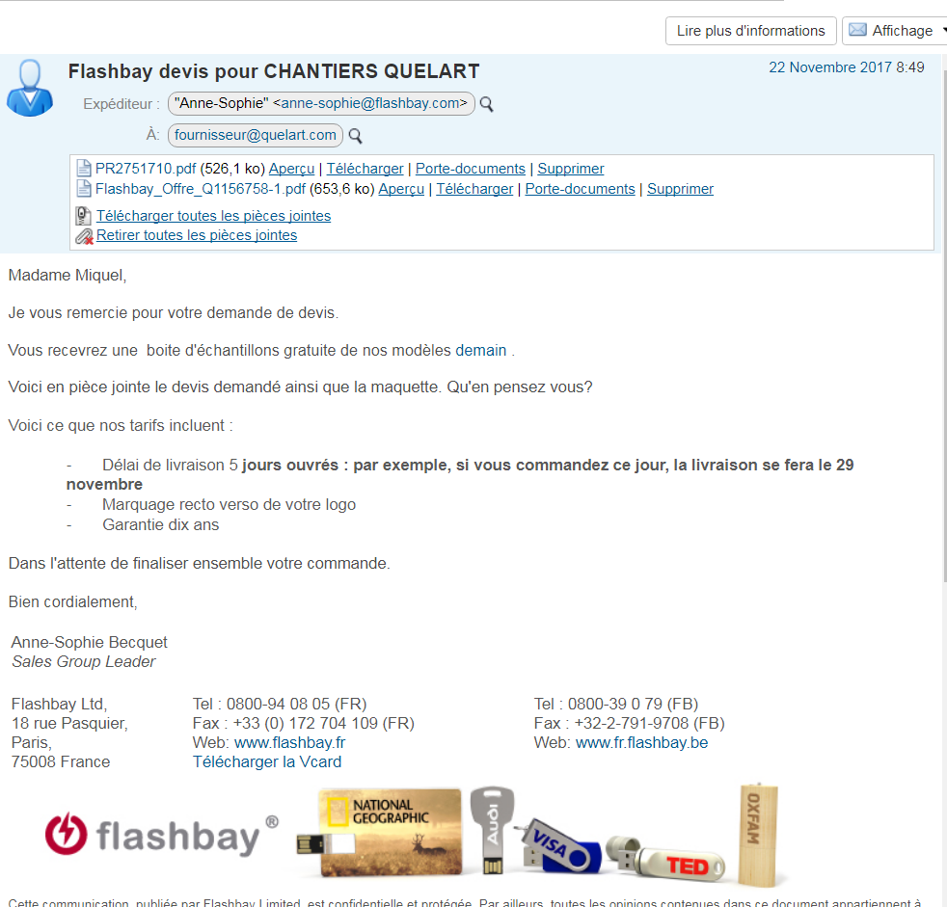
First Email
Form:
Correct email formatting :
Consistent font colour & font size
(must match signature)
Clear layout
Consistent structure of autotext with typed text
Suitable amount of text :
Concise
Fast response at first contact:
Respond within 15 minutes (Max 45min)

Slide 3
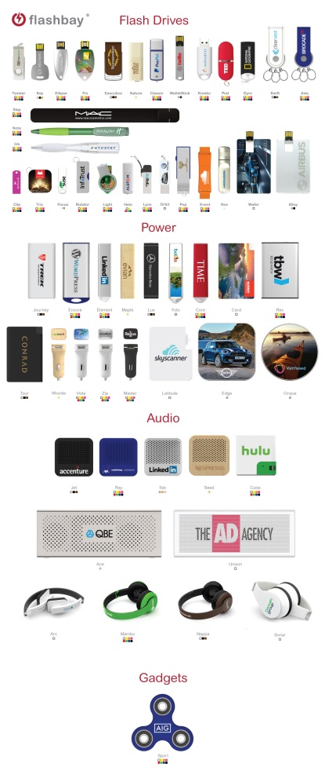
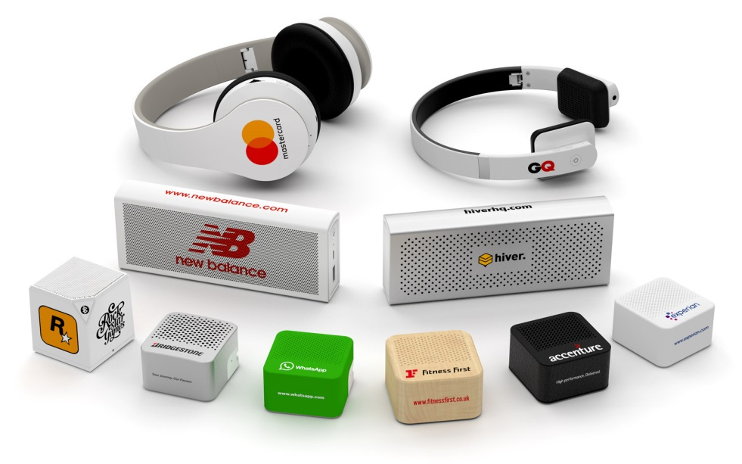
Substance:
Good subject line
Relevant subject with customer’s/company name.
People are receiving plenty of emails every day,
your email has to be identified quickly & efficiently
Suitable attachment
Product group image attached or specific images relating to customer inquiry
Always attached the whole category of products

Slide 4
Insightful first 2 sentences
Mention relevant companies in their industry we have already supplied (or if we supplied them in another territory)
“Flashbay supplied your company in Germany and we will be more than happy to work with your company based in UK as well”

Slide 5
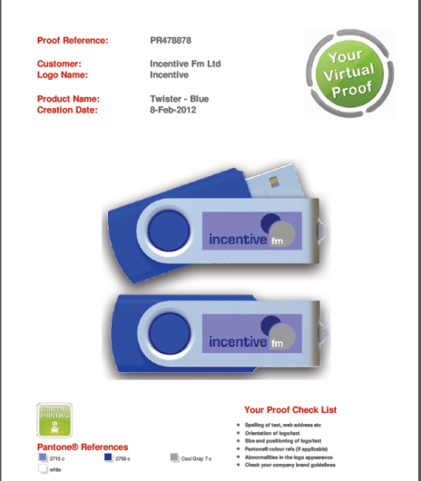
Sample pack
Mention the sample pack will arrive within 24 hours (check the correct address with customer)
Provide a quick virtual proof
Pro-active seeking of customer’s logo (Google) / quick turnaround of relevant virtual proof if logo received
“You will find attached the virtual proof with your logo. What do you think about it?”

Slide 6
Suitable quoting method
Use of quote and pricelist
Upselling when appropriate (accessories etc..)
Match your price with the kind of company you are dealing with + the quantity
Use of specific date and time
Specific reference to:
Order lead time: If you order today, you will receive the goods on Monday 4th August to LVMH 58-60, avenue de la Grande Armée 75017 Paris «
Date the decision will be taken: When can you make a decision? - Following our conversation, I’ve noted that you will make a decision at the end of next week
Date you will call the customer back: So I will call you back next Tuesday to talk about that and answer to your possible other questions
Defining next step in sales cycles
Lead customer toward a purchase

Slide 7
Follow-up
Always attach a virtual proof to your email
Reference to customer’s requirement ( What information is helpful in the lead form?)
The date they want to receive the order
The model & the quantity they are interested in
What do you think about the samples pack?
Do you like any of our models?
Would you be interested in any other products?
Intelligent use of price match where required
Send better offer
Never take no for an answer!
Send memo email after every call
Mention why Flashbay is the best flashdrives supplier (sample, leadtime, very good review from customers, 10 years warranty etc...)

Slide 8
Match your price when possible
Offer free shipping cost / offer accessories (check before with your group leaders)
Explain to customers what the Flashdrives/Powerbank/Audio can do :
Communication tools useful for your brand
Corporate/functional gift
Flashdrives : We can load data for you for conferences, presentations etc..
Useful for your employees / collaborators as work tools
Goodies bag

Slide 9
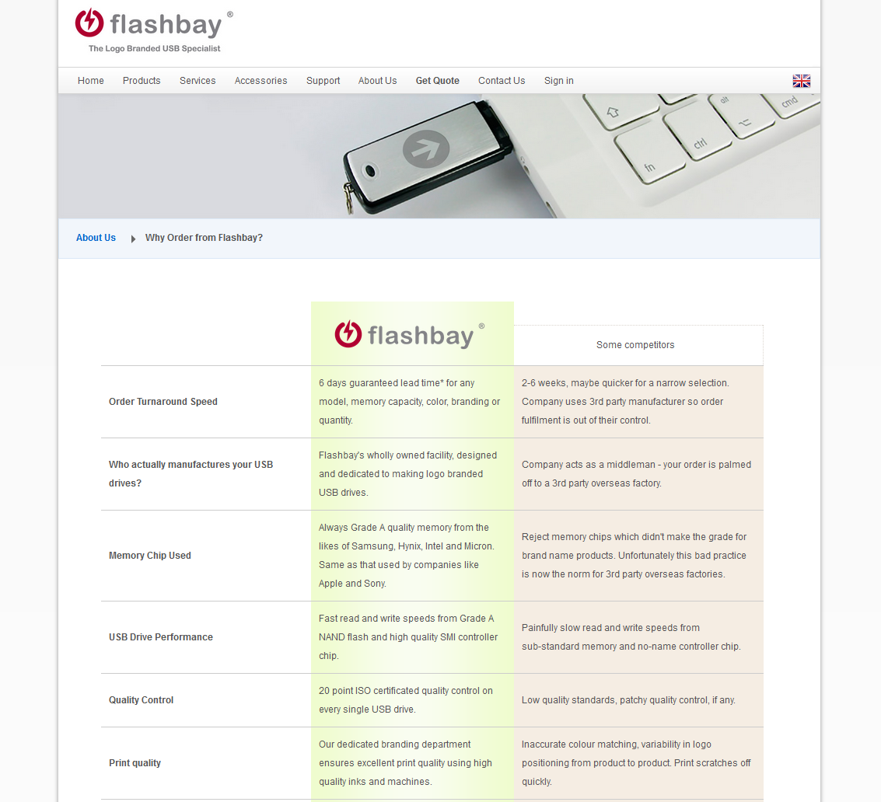
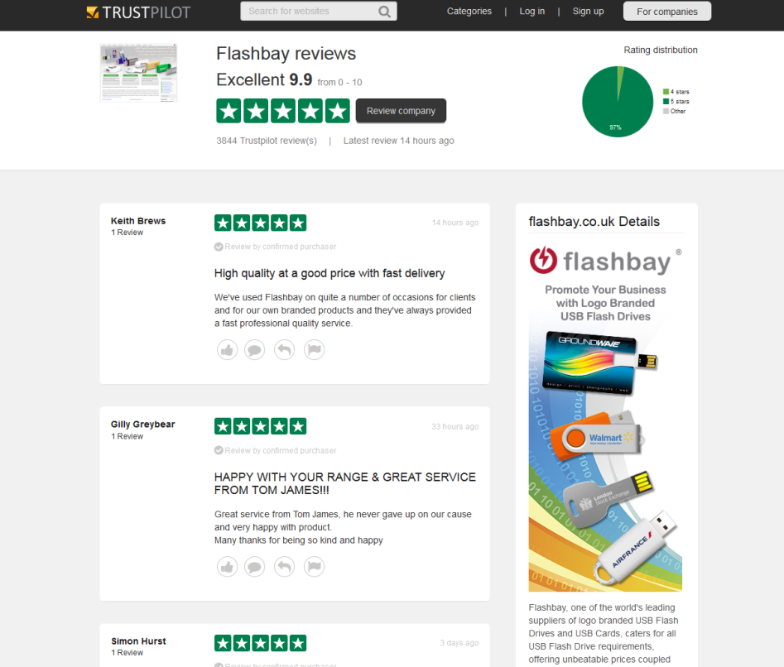
TrustPilot link – Why order from Flashbay Link

Slide 10
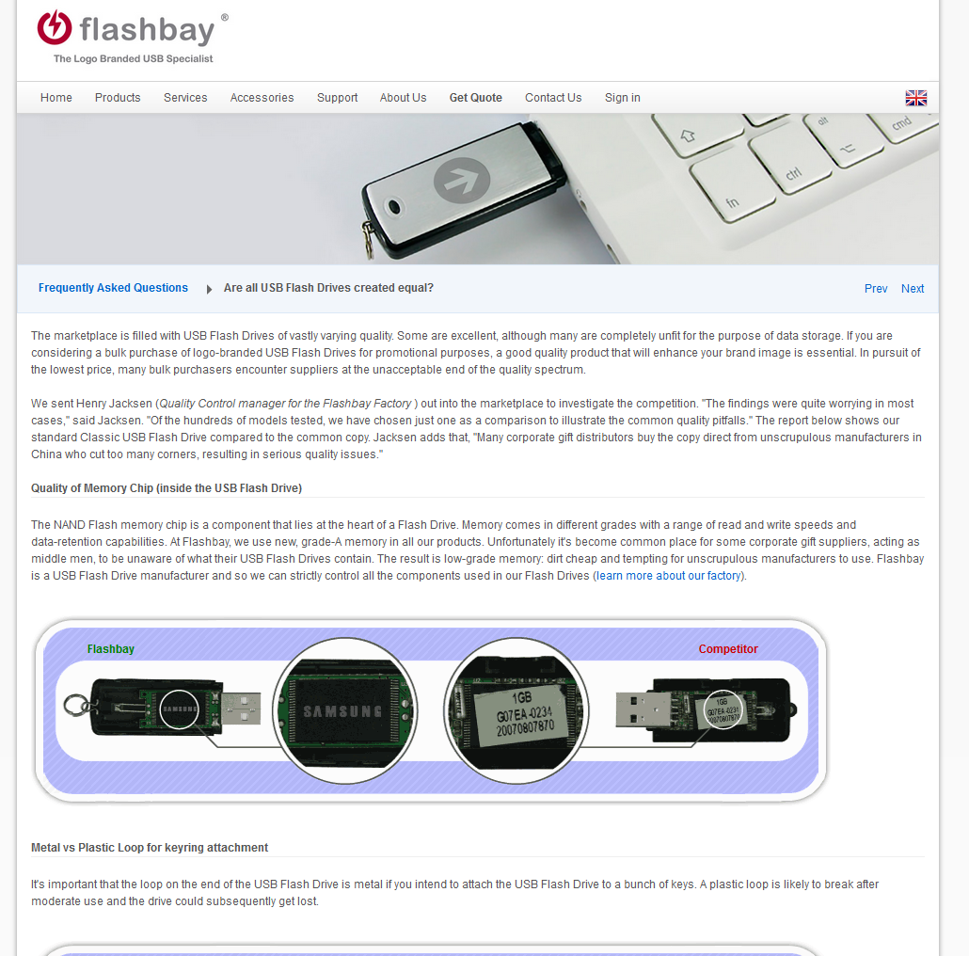
Attach the doc - Are all USB Flash drives created equally?

Slide 11
Refresh Leads/Customers
Contacting your prospective & existing customers every three months or sooner builds trust & professionalism and keeps “top of mind” awareness.
Remind the customer of their last order/last enquiry
Suggest our new models by sending samples of our new models + Powerbank
Give customer reasons to buy (events, gifts etc..)
Suggest new avenues when customer is interested (schedule a new phone call)

