Slide 1
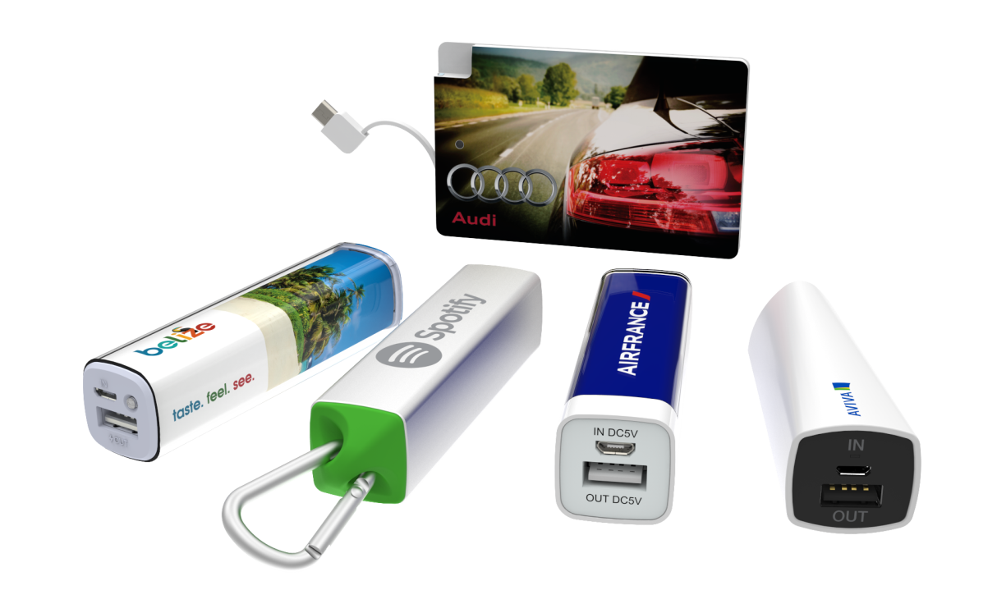

Flashbay – Power banks

Slide 2
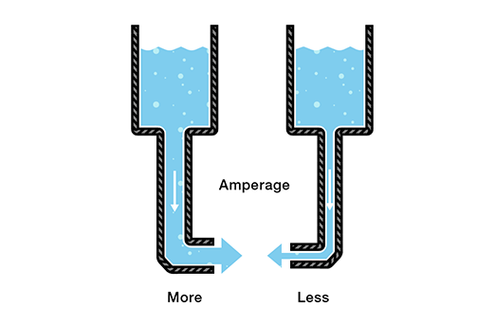
Short Introduction to Electrical Current
Electricity is the move of electrons. Electrons create charge, which we can harness to do work.
Ampere: Amount of electrical current
A milliampere hour (mAh) is the amount of energy charge in a battery that will allow one ampere of current to flow for one hour. Battery capacities are given in mAh
Volt: Electrical force that makes electricity move through something. It is the difference in charge between two points.
Very simplified:
When describing voltage, current, and resistance, a common analogy is a water tank. In this analogy, charge is represented by the water amount, voltage is represented by the water pressure, and current is represented by the water flow. So for this analogy, remember:
Amount of Water = Charge (mAh)
Thickness of pipe = Ampere

Slide 3
A Power bank with 2600mAh can theoretically deliver 2600mA / hour.
Our Power banks are limited to a maximum of 1A output.
Most mobiles have an input of 1A.
As the internal circuits consume some power, roughly 20% of the power is “lost” on the way. This factor increases depending on how heavily the receiving device is being used.
Formula for calculating charging times:
Charging time = mAh of Battery to be charged / 0,8 x Output Milliamps of power source
Example:
Iphone 6s battery capacity = 1810mAh
Power bank output =1A (1000mAh)
Charging time = 1810mAh / 0,8x1000mAh = ca. 2h 15 min
The same formula can be used to calculate the time needed for charging the PB, albeit with a different output power source.
Typical output sources:
USB 1.0, USB 2.0: 500mAh, 0.5A
USB 3.0: 900mAh, 1.5A
Wall socket: usually max of 15 A
As the Power bank has a maximum input of 1A, charging time is not shortened in output of source is higher than 1A
How often can I charge a specific phone model?
Formula:
PB capacity x 0.9 x.0.8 / Phone capacity
Why 0.9? Because Power bank batteries are never 100% charged.
As the efficiency loss increases beyond 90%, leading to wasted charging potential. Going from 95% to 100% can take exponentially more power.

Slide 4
Unique Selling Point Power banks
Many customers are worried about poor quality components as these can cause PB’s to break or even explode.
We offer top quality PBs with all relevant safety features:
Output over-current and over-voltage protection
Input over-current and over-voltage protection
High temperature shut down
Short-circuit protection
Electrostatic Discharge (ESD) protection
All other services (except the warranty) are the same as for our USBs, e.g. quality branding and components, first class service, in house R&D and production (although only in house designs are ET and FT for now)
At the moment important to get higher volume so that we can realise Economies of Scale. That means offering at a lower price point (Usually level 5 max., depending on the market)
RF is easily available from competitors (and pretty ugly...) so try to guide customers to our signature models

Slide 5
Handling objections / FAQs
Q: Do you offer higher capacities?
A: Yes we offer bigger capacities such as: 5200mAh, 6000mAh, 6700mAh.
Q: I’ve heard that Power banks can be dangerous. Are your PBs safe?
A: Refer to safety features
Q: Is it compatible with all phones?
A: Yes. Different phones will need different cables. Refer to user manual of your phone.
Q: I have an IPhone. Can I use it with my IPhone? Why don’t you supply an Apple cable?
A: Yes, with a lightning to USB cable supplied with Apple products. All Apple products come with a lightning to USB charger cable that can be used with the Power bank.
Q: Why don’t the PB come fully charged?
A: For safety reasons it is not permitted to transport fully charged PBs as cargo on planes
Q: Do they come pre-charged?
A: Power banks come ca. 30% pre-charged
Q: Can I take my Power bank on the plane?
A: Guidelines on this are not completely clear at the moment. Some airlines allow for up to 2 PBs to be taken on as hand luggage. If in doubt, please check with your airline beforehand.
Q: What is the life cycle of a Power bank?
A: On average a Voltbay Power bank - if properly maintained - can be used for about 400 - 500 cycles.
One cycle means a charge and then discharge. If you don’t charge the power bank fully before discharging it is still counted as one cycle.
The life-cycle also depends on the power banks storing conditions
Q: What is the warranty period, and what does it cover?
A: The Warranty period is 2 years and can be applied for the power bank only, the cable is excluded.

Slide 6
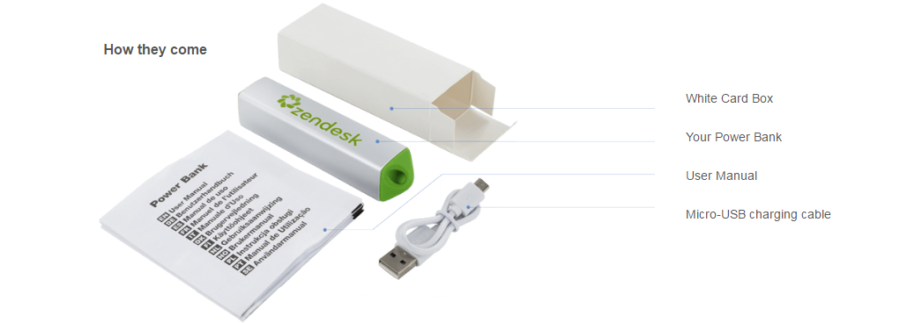
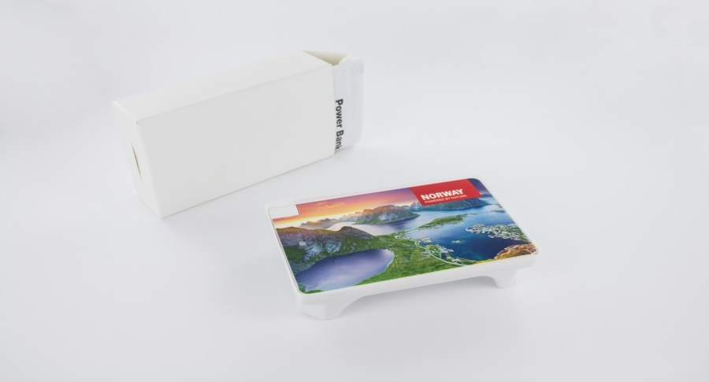
Packaging and Extras
What does the standard delivery option look like?
Comes with cable, manual and is packaged in cardboard box
The Card has also a plastic holder (the cable is placed under the PB in the plastic holder)

Slide 7
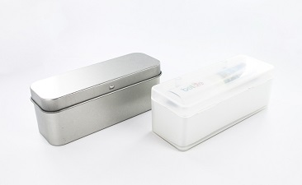
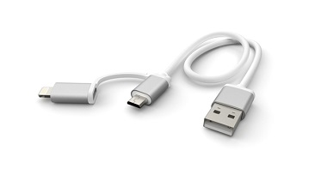
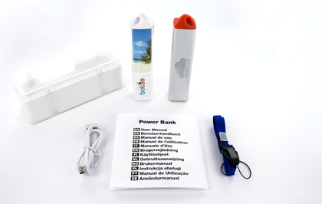
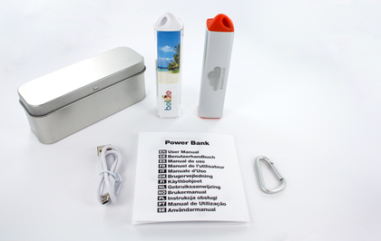
What are the different combinations of accessories and Power banks and how are the packed ?
We have 3 different packaging options apart of the standard packaging.
MBXL (Magnet Box X-Large) PTXL (Presentation Tin X-Large)
Accessories are MBXL , PTXL and DHC cable upgrade.
The accessories will not be attached to the Power bank, more info on Power Bank Product knowledge wiki page.
Pantone matching only available for certain models.
Standard 2 side branding ET and RF. 4 side branding also available on ET with 2-3 days longer lead time (always check with Operations before placing order). Charge extra.

Slide 8
Scheduling orders
All item codes can be found in the price list
Be aware that orders for flashdrives and powerbanks must be placed seperately
Powerbanks can only be shipped in multiples of 25
A manual language must be chosen

Slide 9
Email Templates
A lot of SAMs are still using their standard USB templates. It makes sense to rework them and add keep them in a separate folder.
Mind longer lead times than USBs (these are mainly due to customs and special transportation rules for dangerous goods).

Slide 10
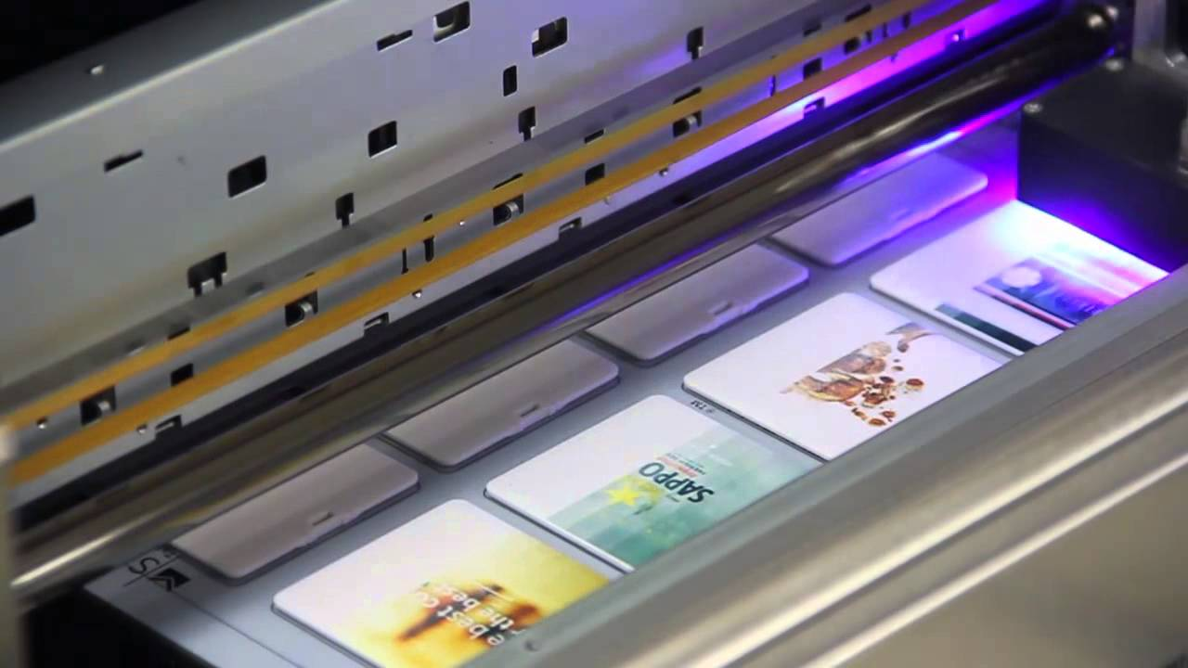
Branding/Samples
Branding
There is no difference to USBs except Card model, which uses an advanced screen printing method.
Dummy Samples
Can be ordered via sample tool
By default samples are sent from all available models (if customer does not want all models, inform Warehouse in email)
Working Samples
At the moment order via Aftersales

