Slide 1
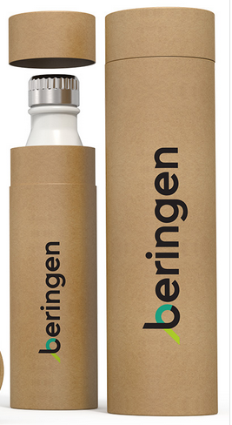
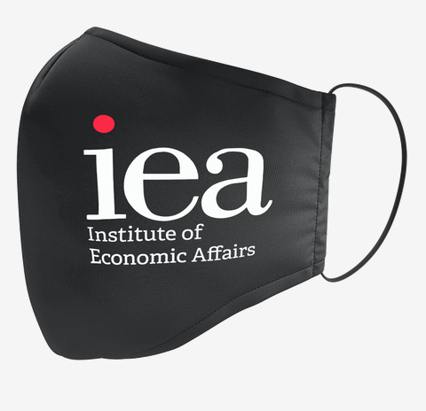
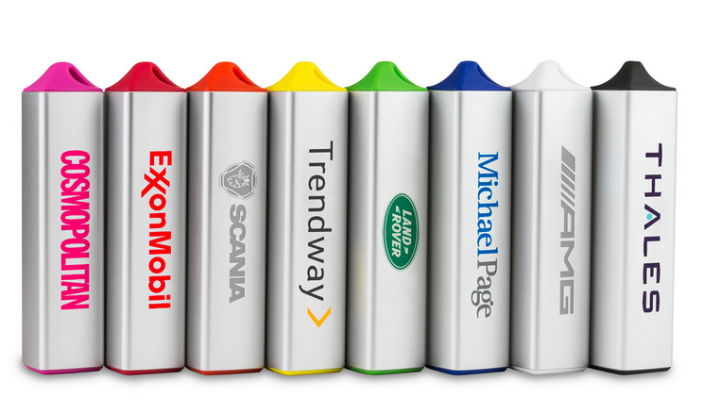
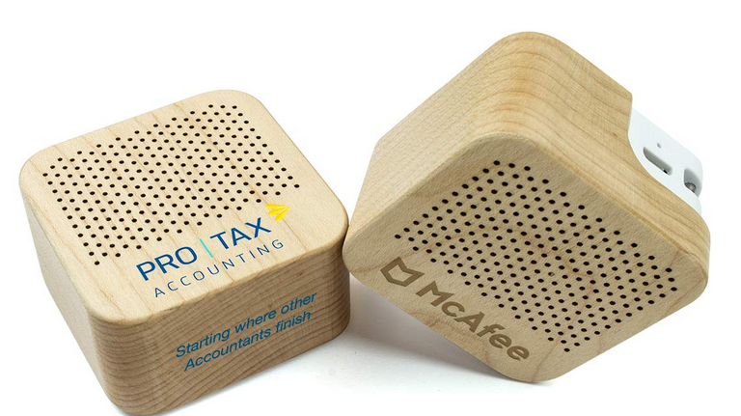
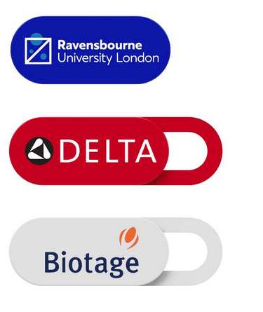
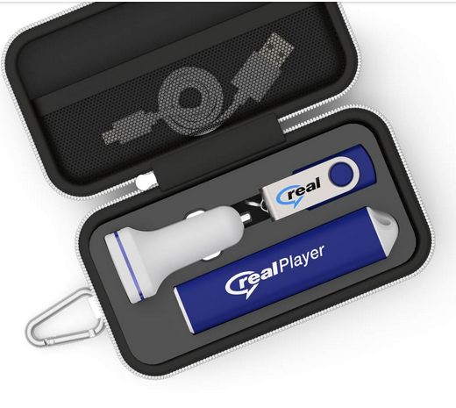
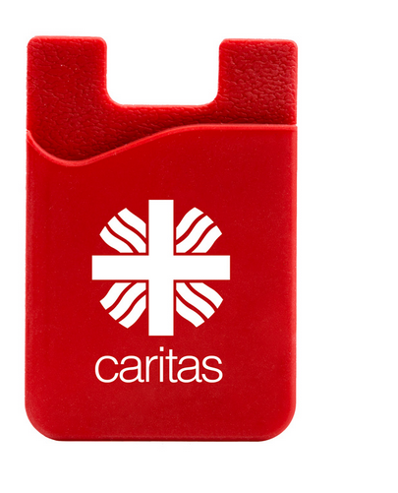
Which other products do we sell?
Power : Power Banks, USB Travel Chargers, Wireless Chargers, USB Car chargers
Drinkware: Water Bottles, Travel Cups, Straws
Audio: Bluetooth Speakers, Bluetooth Headphones, Bluetooth Earphones
Gadgets: USB Cables, Phone Grips, Phone Stands, Phone Wallets, Multi Tools, Cable Tidies, LED Torches, Webcam Covers
Face Masks: Face Masks and Face Shields
Gift Sets: in 3 different sizes, 5 different types

Slide 2
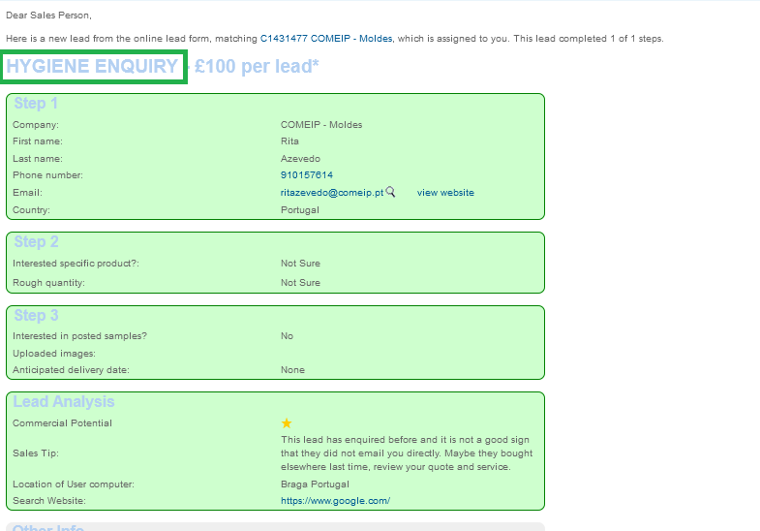
New Web Lead form
What to pay attention to :
Which product category lead is interested in
Do they want samples?
Do they have a deadline?
What quantity they are interested in?
What is the star rating?
Any other info?

Slide 3
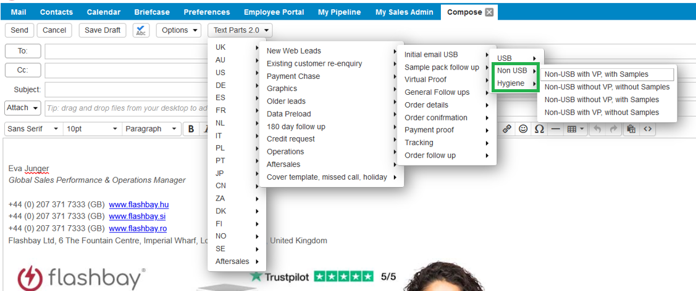
Text Parts :
Choose the correct template
Why is it important to use it?
Different lead time
Different Warranty period
Different information in the text parts

Slide 4
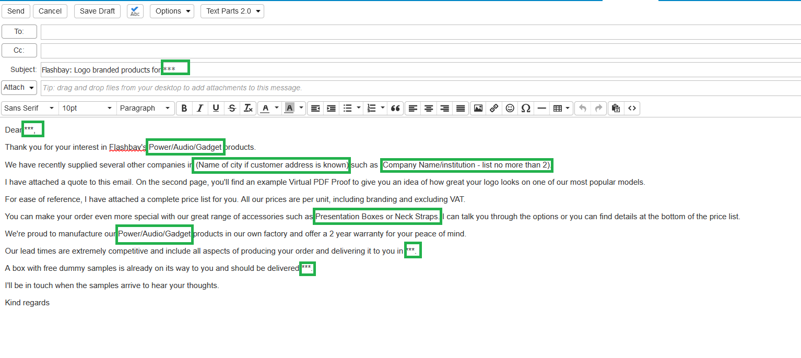
Text Parts :
Amend and proof read the text part before pressing send :

Slide 5
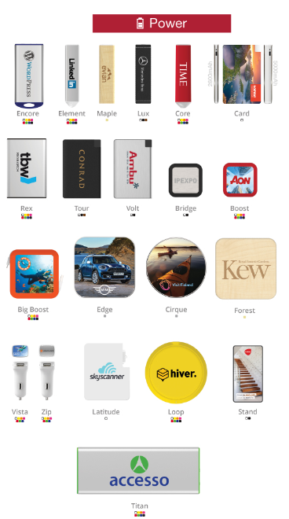
Power
Power Banks
How many capacities do we offer?
What is the life cycle of a Power Bank?
Do they come fully charged?
How many times a PB can charge the phone?
What are the order quantities?
Wireless chargers
How does the wireless chargers work?
Compatibility (QI enabled devices)
USB Car charger:
How many devices can it charge?
USB Travel Chargers:
What adapters are supplied?
What is the Warranty period for all Power products?
Remember: MOQ and order quantities for each Power sub category

Slide 6
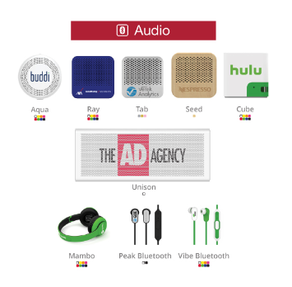
Audio
What is the Bluetooth version used and what is the Bluetooth range?
How long does it take to charge:
Headphones (MO 45 mins, AC 30 mins)
Speakers (mono: 1,5 hours, stereo: 3 hours)
Earphones (1,5 hours)
Which customers are likely to buy, what’s the target audience?
Do the products come pre-charged?
Can the speaker be used as a Power Bank?
What is the Warranty period?
What are the order quantities?
When to send working sample?

Slide 7
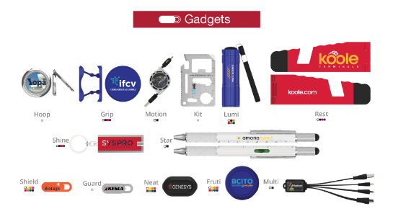
Gadgets
Range of Gadgets is changing depending on the market trends.
What is the top seller gadget?
Why is Shield (SH) thicker than the ones sold by competitors?
What is the Warranty period?
What is the MOQ and order quantities?
Multi (MU) and Motion (MT) upsell with Power Banks

Slide 8
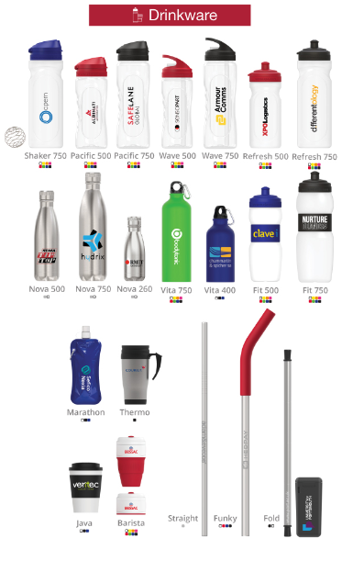
Drinkware
Which model is the top seller?
What certificates do we have for Drinkware, why are they important? - (BPA, EU Food Grade)
How many colours can we print on Drinkware?
What can you upsell?
What is the Warranty period?
What is the MOQ and order quantities?

Slide 9
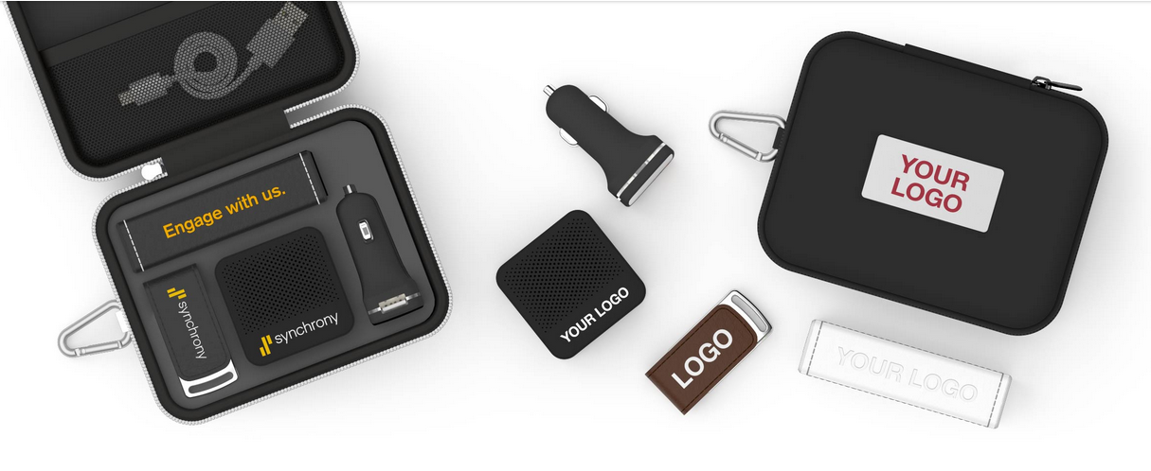
Gift sets
How many types of Gift Sets, how many sizes? (5 types, 3 sizes).
What can be sold as an upgrade for Gift Sets?
What is the warranty period?
What is the MOQ and order quantities?

Slide 10
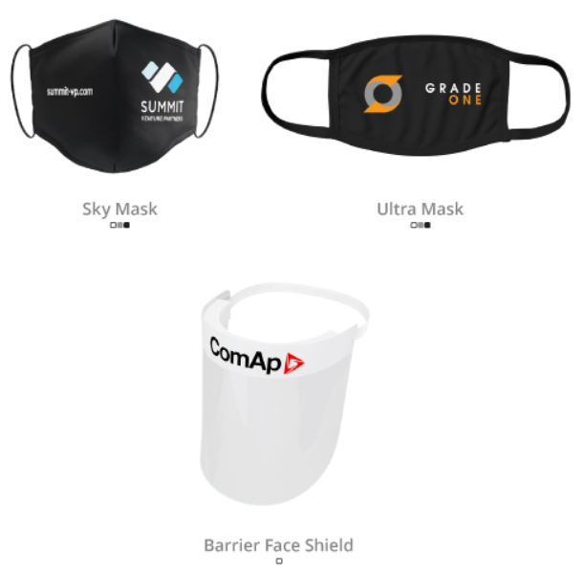
Hygiene
Are the products re-usabale?
How many times could the masks be washed?
How should the Face Shield be cleaned?
Are the Face masks medical, do we have medical certificates?
Do we sell masks for children?
Are the masks individually packed?
What is the Warranty?
What is the MOQ and order quantities?

