Slide 1
C.1 What is Zimbra?
Zimbra is the email software Flashbay uses to communicate internally and externally
Zimbra is where you can find all necessary employee and Company information

Slide 2
C.1.1 Zimbra Tabs

Slide 3
C.1.1.1 Email (your inbox)
What is essential for a Sales Account Manager (SAM) to know about the Zimbra Inbox?
The Zimbra inbox contains all communication with Leads, Customers, Group leader, team members, Operations, Virtual Proof, Aftersales, Accounts, etc.
What are the biggest DOs and DON’Ts?
DO:
Save every email you send/receive.
Label the email folders with the correct company/customer name
Drag the emails to the correct folder.
Keep an eye on your Junk folder.
DON’T:
Do not let them pile up in your Sent folder - after every email you send, drag it directly to the correct folder.
Do not open attachments if you don’t know the sender (person or company). If suspicious, forward to IT.
Why is this important?
To keep an organised overview of all your internal and customer information.

Slide 4
C.1.1.2 Email-Folder Structure
It is important for your email-folder structure to be efficient - use one standard for labelling all emails.
How should you organise your customers?
Within the alphabetical list of folders, create sub-folders for each customer i.e. Starbucks under ‘S’.
In which order should they be ranked?
Focus on the money - rank the high value prospects as most important to follow up.
How long should you keep old emails? When should you delete emails from customers?
Never delete emails containing communication between you and your customers.

Slide 5
C.1.1.3 Email: Organising Internal/External Emails
What do you do with emails from Operations, Accounts or Aftersales about your customer?
Internal emails regarding a customer should go into the same customer folder so all information is easily accessible.
For example:
From Virtual Proof with subject: “ C704395 Philips UK Ltd.” – Philips sub-folder
From Accounts with subject: “ Your Invoice IN398421 from customer C123456 BMW “ – BMW sub-folder
From your Group leader with subject: “ Feedback today! “ – Management folder
From Operations with subject: “(RUSH REQUEST) C105689 University of London” – Operations folder
From Team Leader with subject: “ Overdue Invoices “ – Management folder
From lead with subject: “ Information from Flashbay for Oxfam “ – create new Oxfam sub-folder under ‘O’
How should you organise your email containing general information from Flashbay?
Suggestion: Create an “Internal” folder and create a couple of sub-folders so it’s easy to find correspondence when needed.

Slide 6
C.1.2 Contacts/Address book

Slide 7
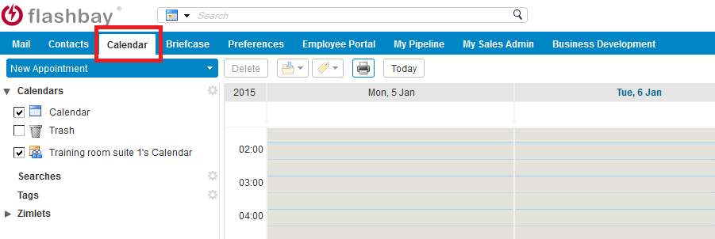
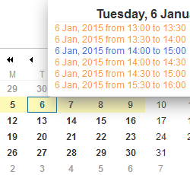
C.1.3 Calendar
All calendar items are visible in both the tab in the header and the calendar in the bottom left corner.

Slide 8
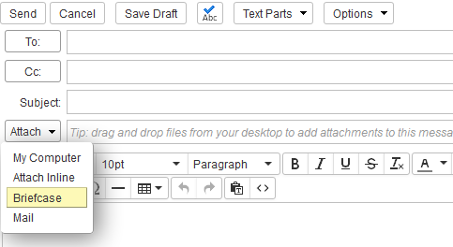
C.1.4 Briefcase
Use your Briefcase to store documents that you
would regularly attach to other emails.

Slide 9
C.1.5 Preferences / Settings when absent
Setting up your ‘Out-of-Office’ response:
Preferences > Mail > Receiving Messages > Send auto-reply message
In the ‘Send auto-reply message’ box, state the dates you are away, who will cover for you and their contact details (email / phone number).
Don’t forget to select the Start/End dates of the message.
How to setup Inbox/Outbox shares for your colleagues:
If absent, your group leader will assign a team member to cover your account with access to your Inbox, Sent box and Drafts.
To share these folders, right click on the specific folder > ‘Share folder’ > type the email address of your colleague > Select ‘Admin’ > OK.

Slide 10
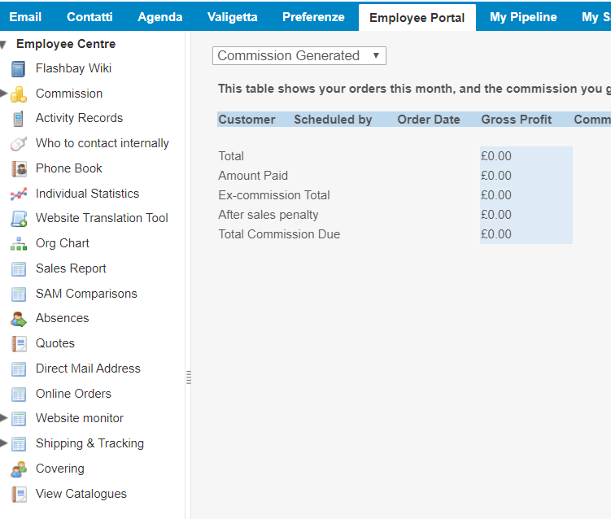
C.1.6 Employee Portal and Sub Tabs
Your Employee Portal allows access to important information related to your sales work and general Flashbay information.
Flashbay Wiki: - Easy access to all aspects of working at Flashbay including HR policies and procedures, product information
Commission: - Overview of your performance for the specific month - Overview of paid/unpaid orders - Overview of your customers’ TrustPilot reviews
Activity Records: - Keep track of the amount of emails sent and phone calls made
Phone Book: - Contact information for all Flashbay employees
Sales Report: - Useful statistics and reports to keep track of your sales performance
Pipeline Check: - Pipeline checks with feedback on your follow ups from your Group Leader
Absences: - Keep track of holidays, sick days and other absences

Slide 11
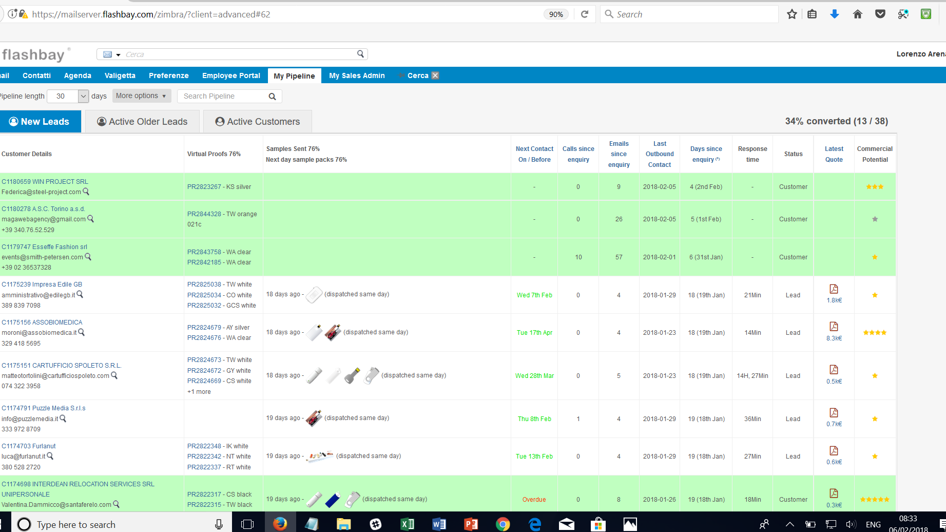
C.1.7 My Pipeline
Easy overview of your work on newly received web leads.
Check conversion rates, proofs and sample packs sent.
Which leads have been converted into customers?

Slide 12
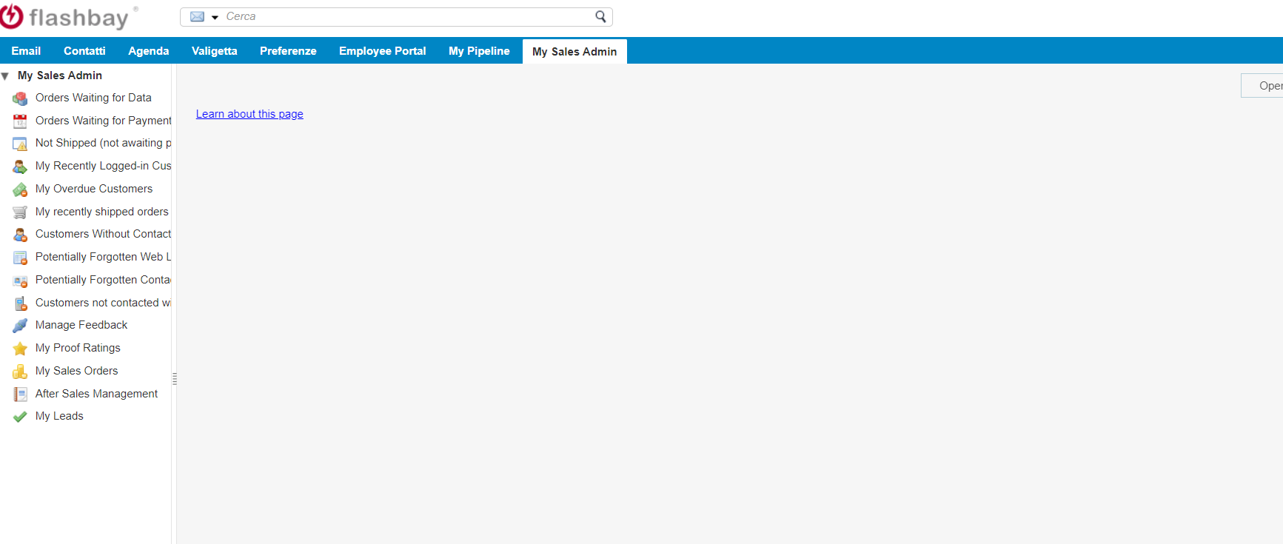
C.1.8 My Sales Admin
Easy Overview of:
Order statuses
General account management
Access portal to invite customers to leave reviews on TrustPilot

Slide 13
C.1.8 My Sales Admin – Four Important tasks
Keep yourself updated
Browse through all tabs in your ‘My Sales Admin’ every day to keep track of orders with pending data, overdue payments and tracking information on orders sent from our factory.
Leads/Customer details
Work through your Forgotten Contact details and enter these in NetSuite to keep your customer account information up-to-date.
TrustPilot reviews
Send out invites for reviews to your satisfied customers.
Virtual Proof Rating
Check if you have rated all your Virtual Proofs.

