Slide 1
Memory - General Knowledge

Slide 2
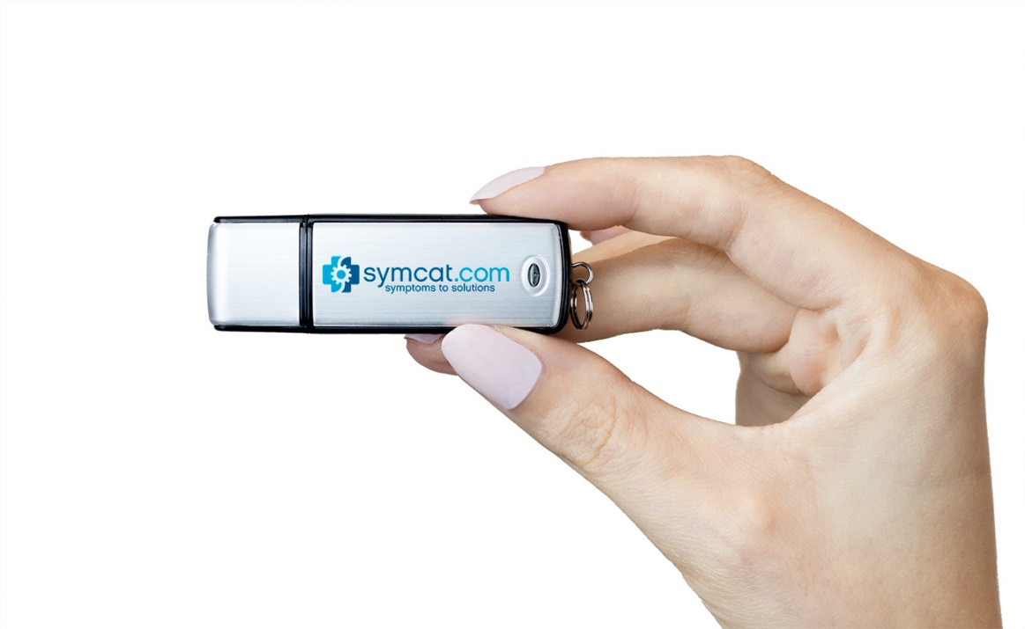
B.2.1 What is a USB Flash Drive?
USB - Universal Serial Bus
A USB Flash Drive Is a compact USB flash memory drive that is like a portable hard drive, letting you store and transport your most precious computer data.

Slide 3
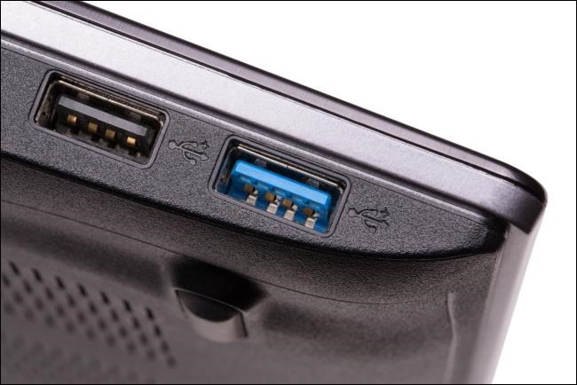
B.2.1.1 What is USB 2.0 vs USB 3.0?
USB 3.0 is a new generation of USB 2.0 and delivers a significantly higher reading/writing speed.
USB 3.0 has blue as a standard colour on the connector.

Slide 4
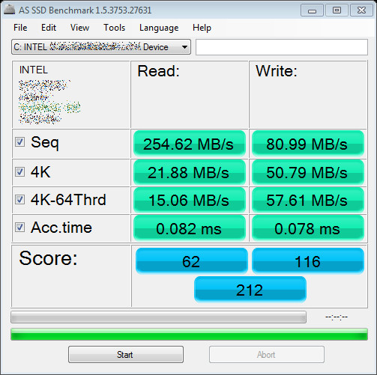
B.2.1.2 What are the USB Flash Drive read and write speeds?
The ‘read’ speed determines how long it takes to open (read).
The ‘write’ speed determines how long it takes to save (write) data.
A guideline of our standard flash drive read/write speeds:
USB 2.0:
Sequential write speed range = 3~10 MB/s
Sequential read speed range = 10~25 MB/s
USB 3.0:
Sequential write speed range = 10~45 MB/s
Sequential read speed range = 60~150 MB/s

Slide 5
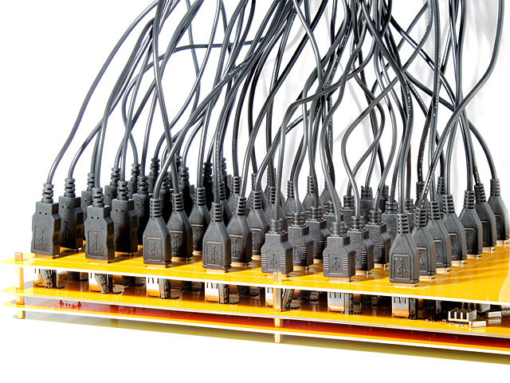
B.2.1.3 What determines the reading and writing speed?
Rarely, if ever, are the advertised USB read/write speeds reached on a typical PC.
There are several factors that determine the speed:
- Amount of data being transferred
- Number of USBs connected to the system
- Electromagnetic interference (in places like factories)
- HD speed (when transferring data to/from HD)
- USB controller

Slide 6
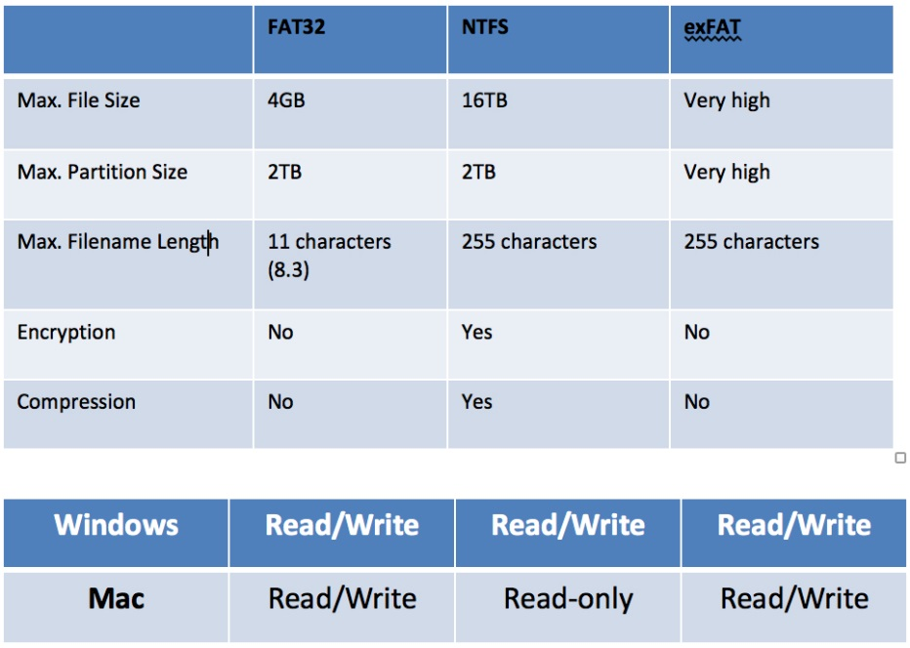
B.2.1.4 Formats on the USB Flash Drive
FAT32 works on ALL operating systems
NTFS works on Windows and limited to Read Only on Macs
exFAT works on All operating systems except very old versions of Windows
If you are unsure of what file system you need to use, ask your IT team who will be able to assist.

Slide 7
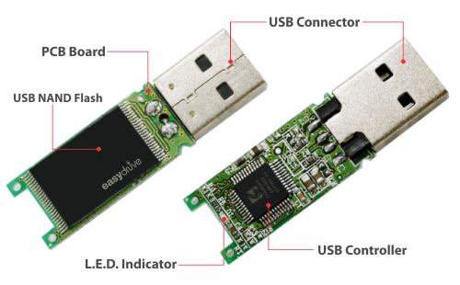
B.2.1.5 What controller do we use in our USB Flash Drive?
Flashbay currently uses the SMI 324 controller
NAND Flash – memory chip
We never compromise on quality and always use original ones Supplied by: Samsung, Toshiba, Hynix, Intel and SanDisk.
Explanation of the SMI 324 Controller

Slide 8
B.2.1.6 4 x Standard USB Models

Slide 9
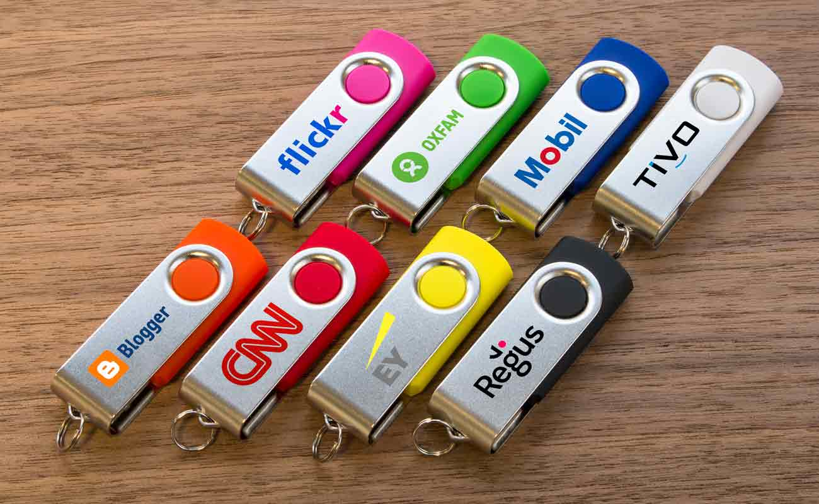
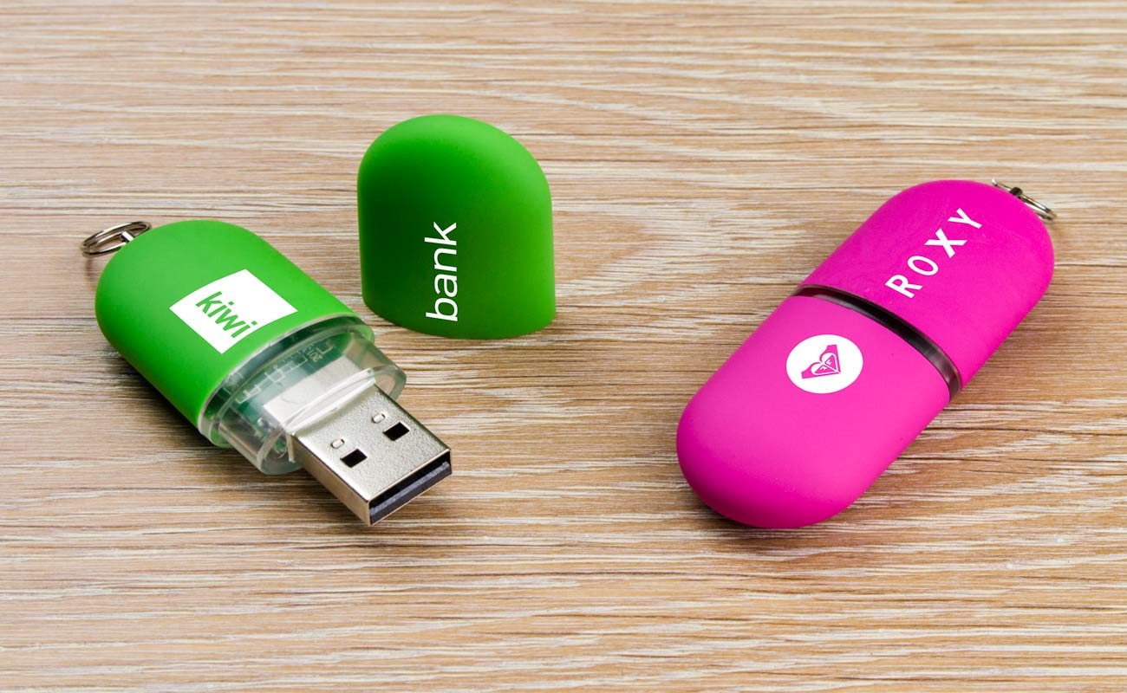
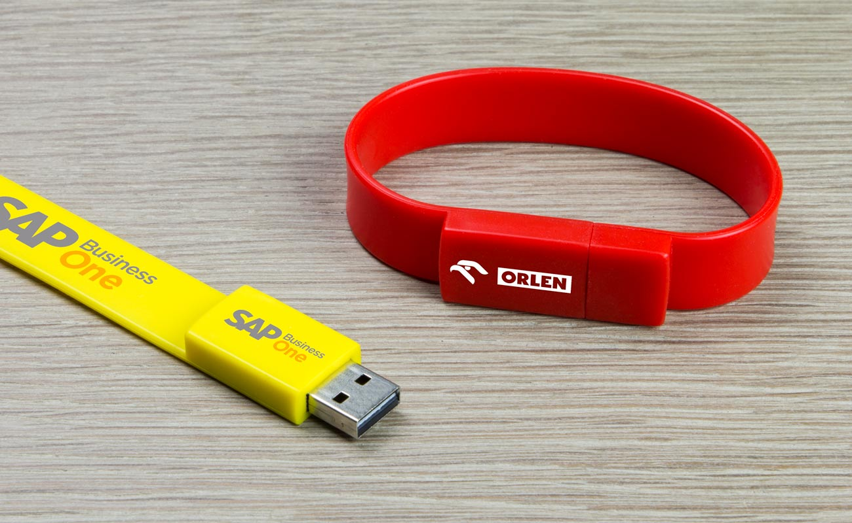
These models are available from our competitors – we still make these products in our factory
Twister (TW)
Pod (PO)
Classic (CS)
Lizzard (WB)

Slide 10
B.2.1.7 Flashbay Exclusive USB Drives
All other USB designs are all designed by Flashbay!
They are split into 4 main categories:
Flashbay exclusive USBs (Standard USBs)
Flashbay exclusive OTG USBs
Flashbay exclusive multifunctional USBs
Flashbay exclusive USB cards

Slide 11
B.2.1.7.1 Flashbay exclusive USBs (Standard USBs)

Slide 12
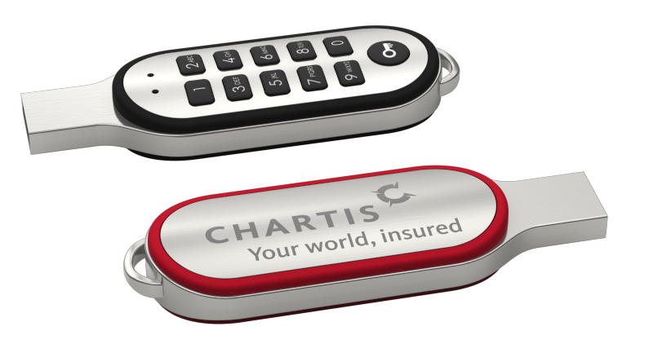
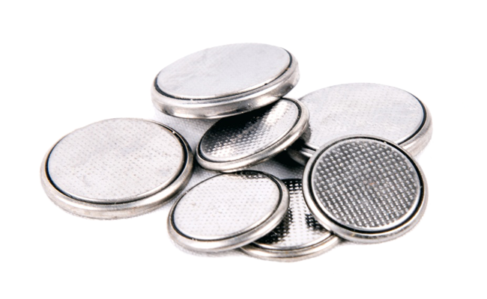
Code Secure USB Flash Drive
NOT an encrypted flash drive.
However, if a customer has encrypted data we can preload it.
Available in USB 2.0 - 16GB only - 32GB will follow later.
(available capacity for user storage is 14.8GB).
20mAh NiMH battery which charges each time it is plugged in.
Fully-charged in three hours and will last for one year.
If the wrong PIN code is entered 10 times in a row, the drive will reset to the default number and wipe all data.
= 1 YEAR

Slide 13
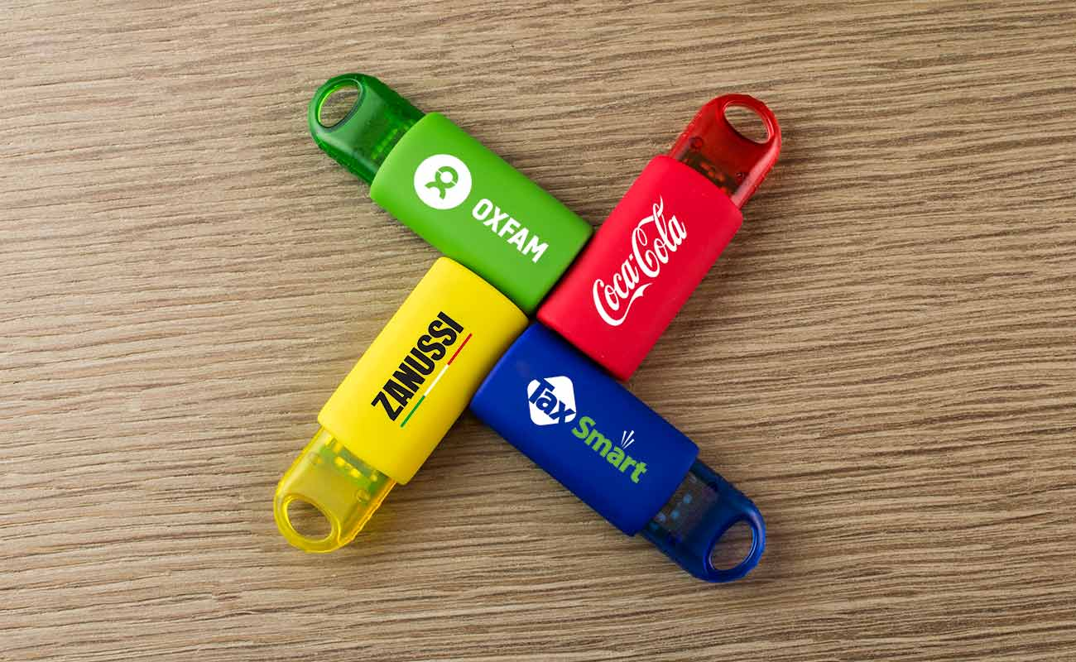
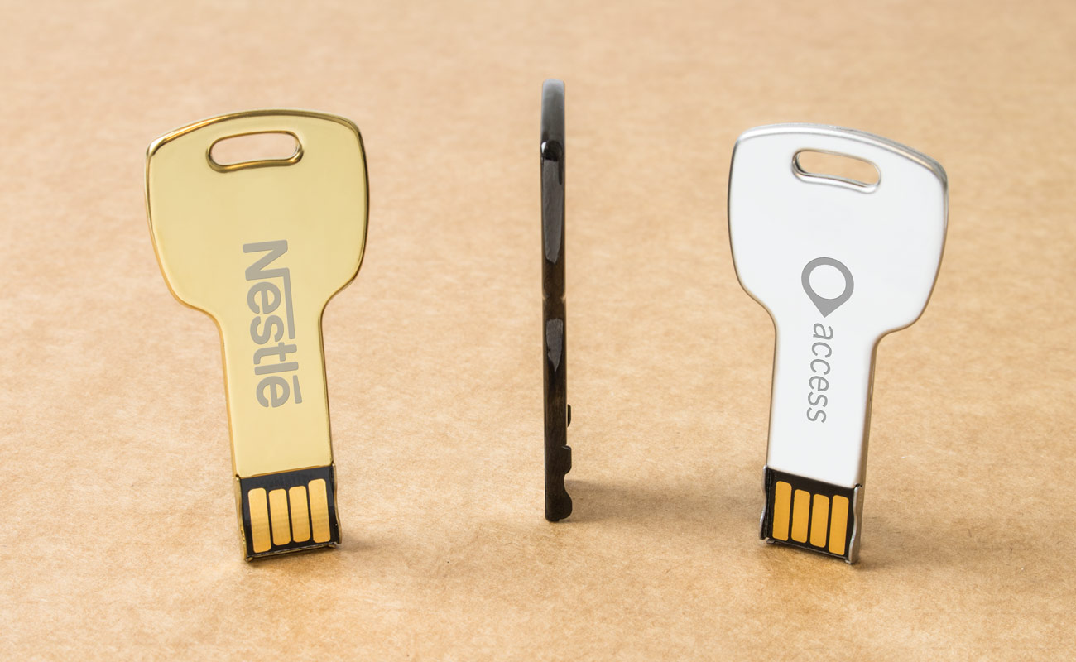
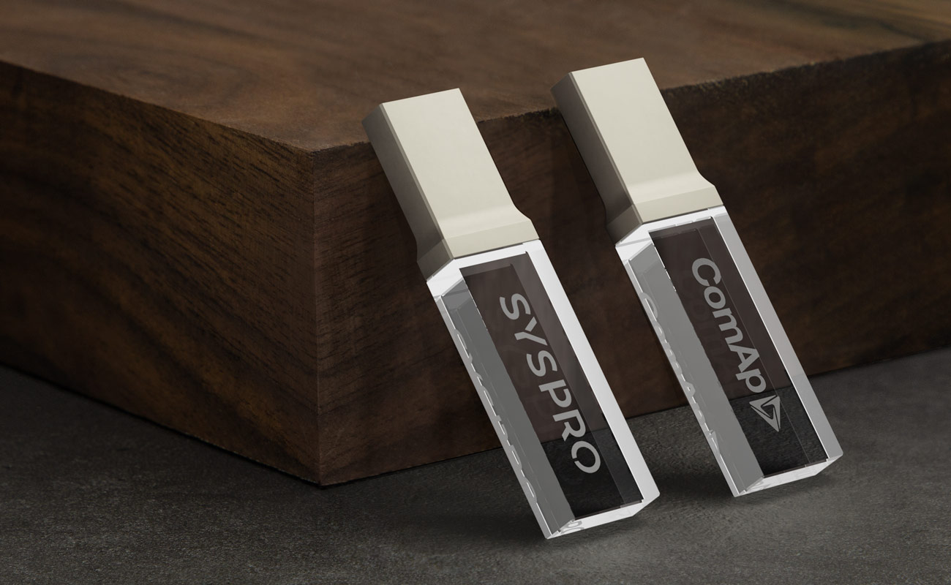
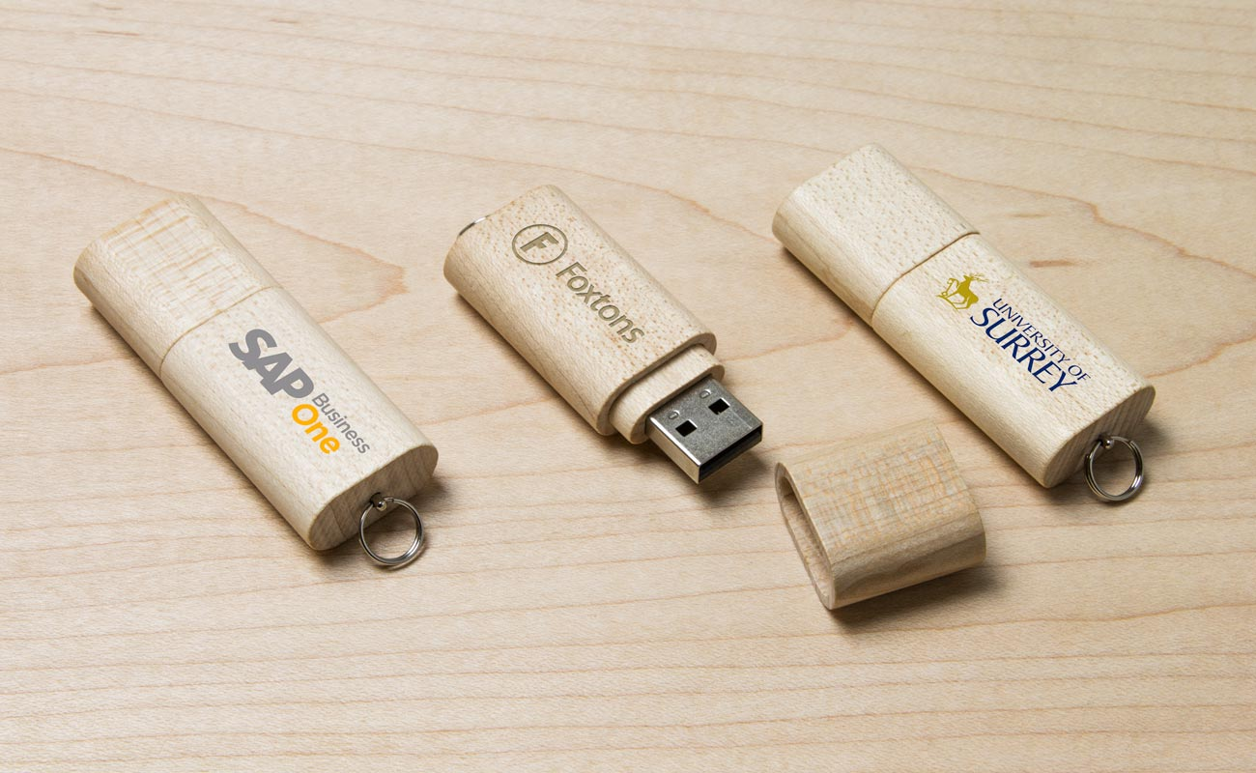
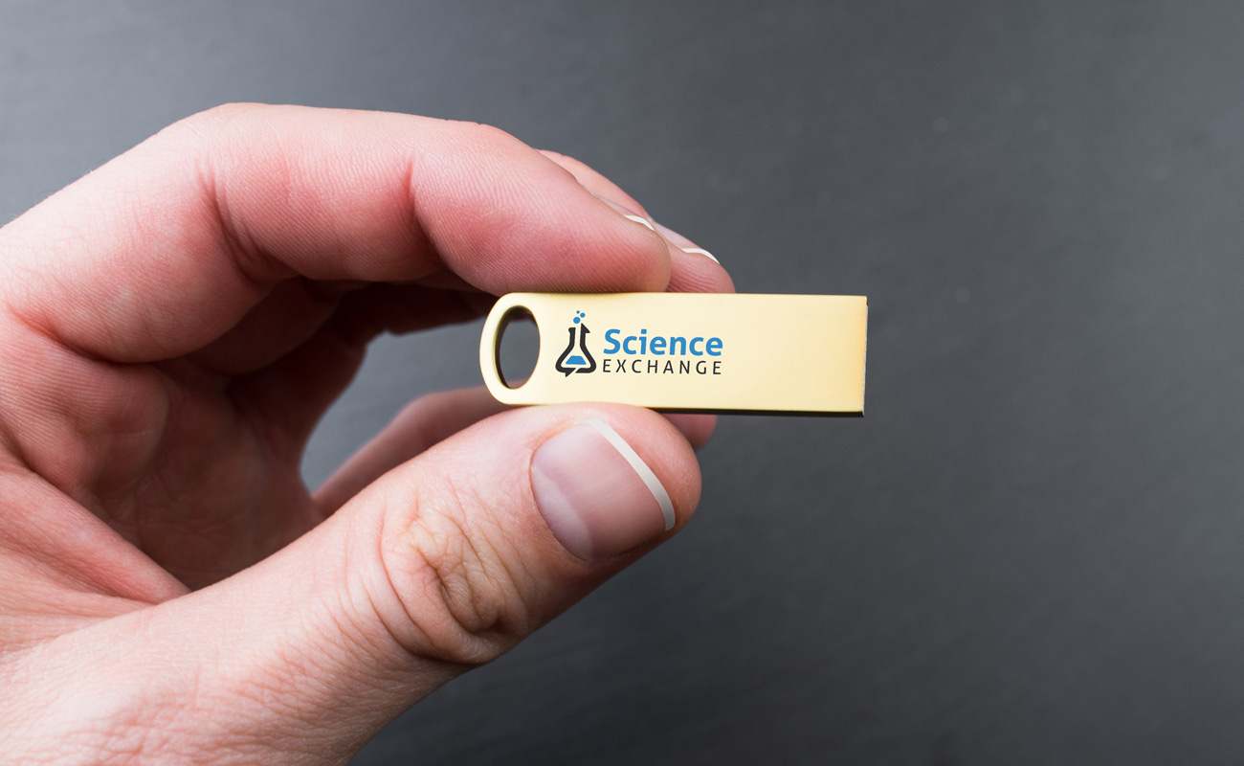
Key (KS)
Kinetic (KN)
Focus (FC)
Nature
Crystal (CY)

Slide 14
B.2.1.7.2 Flashbay exclusive OTG (On The Go) USBs

Slide 15
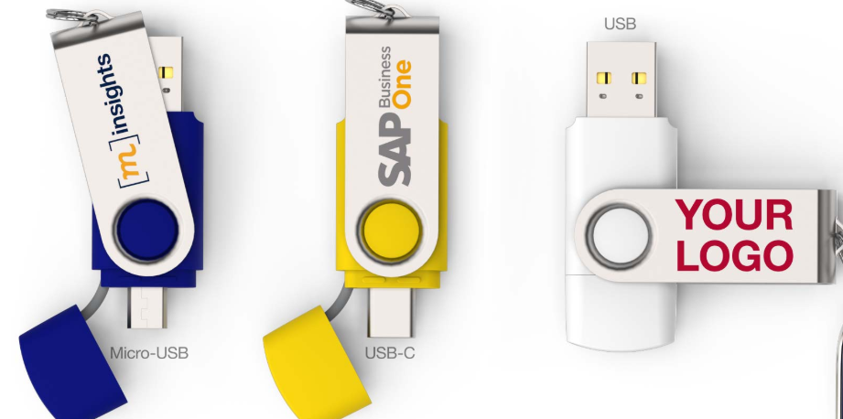
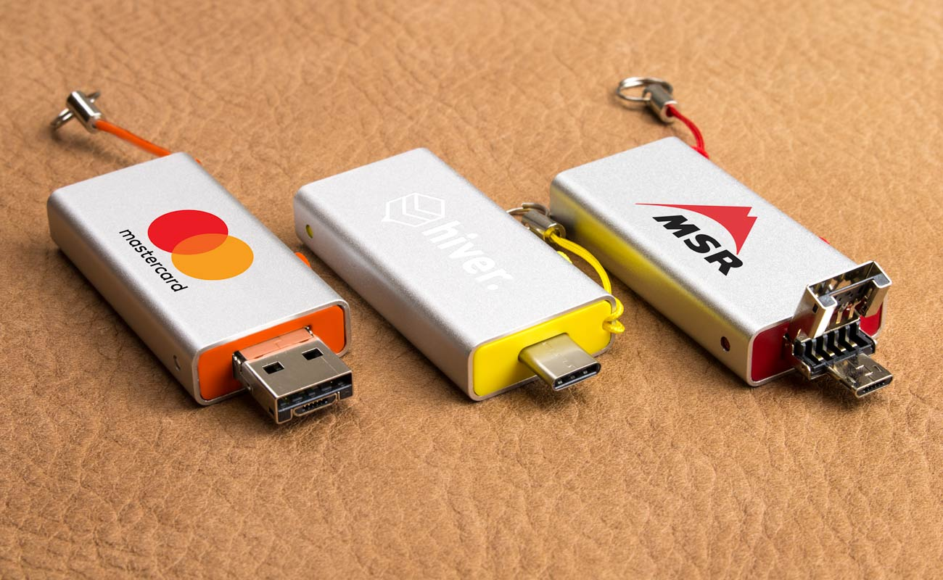
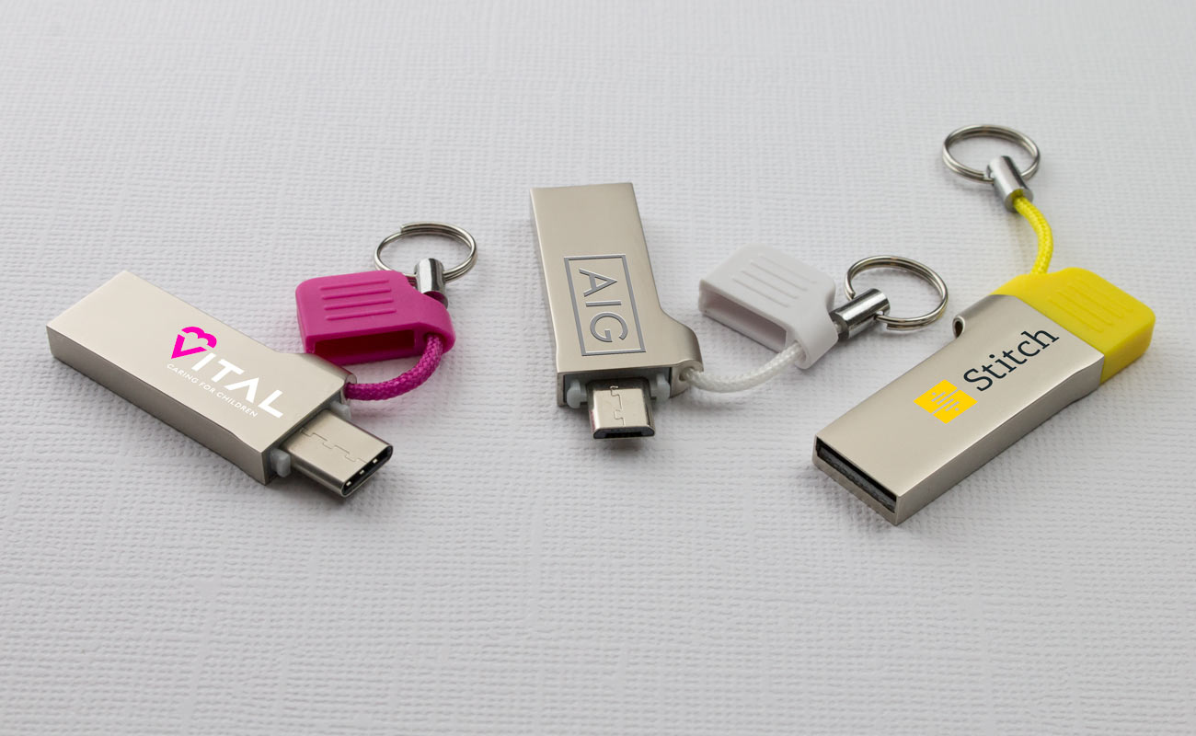
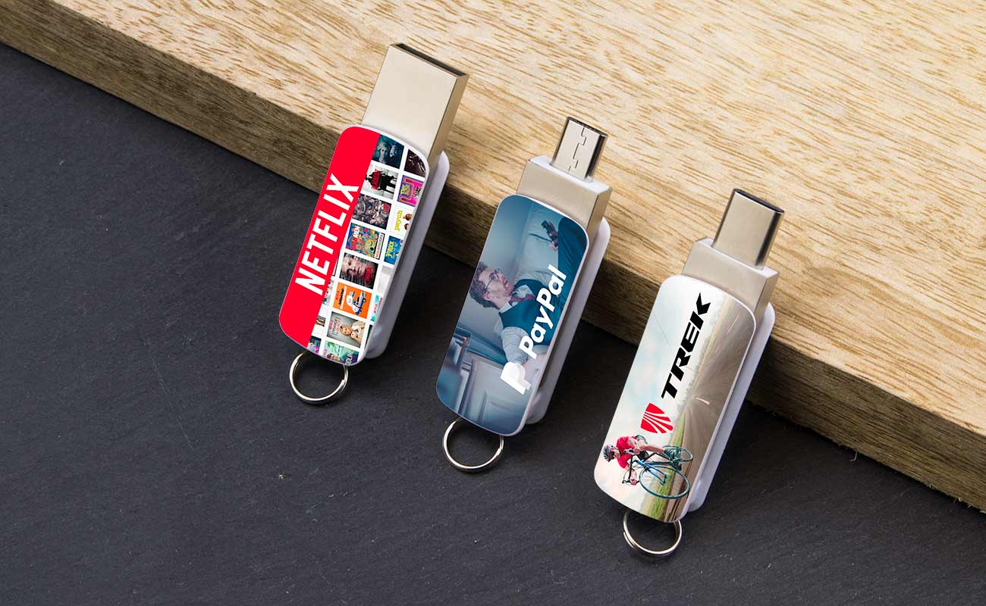
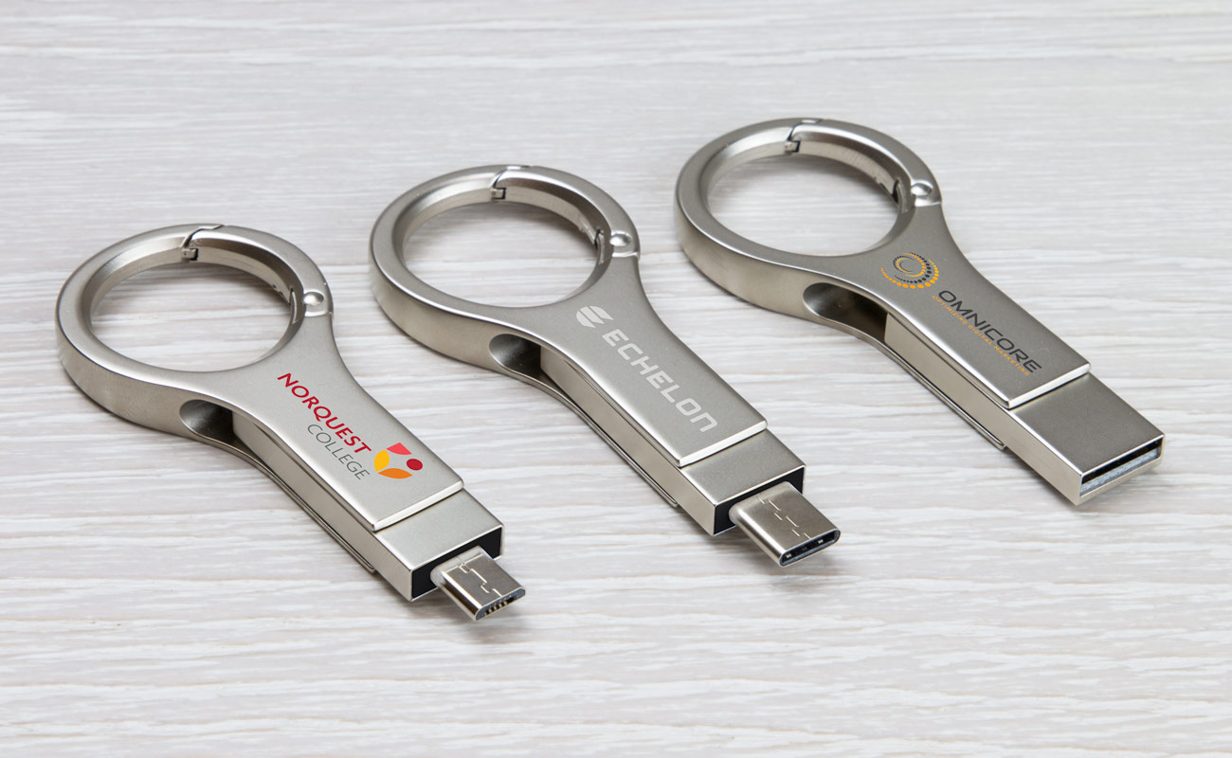
Lynx (LY)
Orbit (OR)
Active (AT)
Twister GO (TG)
Slide (SE)
USB 3.0 not available

Slide 16
B.2.1.7.3 Flashbay Exclusive Multifunctional USB Flash Drives

Slide 17
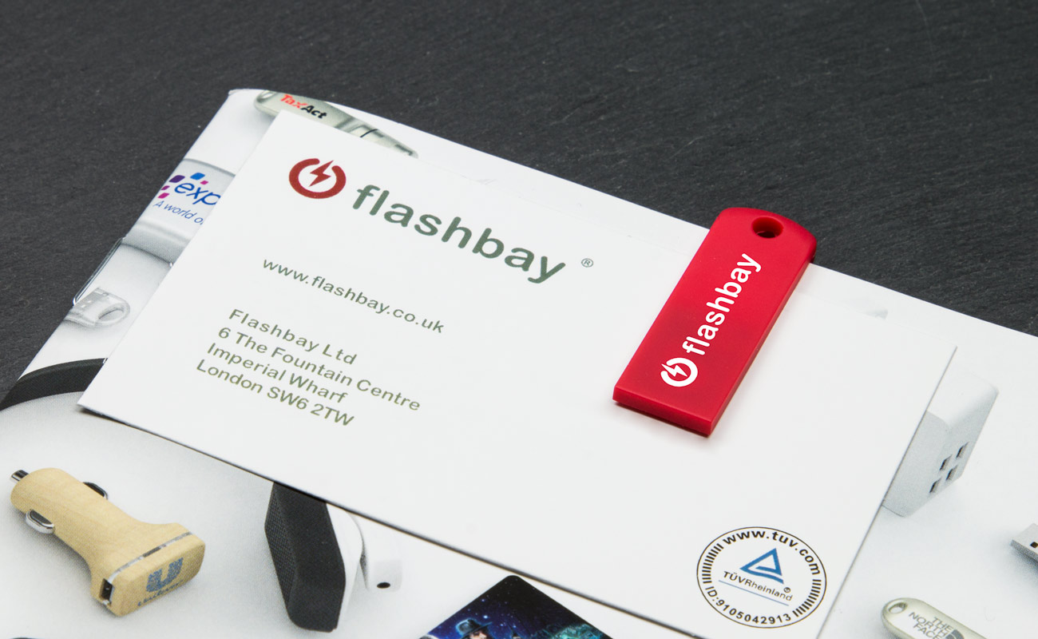
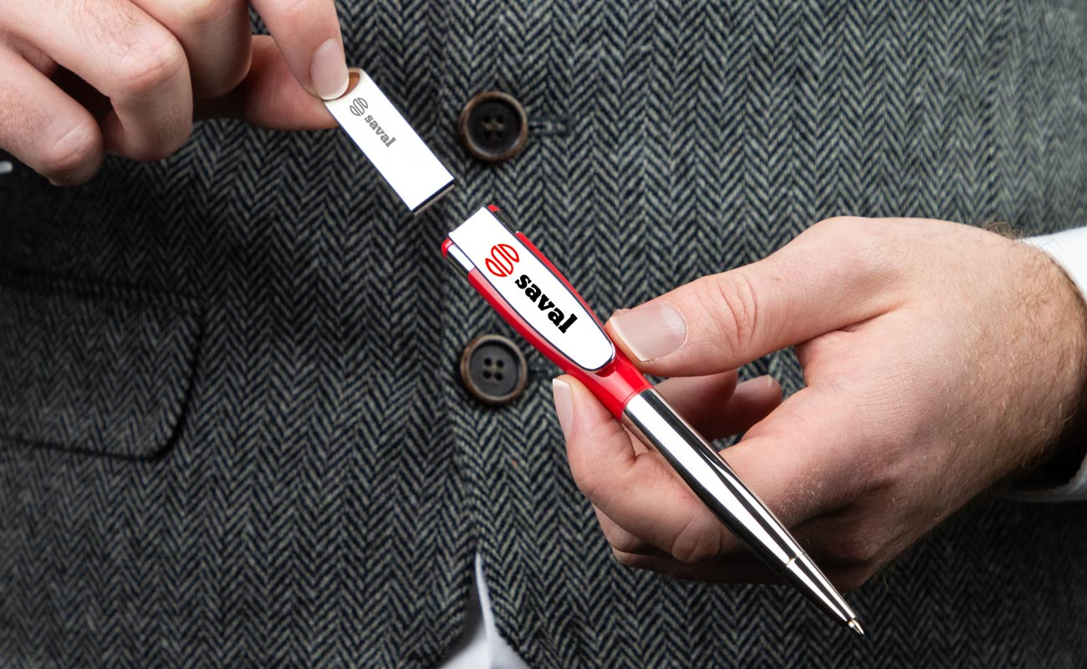
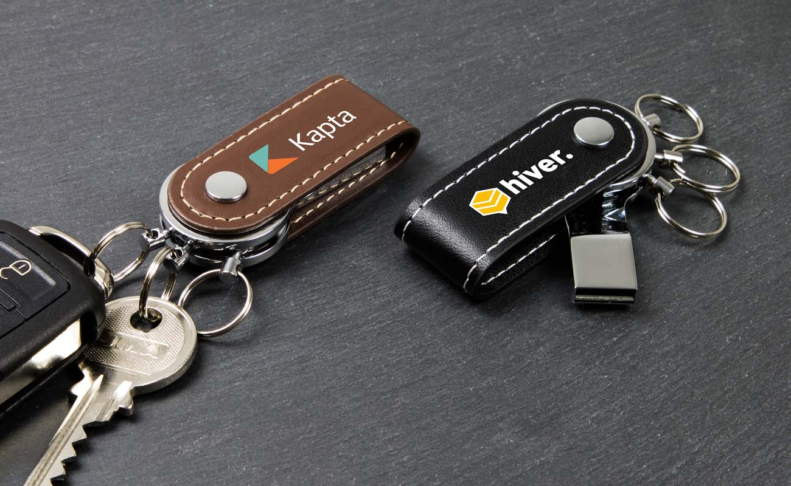
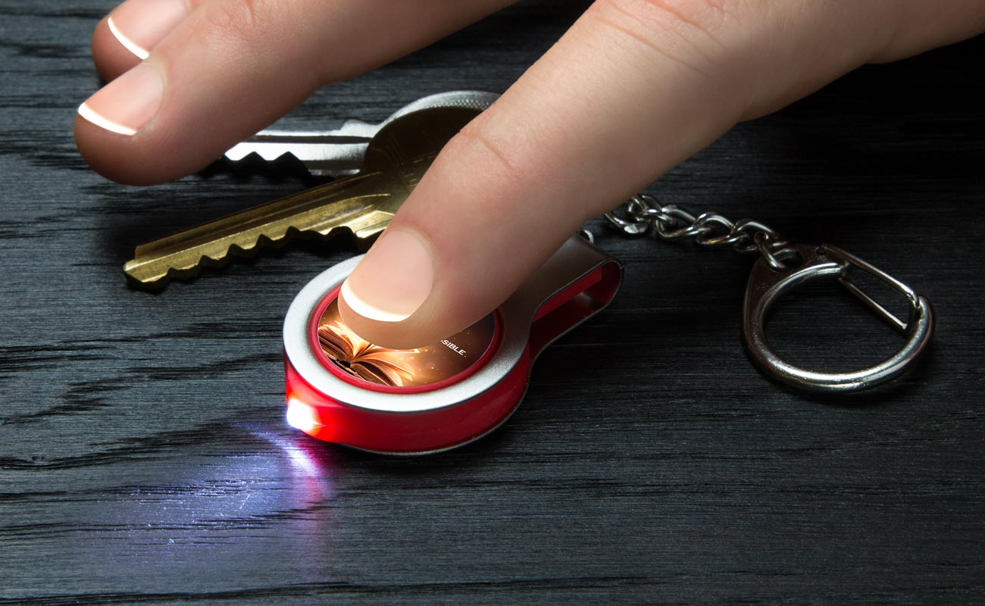
Jot (JO)
Light (LT)
Swift (ST)
Clip (CL)

Slide 18
B.2.1.7.4 Flashbay Exclusive USB Cards

Slide 19
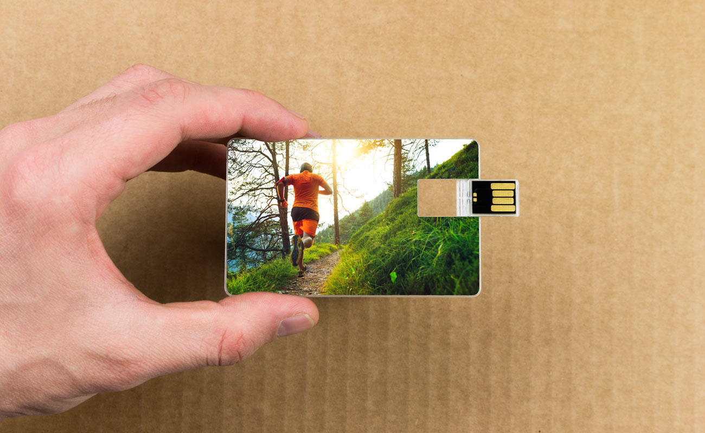
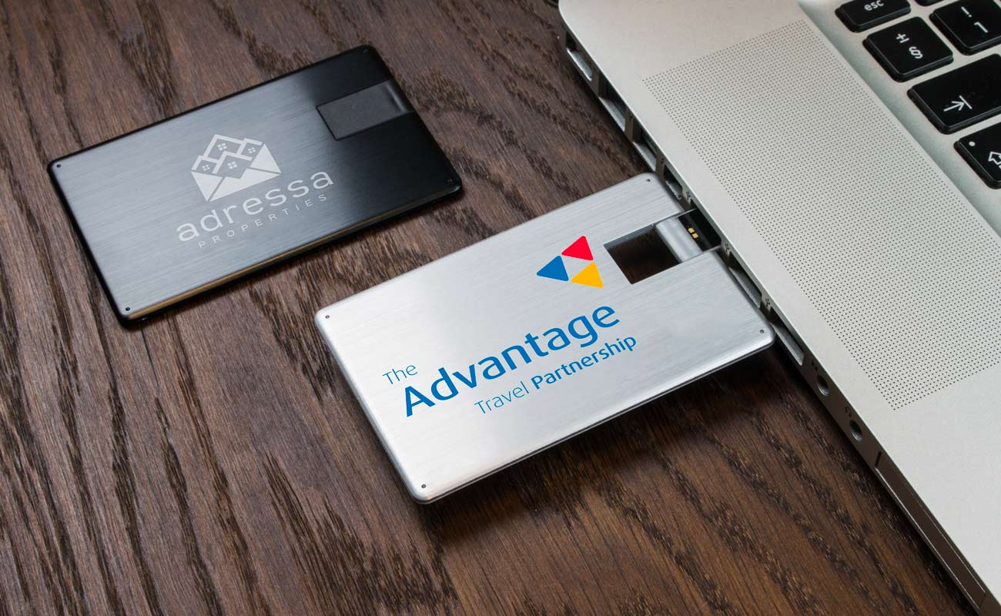
Wafer (WA)
Alloy (AY)

Slide 20
B.2.1.8 Flash Drives cont.

Slide 21
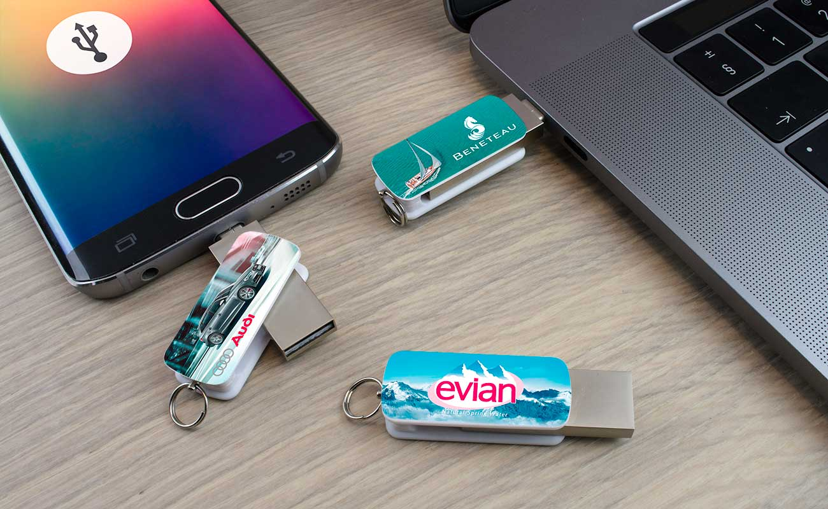
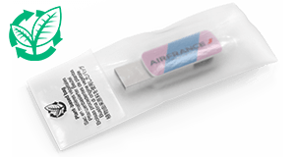
B.2.1.8.1 Orbit OTG USB Flash Drive (OR)
MOQ: 10 units
Capacity:
Warranty: 10 years warranty on functionality
Material: Plastic
Internal Code: OR
Branding method:
Available in: USB 2.0 and Micro-B code: ORB or Type-C code: ORC
Note: DPUS is limited for OTG USB drives. For more information check Flashbay Wiki.
Branding Options and Print Area
Branding Area:
Area Front: 35mm X 15mm
Area Back: 35mm X 15mm
How they come

Slide 22
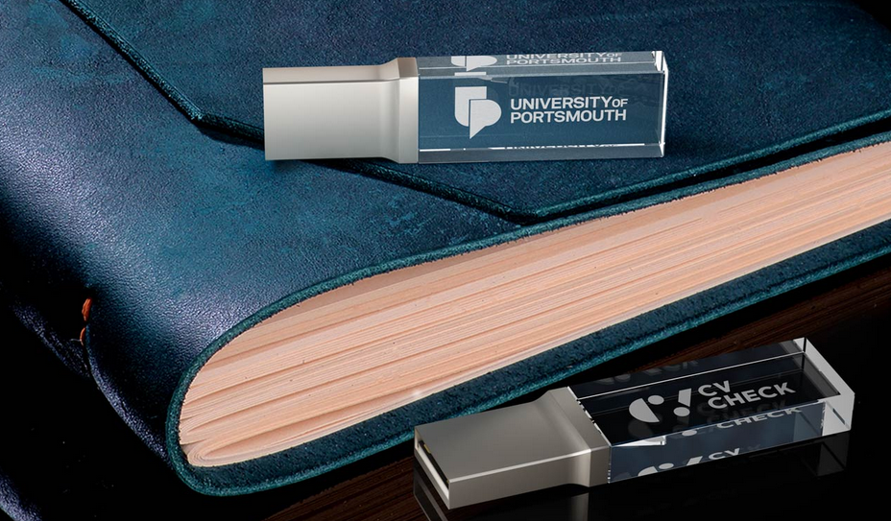
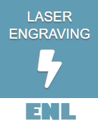
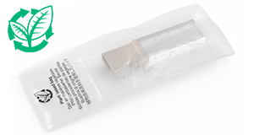
B.2.1.8.2Crystal USB Flash Drive (CY)
MOQ: 10 units
Capacity: USB 2.0
Warranty: 10 years warranty on functionality
Material: K9 glass
Internal Code: CY
Branding method:
Available in: USB 2.0 only
Colour:
Other info: 2 dimensional logo engraving ‘inside the glass’.
Printing area is one side due to the transparent shell.
Branding Options and Print Area
Branding Area:
Laser Engraving: Area Side: 26mm X 9mm
How they come

Slide 23
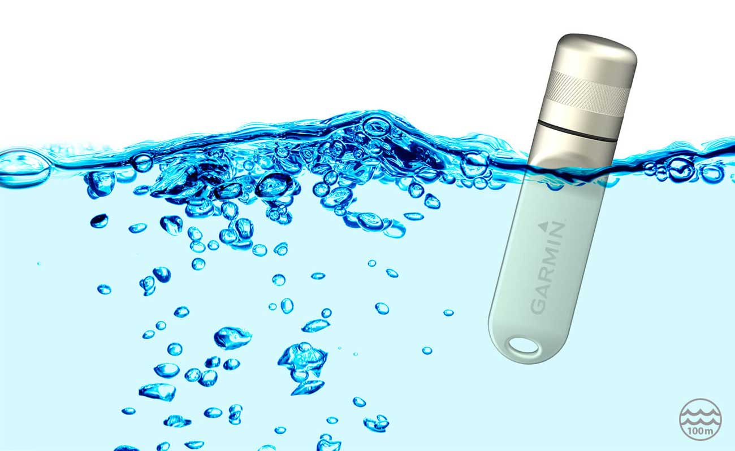
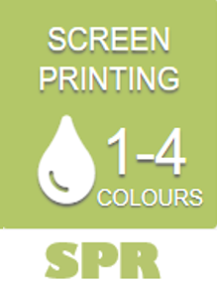
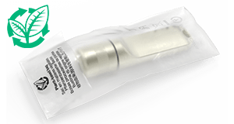
B.2.1.8.3Nox USB Flash Drive (NX)
MOQ: 10 units
Capacity:
Warranty: 10 years warranty on functionality
Material: Chrome
Internal Code: NX
Branding method:
Available in: USB 2.0 & USB 3.0
Colour:
Other info: Waterproof to depths of up to 100m.
Tips: Great for companies looking for a robust USB Flash Drive or for companies that work in a maritime environment.
Branding Options and Print Area
Branding Area:
Laser Engraving
Area Front: 25mm X 12mm
Area Back: 25mm X 12mm
Screen Printing
Area Front: 24mm X 12mm
Area Back: 24mm X 12mm
How they come

Slide 24
Thank you for your attention ☺

