Slide 1
NetSuite
When going through this learning pack we advise you take notes in order to solidify this content.

Slide 2
C.2.1.1 What is NetSuite (NS) / Lead?
NetSuite is a CRM / ERP* software (Customer Relationship Management / Enterprise Resource Planning) which enables Sales Managers (SM) to manage all aspects of the day to day business (sales processes, accounting, order fulfilment, entering leads etc.)
A Lead is defined as a company/organisation which is interested in our products and services and is enquiring through several means (most common are via our website & phone).
Flashbay doesn't sell to individuals and/or companies who trade USB memory products on their websites.

Slide 3
C.2.1.2 How is a Lead created & distributed?
Leads will be created when enquiries are made via our websites, through in & outbound calls, marketing campaigns and other tools used by Flashbay.
These then get distributed between the teams ( according to country, new or existing lead / customer, daily activity etc.)
We have Web leads and Phone leads, which can be further classified as:
a) Inbound Leads (set up by the answering SM (after checking for duplicates);
b) Outbound Leads (set up by the calling SM);
If an existing customer (details already in NS) sends an enquiry, it will be forwarded automatically to the corresponding SM.

Slide 4
C.2.1.3 Checking for duplicates and creating a lead in NS
You will receive an automatic email notification when the lead has been assigned to you. (qualifying a lead, mental checklist: website, country, contact, comments, what does the customer want? what information has passed on to us in the enquiry etc.)
NOTE: Sometimes a customer may use a different spelling in the company name (or different email domains, different types of enterprises etc.) when submitting an online form. If not checked properly, this will lead to a duplicate. Thus always check whether it is a duplicate of an existing lead/customer by using the Netsuite global search function. If it is, pass it on to the correct SM.
To see your leads in NetSuite click: Lists > Relationships > Leads
While checking for duplicates, the live search field in the upper right corner is really helpful. Start typing and results are being shown instantly via selectable popup. You can search for First and Last Names, Companies, Email domains etc. You can even set up filters, for example by entering “cust:” or “lead:” in front of the search term to check for customer / lead entries only.

Slide 5
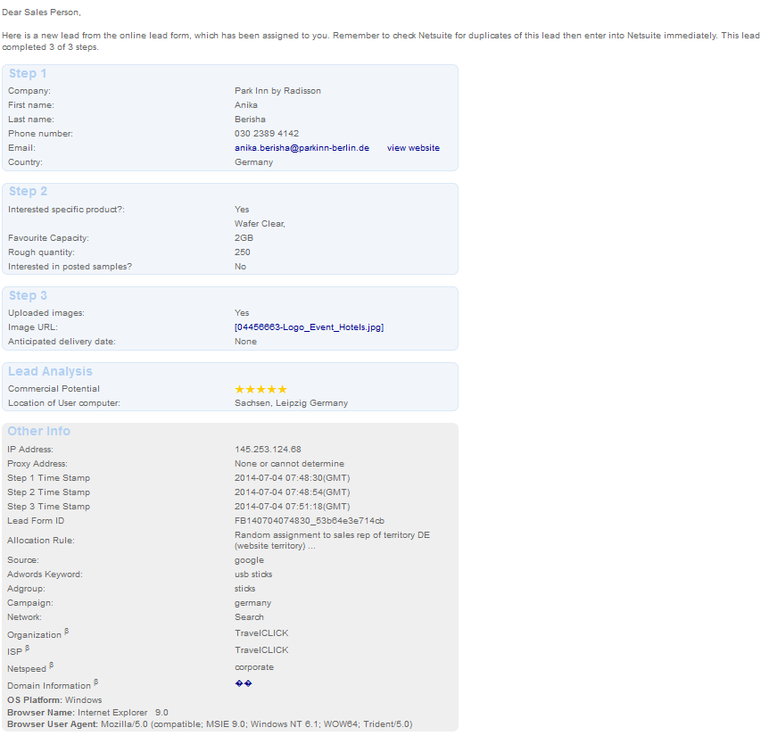
C.2.1.4 Example Lead through the website:

Slide 6
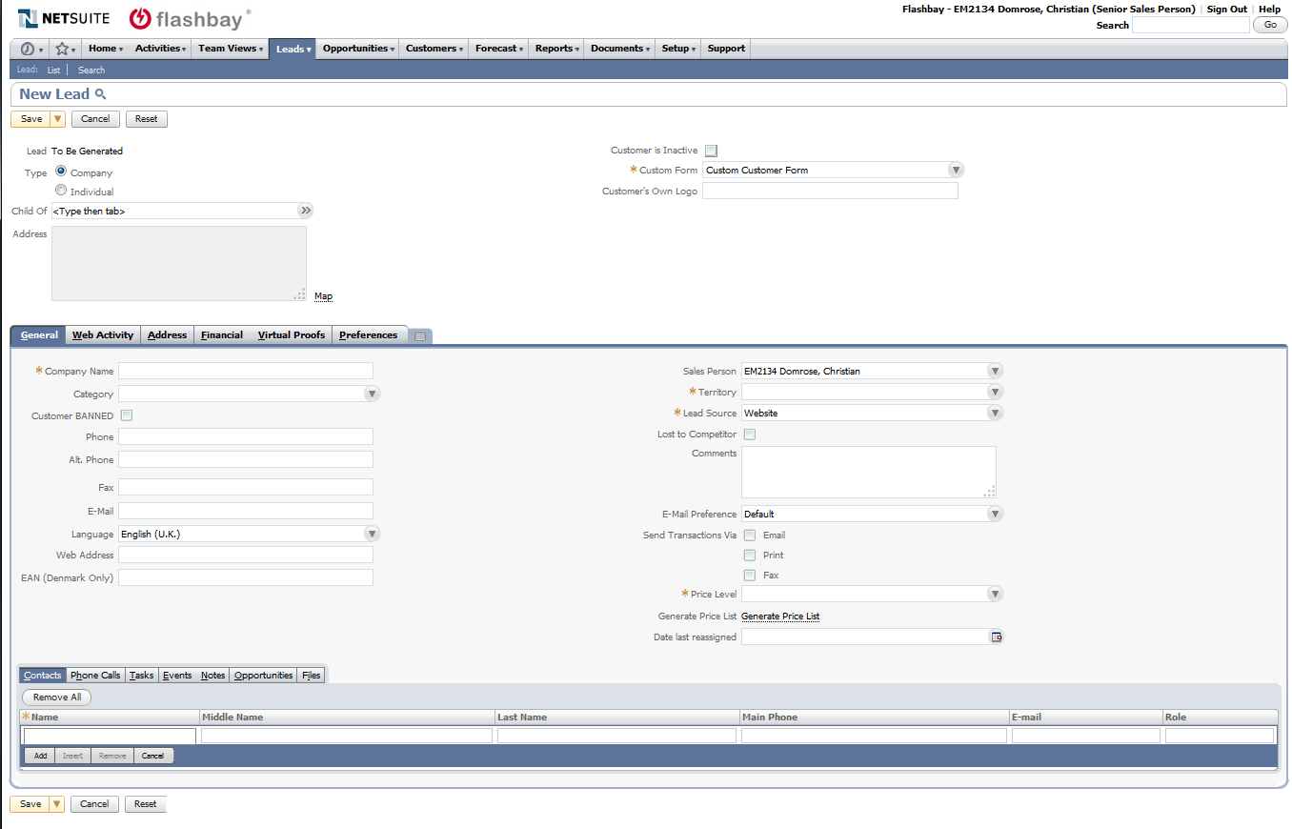
C.2.1.5 Manually entering a new lead into NetSuite
Leads can be entered by hovering the mouse over „Leads“ -> „Relationships“ -> then click „New“
A blank „New Lead“ page will load with different tabs where the information from the web or phonelead can be entered

Slide 7
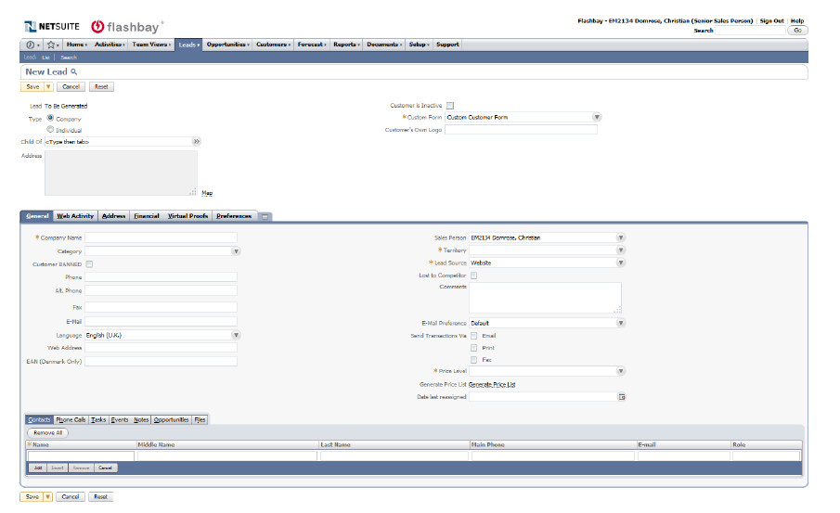
C.2.1.6 General Tab
Specify if the received lead is a company or individual : (majority will be classified under company which enables us to add multiple contacts, in single cases we specify the lead as a individual when no company or institution can be given)
1) Company name
2) Category (reseller or educational, this is not specified if the lead is regular company)
3) Phone
4) Email
5) WWW
6) Territory
7) web leads / cold call etc.
8) Comments
9) Price level
* check if Duplicate appears on top of page when you enter details
bottom tab “contacts” show all the contacts which have been added to this lead/ customer

Slide 8
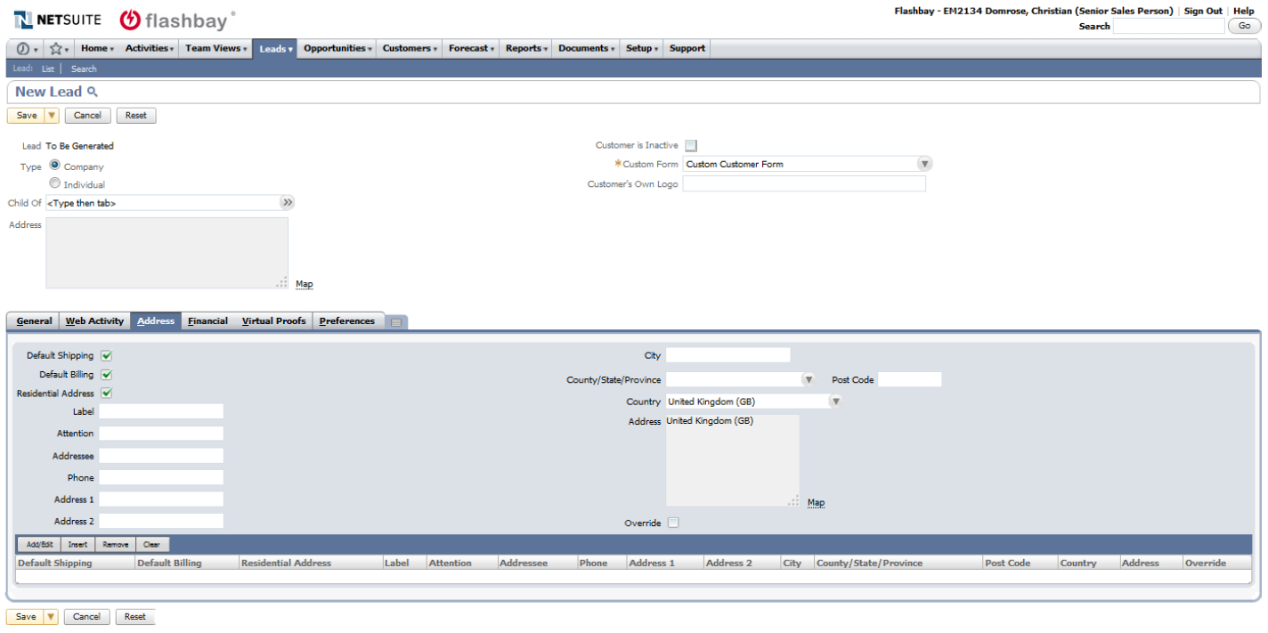
C.2.1.7 Address Tab
Add address details when entering the lead, this will save time later on and can be done in conjunction while checking the leads website.
Here we specify the shipping and billing address, usually the same but occasionally customers need Invoices and Shipments send elsewhere.
Always add contact phone number so customer can be contacted in case of deliveries.
Don’t forget to change the country, standard setting is UK.

Slide 9
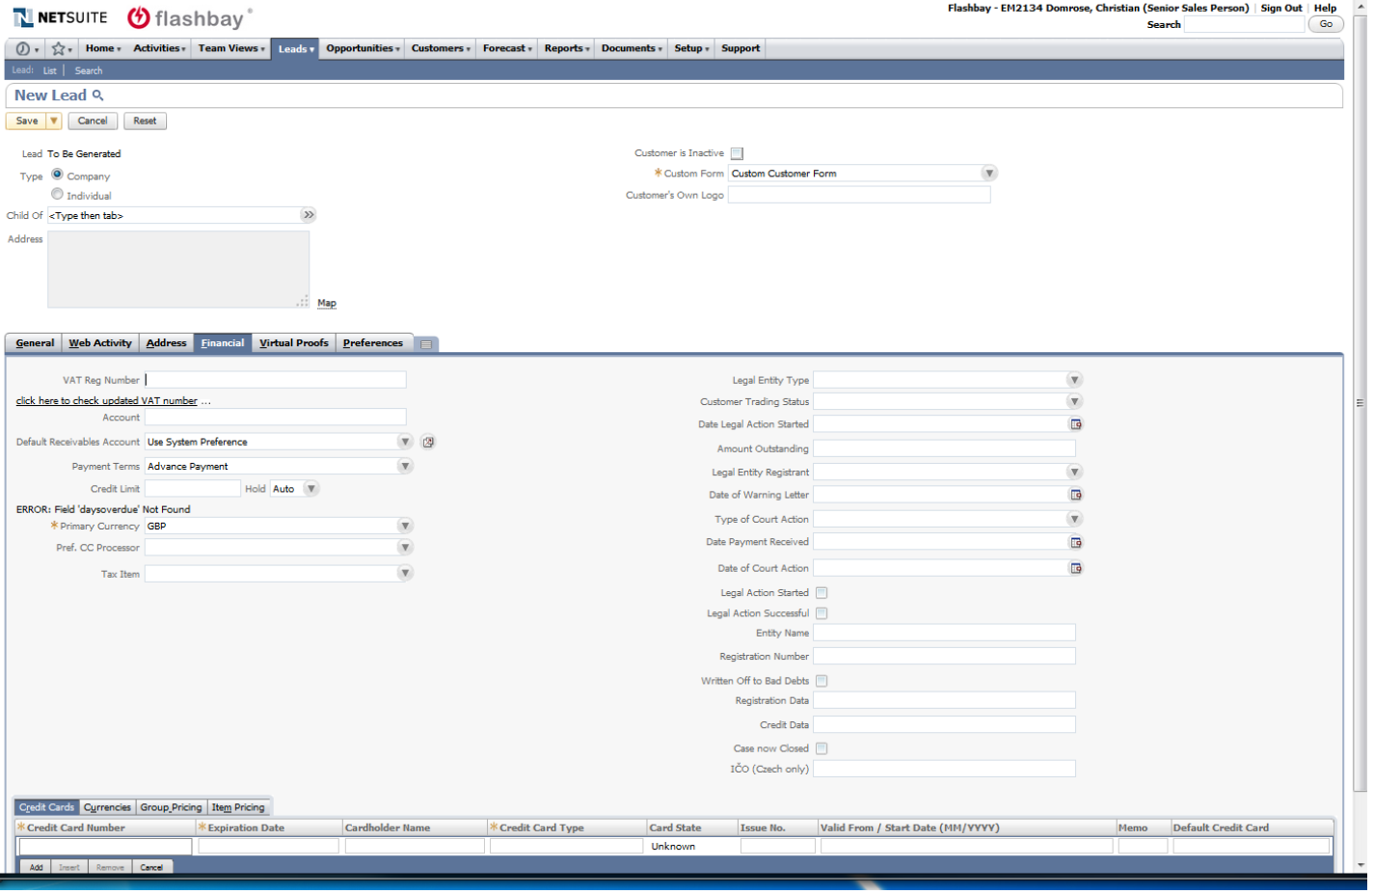
C.2.1.8 Financial
This tab shows the current payment terms for the lead/customer, default setting is advanced payment;
Terms can be changed after request and approval by your Team leader;
It saves time setting up the VAT when the lead is being set up and while browsing the contacts website;
Credit tool can be used to do basic credit checks and approve payment terms

Slide 10
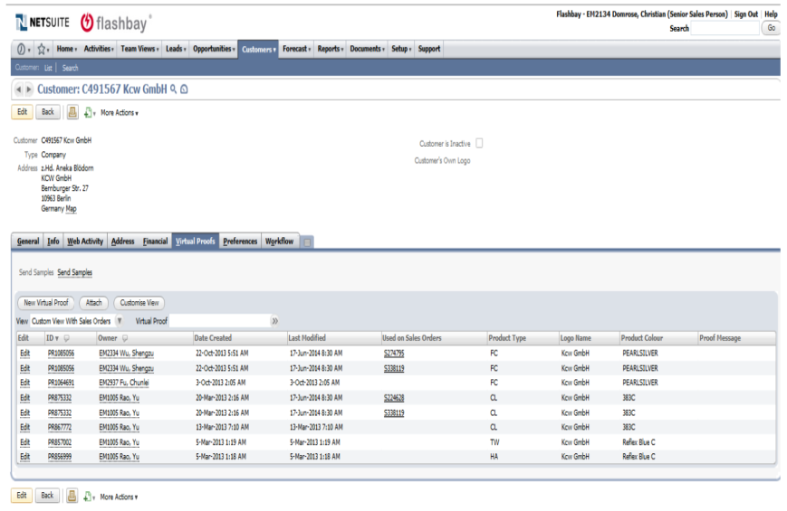
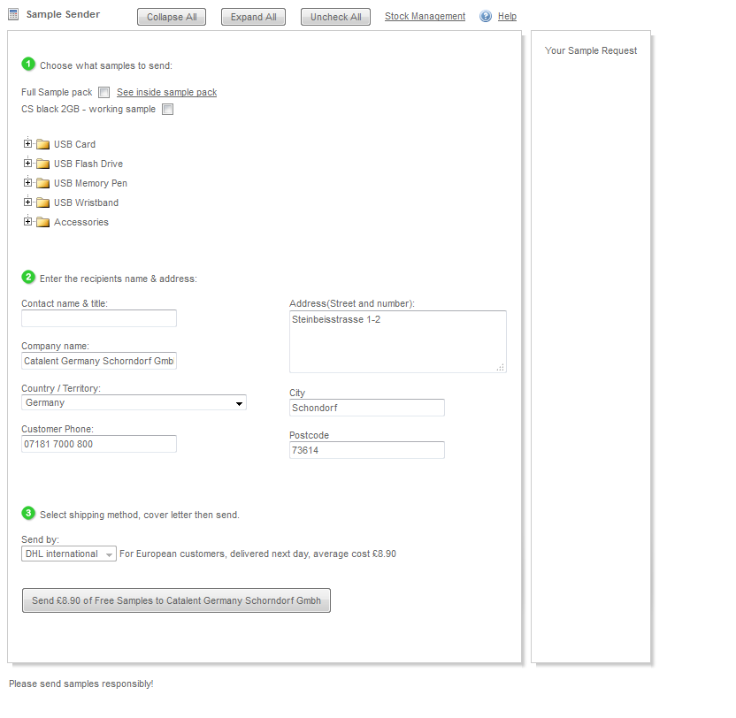
C.2.1.9 Virtual Proof / Sample Tool
Virtual Proofs (VP) for the lead/customer are saved here and can be downloaded anytime (Model, colour and Logo name are being shown here)
You can see for which sales order VP have been used (the hyperlink will lead right to the sales order) - this is helpful if customer can’t remember which VP have been used in the past
Dummy samples are being send from the Link “Send Samples”, which gives you access to the sample menu.

Slide 11
C.2.1.10Useful Information
Certain information is always hyperlinked in NS ( PRs, Emails, Customers, Invoices, Sales Orders etc.) and can be utilized to look up for something quicker, for example:
Proof -> Sales Order -> attached Documents or Invoice -> Sales Order -> Customer
Learn the common shortcuts – i.e. Copy (Ctrl + C), Cut (Ctrl + X) and Paste (Ctrl + V) as they will help immensely to save time
Main tab is Leads / Relationships exists to set up new leads or look up your customer and lead lists.

Slide 12
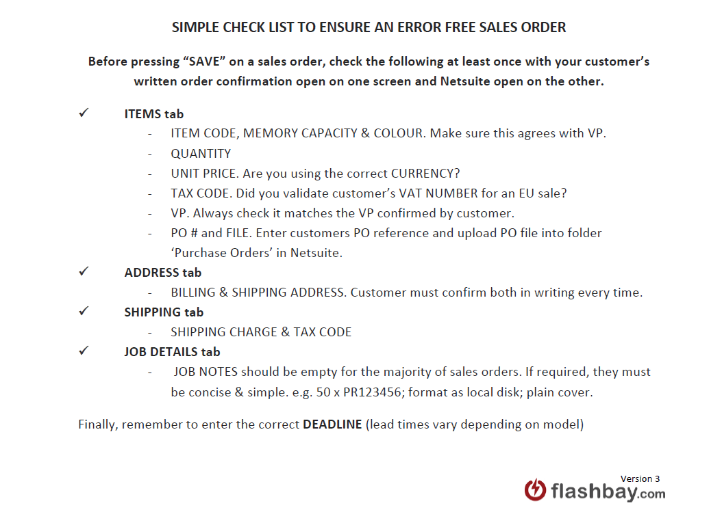
C.2.2.1 NetSuite / Scheduling a Sales Order
Ensure that all aspects of an order have been approved by the customer via a proper written order confirmation before placing any order in NetSuite.
Quote (deadlines, amounts, capacities, etc.)
Virtual Proof (including orientation and branding)
Data (screen shot for confirmation has been sent to the client)
Use the Sales Order Check List to cross check if you received all confirmations needed from your Lead / customer to avoid mistakes.
The process of scheduling a sales order is much easier if you begin by updating the parent customer record with the correct currency, VAT number, billing address, shipping address, contacts etc.

Slide 13
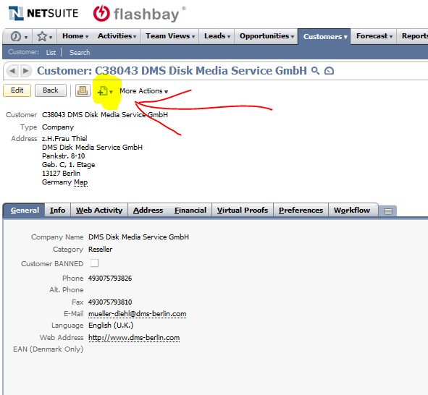
C.2.2.2 NetSuite / Scheduling
a Sales Order
To initially create the sales order record, first go to the lead/customer record in NetSuite click on the marked Page Icon and select ”Sales Order”, you will be directed to a new page (see image on the next page).

Slide 14
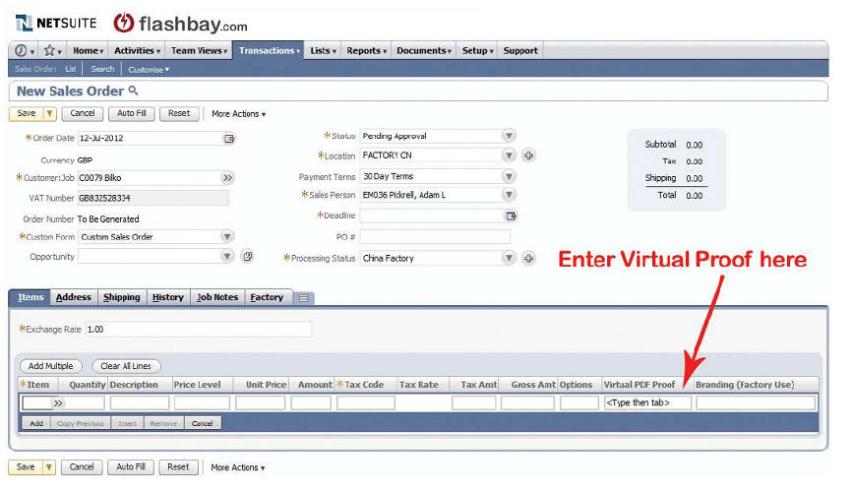
C.2.2.3 NetSuite / Scheduling
a Sales Order
1) Always work your way across and top to bottom
2) The top 14 fields check although Order date, currency, customer Job, VAT, Order Number, Custom Form, Opportunity, Status, Location, Sales Person, Processing Status will be set by NetSuite as default
3) Payment terms and Deadline, as PO# have to be set by SAM
Add items using the appropriate product code (product codes can be found on the website or price list).
Check that you have selected the correct memory size and colour
Enter required quantity
Enter agreed unit price
Select the correct Tax Code:
VAT: S for UK and EU countries where no valid VAT number is provided
VAT: ES for all EU countries if a valid VAT number is provided
VAT: CH for Switzerland
VAT: AU for Australia
VAT: NO for Norway
VAT: O for other countries outside the EU
Enter the respective virtual proof number or click on the double arrows to load a list of virtual proofs belonging to the customer
Click Add to insert more items, otherwise click the Address tab.

Slide 15
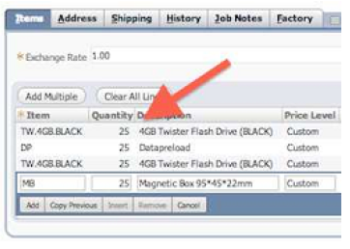
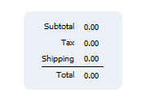
C.2.2.4 NetSuite / Scheduling a Sales Order
How to specify the convention of a product and accessory or service:
Example:
50 X TW
50 X DP
sales order is set for 50x TW with 50x DP
50 X KN
50 X MB means
Sales order is set for 50x KN with 50x MB
A more complex example would be:
50 X TW
25 X DP
1 X DPUS
50 X KN
25 X DP
50 X TX
50 X MB
Sales order set for 50x TW, only 25x of those TW will have data furthermore that data will be locked, other 25x units are with out data and DPUS 25 of KN will have DP & 25 no DP and 50x TX in 50x MB
Always keep the right order when adding products to NS: add USB Model, then any extra service if applicable. This is important so our production team knows which sticks receive what services and extras
The total of the order ( right side ) is an immensely helpful tool. Here you see the total charge, tax and shipping.
If you calculated everything in your order, you can check the numbers and see if they add up.

Slide 16
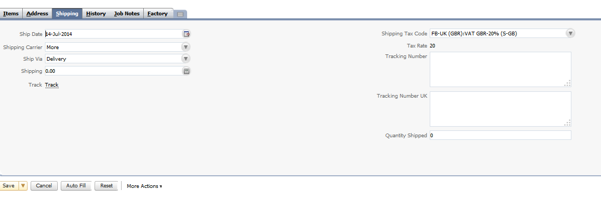
C.2.2.5 NetSuite / Scheduling a Sales Order – Important tabs
Address Tab
Each order requires a billing and shipping address. Click the dropdown menu to either enter a new address; select a previously used address; or to customise a previously used address.
Shipping Tab
Always aim to ship to the customer's business address.
We won't ship to: PO Boxes, Conferences, Exhibitions, Event facilities
(We need to ensure that the courier is able to safely deliver the order to the location without risk that it is lost or delayed as often occurs with the above classes of location. If appropriate and necessary to meet a deadline or firm customer preference we can ship to a hotel where a customer will be staying).
Leave the Ship Via field as "Delivery" or set to "FREE DELIVERY" as appropriate
Enter the agreed charge for Shipping
Check the Shipping Tax Code is correct

Slide 17
C.2.2.6 NetSuite / Scheduling a Sales Order – Important tabs
Job Detail tab
Enter any information specific to the order
Examples of other types of information that should be included in Job Notes would be:
a) Print quantity A using PR1 and print quantity B using PR2
b) 2 shipping addresses. Ship 100 units to shipping address and ship 50 units to: A N Other 1234 ABCD Street ABCD United Kingdom Tel: 44123412341234
Job Notes for most standard orders should be left blank. There is no need to repeat obvious information in this area.
Deadline
Deadline must be specified on each order. You must pay particular attention to lead times when communicating with customers to avoid deadline problems. The standard lead time of each product is shown on the website. You should consult Operations(operations.cn@flashbay.com), to confirm whether we can achieve a deadline within.
The standard lead time if your order is over 5,000 units or has items/services falling outside our standard offering.

Slide 18
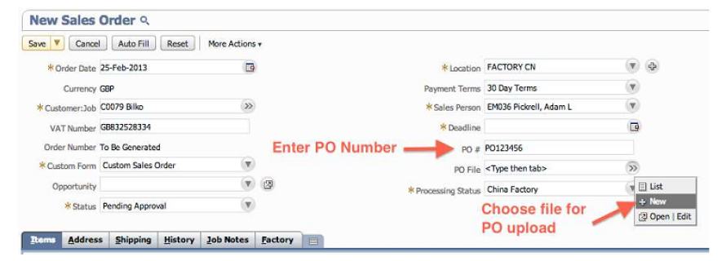
C.2.2.7 NetSuite / Scheduling a Sales Order – PO
PO number and PO file upload
If your lead/customer supplies their own order reference, add this to the PO # field. This reference will subsequently show on the invoice.
Some customers will provide you with a purchase order. You must enter the purchase order number and reference into the PO# field in NetSuite and attach a copy of the purchase order to the sales order using the 'PO File' field in NetSuite.
Purchase Order documents must be saved in NetSuite Sales Order. When placing the sales order, make sure you enter the PO number in the relevant field and upload the PO from the right folder, as the system defaults to the last folder used.
If you receive the PO from your customer after you scheduled an order you need to contact operations.cn@flashbay.com, so they can attach the file to the order.

Slide 19
C.2.2.8 NetSuite / Scheduling a Sales Order - Amendments
Changes after an order has been submitted
Ensure that all aspects of an order have been approved by the customer via a proper written order confirmation before placing any order in NetSuite
Do not amend any order information or details in NetSuite yourself, after you clicked SAVE on the Sales Order entry page.
The 'Edit' button on sales orders should never be used. Amending orders interferes with this crucial process.
If you or the customer wish to change any details on the sales order, please follow the following procedure:
If an amendment is production related you must email After Sales Team, Operations Team and your Group Leader CC:
Change of model
Change of capacity
Change of product colour
Change of Virtual Proof
Change of quantity
Addition or removal of items
Aftersales team will identify the cause of the amendment. Amendment might be considered as sales mistake and the order could be marked ex-commission and ex-profit.
To make sure all amendments are processed in a timely manner please use the following format for the subject line:
PRODUCTION AMENDMENT [Sales Order Number]; For example: PRODUCTION AMENDMENT S123456
If an amendment is non-production related, (excluding changes, listed above) you must email Operations and your Group Leader CC. Please use the Text Parts 'Non Production Order Amendment' with a brief description of the details which need to be amended.

