Slide 1
Flashbay
Information Technology
Training

Slide 2
PC Basics
Usage Guidelines:
Never plug in USB’s into the computer
Never use your computer to charge phone, tablets, fans or any other devices
Never leave your computer unlocked and unattended
Never Restart your PC unless authorised by IT
Always log off your PC at the end of the day
Always keep customer data in the public folder
Always regularly clear your downloads, desktop & documents folder and then empty the recycling bin
Always regularly clear your browser cache

Slide 3
Slack
What is Slack?
Slack is a powerful instant messaging tool that we use to communicate Internally.
We use slack to communicate to our teams all over the world.
We started using Slack in 2017 and it has quickly become one of our most vital tools that we use in our day to day operations.

Slide 4
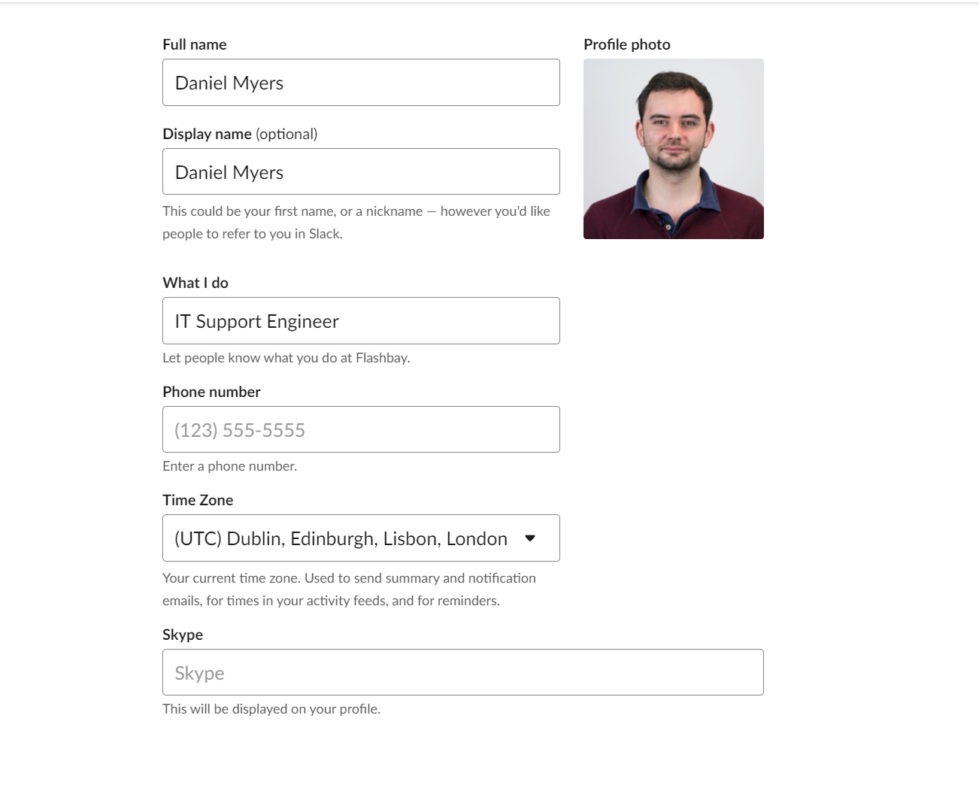
Slack
Your Slack Profile:
So people know who you are it is important you fill out your profile
information correctly.
Your profile picture will be taken on your first week, you can use this as your profile picture
Make sure you enter your full name in the
“Full Name” & “Display Name” columns
Ensure you fill out the “What I do section”
You should also specify what team you are in.
For instance if you are a SAM in the French team you should put:
Sales Account Manager FR

Slide 5
Zimbra Tips
Zimbra Quota:
Zimbra is our mail client. You have already been shown how to use Zimbra and how to structure your inbox.
As well as structuring your inbox properly you should also manage your quota. This means clearing out old emails and attachments on a regular basis so you do not run out of email quota.
We have created filters that will help you quickly identify emails/ attachments that are safe to delete.
If you spend 5-10 minute at the end of each day to use these filters you should never have any quota issues and your inbox will be clutter free.
Note: Before you delete any email check with your Trainer/ Group Leader first.

Slide 6
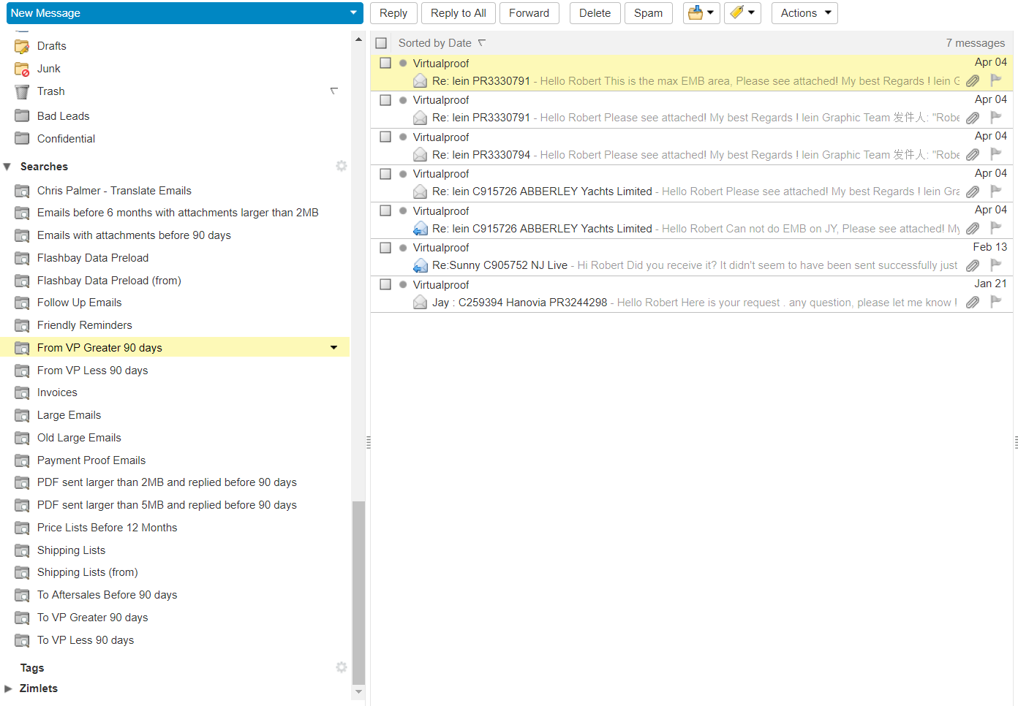
Zimbra Tips
Using the filters:
The filters are in the “searches” tab
If you are unsure of what to delete and what should be kept always refer to your Group Leader before deleting.
Using your filters daily is important as it will stop you having to spend a lot of time clearing out mail/attachments.
If you know you are going on holiday make sure you spend the time to clear out filters so you do not run out of quota whilst you are way.

Slide 7
Snom Phone
Snom Phone Troubleshooting Tips:
Calling customer is a vital part of your role in Flashbay. Occasionally there can be issues with the phones. Below are some tips on how to troubleshoot common issues:
If your extension is unreachable press DND 4 times. This will 90% of the time fix the issue. If you issue persists please contact IT.
If you are experiencing call quality issue with your customer, try switch to the handset, see if it improves and report to IT. This will help us identify if the issue is to do with your headset or handset.
If you have call issues take the records from your activity records and forward them to itsupport@flashbay.com along with a description of the issue.
When reporting issue please give a full explanation along with any examples you may have.

Slide 8
Who to contact?
Who to contact:
Below is a table of who you should report certain issues to. It is important you follow this table as it will help resolve any issues or queries quickly and efficiently.
HR Team
Netsuite passwords | Netsuite User Setup | Office equipment | Office related requests
Global Sales Operations Team (GSP)
Quota Tool | Sample Packs | Netsuite Sales Orders | Trustpilot issues | MindTickle
Graphics
Logo query’s/ issues | VP query’s/ issues | Graphic file issues (.ai .esp)
IT Support
Zimbra issues | PC issues | Filezilla &FTP issues | Data Preload FAQ | Netsuite performance issues
Internet issues | Phone Issues | Technical questions | Slack Issues

Slide 9
Virus & Malware

Slide 10
Spam Emails
Introduction
The recent surge of new viruses such as Ransomware has become increasingly more aggressive lately. The most common way these viruses are delivered is in email attachments.
As we are a B2B sales company we receive a lot of invoices for payments. Invoices typically come through via email and a lot of the time these are automated.
Because these emails are mostly automated it is very easy to manipulate for spam purposes
Note: This is the most common way but not the only way we receive Spam so it is important to be very careful with any external emails you receive.
The result of opening an attachment or link that has a virus in it could be catastrophic for the business leading to:
loss of data,
Sensitive data being stolen or manipulated
Damage to computer systems beyond repair
In the next few slides we will show you how to identify viruses and guide you through the process of what to do in the event of receiving Spam emails.
Notes:
Question 1- Multi Choice
What can happen if you open a virus or Malware on your computer?
1- Can cause loss of data 2- Nothing
3- Damage the computer beyond repair 4- Sensitive data can be stolen
5- Slow down your internet connection 6- Cause disruption to the phones
Answer
1- Can cause loss of data
3- Damage the computer beyond repair 4- Sensitive data can be stolen

Slide 11
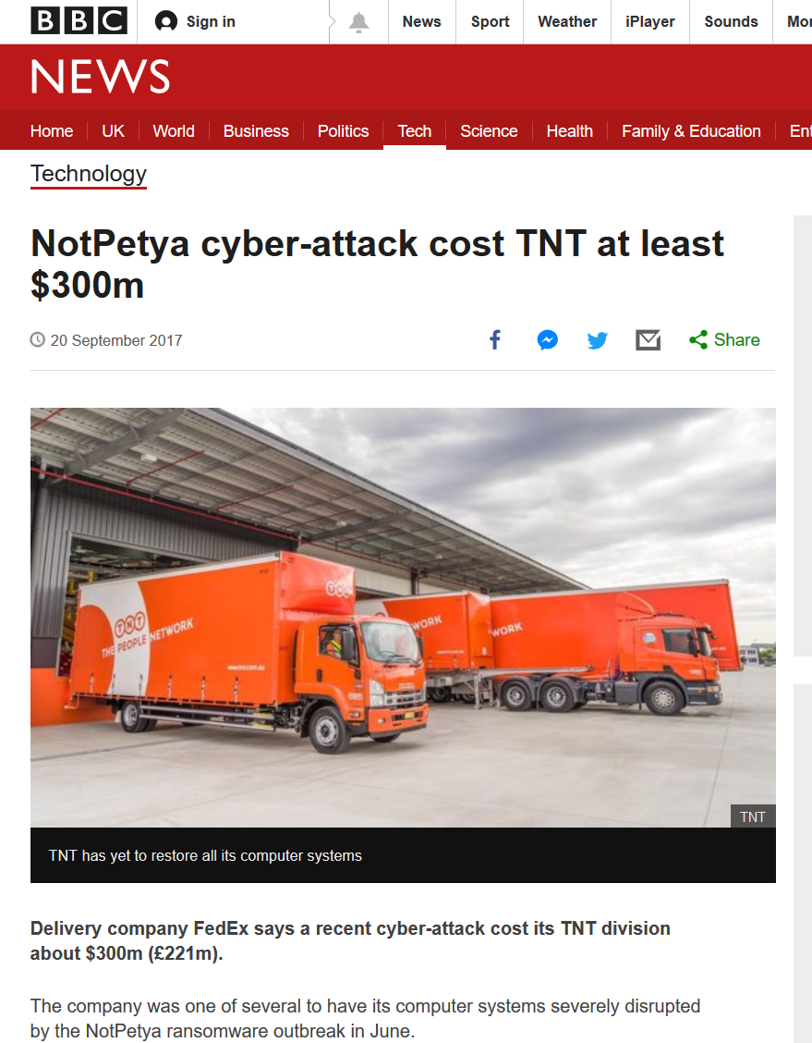
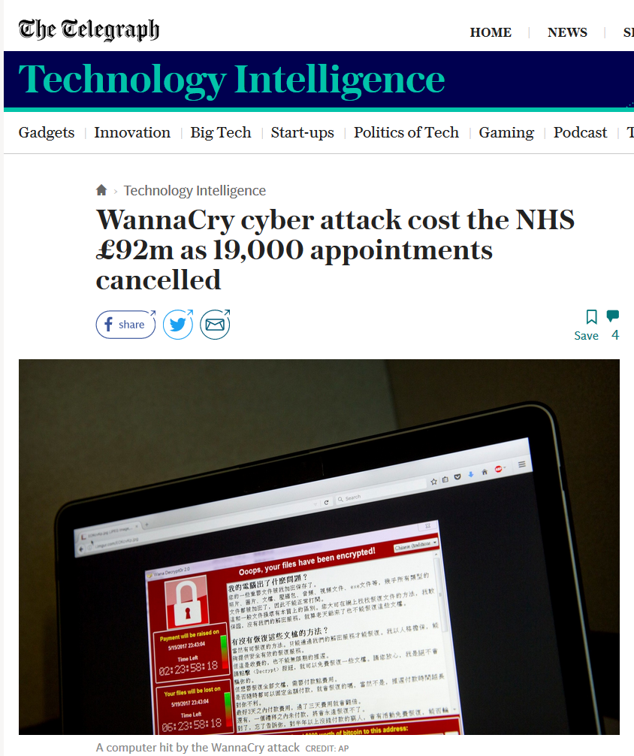
Recent attacks
The Big ones
There has been outbreaks of Viruses across the world. I have taken these two examples from 2017 which dominated the news as it caused chaos to the affected businesses.
NHS- WannaCry Attack
This virus actually infected 230,000 computers in at least 150 countries.
This virus infected all of the NHS systems and crypto locked their file. As they would not pay the ransom all this data had to be wiped and as a result was lost.
TNT- Notpetya
This virus hit TNT systems on a global scale crippling the entire network. All tracking information was lost which also affected us as we use TNT as a distributer.
Notes:
Question 1- Multi Choice
What can happen if you open a virus or Malware on your computer?
1- Can cause loss of data 2- Nothing
3- Damage the computer beyond repair 4- Sensitive data can be stolen
5- Slow down your internet connection 6- Cause disruption to the phones
Answer
1- Can cause loss of data
3- Damage the computer beyond repair 4- Sensitive data can be stolen

Slide 12
Virus & Malware
Virus Prevention
Here are some simple things to lookout for when receiving emails and how to deal with them safely.
1. Unknown sender: If you do not know the sender, do not open any attachments in that email and contact IT for verification.
2. Invoice:
We get a lot of spam in the form of invoice emails. If you see the attachment looks strange, spelling or grammar is incorrect, you are not the only recipient or the signature does not match the senders email you need to forward this to IT for verification straight away.
3. Zipped files: Under no circumstances open Zipped Files, forward the email to IT for verification straight away.
4.Links If you don't recognize the sender or are in any way suspicious of an email never click on or copy any links in the message. Instead mark the email as spam and it will be removed from your inbox.
Notes:
Questions 3 – multi Choice
What do you do if you receive an email with a .Zip or .exe attachment?
1-Open it and see what it is? 2- Delete the email
3- Report straight away to IT for verification 4- Forward it to your Team leader for verification
Answer
3- Report straight away to IT for verification
Question 4 –Multi Choice
If you get an email from an unknown sender do you?
1-Open the email and see what it is about 2- forward IT and ask them for verification
3- Send it to your colleague or GL to verify 4- treat it as a normal email
Answer
2- forward IT and ask them for verification
Question 5- Multi Choice
If you get an email that has links to external pages do you?
1-Forward to IT for verification 2- Follow the links as instructed
3- Respond to the email saying we do not except links 4- Delete straight away
answer
1-Forward to IT for verification

Slide 13
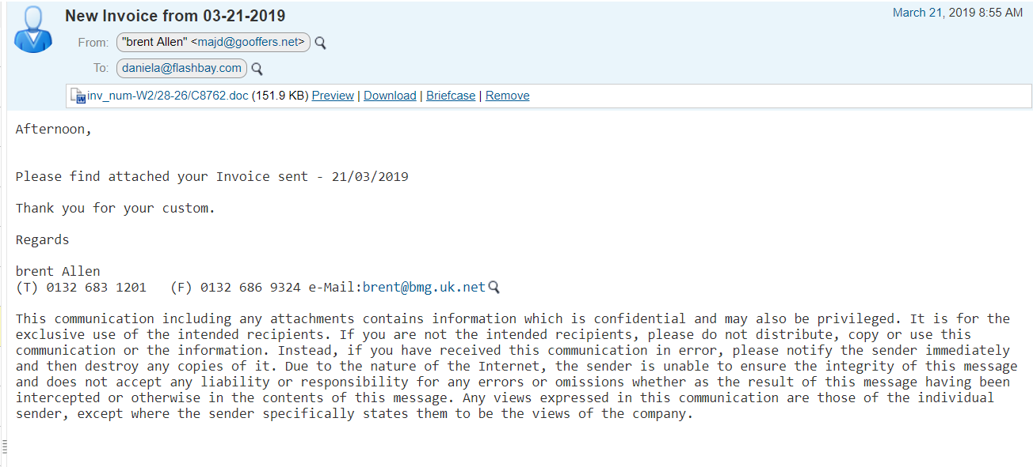
Virus & Malware
Other warning signs of viruses:
There is no specific person addressed in the body of the email, this suggests the email could have been sent by a Bot.
The email of the sender does not match the one used in the signature.

Slide 14
Virus & Malware
Attachments with .zip .rar should never be opened as these can easily hide Malware within the zip
Other attachment that should never be opened:
.exe (Executable File)
These files are programs and will run as soon as you click on them. If you see this in your attached you can guarantee it will be a virus.
.com (DOS Command File)
This is another type of executable program that again will run as soon as you click it
.bat (Batch File)
This is a script that will run a series of command on the PC and will run as soon as it is clicked on.
.js (JavaScript File )
This is a text file containing JavaScript code that when run can send instructions to webpages and can manipulate what you see on your browser and compromise the computer.

Slide 15
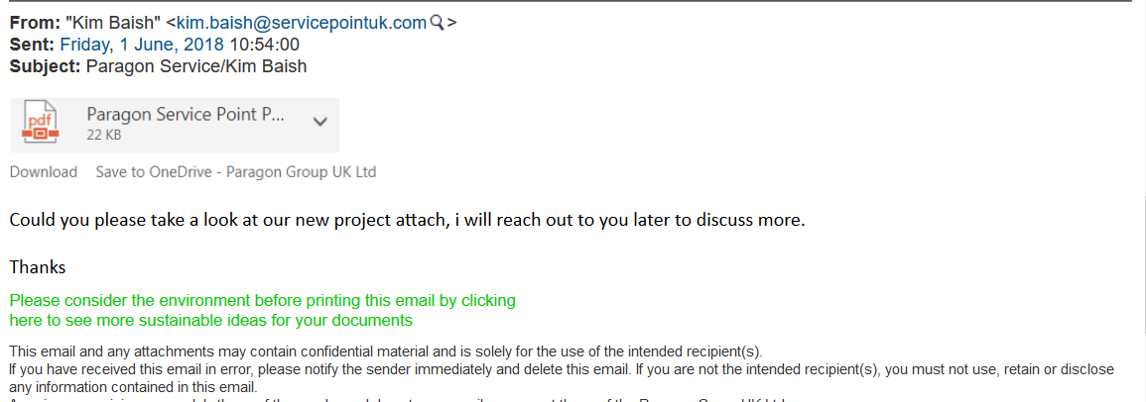
Virus & Malware
5. No signature at the end of the email.
6. Link in the body of the email
This is actually a link and not an attachment

Slide 16
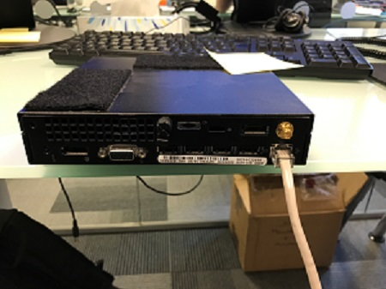
Virus & Malware
In the event of virus infection
As soon as you are aware that your computer has become infected you should immediately disconnect the Ethernet cable and contact IT. This will take the computer off the network protecting other users from getting infected.
Note: When you contact IT please make sure you call as you will be disconnected from the Network and unable to send Emails.
Simply Push down on clip and remove
Notes:
Question 6 – multi Choice
You have just noticed you have clicked on a virus, what do you do?
1-Shut down computer 2-Take out network cable and call IT
3- Try do delete virus and call IT 4- Restart computer and call IT
Answer
2-Take out network cable and call IT

