Slide 1
Explorer Part 2

Slide 2
Wiki
The Flashbay Wiki provides useful information on all aspects of working at Flashbay.
To access the Flashbay Wiki go to Zimbra>Employee Portal>Flashbay Wiki
It’s important to spend some time ‘getting to know’ the Flashbay wiki as this is where you will find the answers to all of your questions. Before asking your Manager a question please always check the Wiki first!

Slide 3
Navigating the Wiki
The wiki is divided into the following 11 sections and each section is divided into various sub sections that can be accessed by clicking on the name e.g. ‘UK Human Resources’
Human Resources
Global IT Policies and Useful Information
Sales Staff Manual
Aftersales
Memory
Power
Drinkware
Audio
Gadgets
Face Masks
Gift Sets

Slide 4
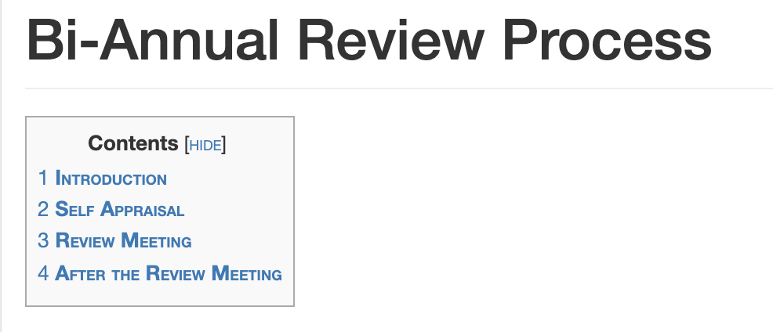
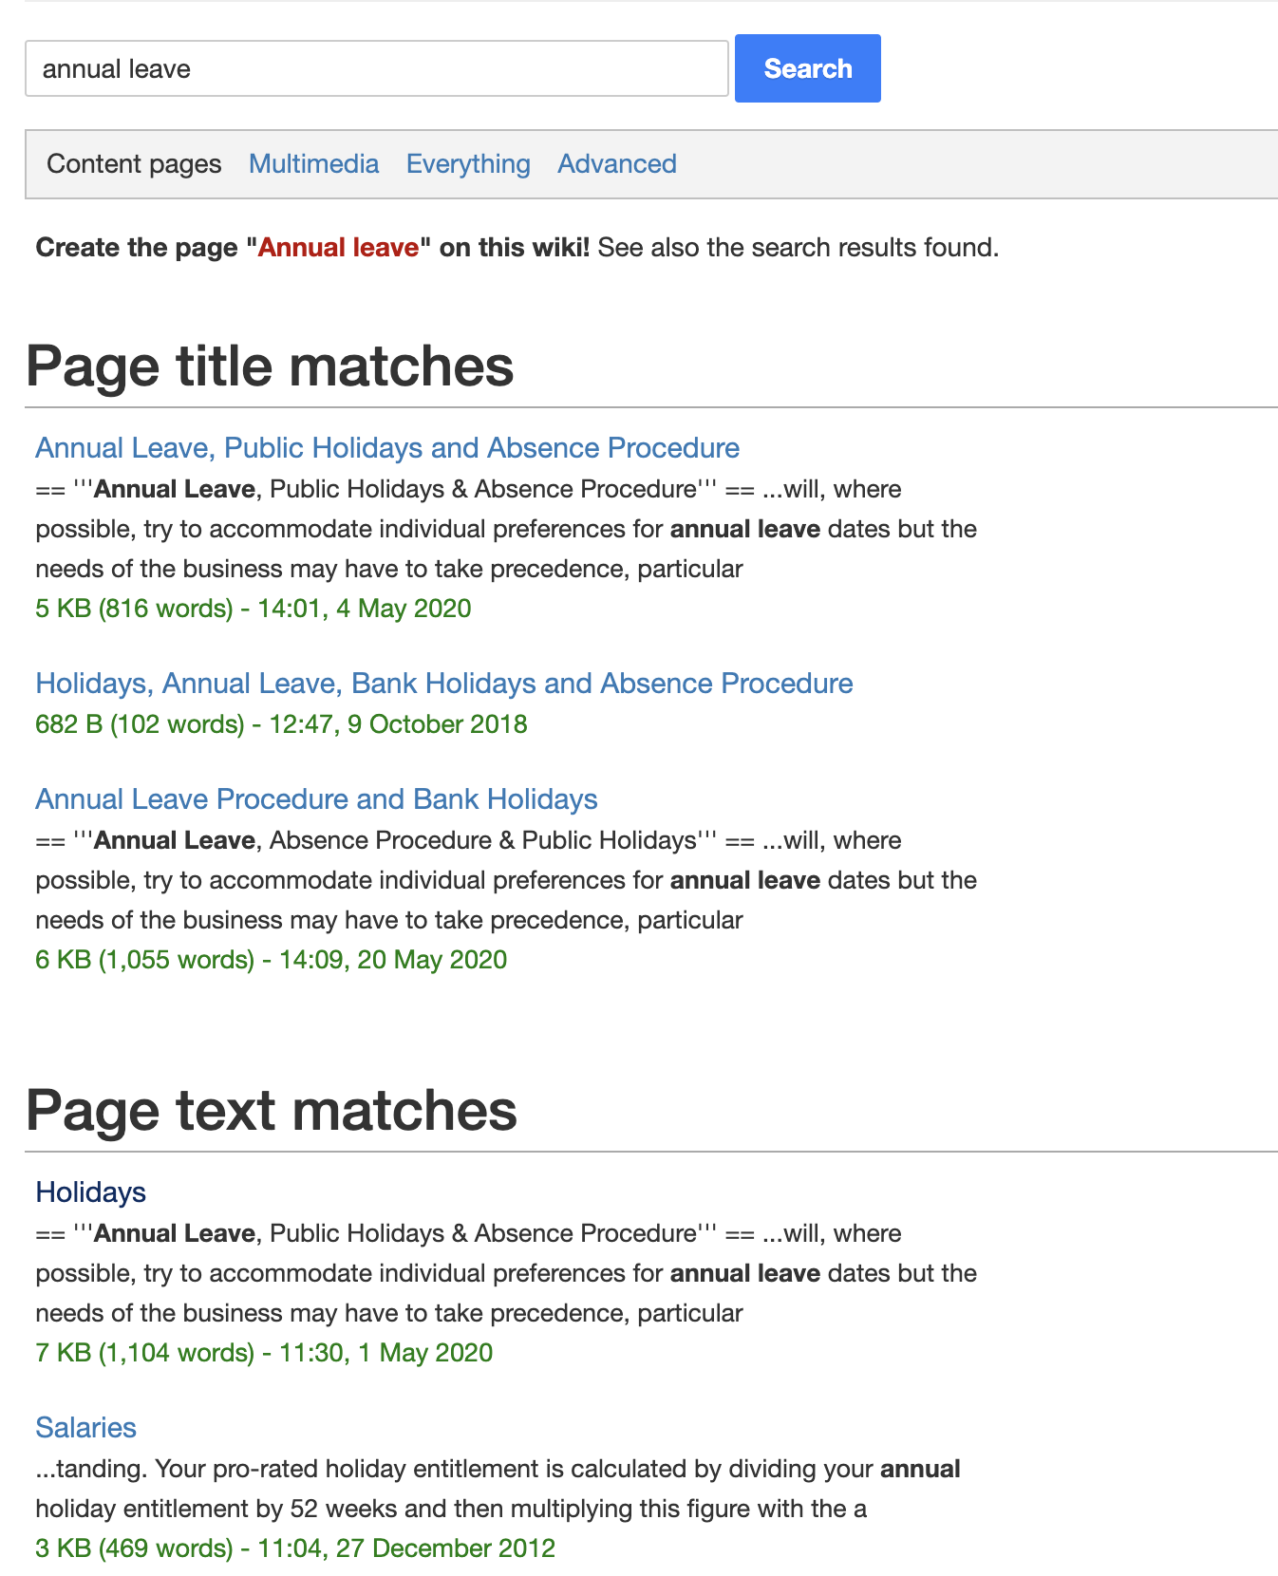
Navigating Wiki
It is important to spend time getting to know the wiki as the more familiar you are with how to navigate it, the quicker you will be able to find the information you require and the easier your job will become!
Each individual page has a contents page at top where individual items
will be numbered. You can click on the item you are interested in and
you will be taken immediately to that section.
In the top right hand corner of the Wiki you will find a search box. You can
type any word or phrase into this box and it will show you all of Wiki articles
related to the word or phrase.
The search results will be broken down into ‘Page Title Matches’, e.g. a page
with a title containing your search term or ‘Page Text Matches’ e.g. any page that
contains your search term.
The wiki is over 10 years old and there is a LOT of information stored here
so the more specific your search the better!

Slide 5
Recent Updates
On the Wiki home page there is a ’Recent Updates’ section which you can view if you scroll down to the bottom of the page.
This section summaries any recent changes including edits to pages that already exist or the creation of new pages. It includes a link to the page where you can read the information in full.
It is important that you check this section at least once per week to ensure you are up to date with the latest information.

Slide 6
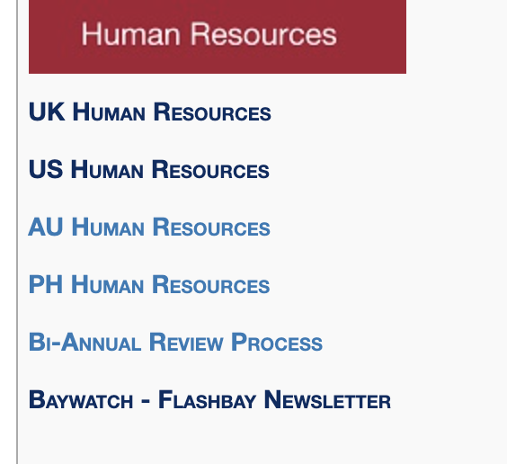
Human Resources
The HR sections relevant to our UK based employees are:
UK Human Resources
Bi-annual Review Process
Baywatch – Flashbay newsletter
What can you find in UK Human Resources?
Holidays: how to book a holiday, your holiday entitlement, public holidays, cover procedure for the sales team.
Benefits: details of the benefits Flashbay offers and how to use them
Handbook and Policies: a copy of all policies that apply to our UK employees can be found here. These are detailed policies covering a range of topics such as Absence, Maternity and Paternity .
Update your Personal Information: details on how to update your information and what we need to know.
New Employee Portal: useful information for new starters e.g. when is pay day?
Office Manual: overview of our expectations within the office environment

Slide 7
Global IT Policies and Useful Information
All sections are relevant to our UK based employees.
Global IT policies: a copy of all of the IT policies that apply to our UK
employees, you read and signed these as part of your new starter documentation.
Useful IT Information: information relating to Zimbra, browsers (Google/Firefox), Data preloading, setting and securing passwords, information on preventing viruses and Flashbay’s phone system.
Sharing and forwarding mailboxes: detailed instructions on the procedure for setting up and revoking shares and forwards of your mailbox when on planned leave.
NetSuite: information on what NetSuite is and how to use it.
Slack: information on what Slack is and how to use it.

Slide 8
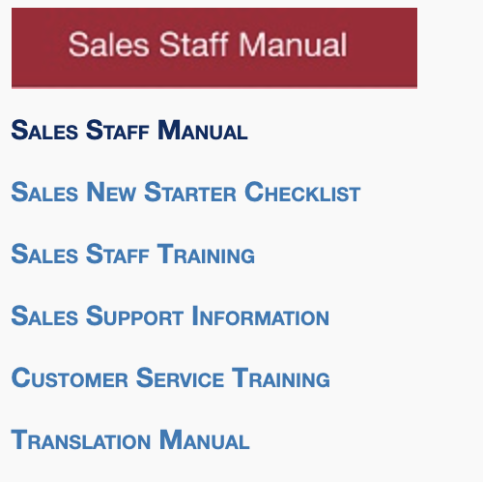
Sales Staff Manual
This section of the Wiki is relevant to members of the sales team.
Sales Staff Manual: contains a large number of sub topics containing important
information you will need to know in order to perform your role as a Sales Account
Manager at Flashbay. E.g. ‘Orders on hold’, ‘’Blank Unit Orders’
Sales New Starter Checklist: a document detailing everything new starters will
cover in their first 2 weeks.
Sales Staff Training: here you will find a copy of the PowerPoint presentations for each of the Sales Hero Academy topics e.g. Explorer Part 1 and 2. http://wiki.flashbay.com/index.php?title=Sales_Staff_Training
Sales Support Information: here you will find the product codes and commodity codes for all products.
Translation Manual: here you'll learn how you can easily translate our English pages into your local language.

Slide 9
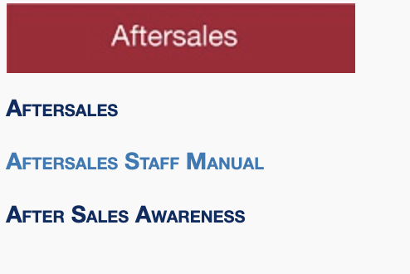
Aftersales
This section of the Wiki is relevant to all members of the sales team.
Aftersales: detailed information on the steps involved in an Aftersales case
from beginning to end.
Aftersales Staff Manual: aims to provide guidance to aftersales employees on the processes and procedures that the Aftersales team must adhere to.
Aftersales Awareness: information on common mistakes and how best to avoid an Aftersales case.

Slide 10
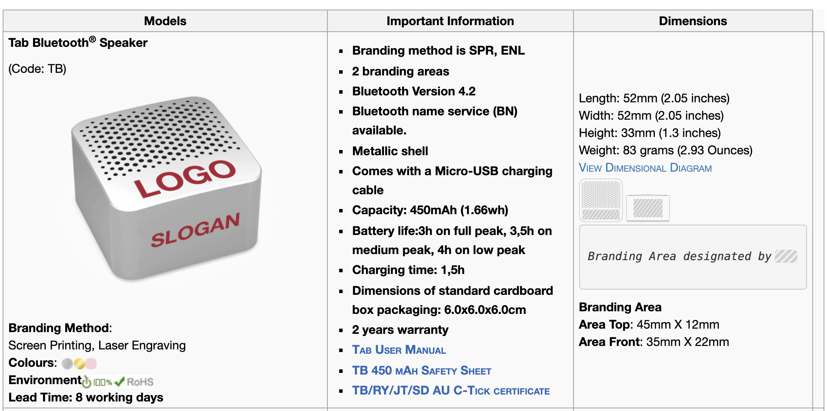
Product Categories
There are 7 individual sections for each product category. These sections of the Wiki are relevant to all members of the sales team.
Memory
Power
Drinkware
Audio
Gadgets
Face Masks
Gift Sets
In each section you will find details of all of the products in that
category, images of the products and all the information related
to that product such as branding method, colours, lead time etc.

Slide 11
Questions?

