Slide 1
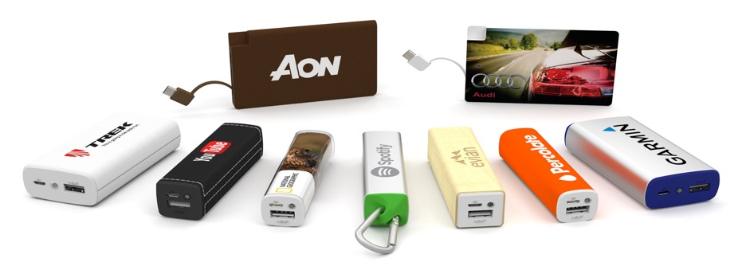
Flashbay Power Product Range

Slide 2
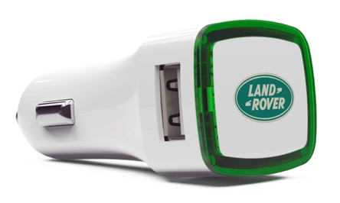
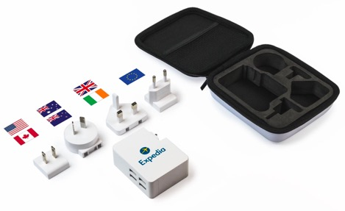
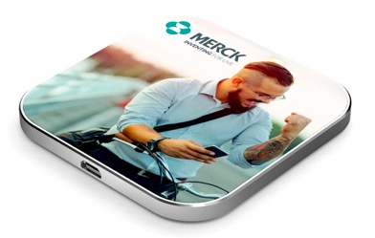
Power Product Range

Slide 3
Power Product Range
The ‘Power Range’ is a fairly new and expanding addition to the Flashbay product range. Currently, the Power category can be sub-categorised into:
Power banks
USB Chargers

Slide 4
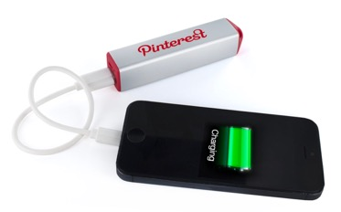
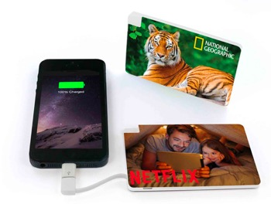
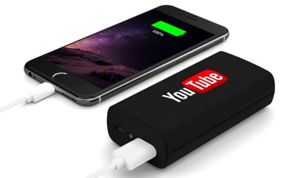
The Flashbay Power Bank Range
Put simply, Power Banks are portable rechargeable batteries that can be used as a power source for mobiles/tablets on the go!
Here are some examples of the Flashbay models:

Slide 5
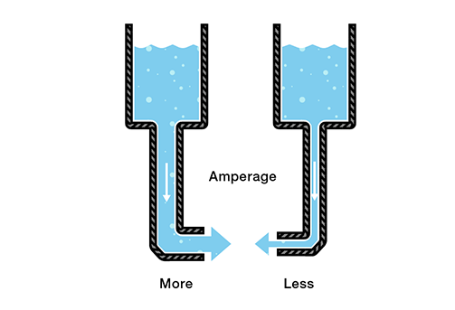
Short Introduction to Electrical Current and batteries
Electricity is the movement of electrons. Electrons create charge, which we can harness to do work.
Ampere: Amount of electrical current
A milliampere hour (mAh) is the amount of energy charge in a battery that will allow one ampere of current to flow for one hour. Battery capacities are given in mAh
Volt: Electrical force that makes electricity move through something. It is the difference in charge between two points.
Very simplified:
When describing voltage, current, and resistance, a common analogy is a water tank. In this analogy, charge is represented by the water amount, voltage is represented by the water pressure, and current is represented by the water flow. So for this analogy, remember:
Amount of Water = Charge (mAh)
Thickness of pipe = Ampere
If you would like more information about this please see Appendix 1.

Slide 6
Unique Selling Point Power banks
The main USP with our power banks is that they are safe!
Many customers are worried about poor quality components as these can cause PB’s to break or even explode.
“We offer top quality PBs with all relevant safety features”:
Output over-current and over-voltage protection
Input over-current and over-voltage protection
High temperature shut down
Short-circuit protection
Electrostatic Discharge (ESD) protection
All other services (except the warranty) are the same as for our USBs, e.g. quality branding and components, first class service, in house R&D and production.

Slide 7
Handling Power Bank objections / FAQs
Q: What capacities do we offer?
A: We offer capacities ranging from 2600 mAh to 6700 mAh
For most users 3000 mAh is easily enough, as nearly all current phone models can be charged once or more with this capacity. Normally a power source for recharging the PB is readily available once the PB is empty.
Q: I’ve heard that Power banks can be dangerous. Are your PBs safe?
A: Yes! Refer to safety features. (see following slides)
Q: Is it compatible with all phones?
A: Yes. Different phones will need different cables. Refer to user manual of your phone.
Q: I have an IPhone. Can I use it with my IPhone? Why don’t you supply an Apple cable?
A: Yes, with a lightning to USB cable supplied with Apple products. All Apple products come with a lightning to USB charger cable that can be used with the Power bank. (see diagram on following slide)
Q: Why don’t the PB come fully charged?
A: For safety reasons it is not permitted to transport fully charged PBs as cargo on planes
Q: Do they come pre-charged?
A: Power banks come ca. 30% pre-charged
Q: Can I take my Power bank on the plane?
A: Guidelines on this are not completely clear at the moment. Some airlines allow for up to 2 PBs to be taken on as hand luggage. If in doubt, please check with your airline beforehand.
Q: What is the life cycle of a Power bank?
A: On average a Power bank - if properly maintained - can be used for about 400 - 500 cycles.
One cycle means a charge and then discharge. If you don’t charge the power bank fully before discharging it is still counted as one cycle.
The life-cycle also depends on the power banks storing conditions
Q: What is the warranty period, and what does it cover?
A: The Warranty period is 2 years and can be applied for the power bank only, the cable is excluded.

Slide 8
Power Bank packaging
Packaging
As standard, all Power Banks come with
Micro-USB Charging Cable
User Manual
White Card Box
*The Tour and the Card come with an additional Lightning Adaptor

Slide 9
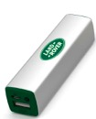
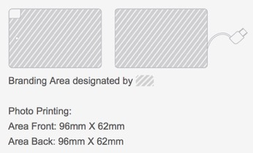
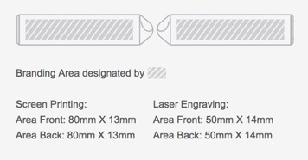
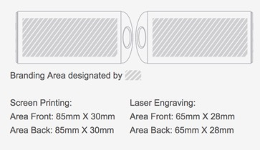
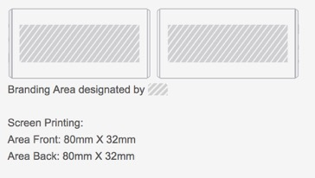
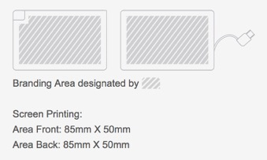
Power Bank branding and pantone matching
Branding
Element
Core
Lux
Maple
Foto
Encore
Card
Pantone Matching: 3 Power models can have pantone matched shells – for a full and up to date list please use the price list.
Journey
Tour

Slide 10
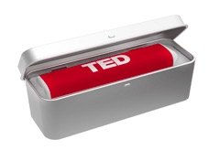
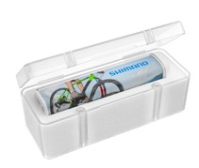
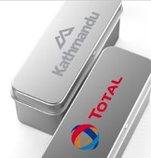
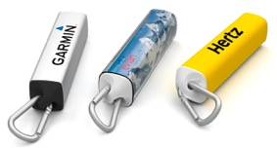
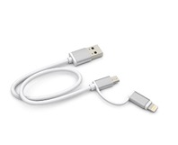
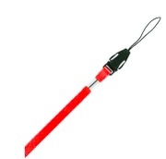
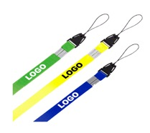
Power Bank accessories
Presentation Tin Extra Large: PTXL
The Presentation Tin looks great and also protects your Branded Promotional Product. It has a white foam cut-out fitted to the product and the top of the Presentation Tin features a large branding area ready to be printed with logo.
On delivery the presentation boxes are boxed up in a standard white presentation box
Both these boxes can be branded (screen printed)
Use the product codes in the price list to see which accessories can be used with what product: e.g.
Magnet Box Extra Larger: MBXL
Magnet Box is made from translucent plastic. The lid is kept securely shut by two small magnets. The Magnet Box has a grey foam cut-out fitted to the product and the front of the box can be screen printed with your logo.
Dual Head Cable Upgrade: DHC
Printed Neckstrap: PNS
Carabiner: CB
Neckstrap: NS
The aluminium carabiner features a spring-loaded clasp that easily opens and securely closes to the end of the Power Bank. The perfect accessory to attach to rucksacks, keyrings and more.
The Dual Head Cable provides connectivity to both Android and recent Apple devices alike. One head is a Micro-USB and the other a 'Lightning' connector. The Dual Head Cable is the perfect cable upgrade.
The Neckstrap is sold blank (no printing) and has a 7mm width.
The Printed Neckstrap has a 12mm width and is printed with your logo.

Slide 11
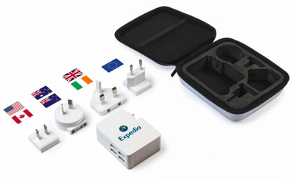
The Flashbay Charger range
The Duo
The Edge
The Latitude

Slide 12
The Duo – the car charger
What is a Promotional USB Car Charger?
A Promotional USB Car Charger allows for the charging of portable devices via a USB port whilst driving.
The Promotional USB Car Charger plugs into a car’s 12V/24V Auxiliary charging socket.
Typically, it is located in the centre console of the car, or in the lower dashboard area, and sometimes doubles up as a cigarette lighter.
The Promotional USB Car Charger can be customised and branded with your own logo, serving as a practical and highly effective marketing tool every time your client is driving.

Slide 13
Duo packaging and Extras
Presentation Tin Extra Large: PTXL
The Presentation Tin looks great and also protects the Duo. It has a white foam cut-out fitted to the product and the top of the Presentation Tin features a large branding area ready to be printed with a companies logo.
Magnet Box Extra Large: MBXL
The magnet box is made from a strong translucent plastic. The lid is kept securely shut by two small magnets. The Magnet Box has a grey foam cut-out fitted to the product and the front of the box can be screen printed with a companies logo.
On delivery the presentation boxes are boxed up in a standard white presentation box
The Duo Dual Head Cable Upgrade: DHC
The Dual Head Cable provides connectivity to both Android and recent Apple devices alike. One head is a Micro-USB and the other a 'Lightning' connector. With its sturdy anodised aluminum ends, the Dual Head Cable is the perfect cable upgrade.
On delivery the Dual Head Cable comes in a separate presentation box to the Duo. When ordered together the two products would be in the same brown carton box

Slide 14
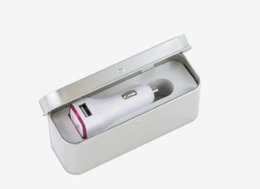
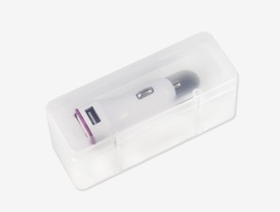
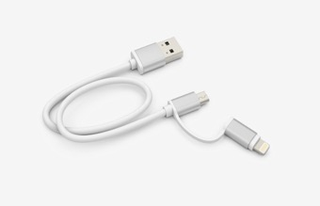
Duo packaging and Extras
Presentation Tin Extra Large: PTXL
The Presentation Tin looks great and also protects the Duo. It has a white foam cut-out fitted to the product and the top of the Presentation Tin features a large branding area ready to be printed with a companies logo.
Magnet Box Extra Large: MBXL
The magnet box is made from a strong translucent plastic. The lid is kept securely shut by two small magnets. The Magnet Box has a grey foam cut-out fitted to the product and the front of the box can be screen printed with a companies logo.
On delivery the presentation boxes are boxed up in a standard white presentation box
The Duo Dual Head Cable Upgrade: DHC
The Dual Head Cable provides connectivity to both Android and recent Apple devices alike. One head is a Micro-USB and the other a 'Lightning' connector. With its sturdy anodised aluminum ends, the Dual Head Cable is the perfect cable upgrade.
On delivery the Dual Head Cable comes in a separate presentation box to the Duo. When ordered together the two products would be in the same brown carton box
Duo in ‘Presentation Tin Extra Large’
Duo in ‘Magnet Box Extra Large’
Dual Head Cable Upgrade

Slide 15
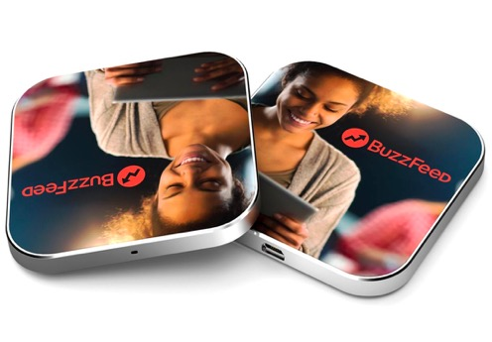
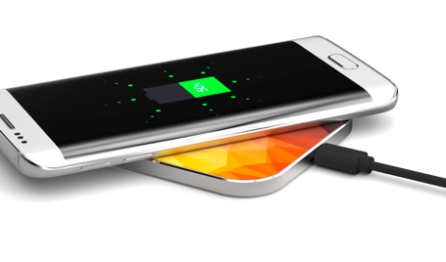
The Edge – the inductive charger
Also known as a ‘wireless charger’, an inductive charger charges the battery in portable electrical devices without having to plug the device directly into a power socket.
The charger itself must be plugged into the mains electrical supply, but the portable electric device sits loosely on top.
As the picture shows, the top surface of the Edge provides a large branding area for photo printing.

Slide 16
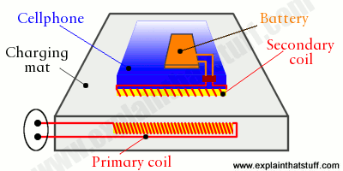
What are they and how do inductive charges work?
How do they work?
The Inductive Charger works by transmitting electricity across an electromagnetic field, from the charger to the portable electrical device.
Both the charging pad and the portable device contain induction coils – essentially a core of iron wrapped in copper wire.
When the portable device is placed on the charging pad, the proximity of the coils creates the electromagnetic field used to transmit electricity.
As electricity is passed across to the induction coil in the portable device, it is used to charge the device battery.

Slide 17
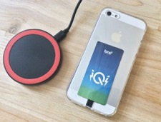
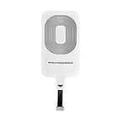
Inductive charger FAQs
What devices are compatible with Inductive Chargers?
A device must be Qi-enabled in order to be compatible with Inductive Chargers. The following mobile phones and tablets meet this criterion:
Samsung Galaxy: S7, S7 Edge, Note 5, S6, S6 Edge.
Microsoft Lumia: 1520, 1020, 930, 929, 928, 920.
Google Nexus: 4, 5, 6, 7 (2013)
BlackBerry: Priv.
Additionally, it is possible to add adapters to other devices which enable wireless charging.
How long does it take to charge a device?
The specifications of the Inductive Charger are unknown as yet.
Are they safe?
Inductive charging is actually very safe to use.
The electromagnetic fields generated by the transmitters are very small and weak in power, only operating over short distances.
The International Commission on Non-Ionizing Radiation Protection (ICNIRP) has found no evidence of adverse effects on human health when exposed to inductive charging.
Indeed, wireless charging is actually safer than plugging in a device in some ways. As it does not require contact with exposed external electrical connectors, the possibility of electrical shocks and failure are reduced.
Some phones aren’t compatible with the inductive chargers – however they can work with an adaptor. Flashbay don’t currently offer these but are likely to in the future. This is how they work/ what they look like:

Slide 18
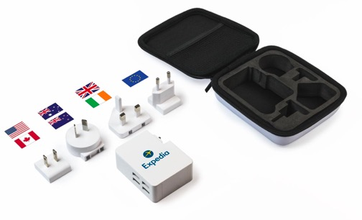
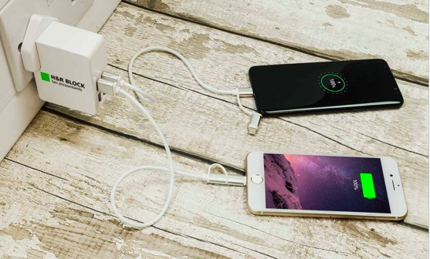
The Latitude – the travel charger
The latitude is the most recent addition to the Power range!
Light and portable
Comes with its own travel case
The Latitude features 4 USB ports
The charger comes with a selection of 4 removable plug types that will work in:
USA,
Canada,
Europe,
United Kingdom,
Ireland,
Australia,
New Zealand,
Japan
China
The latitude is safe
Output over-current and over-voltage protection
Input over-current and over-voltage protection
High temperature shut down
Short-circuit protection
Electrostatic Discharge (ESD) protection

Slide 19
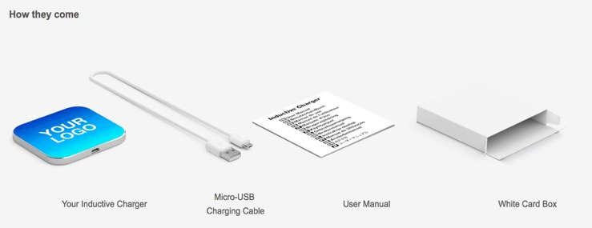
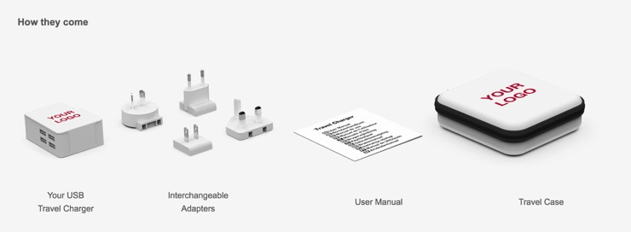
The Edge and Latitude packaging and Extras
This is currently how both the Latitude and Edge come.
The Latitude comes wrapped in a plastic bag, i.e. the travel case is wrapped.
The edge comes boxed, as the diagram shows
Currently there are no accessories for these products, however soon the edge will be available with presentation boxes.

Slide 20
Scheduling Power orders in NetSuite
All item codes can be found in the price lists.
Orders for Power, Audio and Memory products must be placed separately in NetSuite.
This is important regarding new business commission:
If a new business order contains two separate product categories only one of the orders will gain the 6% commission.
In these circumstances, let your group leader know and your commission statement will be updated accordingly.

Slide 21
Other important points to note…
A lot of SAMs are still using their standard USB templates – this goes against the Flashbay standards
Please rework them and then keep them in a separate folder (this applies for the Audio range too)
Power products have longer lead times than USBs (these are mainly due to customs and special transportation rules for dangerous goods)
Current lead time picture (June 2017)
Power banks 7-9 days, model dependant
Chargers – 7-9 days, model dependant
Do not add link to Flashbay Trustpilot page as this might confuse customers – as currently this is very USB led.
Dummy samples can be ordered via sample tool - samples are sent from all available models (if customer does not want all models, inform Warehouse in email)
Working samples – please contact aftersales

Slide 22
Appendix 1
A Power bank with 2600mAh can theoretically deliver 2600mA / hour.
Our Power banks are limited to a maximum of 1A output.
Most mobiles have an input of 1A.
As the internal circuits consume some power, roughly 20% of the power is “lost” on the way. This factor increases depending on how heavily the receiving device is being used.
Formula for calculating charging times:
Charging time = mAh of Battery to be charged / 0,8 x Output Milliamps of power source
Example:
Iphone 6s battery capacity = 1810mAh
Power bank output =1A (1000mA)
Charging time = 1810mAh / 0,8x1000mAh = ca. 2h 15 min
The same formula can be used to calculate the time needed for charging the PB, albeit with a different output power source.
Typical output sources:
USB 1.0, USB 2.0: 500mAh, 0.5A
USB 3.0: 900mAh, 1.5A
Wall socket: usually max of 15 A
As the Power bank has a maximum input of 1A, charging time is not shortened in output of source is higher than 1A
How often can I charge a specific phone model?
Formula:
PB capacity x 0.9 x.0.8 / Phone capacity
Why 0.9? Because Power bank batteries are never 100% charged.
As the efficiency loss increases beyond 90%, leading to wasted charging potential. Going from 95% to 100% can take exponentially more power.

