Slide 1
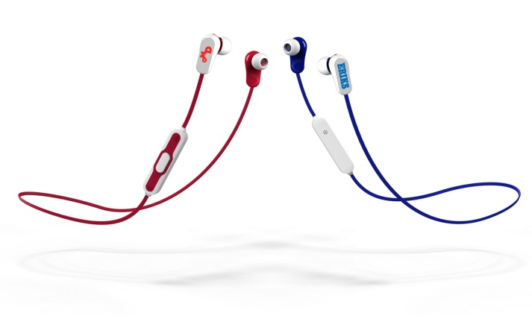
Flashbay
Audio Training
An introduction to selling the Flashbay Audio product category

Slide 2
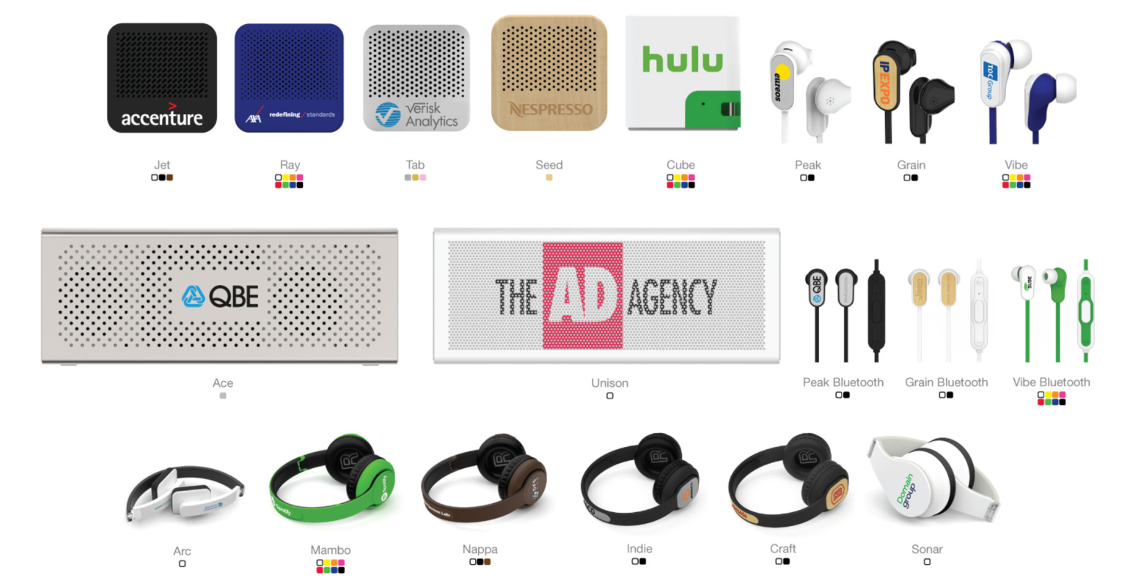
The Audio Product Range
The Audio product range was introduced in 2017,
over 15 products to date
Sub categories:
Bluetooth Speakers (mono and stereo)
Bluetooth Headphones
Bluetooth Earphones
Earphones
Best sellers: Unison (UN), Tab (TB), Mambo (MO).

Slide 3
Samples
Dummy Samples:
Loose samples
Part of Gift Set Large
Working Samples:
Speakers: Tab (TB), Unison (UN);
Headphones: Arc (AC) by call request, Mambo (MO);
Earphones: Vibe (VB, VBB), Peak (PK,PKB) in white only.
Future Sample Pack
Always check availability of working stock with the warehouse team.

Slide 4
Consumer Market Comparisons
The tables below provide context on our relative technical specifications:
Specification | Flashbay Speakers | Consumer Speakers
Sensitivity | 80dB | 87dB
Power Handling | 3W | 3W
Frequency Response | 20Hz – 20kHz | 20Hz – 20kHz
Specification | Flashbay Headphones | Consumer Headphones
Sensitivity (dB) | 108dB | 115dB
Power Handling (W) | 20mW | 20mW
Frequency Response (Hz) | 20Hz – 20kHz | 20Hz – 20kHz

Slide 5
What is a Speaker’s Power and Sensitivity?
Sound | Volume in dB
Whisper | 15-25
Home or Office Background Noise | 40-60
Normal Speaking Voice | 65-70
Orchestral Climax | 105
Rock Concert | 120+
Pain Threshold | 130
Jet Aircraft | 140-180
A speaker’s sensitivity is measured in Decibels (dB)
A speaker’s maximum electrical power is measured in Watts (W)
This is an indication of how loud a speaker can play:
A speaker with a sensitivity rating of 90 dB means that at 1 watt of power, the sound produced by the speaker at a distance of 1 metre is 90 decibels.

Slide 6
What is the most important Factor in determining Volume?
A speaker’s sensitivity is more important than its amplifier power in determining the volume it can produce.
As the chart shows, you need to double the power input in order to get a constant increase in volume of three decibels.
In other words – there is a significant loss in volume gain as power increases.
Too low a dB rating requires too much power to generate good volume - this risks blowing the speaker.
Too high a dB rating means you are unlikely to have sufficient power to make full use of the speaker.
Power in Watts | Volume in dB
1 | 87
2 | 90
4 | 93
10 | 97
20 | 100
40 | 103
100 | 107
200 | 110
400 | 113

Slide 7
What is a Speaker’s Frequency Response?
A speaker’s frequency response is measured in Hertz (Hz). and is given as a range.
This is an measure of the speed at which the speaker cone vibrates, and provides indication of the pitch of a speaker – how high and low a speaker can play.
A speaker with a frequency of 20Hz-20kHz means that the lowest bass output is 20Hz and the highest treble output is 20kHz (20,000 Hz).
Sound | Frequency in Hz
Lowest Elephant Noise | 4
Lowest Sound a Human Hears | 20-30
Normal Speaking Voice | 250
First Cry of a Baby | 432
Most Irritating Frequency (Chainsaw) | 4,000
Highest Note on a Piano | 4,096
Highest Sound a Human Hears | 20,000
Highest Dolphin Noise | 200,000

Slide 8
What is the Battery Life and Charge Time of our Products?
 | Item | Battery Life (hours) |  |  | Charge Time
 |  | Max Volume | Mid Volume | Low Volume
Bluetooth® Headphones | Arc Headphones | 5 | 8 | 10 | 30 mins
 | Sonar Headphones | 5 | 8 | 10 | 45 mins
 | Mambo Headphones | 5 | 8 | 10 | 45 mins
 | Indie Headphones | 5 | 8 | 10 | 45 mins
 | Craft Headphones | 5 | 8 | 10 | 45 mins
Bluetooth® Mono Speaker | Tab Loudspeaker | 3 | 3.5 | 4 | 1.5h
 | Seed Loudspeaker | 3 | 3.5 | 4 | 1.5h
 | Ray Loudspeaker | 3 | 3.5 | 4 | 1.5h
 | Cube Loudspeaker | 3 | 3.5 | 4 | 1.5h
Bluetooth® Stereo Speaker | Ace Loudspeaker | 2 | 4 | 10 | 3h
 | Unison Loudspeaker | 2 | 4 | 10 | 3h
Bluetooth® Earphones | Grain Bluetooth Earphones | 2.5 | 3 | 3.5 | 1.5h
 | Vibe Bluetooth Earphones | 2.5 | 3 | 3.5 | 1.5h
 | Peak Bluetooth Earphones | 2.5 | 3 | 3.5 | 1.5h

Slide 9
What is Bluetooth®?
Bluetooth® is a wireless technology standard for exchanging data over short distances from fixed and mobile devices, and building personal area networks (PANs).
Our products work with a wireless range of 2402MHz – 2480MHz, which equates to 8m.
We use Bluetooth version 4.1 and 4.2 depending on model.
Bluetooth name: our customers can specify the name (up to 20 characters) that the device shows during the Bluetooth ® pairing process.

Slide 10
Unique Selling Point: Audio
Reasonably priced (our cost prices are c. 1/20th those of good consumer standard items);
Relatively new to the promotional market, competitors barely offer;
Audio products are used every day, so customers logo gets more exposure;
Fully safety-certified products (RoHS, REACH, FCC);
Target audience: younger generation, long distance commuters, everyone who listens to music;
Spot the opportunity to cross sell to existing customers Audio products.

Slide 11
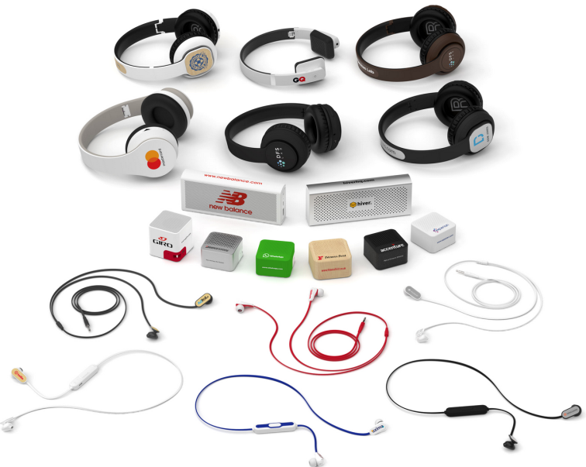
Audio Product Awareness
Pay attention that Lead times are longer and less flexible than with USB Flash Drives;
Audio products are more subjective then USB Flash Drives, verify 100% customer satisfaction before sending TrustPilot;
Know which product to offer – very different branding areas;
Orders for Flash Drives/Power products/ Gadget and Audio Products must be placed separately

Slide 12
FAQ’s
Q: What percentage of battery charge are our Audio products shipped with?
A: They are approximately 30%-70% charged.
Q: What is the wireless range of our Audio products?
A: The Bluetooth connection range is approximately 2402MHz-2480MHz – this equates to a distance of around 8m.
Q: How many hours of playing time do our Audio products offer?
A: Very wide range depending on the product type and volume from 2h to 10h
Q: How long does it take for the Audio devices to charge?
A: Depends on the product type and battery capacity range from 70mAh (0.5h charge) to 2200mAh (3h charge) using 400mA charger.
Q: Can I use and charge my Bluetooth devices at the same time?
A: Yes.

Slide 13
FAQ’s
Q: Are our Audio products allowed on commercial flights, or are there any restrictions?
A: Yes, all allowed in hand and hold luggage – only restriction is the battery cell’s weight cannot exceed 5kg/box.
Q: Do any of the speakers function as power banks as well?
A: Yes – the AE/UN have 2200mAh capacity with additional power bank feature.
Q: What type of battery is inside my Audio devices?
A: Li-ion Battery.
Q: What is the warranty period and what does it cover?
A: 2 years full warranty.
Q: What are the order quantities
A: MOQ is 10 units. Order quantities are 10, 25 and multiple of 25 (except for earphones).

