Slide 1
Aftersales

Slide 2
What is Aftersales?
Aftersales refers to all measures, which are taken by manufacturers and retailers in order for a successful sale to their customer.
Good Aftersales service encourages repeat and additional purchases, increasing customer satisfaction and ensuring long-term customer loyalty. Diligent Aftersales care often ensures a higher future margin than new business, and is a sustainable way to increase customer value and profitability.
Our Aftersales department deals with all issues that arise post sales, in order to maintain a business relationship with the customer. Our aftersales team is located in our UK warehouse, which we will be visiting today.

Slide 3
Plan for today
Reporting cases
Responsible parts
Examples
Case study
Introduction to Aftersales team
Introduction to Warehouse team and samples dispatch procedure

Slide 4
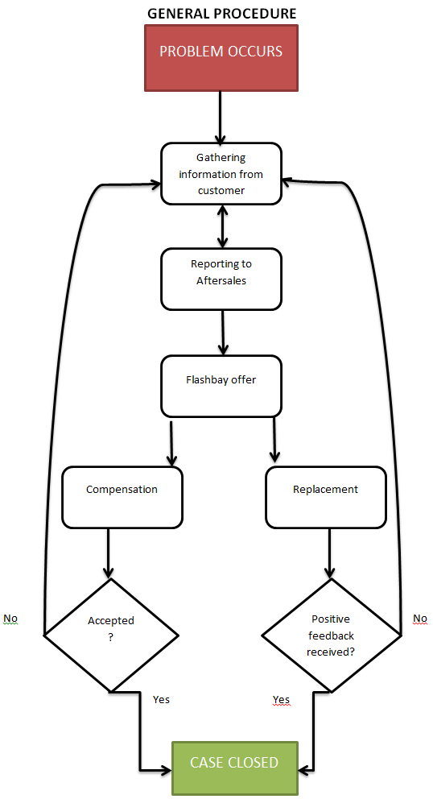

Slide 5
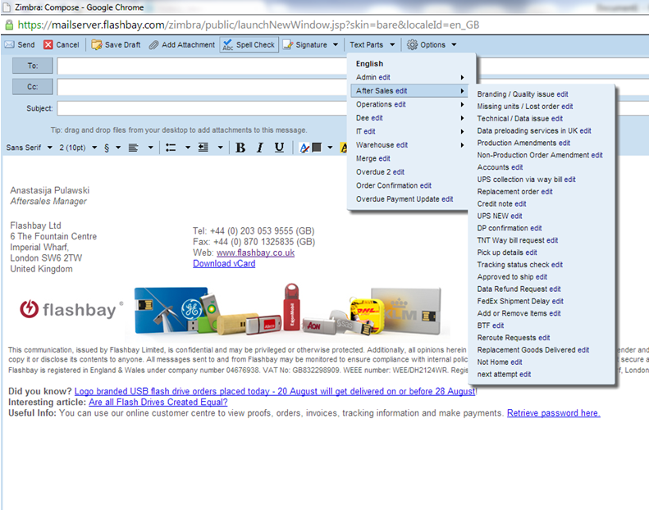
How are Aftersales Reported?
We write an email to aftersales.[country code]@flashbay.com with the Sales order number and customer number as the subject. You can then find aftersales related reporting templates under the Text Parts in Zimbra.

Slide 6
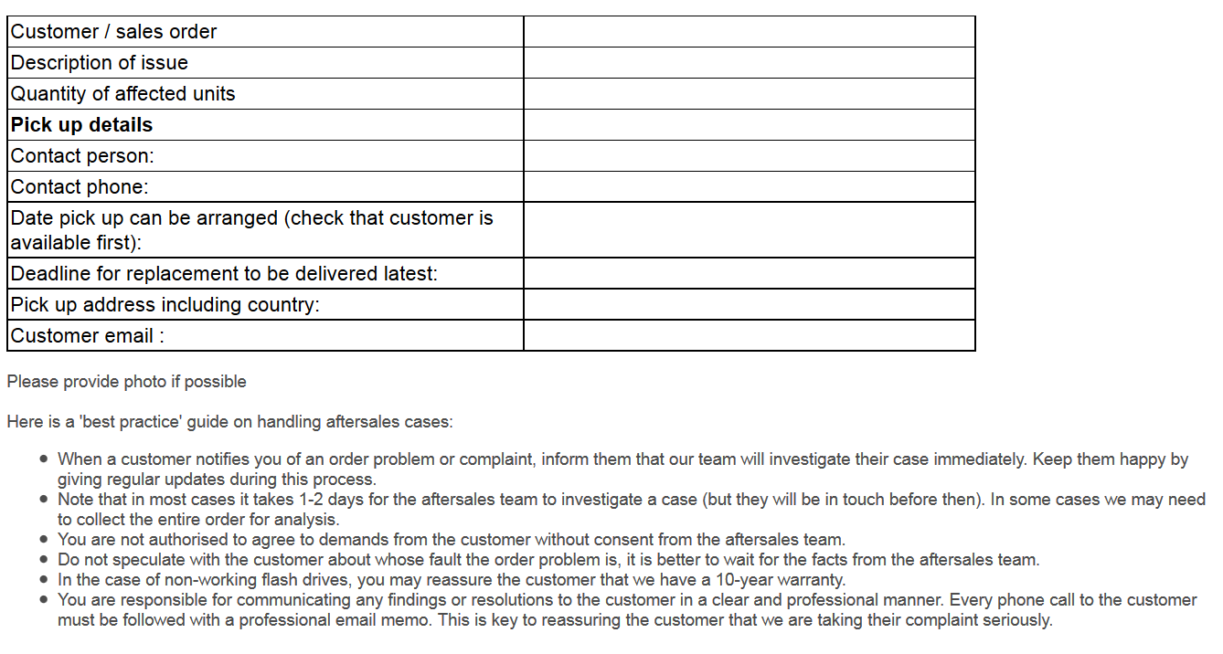

Slide 7
How do Most Aftersales Cases
Originate?
The most common causes of Aftersales are:
Courier Error
Factory Error
Sales person Error
Completely unpreventable error -very rare (“customer error”)

Slide 8
Examples
Courier Errors:
Delays in transit. Wrong delivery address. Package being delivered damaged. Package being lost.
(shiptrack@flashbay.com – first point of contact)
Factory Error:
Incorrect printing, incorrect shipping addresses. Delays in production, technical issues, requests not respected
Completely unpreventable:
Wrong phone number provided, wrong names for individual engraving, wrong initial
request

Slide 9
Sales Person Errors
Wrong VP enclosed to order
Discrepancy between artwork and VP from graphic
Missing services
Delivery address
Wrong currency
Wrong quote sent for approval
DPUS not explained (screenshot)
DP screenshots not confirmed
Not checking simple data from customer
Wrong details of order (capacity, USB 3.0, quantity, special request)
Not taking the best care to meet deadline
Unclear communication with Operations team / graphics
(amendments)
Could sales person do better to prevent the error from happening?
Always check ALL details of the order BEFORE clicking save button!

Slide 11
Aftersales Resolution
Once the aftersales case has been resolved and the customer is happy with the outcome then your Group Leader will conduct a brief meeting with you to determine what steps could have been taken to avoid similar cases arising in the future.

Slide 12
Further Reading
The Flashbay wiki is an incredibly valuable resource and contains lots of information pertaining to past aftersales cases and general product knowledge.
Good places to start are:
http://wiki.flashbay.com/index.php/After_Sales_Awareness
http://wiki.flashbay.com/index.php/Product_Knowledge#Services
These resources are constantly updated so try to check and refresh your product knowledge from time to time.

