Slide 1
C.5 Negotiation
When going through this learning pack we advise you take notes in order to really solidify this content. It is imperative you know our product range off by heart when dealing with customers.

Slide 2
C.5.1What is negotiation?
A bargaining process between two or more parties seeking to discover common ground and reach an agreement.

Slide 3
C.5.2 Where do we encounter negotiation?

Slide 4
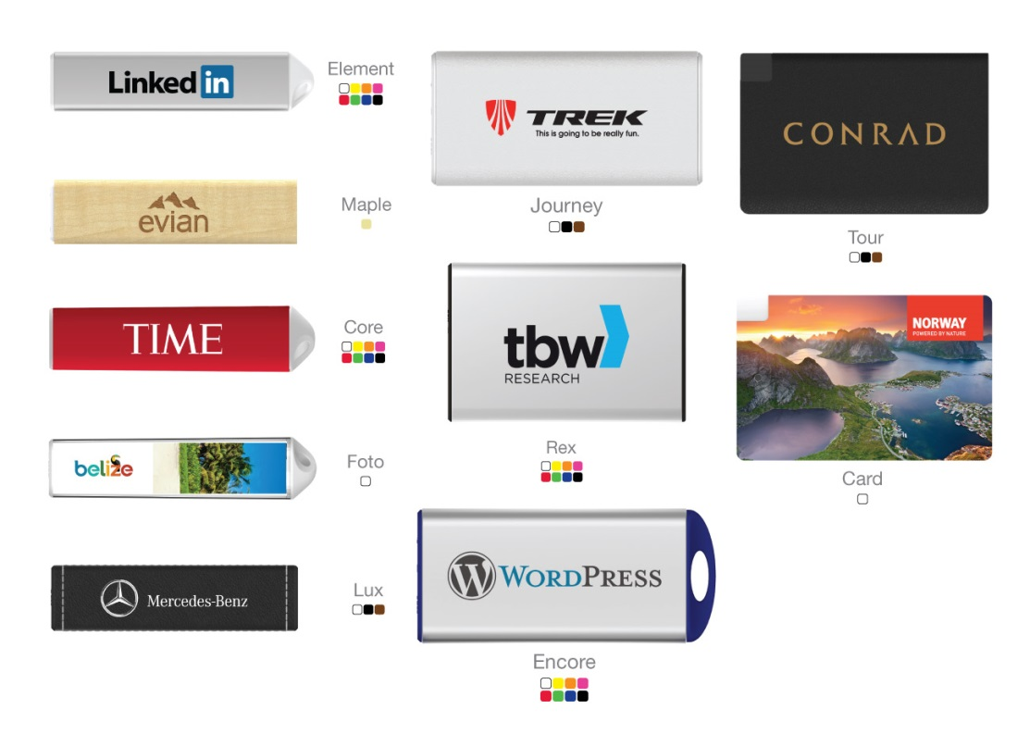
C.5.3 What are the benefits with Flashbay?
Delivery in only 5 working days
Our own factory
Free Samples (Next day)
Instant Quote (15 min)
Factory Direct Prices
10 Units Minimum Order
10 Year Warranty/2 Year Warranty
No Hidden Cost
Free Virtual Proof
TrustPilot
Unique Design
Printing included on all printable sides
Original NAND Flash
Aftersales department
Our Sales Staff

Slide 5
C.5.4 How to negotiate on the phone?
Your phone is one of your best sales tools.
No price negotiation on phone, you’ll lose controll of your profit margines.
Focus on benefits with Flashbay that are relevant for your customer.
Know your competitiors – What is their lead time, benefits and what additional costs do they have?
Do you know how many units and what capacity your customer is interested in? If not, ask them so you can send a specific quote.
Are they happy with the Virtual Proof?
Do they have an expected delivery date? Can your competition meet that deadline?
Can you upsell? 8GB for price of 4GB or advice on lower unit price if we increase the units.
Explain the next step – you’ll shortly send them an email with a revised quote

Slide 6
C.5.5 How to negotiate by email?
Polite email – be more professional than your customer.
Summary of the benefits, no bullet points. Remember the email is likely to be read by a manager that did not hear your good points on the phone
If you know the unit, capacity and model you can go straight for the order details?
Do not send a new lower Price List – send a quote for the customers request
Remember all special offers have to have an expiration date. When will your customer make a decision?
Follow up on the special offer before it expires.
Send over a link to our TrustPilot so the customer can read the thousands of positive reviews Flashbay has.
Also send a link to the model on our website for more pictures and a video.

Slide 7
C.5.6 Mentioning the next step
With no exception, all phone calls and emails should include the next step in the sales cycle. This can be ‘I’ll contact you when the samples have arrived’ or ‘I’ll be in touch tomorrow to hear what you think of the Virtual Proof’
Don’t close the door on yourself by saying ‘Sure, just let me know when you’re ready’, rephrase it to ‘I’ll get in touch in a few days/weeks, if you have any questions before then please let me know.’
Remember your competition doesn’t sleep and neither should you, so follow up when you say you’ll follow up.
Your pipeline is a great tool to schedule follow ups for all new leads, active older leads and active customers.

Slide 8
C.5.7 What is NAND Flash?
"NAND flash" is the memory chip used in USB flash drives and many electrical items such as smartphones and Apple iPods. NAND flash memory chips are manufactured by just a few hi-tech giants like Samsung , Intel and Hynix in a variety of capacities and levels of performance.
Prices change daily in accordance with laws of supply and demband just as commodities such as coffee and gold.
It determines the R/W speed as well as the warranty of the USB Flash Drive.
As much as dealing with NAND flash will soon become a large part of your daily work, we can not expect our customers to understand the detailed technology that’s inside the USB Flash Drive. To simplify you can call the NAND Flash the car engine of the USB Flash Drive, it will determine how fast it works and the warranty.

Slide 9
C.5.8 Scenario
The customer is asking for a 1GB Classic, they got a 50p/unit better price from a competitor and have decided they will not order from Flashbay. How would you approach this?

