Slide 1
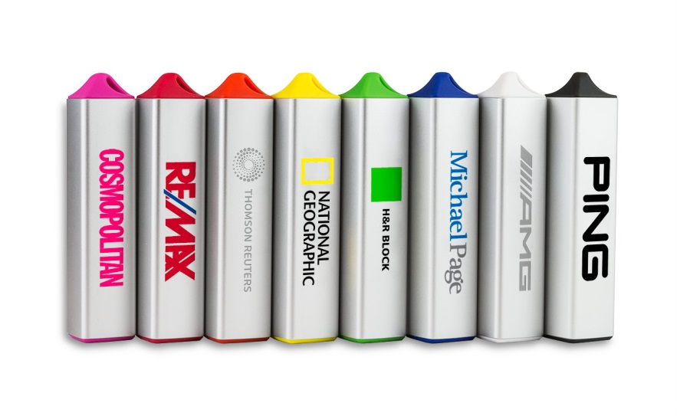
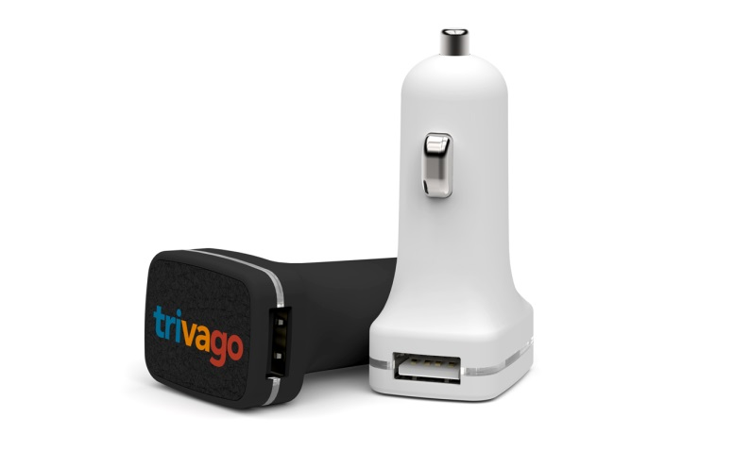
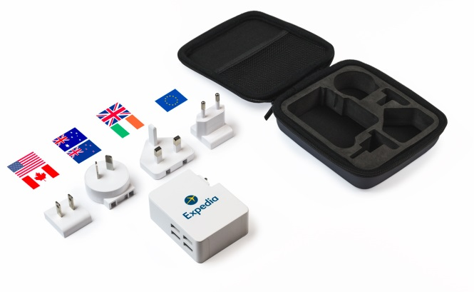
Power Products Training

Slide 2
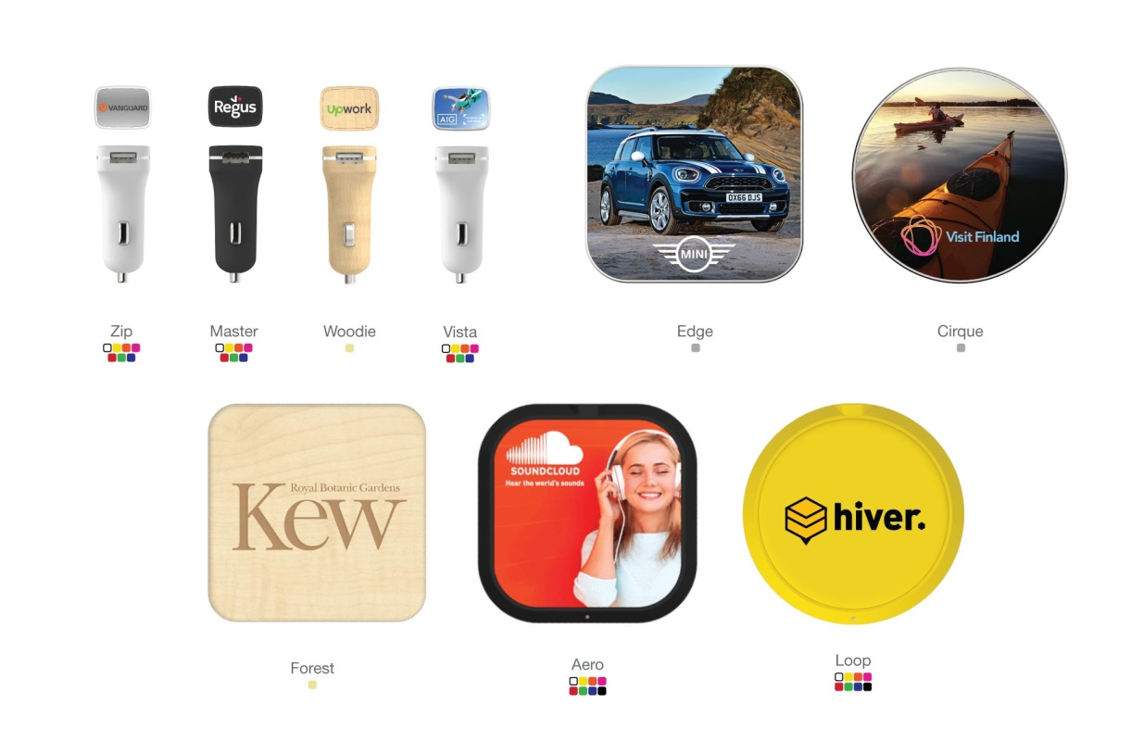
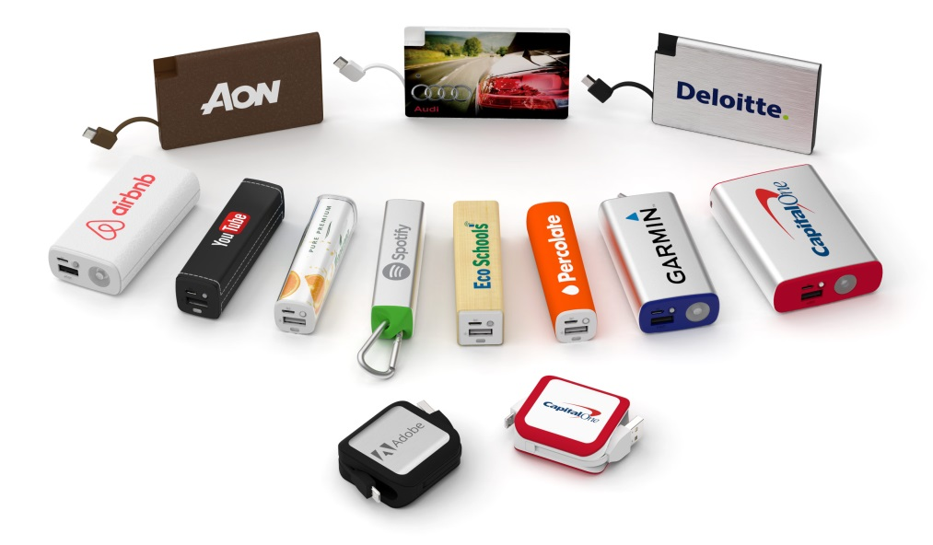
Power Product Range
The ‘Power Range’ is a fairly new and expanding addition to the Flashbay product range.
Currently, the Power category can be sub-categorised into:
Chargers

Slide 3
What is a Power Bank?
Power Banks are portable rechargeable batteries that can be used as a power source for mobiles/tablets on the go!
The Power Bank itself can be recharged and used again and again.
Power Bank Capacities:

Slide 4
Power Bank charging?
How do I recharge my Power Bank?
All of Flashbay`s Power Banks have a USB connection you can plug into a wall socket or a computer to charge the battery. It will automatically start charging when plugged in and a LED light will indicate when the Power Bank is fully charged.
How long does it take to recharge the Power Bank?
This will depend on the capacity of the Power Bank. It will take longer to fully charge a 10050mAh Power Bank then one with 2600mAH. Charging via a wall socket is also generally quicker than connecting your Power Bank to the USB port of your computer.
What is the life cycle of a Power Bank?
On average a Power Bank - if properly maintained - can be used for about 400 - 500 cycles. One cycle means a charge and then discharge. If you don’t charge the Power Bank fully before discharging it is still counted as one cycle.
How can the charging status be checked?
Every Power Bank has an LED that helps indicate the charging status.
The LED is lit during charging or if plugged into phone/tablet.
Battery LED light
Green: 50%-100%
Orange: 25%-49%.
Red: 0%-24%

Slide 5
Power Bank Safety
Many customers are worried about poor quality components as these can cause Power Banks to break or even explode.
We offer top quality Power Banks with all relevant safety features:
Output over-current and over-voltage protection
Input over-current and over-voltage protection
High temperature shut down
Short-circuit protection
Electrostatic Discharge (ESD) protection
All other services (except the warranty) are the same as for our USBs, e.g. quality branding and components, first class service, in house R&D and production.
We use high quality batteries:
For the Power Banks Grade ‘A’ Samsung Li-ion batteries are used for all models except the Card shaped Power Bank products.
For the Card shaped ones Li-polymer batteries are used.

Slide 6
Power Bank FAQs
Q: What capacities do we offer?
A: We offer capacities ranging from 1000mAh to 6700mAh. For most users 3000mAh is easily enough, as nearly all current phone models can be charged once or more with this capacity. Normally a power source for recharging the Power Bank is readily available once the Power Bank is empty.
Q: Is it compatible with all phones?
A: Yes, but different phones will need different cables. Please refer to user manual of the phone.
Q: I have an iPhone. Can I use it with my iPhone? Why don’t you supply an Apple cable?
A: Yes, with a lightning to USB cable supplied with Apple products. All Apple products come with a lightning to USB charger cable that can be used with the Power Bank.
Q: Why don’t the Power Banks come fully charged?
A: For safety reasons it is not permitted to transport fully charged Power Banks as cargo on planes.
Q: Do they come pre-charged?
A: Power Banks come ca. 30% pre-charged
Q: Can I take my Power Bank on the plane?
A: Guidelines on this are not completely clear at the moment. Some airlines allow for up to 2 Power Banks to be taken on as hand luggage. If in doubt, please check with your airline beforehand.
Q: What is the Warranty period, and what does it cover?
A: The Warranty period is 2 years and can be applied for the Power Bank only, the cable is excluded.

Slide 7
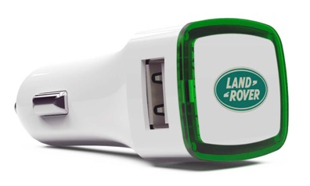
What is a USB Car Charger?
A USB Car Charger allows for the charging of portable devices via a USB port whilst driving
The USB Car Charger plugs into a car’s 12V/24V Auxiliary charging socket
Typically, it is located in the centre console of the car, or in the lower dashboard area, and sometimes doubles up as a cigarette lighter
The USB Car Charger can be customised and branded with the customers logo, serving as a practical and highly effective marketing tool every time your client is driving.

Slide 8
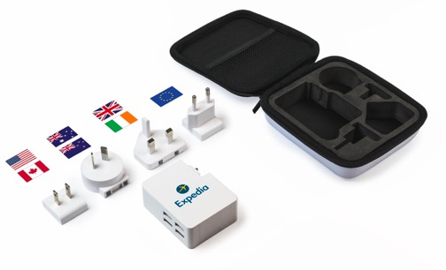
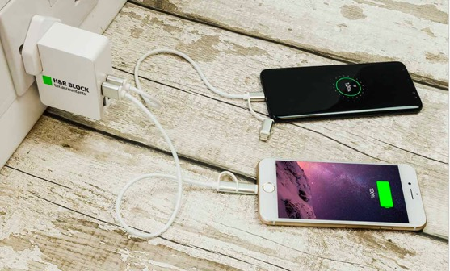
What is a Travel Charger?
The Travel Charger is light and portable and comes with its own travel case.
The Latitude features 4 USB ports
The Travel Charger comes with a selection of 4 removable plug types that will work in:
USA, Canada, Europe, United Kingdom, Ireland, Australia, New Zealand, Japan, China.
Safety features for Travel Charger
Output over-current and over-voltage protection
Input over-current and over-voltage protection
High temperature shut down
Short-circuit protection
Electrostatic Discharge (ESD) protection

Slide 9
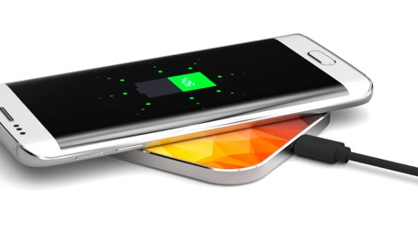
What is Inductive Charger?
Also known as a ‘wireless charger’, an Inductive Charger charges the battery in portable electrical devices without having to plug the device directly into a power socket.
The charger itself must be plugged into the mains electrical supply, but the portable electric device sits loosely on top.
As the picture shows, the top surface of the Inductive Chargers provide a large branding area for photo printing.

Slide 10
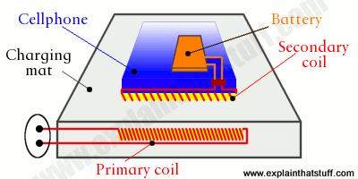
How do Inductive Chargers work?
The Inductive Charger works by transmitting electricity across an electromagnetic field, from the charger to the portable electrical device.
Both the charging pad and the portable device contain induction coils – essentially a core of iron wrapped in copper wire.
When the portable device is placed on the charging pad, the proximity of the coils creates the electromagnetic field used to transmit electricity.
As electricity is passed across to the induction coil in the portable device, it is used to charge the device battery.

Slide 11
Inductive charger FAQs
What devices are compatible with Inductive Chargers?
A device must be Qi-enabled in order to be compatible with Inductive Chargers. The following mobile phones and tablets meet this criterion:
Samsung Galaxy: S7, S7 Edge, Note 5, S6, S6 Edge.
Microsoft Lumia: 1520, 1020, 930, 929, 928, 920.
Google Nexus: 4, 5, 6, 7 (2013)
BlackBerry: Priv.
Additionally, it is possible to add adapters to other devices which enable wireless charging.
How long does it take to charge a device?
The charging time depends on the phone’s capacity. For a 2600mAh a full charge is around 4,3 hours, for a capacity of 3550mAh it takes 5,6 hours.
Are they safe?
Inductive Charging is actually very safe to use.
The electromagnetic fields generated by the transmitters are very small and weak in power, only operating over short distances.
The International Commission on Non-Ionizing Radiation Protection (ICNIRP) has found no evidence of adverse effects on human health when exposed to inductive charging.
Indeed, wireless charging is actually safer than plugging in a device in some ways. As it does not require contact with exposed external electrical connectors, the possibility of electrical shocks and failure are reduced.

