Slide 1
DATA PRELOADING

Slide 2
Data Preloading
What is Data preloading?
Data preloading is an additional service we provide to our customers, they give us data and we preload it onto the USB’s they have ordered from us.
This is very handy if your customers order is quite large as we can duplicate data on all the USB’s at once saving the customer a lot of time.
Because we are sometimes dealing with large orders, when you are providing the preloading service to your customer it is vital that the necessary checks are done in order to ensure the customer receives the products with the data they ordered.
If checks are not done and the order goes to the customer with incorrect data this will cause an aftersales case.
The next few slides will guide you through the process to ensure that you have the knowledge to confidently process data preloads.

Slide 3
Data Types
First off it is important to note there are two types of data you will come across:
Mac Data
Windows Data.
Mac Data will need to be handled By itsupport@flashbay.com
If you try to extract it yourself it will corrupt, not work properly or display incorrect data
The DP email highlights Mac data like this:
Windows data can be extracted on your desktops
If you are having trouble with unzipping data then notify itsupport@flashbay.com
If you have no space on your computer you can move data into your public folder
Notes:
question 1 – Multi choice
What do you do when you receive Mac data?
1- Try and extract it yourself? 2-Tell the customer the data is incorrect and ask for windows data.
3- Send it to IT so that can extract it for you 4- Send to Operations for help
Answer
3- Send it to IT so that can extract it for you
Question 2 – multi choice
What happens if you unzip Mac data on your computer?
1- It will delete itself 2- It will corrupt the data
3- Nothing 4- it will up zip correctly
Answer
2- It will corrupt the data

Slide 4
Zipped DATA
What is Zipped data and why do we use it?
In order for our customers to send data to us we ask them to first zip all of their data into one zipped folder.
Zipping files make it easy to keep related files together and makes transporting, downloading & storing data faster and more efficient.
By zipping the data we are compressing it into one file which we call an “Archive”.
This reduces the size of the data and also keep data from being misplaced or lost.
It also makes it easier to transport the data as you only need to send one file.
Notes:
question 1 – Multi choice
What do you do when you receive Mac data?
1- Try and extract it yourself? 2-Tell the customer the data is incorrect and ask for windows data.
3- Send it to IT so that can extract it for you 4- Send to Operations for help
Answer
3- Send it to IT so that can extract it for you
Question 2 – multi choice
What happens if you unzip Mac data on your computer?
1- It will delete itself 2- It will corrupt the data
3- Nothing 4- it will up zip correctly
Answer
2- It will corrupt the data

Slide 5
Data Preloading Guide
Step One:
Send the data preload link to the customer and request they upload their data to our FTP (our data server) Note: Our FTP only takes up to 10GB of data, any data over that amount needs to be sent in to the office via USB
The customer should follow the steps ensuring that they have zipped the data. Note: we will only accept data in one complete zip folder
If the customer cannot upload:
Most common reason for data not uploading correctly is that the data is corrupt. If the customer experiences problems please ask them to check the data for corruptions, rezip and resend the data.
If they are still experiencing issues then ask the customer to send us the data via a USB instead.
Under very special circumstances we will expect 3rd party transfers from other sites such as WeTransfer or Filemail.
Notes:
Question 3 – multi choice Image
What are the accepted methods to acquire data from a customer?
(See images in word doc)
Answer
FTP and USB
Question 4 – multi choice question
How much data can a customer upload to our FTP?
1- 10GB 2- 20GB
3- 50GB 4- unlimited
Answer
1-10GB
Question 8 Multi Choice
What do you do if a customer has trouble uploading data to our FTP?
1- Straight away ask the customer to send in via USB 2- Straight away send to IT support
3- First ask customer to check data rezip and resend 4- Tell the customer to try again
Answer
3 First ask the customer to check data rezip and resend

Slide 6
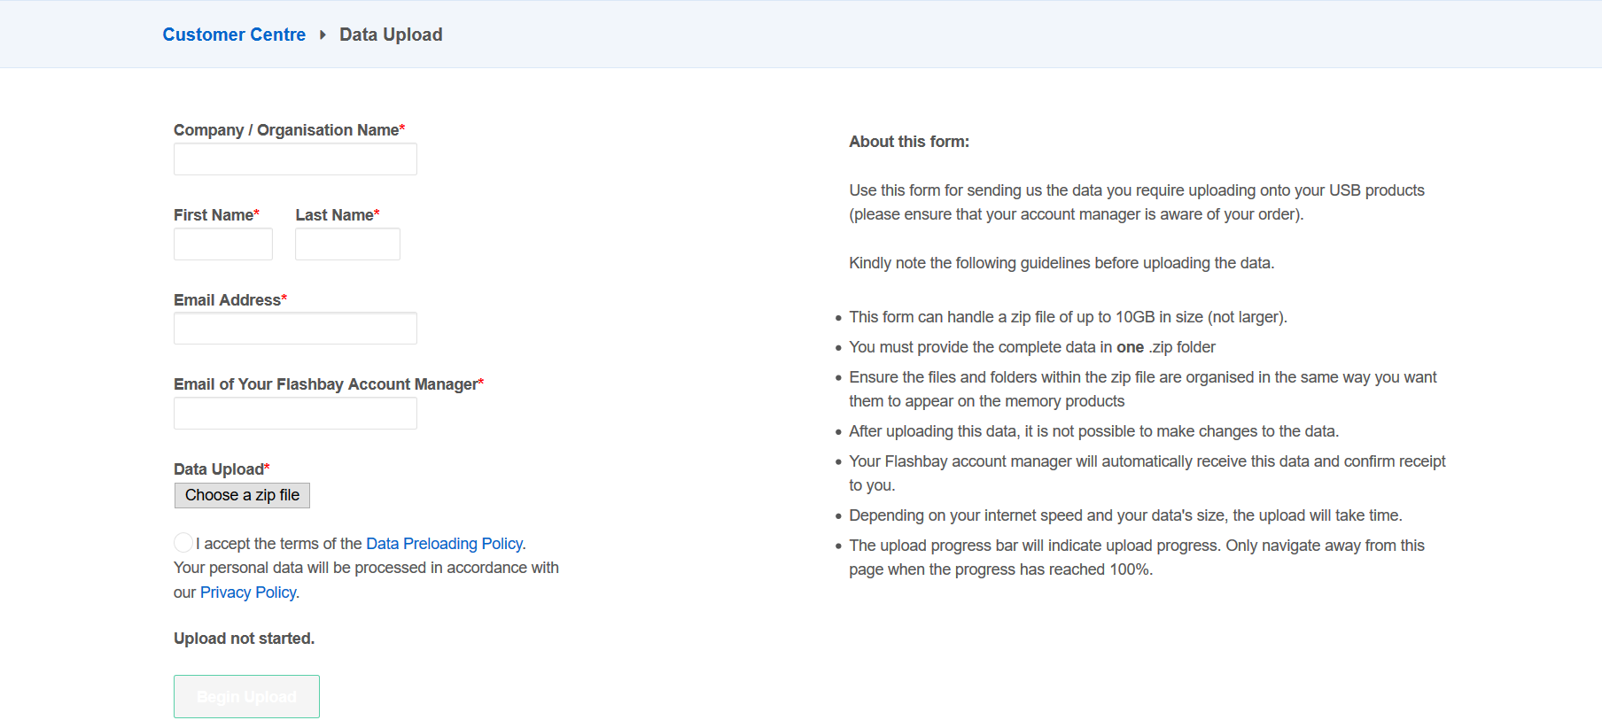
Data Preloading Guide
Upload webpage:
Notes:
Question 3 – multi choice Image
What are the accepted methods to acquire data from a customer?
(See images in word doc)
Answer
FTP and USB
Question 4 – multi choice question
How much data can a customer upload to our FTP?
1- 10GB 2- 20GB
3- 50GB 4- unlimited
Answer
1-10GB
Question 8 Multi Choice
What do you do if a customer has trouble uploading data to our FTP?
1- Straight away ask the customer to send in via USB 2- Straight away send to IT support
3- First ask customer to check data rezip and resend 4- Tell the customer to try again
Answer
3 First ask the customer to check data rezip and resend

Slide 7
Data Preloading Guide
Step Two:
When the customer has sent the data successfully you will receive an email with a link to the data. Click that link and the data will automatically download to your computer.
If customer has sent you Mac data then you need to forward this to IT who will unzip the data on a Mac and place it in your public folder. Note: If you try to download this data on your windows PC you will most likely corrupt the data.
If your customer has sent in the data via USB then please hand over to IT who will take the data from the USB and put it in your public folder.

Slide 8
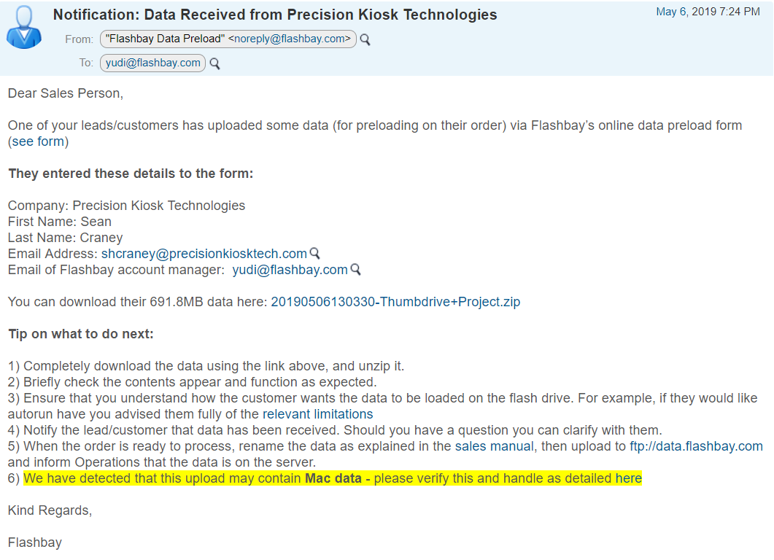
Data Preload Example

Slide 9
Data Preloading Guide
Step Three:
Once you have the data on your desktop you will need to check the data is correct.
Data from Flashbay FTP
Firstly you will need to unzip the data on your computer. This is so you can take screenshots to confirm data with the customer and ensure the data is not corrupt.
Next you will need to take a screenshots of the Properties and Root.
Once you have taken the screenshots you will need to send this to the customer to confirm with the customer that the data is correct.
Data from USB
Data from USB the data will already be unzipped.
This will be put in your public folder by IT.
You can then take screenshots of the Properties and Root confirm with the customer that the data is correct.
Notes:
Question 5 – true or false
Before we send data to operations to be proceed we first check the properties and root with the customer.
Answer
True

Slide 10
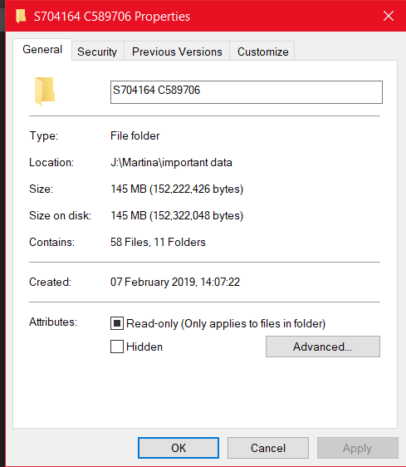
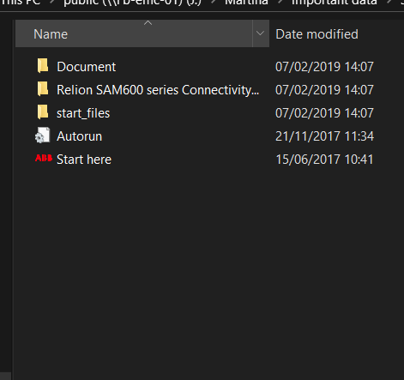
Data Preloading Guide
Properties & Root Explained
Checking the properties and root is a very important process when doing data preloading as it can avoid most aftersales problems. By taking these screenshots and sharing them with your customer you are verifying that the data you have is correct.
Properties
The properties Show the customer 3 important things they can use to verify data.
The total size of the data.
The total amount of folders in the data
The total amount of files in the data.
From this the customer can compare with the data they have to ensure it is all there.
Root
This shows the File Structure from the first folder when you open the data.
This is how the data will look when viewed from the USB.
The way the data looks on the USB is important to the customers and one of the most common ways in which a customer can tell the data is wrong.
Notes:
Question 7 Text Answer -
It is very important to check the properties &____________ with the customer
Answer
Root

Slide 11
Data Preloading Guide
Step Four:
Now the data has been confirmed by your customer you will need to send it to Operations in China who will produce the USB’s and preload the data. We do this by using a program called FileZilla.
You will need to rename the original Zip folder to the S & C number.
Once the data has been sent to Operations you will then need to send Screenshots of the properties and Root so Operations can confirm that they have received the data correctly.
You will also need to provide any additional information to ensure that operations have all the information they need to meet the customers requests.
Note: When writing this email to Ops please ensure to use the Text parts we have provided to ensure you provide all the necessary information.

Slide 12
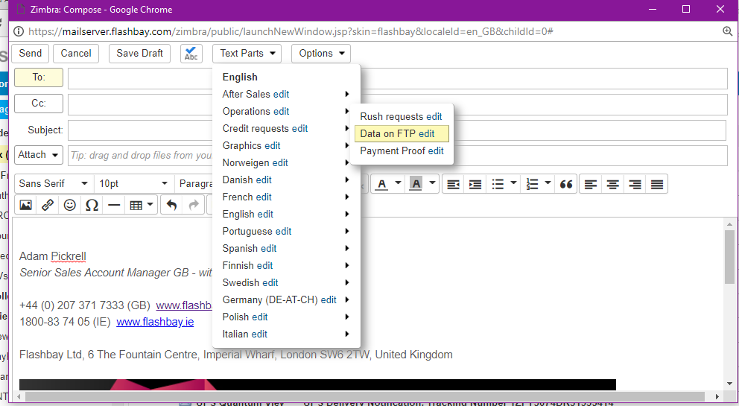
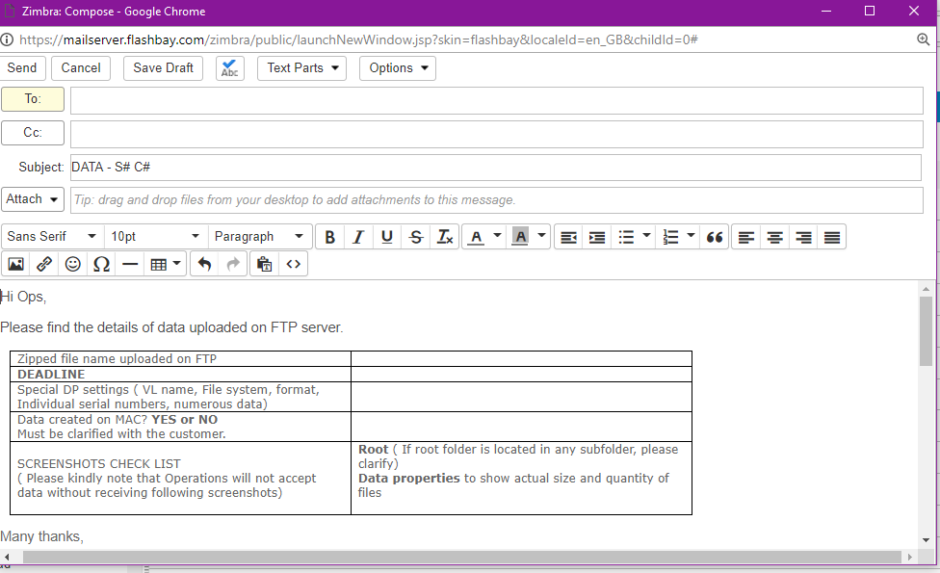
Text Parts to Operation

Slide 13
Data Handling Process
Send via Flashbay Website
Customer data
Data is downloaded to public folder
Extract data
Confirm properties & root with customer
Confirm properties & root with Ops
Send original data through FTP to Operations & confirm
Send in Via USB
Notes:
Question 6 – match Image with label
Below are all the steps of the data preloading process. Put them in order from first process to last process.
(see images in word doc)
Answer
1 customer data
2 send via Flashbay Website / USB
3 Data is downloaded to the public folder
4 Extract Data
5 Confirm properties and root with customer
6 Confirm properties and root with Ops
7 Send Original Data through FTP to Operations and Confirm

Slide 14
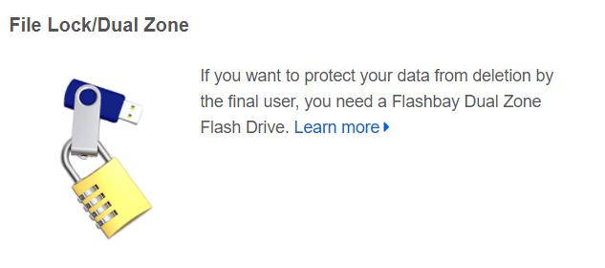
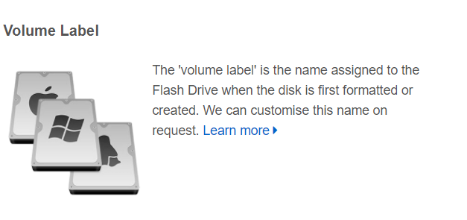
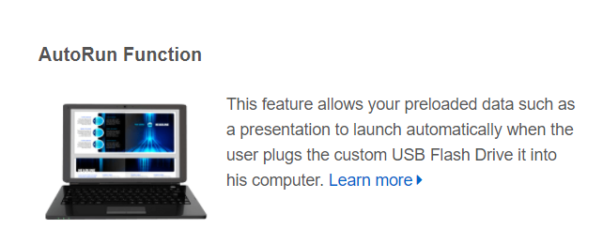
Other USB Services

Slide 15
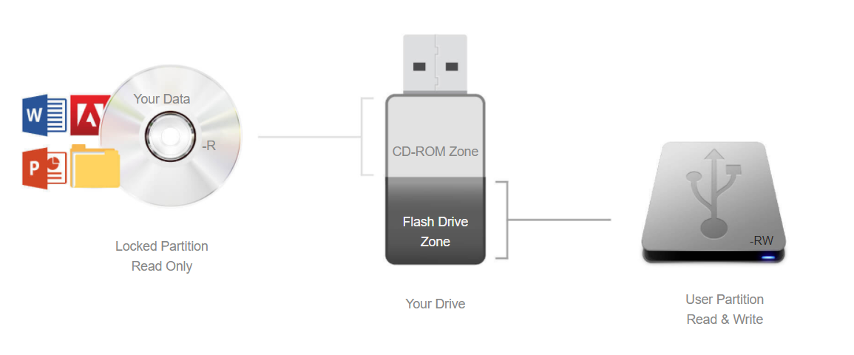
File Lock / Dual Zone
What is File Locking?
If you want to protect your data from deletion by the final user then you require a Flashbay Dual Zone Flash Drive.
This special Flash Drive unites the flexibility of a standard USB Flash Drive with the read-only nature of a CD-ROM.
When you insert the Flash Drive into your USB port, 2 drive icons will appear: one is for the read-only CD-ROM zone and the other for a standard removable drive (user area).
Your 'hard-coded' data is on the CD-ROM zone while still giving users the ability to use the 'Flash Drive zone' as a regular Flash Drive.
Notes:
Question 12 true or false -
When we file lock a USB the drive is split into two Partitions, a read only CD partition and a USB partition
Answer
True

Slide 16
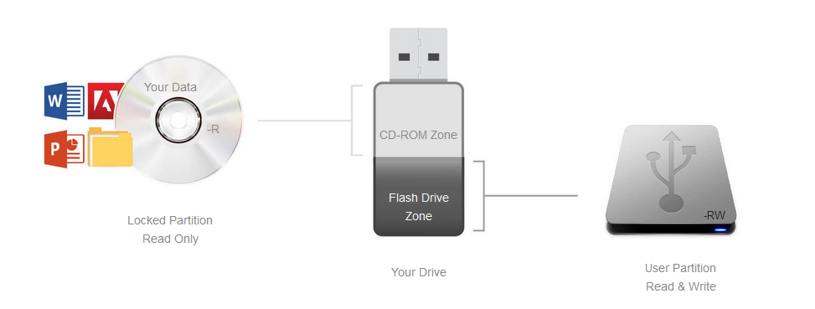
DPUS
What is DPUS?
DPUS is a process we use to do the file locking service.
It Splits the USB into a CD partition and a USB partition
CD partition contains files that are read only; the USB partition can either be locked or unlocked
The CD partition will not work on devices such as TVs
Need DPUS for autorun to work
Notes:
Question 11 multi Choice-
What is DPUS?
1- The process we use to do the file locking service 2- The process we use to do Autorun
3- The process we use to do the volume labelling 4-The process we use to do Data Preloading
Answer
True

Slide 17
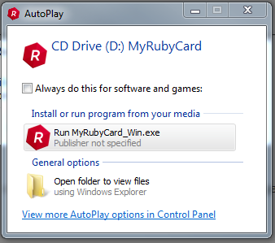
Autorun
Autorun is a Windows feature that allows programs to run automatically after a USB drive has been plugged into a computer.
It doesn’t work for any version of Mac OS
Although this is a handy feature, its purpose was taken advantage of by malware writers. This meant that there were instances of users plugging in a USB only to find that they then had infected their computer with a virus.
Because of this, modern operating systems have disabled Autorun by default. Autorun may work on some Windows operating systems, However, It will only launch a popup window and the user will still need to click to run the program.
If customers request this feature, make them aware that it is not guaranteed to work
Notes:
Question 9 True or False –
Autorun works fine on Mac Operating Systems.
Answer
False

Slide 18
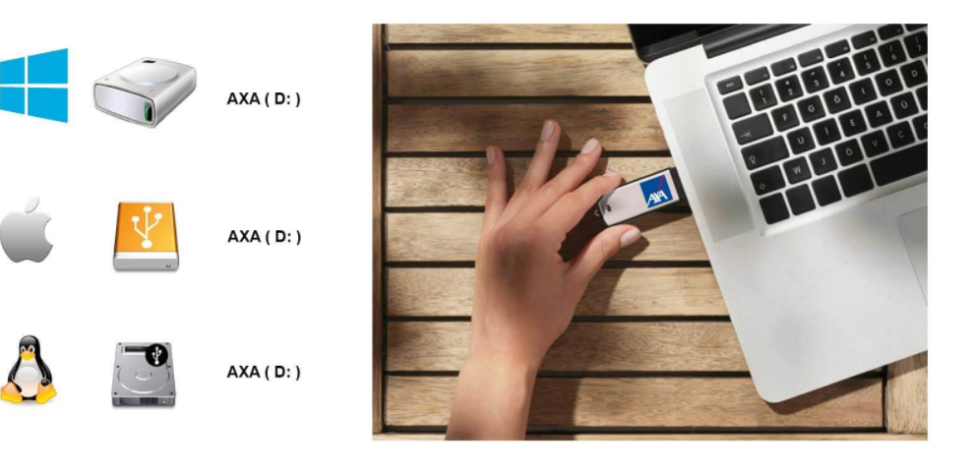
Volume Label
The 'volume label' is the name assigned to the Flash Drive when the disk is first formatted or created. We can customise this name on your request up to a maximum of eleven characters. The customised device appears with this name when plugged into a computer.

Slide 19
Storage Capacity
The maximum usable capacity of a USB will be less than the total quoted capacity. This is because a small portion of the space is needed by the computer to store the data it needs to operate the drive (the firmware)
Below are estimates of how much data our USBs can store:
 | Photos | Music | Films
2GB (1.86GB or 1905MB) | 952 | 476 | 3.81
4GB (3.72GB or 3809MB) | 1904 | 952 | 7.62
8GB (7.44GB or 7619MB) | 3809 | 1904 | 15.24
16GB (14.88GB or 15237MB) | 7618 | 3809 | 30.47
32GB (29.76GB or 30474MB) | 15237 | 7618 | 60.95
64GB (59.52GB or 60948MB) | 30474 | 15237 | 121.90
128GB (119.04GB or 121897MB) | 60948 | 30474 | 243.79
Notes:
Question 10 true or false -
A 4GB USB can store 4GB of data on it
Answer
False

