Slide 1
IT Training – Data Preload

Slide 2
File Systems
What is a ‘file system’?
An efficient way for a data storage device to store/retrieve files
Gives structure to file access by organising the files in a certain way
E.g.
Libraries use the Dewey Decimal System, which organises books according to subject area. This allows users to easily track down the book that they’re looking for in the most efficient manner. If there was no structure, users would have to look at every book in the library until they find the one they want.
File systems have a ‘contents page’ that store a list of filenames and locations of where those files can be found on the device
Technological changes have occurred over time, meaning that features have been added as new file systems are developed. Consequently, there isn’t a ‘one size fits all’ file system that will work on all devices and operating systems

Slide 3
FAT32 vs NTFS vs exFAT
Overview:
Operating systems have got more complex over time. They incorporate new usability features and new security features
Below is a table showing the differences between FAT32 , NTFS and exFAT:
 | FAT32 | NTFS | exFAT
Max. File Size | 4GB | 16TB | Very high
Max. Partition Size | 2TB | 2TB | Very high
Max. Filename Length | 11 characters (8.3) | 255 characters | 255 characters
Encryption | No | Yes | No
Compression | No | Yes | No

Slide 4
FAT32 vs NTFS vs exFAT
Operating System Read/Write Functionality
 | FAT32 | NTFS | exFAT
Windows | Read/Write | Read/Write | Read/Write
Mac | Read/Write | Read-only | Read/Write

Slide 5
USB Speeds
Rarely, if ever, are the advertised USB read/write speeds reached on a typical PC. There are several factors that determine the speed:
Amount of data being transferred
Number of USBs connected to the system
Electromagnetic interference (in places like factories)
HD speed (when transferring data to/from HD)
USB controller

Slide 6
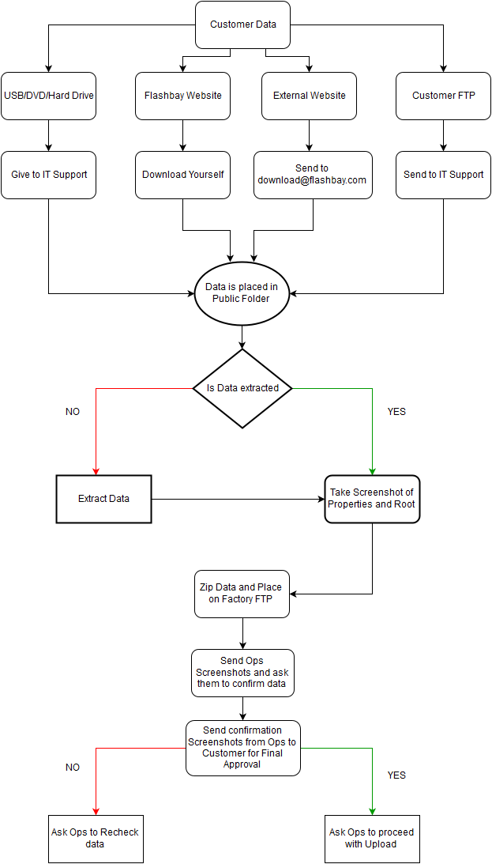
Data Handling Process

Slide 7
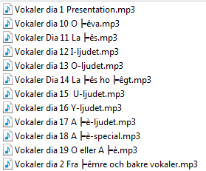
7zip
Viewing the Data/Unzipping:
Occasionally when data contains foreign characters 7zip may not display this correctly in the 7zip viewer.
When unzipping data like this the characters/symbols can show up incorrectly
Solution:
Ask itsupport@flashbay.com or r.czikkel@flashbay.com to confirm the data is ok

Slide 8
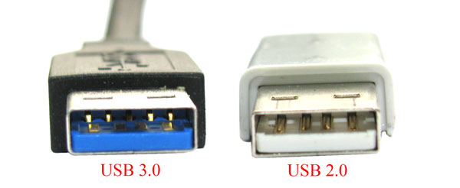
USB 2.0 vs USB 3.0
 | USB 2.0 | USB 3.0
Speed | Up to 480Mbps | Up to 4.8Gbps
Power Capacity | Up to 500mA | Up to 900mA

Slide 9
Local Disk vs Removable Disk
Local Disk:
When the drive needs to be split into several partitions
Autorun will only work on drives formatted as local
Removable Disk:
When using a USB to install programs (iso)

Slide 10
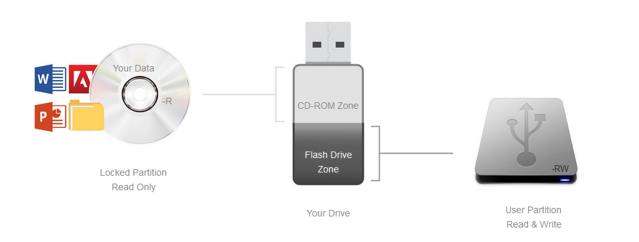
DPUS
Splits the USB into a CD partition and a USB partition
CD partition contains files that are read only; the USB partition can either be locked or unlocked
The CD partition will not work on devices such as TVs
Need DPUS for autorun to work

Slide 11
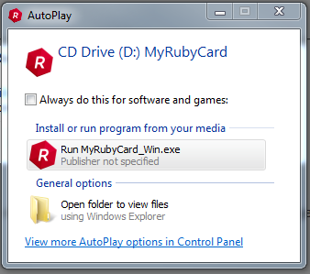
Autorun
Autorun is a Windows feature that allows programs to run automatically after a USB drive has been plugged into a computer.
It doesn’t work for any version of Mac OS
Although this is a handy feature, its purpose was taken advantage of by malware writers. This meant that there were instances of users plugging in a USB only to find that they then had infected their computer with a virus.
Because of this, modern operating systems don’t enable autorun by default. In fact autorun won't work on most versions of Windows, apart from the pop up dialogue box that offers to run the file.
If customers request this feature, make them aware that it is not guaranteed to work

Slide 12
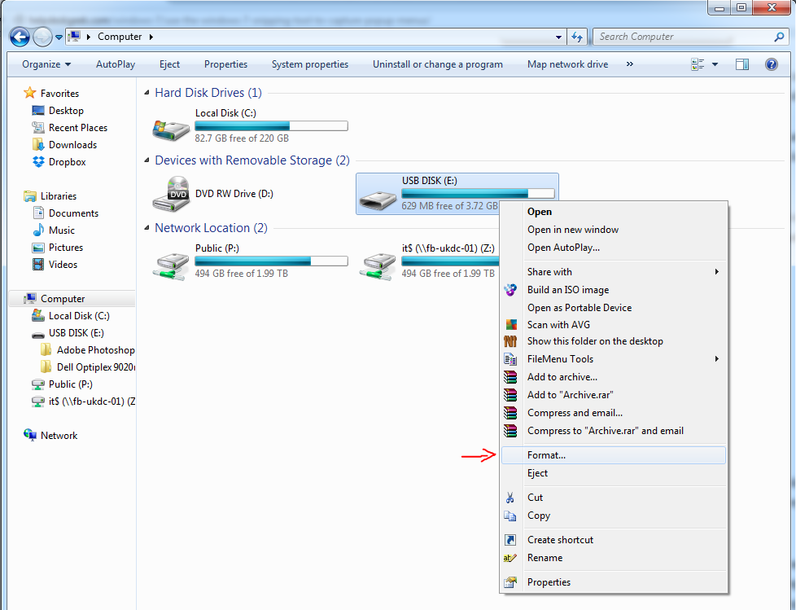
Formatting a USB
Windows:
Go to ‘Computer’
Right-click on the USB drive and click on ‘Format’
3. The following box will appear:

Slide 13
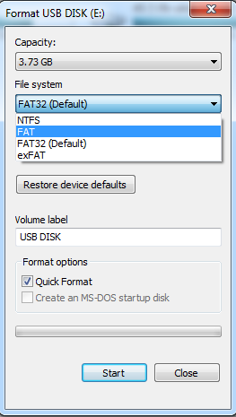
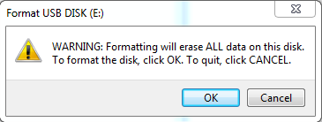
Formatting a USB
3. Select which file system you want to format the USB with. If necessary, you can also change the VL
4. When you press ‘Start’, a warning message appears asking you whether you really want to do it – press ‘OK’

Slide 14
Storage Capacity
The maximum usable capacity of a USB will be less than the total quoted capacity. This is because a small portion of the space is needed by the computer to store the data it needs to operate the drive (the firmware)
Below are estimates of how much data our USBs can store:
 | Photos | Music | Films
2GB (1.86GB or 1905MB) | 952 | 476 | 3.81
4GB (3.72GB or 3809MB) | 1904 | 952 | 7.62
8GB (7.44GB or 7619MB) | 3809 | 1904 | 15.24
16GB (14.88GB or 15237MB) | 7618 | 3809 | 30.47
32GB (29.76GB or 30474MB) | 15237 | 7618 | 60.95
64GB (59.52GB or 60948MB) | 30474 | 15237 | 121.90
128GB (119.04GB or 121897MB) | 60948 | 30474 | 243.79
*When average photo size is 2MB, MP3 is 4MB & film is 500MB

Slide 15
