Slide 1
Flashbay:
Audio Category

Slide 2
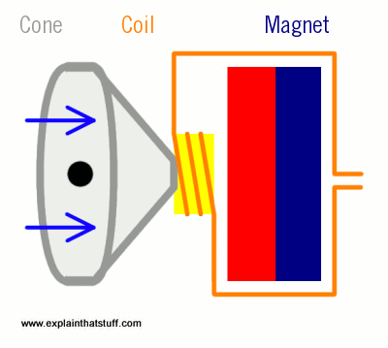
Short Introduction to Speakers
At the front of a loudspeaker, there is a diaphragm - a fabric, plastic, paper, or lightweight
metal cone, not unlike a drum skin (coloured grey in the diagram).
The outer part of the cone is fastened to the outer part of the loudspeaker's circular metal rim.
The inner part is fixed to an iron coil (coloured orange) that sits just in front of a permanent magnet (coloured yellow).
When you connect the loudspeaker to a stereo, electrical signals feed through the speaker cables (red) into the coil. This turns the coil into a temporary magnet or electromagnet.
As the electricity flows back and forth in the cables, the electromagnet either attracts or repels the permanent magnet (blue). This moves the coil backwards and forward, pulling and pushing the loudspeaker cone.
Like a drum skin vibrating back and forth, the moving cone pumps sounds out into the air.

Slide 3
Speaker Specs: Volume
A speaker’s sensitivity is measured in Decibels (dB)
A speaker’s maximum electrical power is measured in Watts (W)
This is an indication of how loud a speaker can play:
A speaker with a sensitivity rating of 90 dB means that at 1 watt of power, the sound produced by the speaker at a distance of 1 metre is 90 decibels.
Sound | Volume in dB
Whisper | 15-25
Home or Office Background Noise | 40-60
Normal Speaking Voice | 65-70
Orchestral Climax | 105
Rock Concert | 120+
Pain Threshold | 130
Jet Aircraft | 140-180

Slide 4
Speaker Specs: Volume
There requisite wattage increases exponentially for a constant increase decibels.
In other words – there is a significant loss in volume gain as power increases.
Thus, the speaker’s original sensitivity is much more important than the power of the
amplifier driving it:
Too low a dB rating requires too much power to generate good volume - this risks blowing the speaker
Too high a dB rating means you are unlikely to have sufficient power to make full use of the speaker
Power in Watts | Volume in dB
1 | 87
2 | 90
4 | 93
10 | 97
20 | 100
40 | 103
100 | 107
200 | 110
400 | 113

Slide 5
Speaker Specs: Pitch
A speaker’s frequency response is measured in Hertz (Hz).
This is an measure of the speed at which the speaker cone vibrates, and provides indication of
the pitch of a speaker – how high and low a speaker can play:
A speaker with a frequency of 20Hz-20kHz means that the lowest bass output is 20Hz and
the highest treble output is 20kHz (20,000 Hz).
Sound | Frequency in Hz
Lowest Elephant Noise | 4
Lowest Sound a Human Hears | 20-30
Normal Speaking Voice | 250
First Cry of a Baby | 432
Most Irritating Frequency (Chainsaw) | 4,000
Highest Note on a Piano | 4,096
Highest Sound a Human Hears | 20,000
Highest Dolphin Noise | 200,000

Slide 6
Consumer Market Comparisons
Flashbay’s products are designed as promotional items – naturally, our value-add comes in our branding capabilities, rather than our technical specifications relative to the consumer market.
The tables below provide context on our relative technical specifications:
Specification | Flashbay Speakers | Consumer Speakers
Sensitivity | 80dB | 87dB
Power Handling | 3W | 3W
Frequency Response | 20Hz – 20kHz | 20Hz – 20kHz
Specification | Flashbay Headphones | Consumer Headphones
Sensitivity (dB) | 108dB | 115dB
Power Handling (W) | 20mW | 20mW
Frequency Response (Hz) | 20Hz – 20kHz | 20Hz – 20kHz

Slide 7
Unique Selling Point: Audio
Accounting for the fact that they are promotional products, our Audio range has tremendous specifications.
You will not find better promotional quality on the market.
Our prices, however, are around 1/20th those of good consumer standard items.
As with all our products, our real value-add is in our branding capabilities.
Additionally, our products are fully safety-certified and offer a consumer standard battery life alongside the following features:
Wireless sound with Bluetooth®️allowing for easy pairing to iPhone, iPad, Android & Windows mobile devices
8-10 hours of playback depending on product
Microphone for hands free calling and answering
Auxiliary audio input

Slide 8
Frequently Asked Questions (FAQs)
Q: What percentage of battery charge are our Audio products shipped with?
A: They are approximately 30%-70% charged.
Q: What is the wireless range of our Audio products?
A: The Bluetooth connection range is approximately 2402MHz-2480MHz – this equates to a distance of around 8m.
Q: How many hours of playing time do our Audio products offer?
A: AC – 5 hours on full peak; 8 hours on medium peak; 10 hours on low peak.
CU – 3 hours on full peak; 3.5 hours on medium peak; 4 hours on low peak.
Q: How long does it take for the Audio devices to charge?
A: AC – battery capacity is 160 mAh, which equates to a half-hour charge using a 400mA charger.
CU – battery capacity is 500 mAh, which equates to a one and a half-hour charge using a 400mA charger.

Slide 9
Emails and Templates
A lot of SAMs are still using their standard USB Flash Drive templates. It makes sense to rework and store them in a separate folder.
Do note that LEAD TIMES are LONGER than with Flash Drives, and in most cases our Power offering. (This is mainly due to customs and special transportation rules for dangerous goods).
With Audio Products, it is even more important to ensure your customer is satisfied BEFORE sending a link to the TrustPilot review:
Audio products are much more subjective then USB Flash Drives
E.g. Customers may have sound quality and volume expectations which differ to our products delivery
USB Flash Drives are a more simple product – if they look good and work, they will typically serve clients perfectly
Therefore it is vital to ensure customer satisfaction prior to sending a TrustPilot review link

Slide 10
Branding/Samples
Branding
Currently, all our audio products are available for Screen Printing
Additionally, the Tab and the Seed are available for Laser Engraving
Dummy Samples
The process is exactly the same as for USB loose dummy samples: the warehouse team will pack them together with requests for other samples
Working Samples
At the moment these are not being offered barring exceptional circumstances

Slide 11
Packaging
What does the standard delivery option look like?
Both the Arc and the Cube come with a charging cable, auxiliary cable, user manual and are packaged in a white cardboard box
The Tab and the Seed do not come with the auxiliary cable

Slide 12
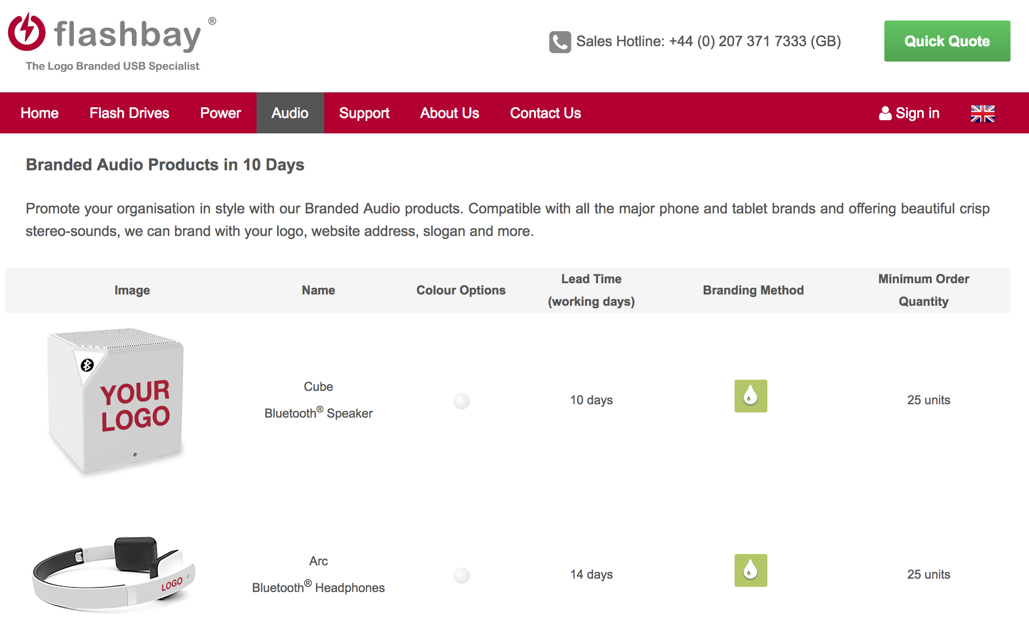
Scheduling orders
All item codes can be found in the Price List
Be aware that orders for Flash Drives and Audio Products must be placed seperately
Audio products can only be shipped in multiples of 25

