Slide 1
Netsuite/Leads

Slide 2
What is Netsuite (NS)/Lead?
NS is CRM / ERP (Customer Relationship Management / Enterprise Resource Planning) software which enables Sales Account Managers (SAMs) to manage all aspects of the day-to-day business (sales processes, accounting, order fulfilment, entering leads etc.)
A lead is a company/organisation who are interested in our products and services, and who are enquiring through several means (most commonly via our website & phone). Flashbay doesn't sell to resellers.

Slide 3
How Is a Lead Created & Distributed?
Leads will be created when enquiries are made via our website, through in & outbound calls, marketing campaigns and other tools used by Flashbay. These then get distributed between the teams (according to country, new or existing lead / customer, daily activity etc.)
We have Web leads and Phone leads, which are classified as:
Inbound Leads → can be set up by the SAM who answered the call (after checking for duplicates/existing leads/customers)
Outbound Leads → are set up by the SAM making the calls
If an existing customer sends an enquiry (details are already within the NS database), it will be forwarded automatically to the corresponding SAM.

Slide 4
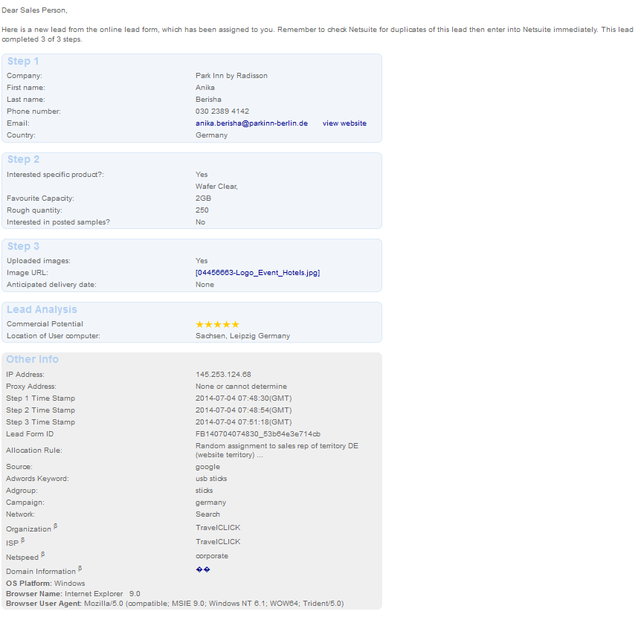
Checking For Duplicates when receiving a Lead
You will receive an automatic email notification when a lead is assigned to you.
Qualify the lead:
Check and compare the company name in NS (possibly check the name of the contact as well)
Quickly check the country and phone number, as well as language of the search term
Thoroughly check the email (full email, just the domain etc.) and location of user
NOTE: It’s your responsibility to avoid duplicates. This will hurt your profit if not checked properly.
While checking for duplicates, the live search field in the upper right corner is really helpful. Start typing and results are shown instantly in the dropdown list. You can search for first and last names, companies, email domains etc. You can even set up filters, for example, by entering “cust:” or “lead:” in front of the search term to check for customer / lead entries only.

Slide 5
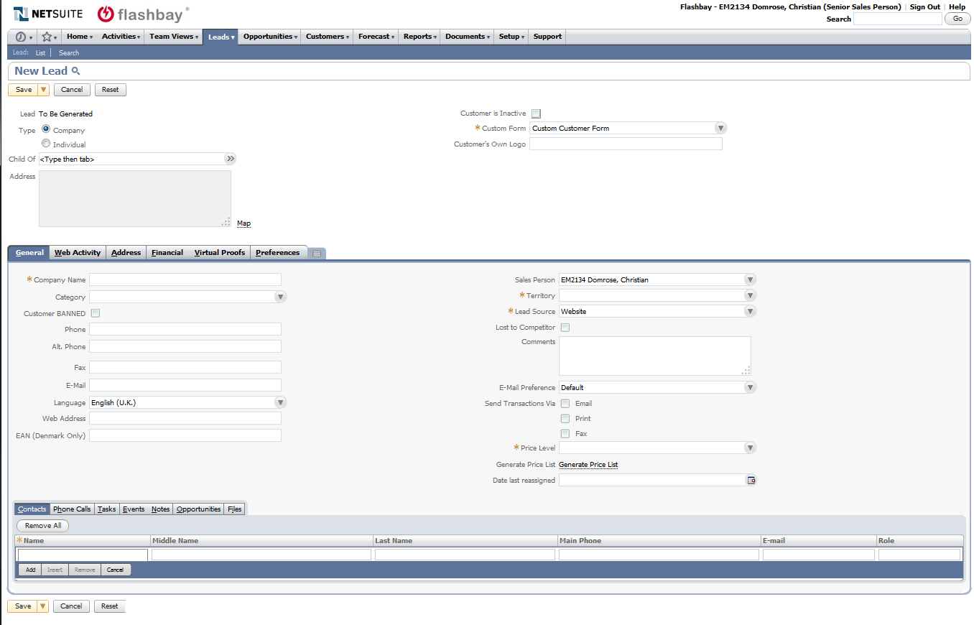
Manually Entering a New Lead Into Netsuite
Leads can be entered by hovering the mouse over “Leads“ -> “Relationships“ -> then click “New“
A blank “New Lead“ page will load with different tabs where the information from the web or phone lead needs to be entered
Sidenote: To see your leads in Netsuite click: Lists > Relationships > Leads

Slide 6
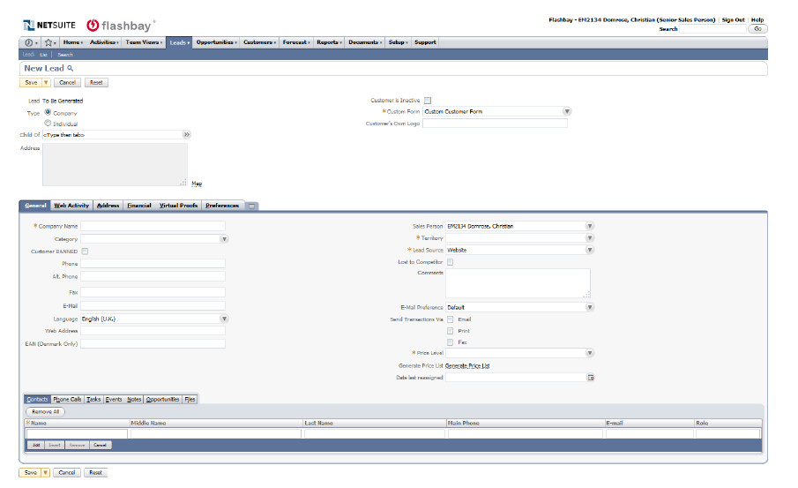
General Tab
Please specify if the entered lead is a company or individual (majority of leads will fall under company; in rare cases we specify the lead as an individual when no company or institution can be given)
Data fields that need to be filled:
Company name
Category (reseller or educational, leave this empty if none of the above)
Phone
Email
Website / Homepage
Territory
How was this lead created: via web lead / cold call / incoming call etc.
Comments
Price level
* Check if “ Duplicate” appears on top of page when you enter the Mail address
Bottom tab “Contacts” show all the contacts which have been added to this lead/ customer

Slide 7
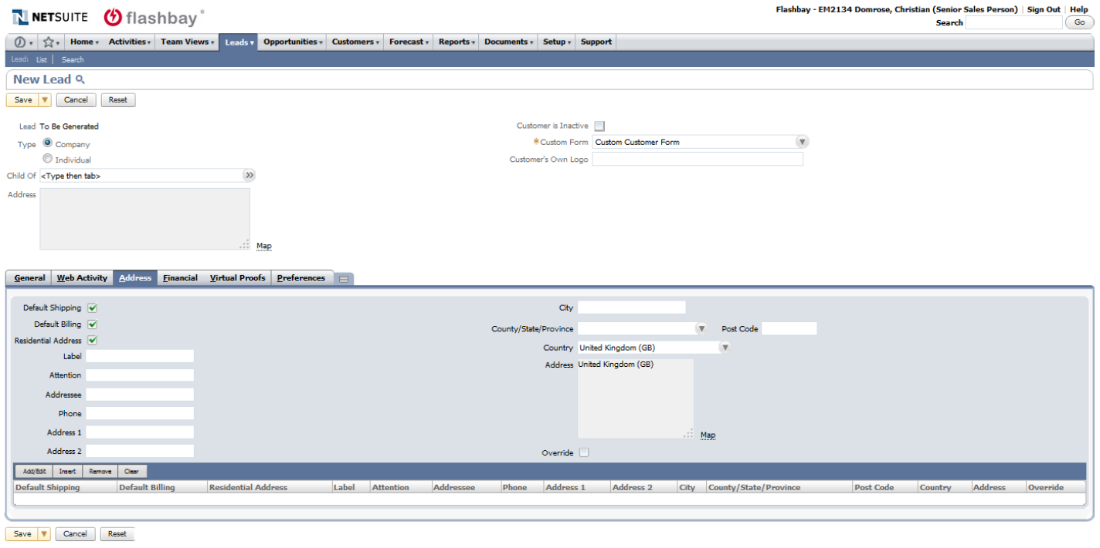
Address Tab
Add address details when setting up lead, this will save precious time later on (when setting up order and sending samples). Grab the address when you check the homepage.
If multiple addresses, we can specify which is the default address - useful if multiple addresses are being entered.
Always add a contact phone number so customer can be contacted in case of delivery emergencies.
Don’t forget to change the country to your current one, standard setting is UK.

Slide 8
Financial Tab
This tab shows the current payment terms for the lead/customer, default setting is advanced payment.
Terms can be changed after request and approval by your Team Leader.
Save precious time by setting up the VAT right away, information to this is usually found on the homepage. Do this while browsing it for other information about the company.
Credit tool can be used to do basic credit checks and approve payment terms.

Slide 9
Virtual Proof Tab
Virtual Proofs (PRs) are achieved here and can be accessed at any time (Model, Colour/Logo used are being shown)
Previous order on which the Proofs have been used are also hyperlinked
This is helpful for lookup of information like prices, previous designs used etc.
Here you also find the „Send Samples“ Link – more on the next page

Slide 10
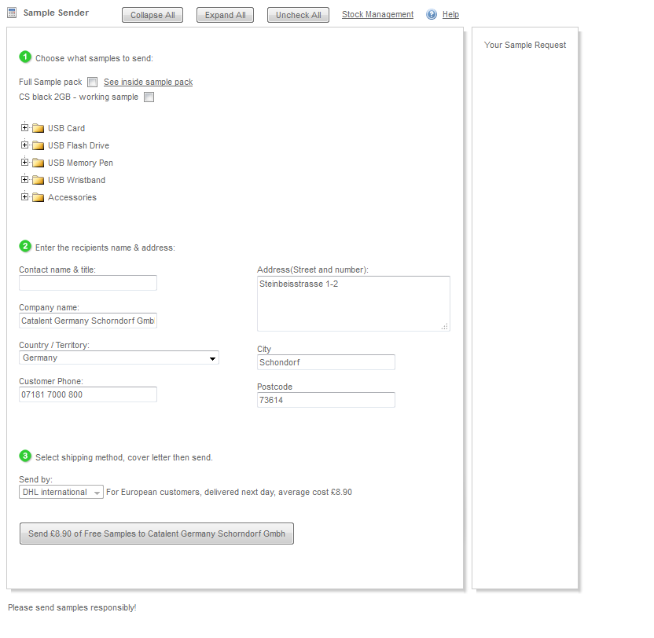
Sample Tool
Dummy samples can be send over this link.
You can send individual models or the „Full Sample Pack“ which includes all our models in different colors and gives the customer the perfect overview over haptic and design options
a 2GB Sample Sticks can be send (only CS model available) which the customer can test on their systems.

Slide 11
Useful Information
Certain information is always hyperlinked in NS ( PRs, Emails, Customers, Invoices, Sales Orders etc.) and can be utilized to look up information quicker, for example: Proof -> Sales Order -> attached Documents or Invoice -> Sales Order -> Customer
Learn the common shortcuts – i.e. Copy (Ctrl + C), Cut (Ctrl + X) and Paste (Ctrl + V) as they will help immensely to save time
Main tab we are working with will be Leads / Relationships to set up new leads and get an overview over lead / customer lists

Slide 12
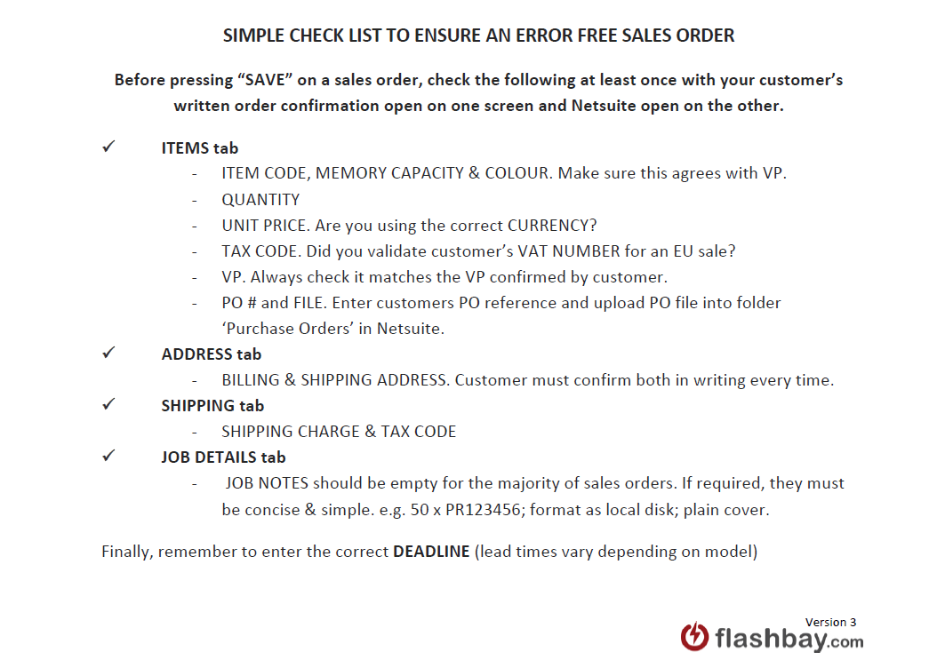
Netsuite/Scheduling a Sales Order
Ensure that all aspects of an order have been approved by the customer via a proper written
Order confirmation before placing any order in Netsuite.
Quote (deadlines, amounts, capacities, etc.)
Virtual Proof (including orientation and branding)
Data (screen shot for confirmation has been sent to the client)
Use the Sales Order Check List to cross check if you received all confirmations needed via email from your lead/customer to avoid mistakes. The process of scheduling a sales order is much easier if you begin by updating the parent
Customer record with the correct currency, VAT number, billing address, shipping address, contacts etc.

Slide 13
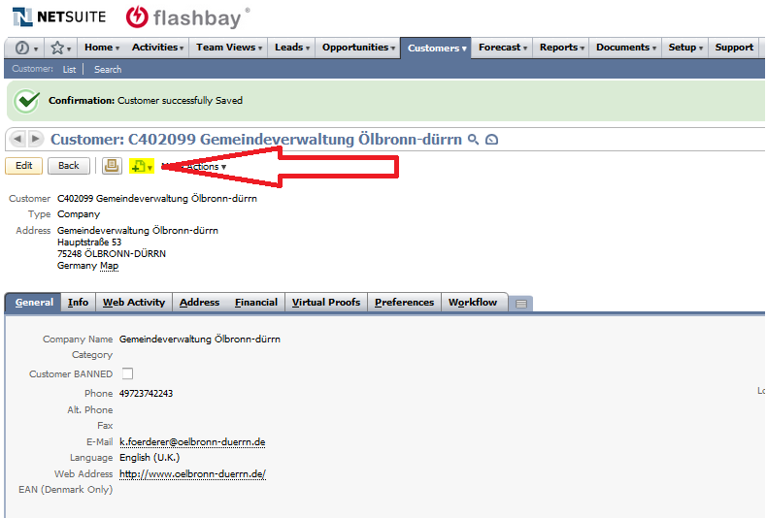
To initially create the sales order record, first go to the lead/customer record in Netsuite
Hover the mouse over the marked Page Icon and select ”Sales Order”, you will be directed to a new page (see image on the next page).

Slide 14
Always work your way across and top to bottom so you don’t miss any fields
The top 14 fields need to be check although Order Date, Currency, Customer Job, VAT, Order Number, Custom Form, Opportunity, Status, Location, Sales Person, Processing Status will be set by Netsuite as default
Payment terms and Deadline, as PO# have to be set by SM
1. Add items using the appropriate product code (product codes can be found on the website or
price list). Check that you have selected the correct memory size and colour
2. Enter required quantity
3. Enter agreed unit price
4. Select the correct Tax Code:
VAT: S for UK and EU countries where no valid VAT number is provided
VAT: ES for all EU countries if a valid VAT number is provided
VAT: CH for Switzerland
VAT: AU for Australia
VAT: NO for Norway
VAT: O for other countries outside the EU
5. Enter the respective virtual proof number or click on the double arrows to load a list of virtual
proofs belonging to the customer.
6. Click Add to insert more items, otherwise click the Address tab.

Slide 15
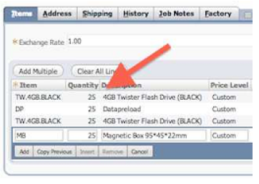
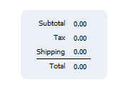
To specify the convention of a product and accessory or service please proceed like the following Example :
50 X TW
50 X DP
Sales order is set for 50x TW with 50x DP
50 X KN
50 X MB means
Sales order is set for 50x KN with 50x MB
A more complex example would be:
50 X TW
25 X DP
1 X DPUS
50 X KN
25 X DP
50 X TX
50 X MB
Sales order set for 50x TW, only 25x of those TW will have data furthermore that data will be locked, other 25x units are with out data and DPUS
25 of KN will have DP & 25 no DP and 50x TX in 50x MB
Always add USB Model, then any extra service the customer asked for, then the next USB Model and so on, this is important so our production team knows which sticks receive what services and extras
The total of the order ( right side ) is an immensely helpful tool. Here you see the total charge, tax and shipping. If you calculated everything in your order, you can check the numbers and see if they add up.

Slide 16
Address Tab
Each order requires a billing and shipping address. Click the dropdown menu to either enter a new address, select a previously used address, or to customise a previously used address.

Slide 17
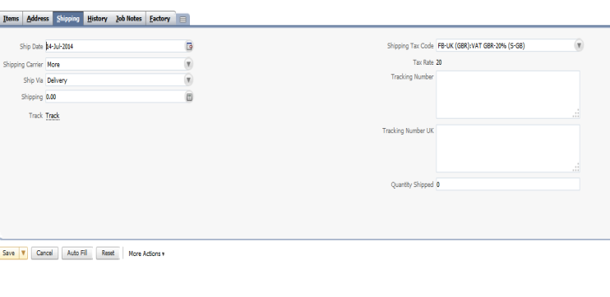
Shipping Tab
Please always aim to ship to the customer's business addresses.
We won't ship to:
PO Boxes, Conferences, Exhibitions, Event facilities
We need to ensure that the courier is able to safely deliver the order to the location without risk that it is lost or delayed as often occurs with the above classes of location. If appropriate and necessary to meet a deadline or firm customer preference we can ship to a hotel where a customer will be staying.
1 . Leave the Ship Via field as "Delivery" or set to "FREE DELIVERY" as appropriate
2. Enter the agreed charge for Shipping
3. Check the Shipping Tax Code is correct.

Slide 18
Job Detail tab
Enter any information specific to the order in Job Notes. Examples of other types of information that should be included in Job Notes would be:
1. Print quantity A using PR1 and print quantity B using PR2
2. Two shipping addresses. Ship 100 units to shipping address and ship 50 units to: A N Other 1234 ABCD Street ABCD United Kingdom Tel: 44123412341234
Job Notes for most standard orders should be left blank. There is no need to repeat obvious information in this area.
Deadline
A deadline must be specified on each order. You must pay particular attention to lead times when communicating with customers to avoid deadline problems. The standard lead time of each product is shown on the website.
You should consult Operations(operations.cn@flashbay.com) to confirm whether we can achieve a deadline within the standard lead time if your order is over 5,000 units or has items/services falling outside our standard offering.

Slide 19
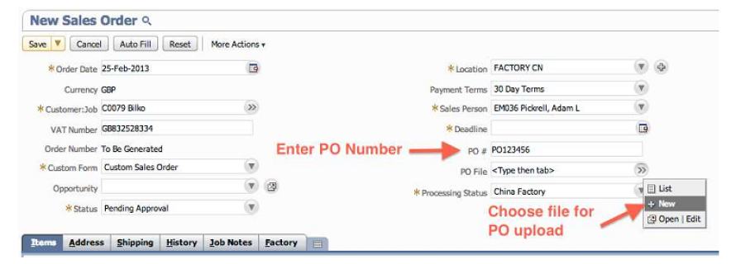
PO number and PO file upload
If your lead/customer supplies their own order reference, add this to the PO # field. This reference will subsequently show on their invoice.
Some customers will provide you with a purchase order. You must enter the purchase order number and reference into the PO # field in Netsuite and attach a copy of the purchase order to the sales order using the 'PO File' field in Netsuite.
Purchase order documents must be saved into the folder Purchase Orders and you may need to select this in the file upload box if you have previously uploaded files to another folder in Netsuite as the system defaults to the last folder used.
If you receive the PO from your customer after you scheduled an order you need to contact operations.cn@flashbay.com, so they can attach the file to the order.

Slide 20
Changes after an order has been scheduled
Ensure that all aspects of an order have been approved by the customer via a proper written order confirmation before placing any order in Netsuite.
Do not amend any order information or details in Netsuite yourself, after you have pressed save on the Sales Order entry page. The 'Edit' button on sales orders should never be used.
Shortly after you enter an order the details are reviewed and the order approved, or in some cases rejected, by Operations. Amending orders interferes with this crucial process.
If you or the customer wish to change any details on the sales order, please follow the following procedure:
If an amendment is production related, which means:
Change of model
Change of capacity
Change of product colour
Change of Virtual Proof
Change of quantity
Addition or removal of items
You must email our After Sales Team with Operations and your Group Leader CC.
The After Sales Team will log the request and assign responsibility to either the sales person or customer each time an order amendment is requested. Please note that all amendments for which sales people are responsible will be considered as sales mistakes and the order will be marked ex-commission and ex profit. All amendments resulting from customer mistakes or changes will be logged for statistical purposes and commission on the order will be unaffected.
Please use the Text Parts 'Production Order Amendment' with a description of why the order needs to be amended. You must include either in the body of the message or as an attachment, the relevant customer communication where an amendment is being requested as a result of a customer’s mistake or change.
To make sure all amendments are processed in a timely manner please use the following format for the subject line:
PRODUCTION AMENDMENT [Sales Order Number] for example:
PRODUCTION AMENDMENT S123456
If an amendment is non-production related, which means any changes not listed above, you must email Operations and your Group Leader CC. Please use the Text Parts 'Non-Production Order Amendment' with a brief description of the details which need to be amended

