Slide 1
Aftersales

Slide 2
What is Aftersales?
Aftersales refers to all measures, which are taken by manufacturers and retailers in order for a successful sale to their customer.
Good Aftersales service encourages repeat and additional purchases, increasing customer satisfaction and ensuring long-term customer loyalty. Diligent Aftersales care often ensures a higher future margin than new business, and is a sustainable way to increase customer value and profitability.
Our Aftersales department deals with all issues that arise post sales, in order to maintain a business relationship with the customer. Our aftersales team is located in our UK warehouse, which we will be visiting today.

Slide 3
How do Most Aftersales Cases
Originate?
The most common causes of Aftersales are:
Sales Person Error (What could these be?)
Factory Error (What could these be?)
Courier Error (What could these be?)

Slide 4
Answers
Sales person Errors:
Order entry, this could cover wrong proofs being ordered, missing services off the order, delivery addresses being entered incorrectly. Wrong Currency being used etc.
Factory Error:
Incorrect printing, incorrect shipping addresses. Delays in production etc.
Courier Errors:
Delays in transit. Wrong delivery address. Package being delivered damaged. Package being lost.

Slide 5
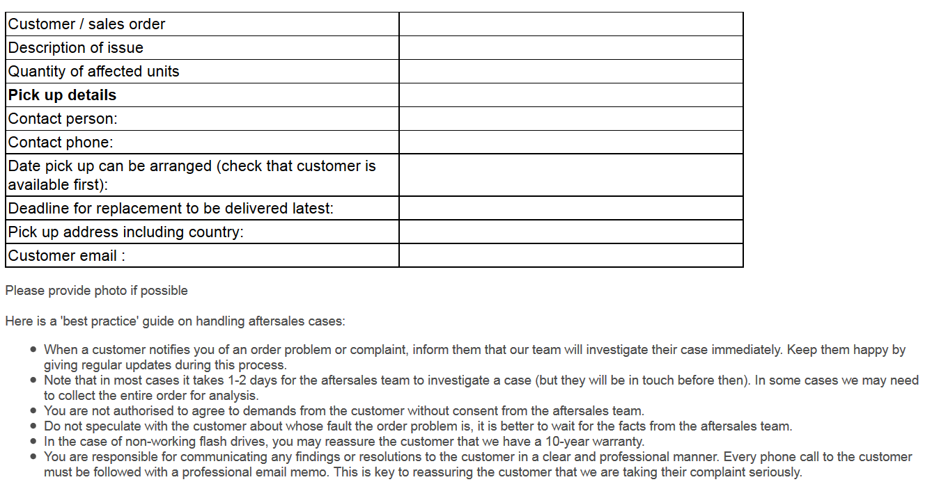
How are Aftersales Reported?
We write an email to aftersales.[country code]@flashbay.com with the Sales order number as the subject. You can then find aftersales related reporting templates under the Text Parts in Zimbra.

Slide 6
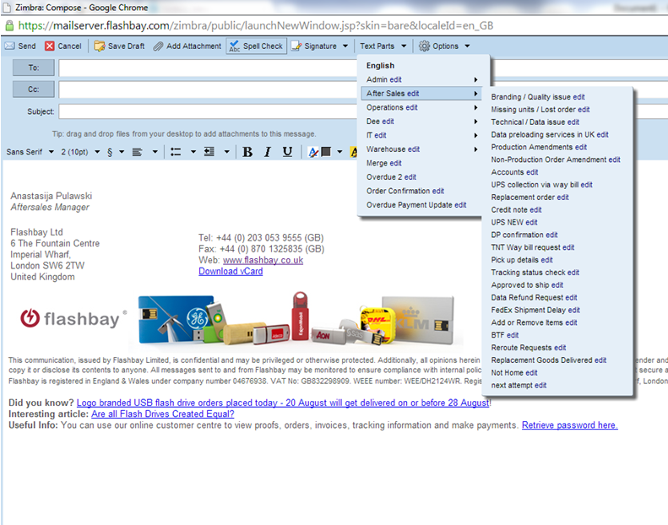

Slide 7
It is important to include as much information as possible in order to facilitate the prompt resolution of the case.

Slide 8
Aftersales Resolution
Once the aftersales case has been resolved and the customer is happy with the outcome then your Group Leader will conduct a brief meeting with you to determine what steps could have been taken to avoid similar cases arising in the future.

Slide 9
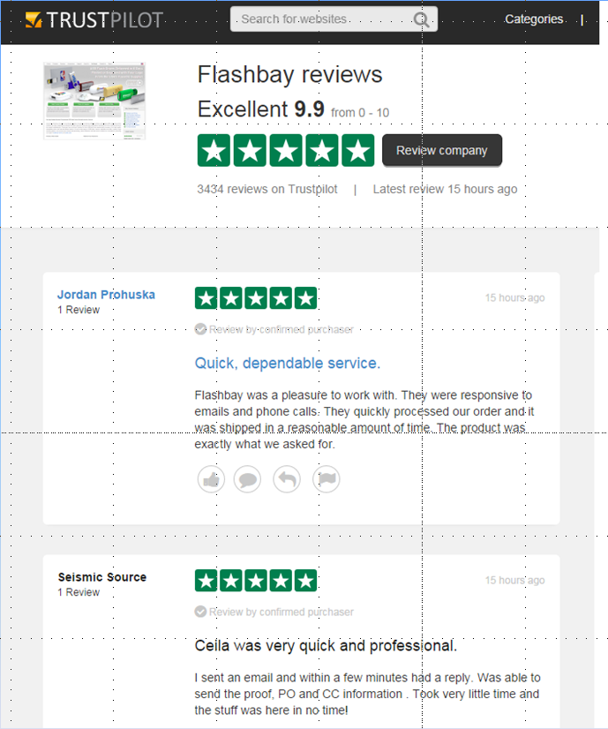
TrustPilot
Great sales work and diligent aftersales following up is rewarded here at Flashbay and as such we operate a TrustPilot Reward Scheme
TrustPilot is an independent review website and if one of you customers places a 5 star review of our services then you will receive a £10 bonus.

Slide 10
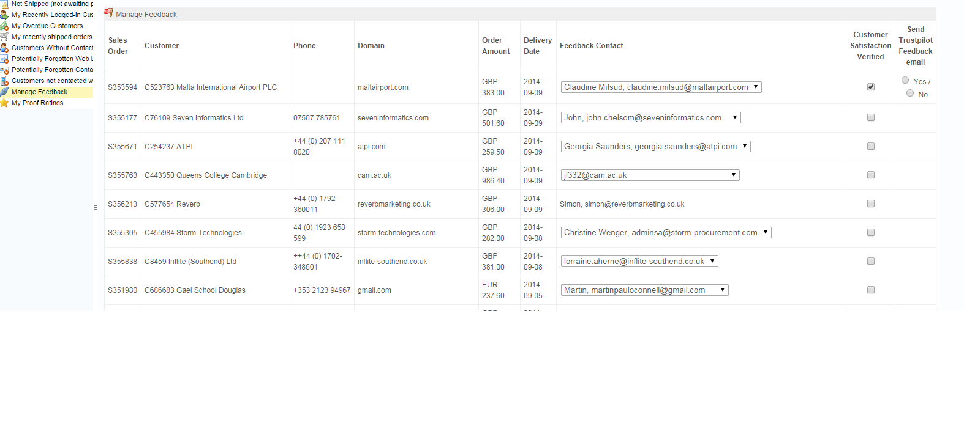
Please make sure the customer is 100% satisfied with their order and the service they have received once the order has been delivered. Once confirmed you can send the contact a link to review on TrustPilot.
Please note that any 3 star, 2 star or 1 star review (even if it is just one) will lose your entire accumulated bonus in the assessment month. You therefore have to make 100% sure that the customer is extremely satisfied with the service and product they have received.

Slide 11
Further Reading
The Flashbay wiki is an incredibly valuable resource and contains lots of information pertaining to past aftersales cases and general product knowledge.
Good places to start are:
http://wiki.flashbay.com/index.php/After_Sales_Awareness
http://wiki.flashbay.com/index.php/Product_Knowledge#Services
These resources are constantly updated so try to check and refresh your product knowledge from time to time.

