Slide 1
Phone Calls

Slide 2
How to Make Good Phone Calls?
GET READY
Prepare professional introduction
BE SPECIFIC
Thank customer for inquiry, should always relate to customer's inquiry and make sure customer understands the reason for your call. Individual approach - addressing customer needs and why Flashbay will meet them
USE DIALOGUE
Yes, you're excited about your business, but a phone call is a dialogue, not a monologue.
Don't make the price most important subject - point out other advantages when buying from Flashbay ( quality, lead time) Good knowledge of the product, branding methods and services we offer will improve customer's confidence, increasing chances of a sale
ASK FOR LOGO & ADDRESS
Always ask for customer's logo in order to create a virtual proof or their address in order to send them a sample pack
CHECK THE DEADLINE
It is important to know whether they have an urgent project or not as you will be able to send your quote accordingly and have a better margin
KEEP IT SHORT
Assume this won't be the only time in your life that you'll talk to them, so you don't need to fit everything into a single conversation.
Explain next step ( Sales Cycle)

Slide 3
Follow up
Following your customer will help you increase the level of accuracy. You will have more information to understand the customer's requirements, and you will be able to adapt your price accordingly
When you call your lead you need to check if your customer is available to talk. If not, ask when you can call them back
Professional introduction:
“Hello, it’s Krystyna from Flashbay”
Ensure they received our sample pack, ask for feedback on the quality of our products
Have they received our price list, quote, VP ? ( explain the fluctuation of the NAND flash price and how they will buy at the best price if they can confirm within 6 days)
Always ask who is making the final decision - proactively guide the customer towards a purchase

Slide 4
Refresh Leads
Important to see if you can re-launch customer project
You may have made a fantastic phone call and follow up but for some reason customer said “NO”. Never give up and don't take "No" for an answer!
Maybe the customer placed their order with a competitor - call them back to check if they are satisfied with the quality and service and then offer a quote
Customers / leads contact might have changed so try to qualify on Netsuite
Keep those calls short and informative; with no initial interest customers will not like long lasting phone calls
Inform about samples / new products & ensure customer still has samples and is informed about any new products or services
Give the customer a reason to buy – preparation – future customer events
Line up the next follow up call :
“If I do not hear from you I will contact you again in a few weeks or when new products introduced”

Slide 5
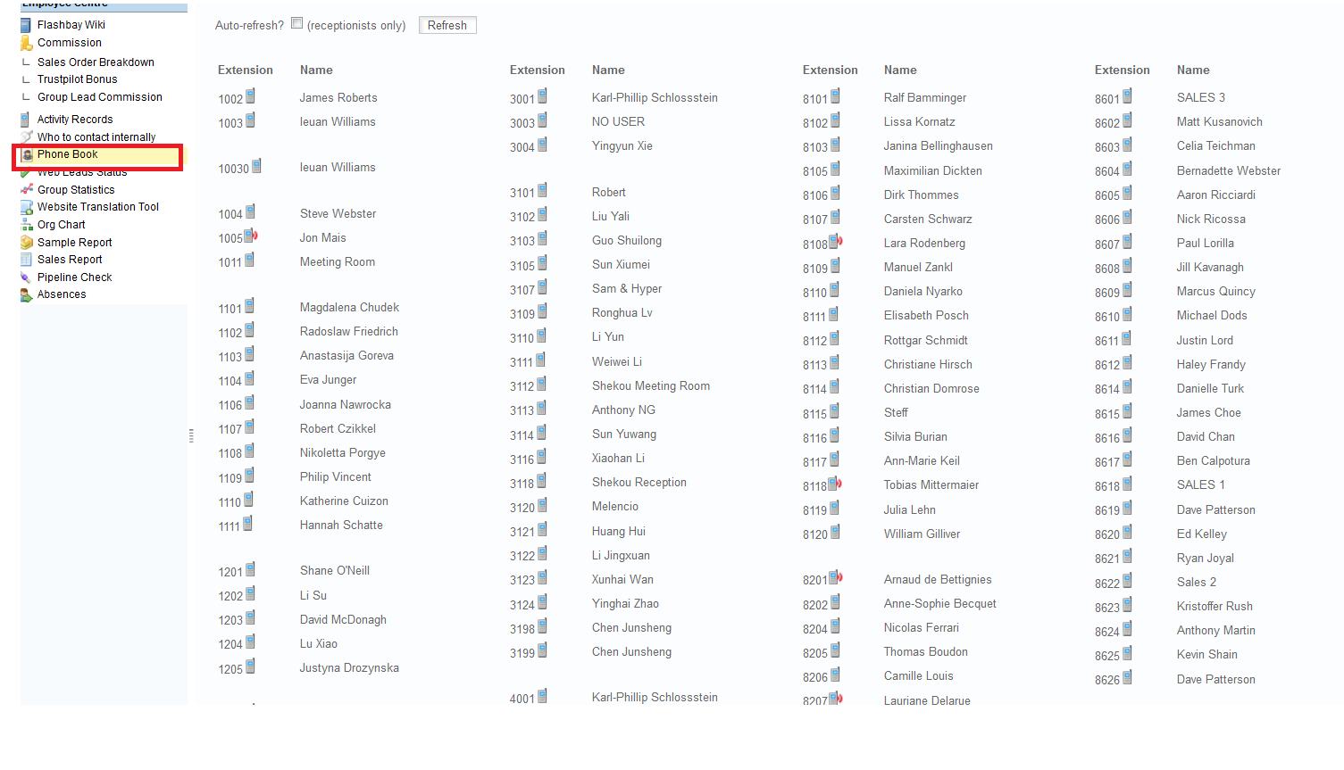
How to Professionally Transfer a Call
Introduce yourself and ask who the customer would like to speak to
Inform the customer that you will try to transfer them to the appropriate person. This will give the caller a chance to ask any other questions and give them a feeling of control.
Say to the customer: “Please hold the line, I will see if I can put you through”
Press Hold
Call the appropriate SAM (you can use the phone book to find the extension)

Slide 6
Do not blindly transfer the call. Wait for the SAM to answer and explain to them that a customer wishes to speak to them. This will give the SAM a chance to prepare for the call and the customer will not have to explain the situation all over again
If the SAM is ready then Press Transfer followed by the Tick button
If the SAM is not available, return to the customer and explain that the SAM is away from their desk. Take a message and inform them that the SAM will contact them ASAP. Thank the caller for their patience and ask if there is anything else that you can do
Then please send a brief email to the appropriate SAM with all the details (customer name, company name, phone number and reason for their call)

Slide 7
Exercise 1: Introduction Phone Call
New starters will do role-play using the details below:
First Lead
Company Name: L’Oreal
Contact Name: Krystyna Kaba
Interested in: KN White
Rough Quantity: 100 Units
Anticipated Delivery Date: 16th September 2014
Logo Attached
Before calling, consider the following points:
How would you introduce yourself and Flashbay?
Key Details
Double check the order deadline
Ask who the final decision maker is
Explain the NAND flash price fluctuation & if customer is able to make a decision quickly (don’t be too pushy on first call)
Ask if they have bought USB sticks before
Ask if they need boxes KCM DP etc.
ALWAYS remember to send a virtual proof
These details can help you send a quote quickly (if project is urgent & if the customer hasn’t bought USB sticks before, can send at a high level. If they already been supplied by a competitor/if project is for the future, considering decreasing the level
Exercise 2
Listening to a Phone Call
20140721-1059 (Lewis)
What do you think of this call?
What are the pros & cons?

