Slide 1
Negotiation

Slide 2
What is negotiation?
A bargaining process between two or more parties seeking to discover common ground and reach an agreement.
Where do we encounter negotiation?
Email
Phone

Slide 3
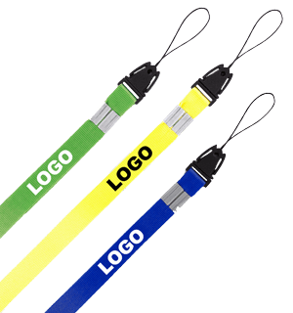
What are the benefits with Flashbay?
6 days guaranteed lead time*
Our own factory
Free Samples (Next day)
Instant Quote (15 min)
Factory Direct Prices
25 Units Minimum Order
10 Year Warranty
No Hidden Cost
Free Virtual Proof
TrustPilot link
Unique Design
Printing included on all printable sides
Original NAND Flash

Slide 4
How to negotiate by phone?
Always give your customer a call straight after getting an email about price, they`ve chosen a different supplier or they`re not interested in USBs at this time.
Be understanding to their needs and budget. Maybe they can give you some information on their budget or price the competitor offered.
Do NOT negotiate price on the phone, spend the time on the phone to mention benefits with ordering from us.
Make sure you use the arguments that are relevant, don`t drown your customer in Flashbay information that isn`t relevant for their needs.
If your customer cares about quality you should focus on the high quality NAND flash we use and our 10 year warranty.
Try to get your customer to narrow down their wish to one model, capacity and quantity.
End the conversation with ”I will have a chat with my manager and see what we can offer you. I will email you within 30 min”

Slide 5
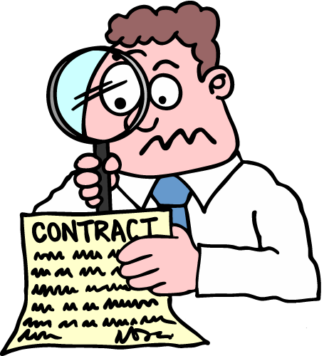
How to negotiate by email?
Thank your customer for their time on the phone and quickly summarise the conversation and your argument.
“This said, I have spoken with my manager and we can offer you as a new customer/returning customer a special offer”
You should not send them a new pricelist, but make a new quote fitting their request.
Try to upsell “I can offer you 4GB for the price of 2GB” or “ I can give you a better price if you increase from 25 units to 50 units”
You should now have a Virtual Proof to attach and if possible send them the link to our webpage where we have videos of our most popular models.
The quality of the video and Virtual Proof will only back up the argument you made about Flashbay and separate you even more from the competitors.

Slide 6
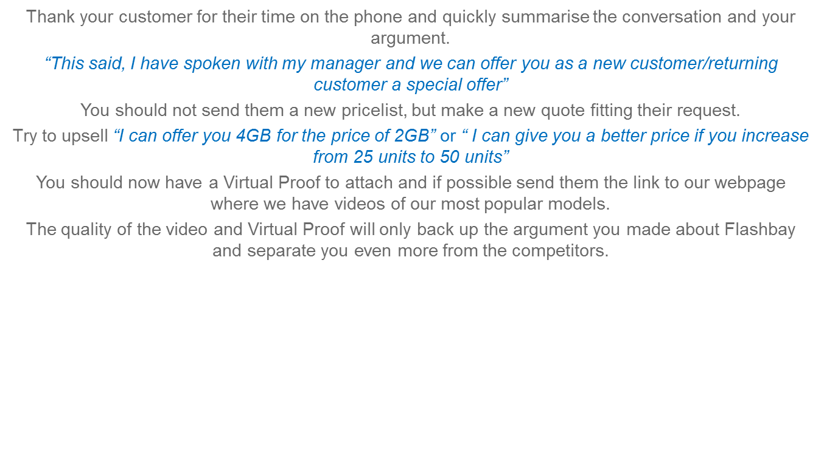
How to negotiate by email?
Why clarifying the next step in email is so important when customer is not ready to order yet:
If customer is saying they need time, don’t just write a “Thank you for the information, contact me when you are ready”
Take back control of the Sales Cycle by letting them know that you will send them updated pricelists and keep them updated on new products etc) – point out the exact date or month when you are going to contact them again (and schedule a reminder)
You can then send them a special offer in a few weeks to see if you can get them interested again.
It is important that you are in charge, for them this is only one purchase they are planning to make, they have other priorities – don’t let them forget about Flashbay.
By being in charge of the situation you will show your customer that you are reliable, know your job and they can trust you with their order. This will make it more likely for them to get back to you when they are looking for USB`s again.

Slide 7
Are all USB Flash Drives created equal?
The simple answer is no, USB`s like most other things come in different quality and price ranges.
The NAND flash memory chip is a component that lies at the heart of a flash drive. Memory comes in different grades with a range of read and write speeds.
The biggest difference is the NAND flash that`s inside the USB.
Flashbay sells only new grade-A memory from suppliers like Samsung, Intel and Toshiba.
Some of our competitors deliver USBs with a much lower grade with slim to non-warranty. In some cases it`s recycled memory chips.
For more information see FAQ on our web page

Slide 8
Scenarios
In teams of two/three you will now do some role play. Please choose who will be the lead/customer and who will be the sales person and play out the following scenarios.
Scenario 1
Customer was looking for a 1GB Classic, they got a 50p/unit better price from a competitor and won’t order with you. How would you approach this?
Scenario 2
Customer emails you saying they are not interested in USBs at this point. What`s the next step you take?

