Slide 1
ZIMBRA Training
Session

Slide 2
What is Zimbra?
Zimbra is the email software Flashbay uses to communicate internally and externally
Zimbra is where you can find all necessary employee and Company information

Slide 3
Zimbra Tabs

Slide 4
Email (Your Inbox)
What is essential for a Sales Account Manager to know about the Zimbra Inbox?
The Zimbra inbox contains all communication with Leads, Customers, Group leader, team members, Operations, Virtual Proof, Aftersales, Accounts, etc.
What are the biggest do’s and don’ts?
DO’s
Save every email you send/receive.
Label the email folders with the correct company name.
Drag the emails to the correct folder.
Keep an eye out for your Junk folder.
DON’TS
After every email you have sent, drag it directly to the correct folder and do not let them pile up in your Sent folder.
Be careful with attachments – don’t open something if you do not know the person/company you have received it from.
Why is this?
To keep an organised overview of all your internal and customer information

Slide 5
Email- Folder Structure
Question Round:
How should you structure your folders correctly?
How should you organise your customers?
In which order should they be ranked?
What should you do with several different contacts from one company (e.g. different departments ordering separately from each other) Do they go in the same folder?
How long should you keep old emails? When should you delete emails from customers?
Answers:
Be efficient, use one standard for your labelling of all emails
Suggested folder name “Audi Netherlands BV”
Focus on the money, rank the most value prospects as most important to follow up
Make sub folders for different contacts with different orders from the same company/organisation. For example, suggested folder name “University of Amsterdam (Johnny)”
Never remove any emails containing communication between you and your customers

Slide 6
Email- Leads
How do you receive leads?
Leads coming in from either website/by phone all need to be created in Netsuite before any contact is made.
How much potential does this lead have?
Based on the potential of the lead (quick action needed?) you schedule your follow-ups during the day.
Where should you put it?
A-Z folder structure is the easy way!

Slide 7
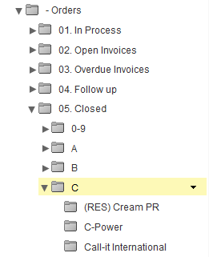
Email- Orders
You have received an order. Hooray! What should you do with the email?
Drag your folder of the lead/customer that ordered from A-Z to your ‘Orders’ section where you keep leads and customers separate.
How should you organise different types of invoices?
‘In Process’ contains customers that have just ordered and have pending data/invoice.
‘Open invoices’ contains customers with payment terms.
‘Overdue Invoices’ contains all customers with overdue payments.
‘Follow up’ folder contains customers that have received the goods and need to receive a follow-up call and email to check if all went well with the delivered USB’s and send an invite for the TrustPilot reviews.
‘Closed’ contains all existing customers that have ordered.
Use the most efficient ways to chase outstanding payments
Use the Overdue Invoices page in NetSuite or the Overdue Customers tab in Your Sales Admin in Zimbra.

Slide 8
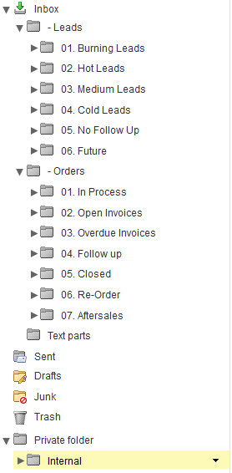
Email- Organising Internal/External Emails
What do you do with emails from Operations, Accounts or Aftersales about your customer?
Internal emails regarding a customer go into the same customer folder so you have all information easy accessible.
How should you organise your email containing general information from Flashbay?
Suggestion: Create an“Internal” folder and create a couple of sub folders so it’s easy to find correspondence when needed.

Slide 9
Assignment
Let’s pretend the below email subjects are unread emails in your folder. Where would you drag these emails and why?
Email from Virtual Proof with subject: “ C704395 Philips UK Ltd.”
Email from Accounts with subject: “ Your Invoice IN398421 from customer C123456 BMW “
Email from your Group leader with subject: “ Feedback today! “
Email from Operations with subject: “(RUSH REQUEST) C105689 University of Amsterdam”
Email from Joanna with subject: “ Overdue Invoices “
Email from lead with subject: “ Information from Flashbay for Oxfam “

Slide 10
Contacts / Address book

Slide 11
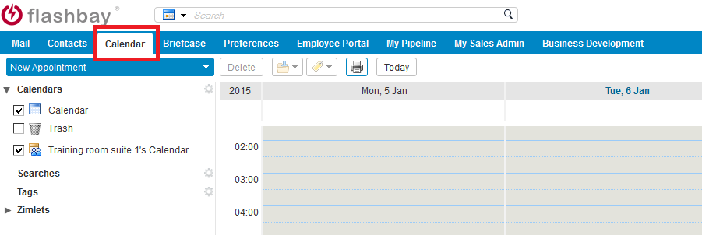
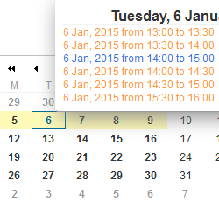
Calendar
All calendar items are visible in both the tab in the header and calendar in bottom left corner

Slide 12
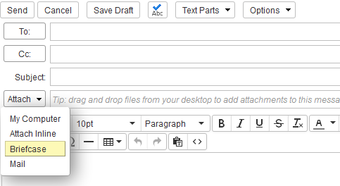
Briefcase
It’s useful to store frequently used documents that you need to attach regularly to your emails in your Briefcase

Slide 13
Preferences / Settings when absent
How to setup your ‘Out-of-office’ response
Preferences > Mail > Receiving Messages > Send auto-reply message
In the ‘Send auto-reply message’ box explain when you are off (from/to), who will cover for you and on which email address and phone number you can reach this person.
Don’t forget to select the start/end dates of the message.
How to setup Inbox/Outbox shares for your colleagues
If absent, your group leader will assign a team member that will cover your account and needs access to your Inbox, Sent box and Drafts.
To share these folders, right click on the specific folder > ‘Share folder’ > type the email address of your colleague > Select ‘Admin’ > OK.

Slide 14
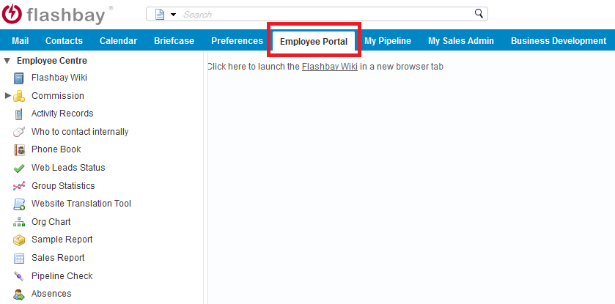
Employee Portal
In your Employee Portal you’ll have access to important information related to your sales work and general Flashbay information

Slide 15
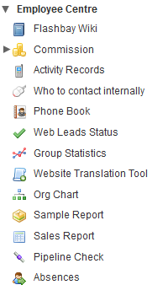
Employee Portal Sub Tabs
Flashbay Wiki: - easy access to all the general aspects of working in our UK business.
Commission: - Overview of your performance for the specific month - Overview of paid/unpaid orders - Overview of your customers’ TrustPilot reviews
Activity Records: - Keep track on the amount of emails sent and phone calls made
Phone Book: - Contact information of all Flashbay employees
Sales Report: - Useful statistics and reports to keep track of your sales performance
Pipeline Check: - Pipeline checks with feedback on your follow ups from your Group Leader
Absences: - Keep track of holidays, sick days and absences

Slide 16
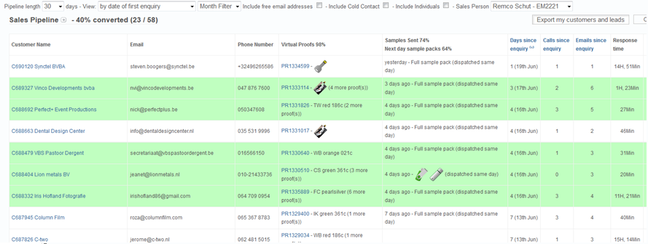
My Pipeline
Easy overview of your work on newly received web leads.
Check conversion rates, proofs and sample packs sent.
Which leads have been converted into customers?
The more rows in green the better!

Slide 17
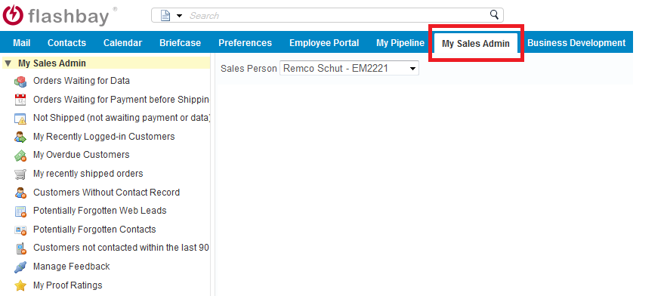
My Sales Admin
Easy overview of
- Order statuses - General account management - Access portal to invite customers to leave reviews on our TrustPilot pages

Slide 18
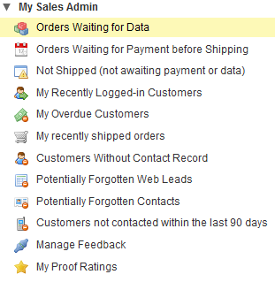
My Sales Admin – 4 Important tasks
Keep yourself updated
Browse through all tabs in your ‘My Sales Admin’ everyday to keep track of orders with pending data, overdue payments and tracking information on orders sent from our factory. Leads/Customer details
Make sure to work through your Forgotten Contact details and enter these in NS to have your customer account information up-to-date
Trustpilots
Send out invites for reviews to your satisfied customers
Virtual Proof Rating
Check if you have rated all your virtual proofs

Slide 19
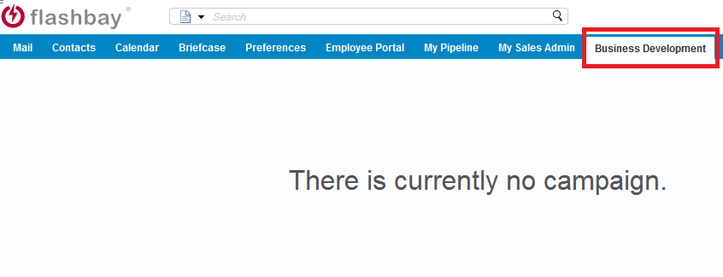
Business Development

