Slide 1
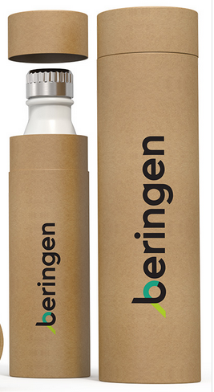
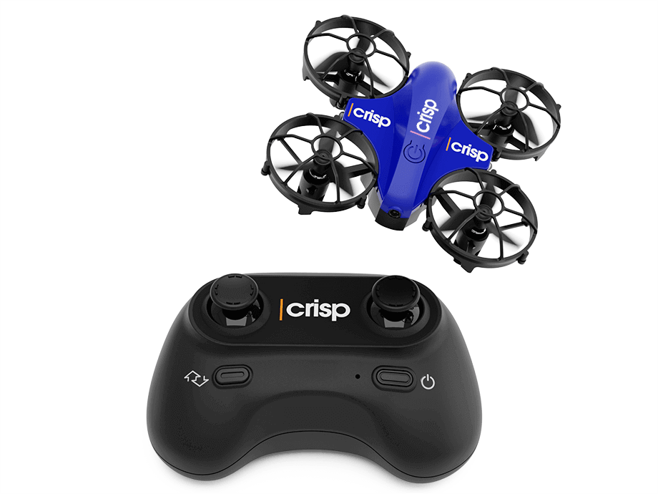
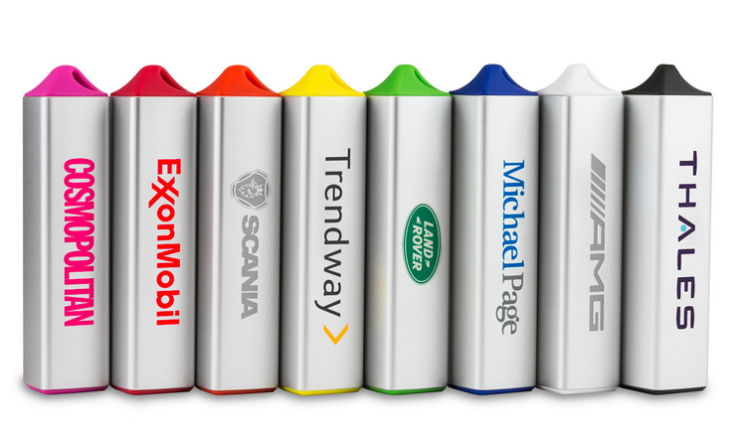
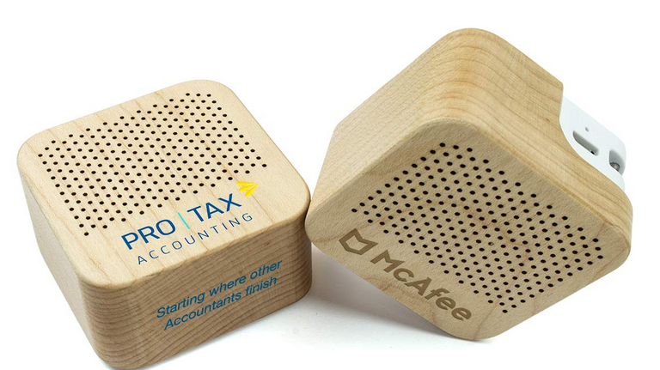
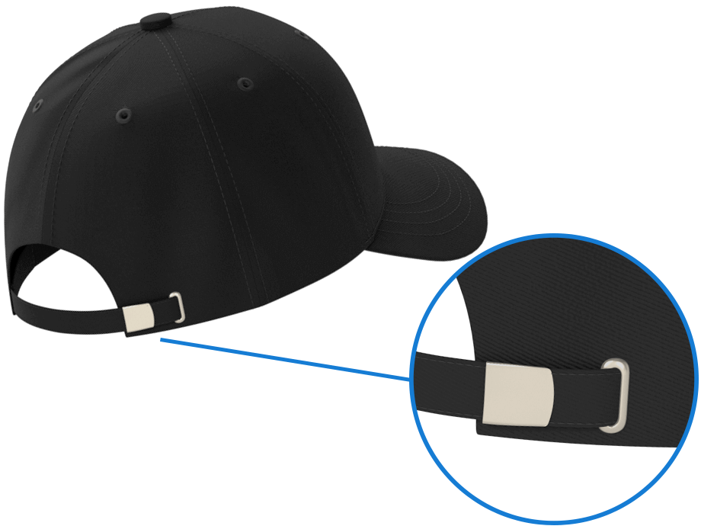
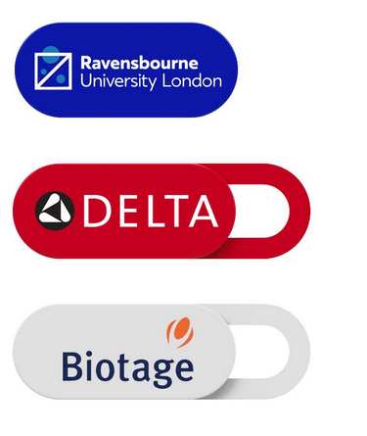
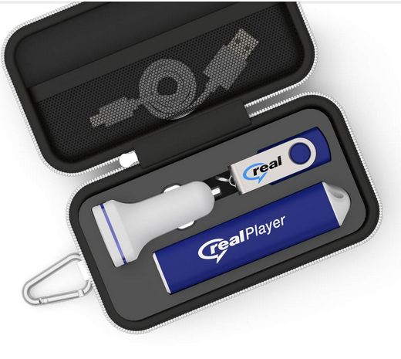
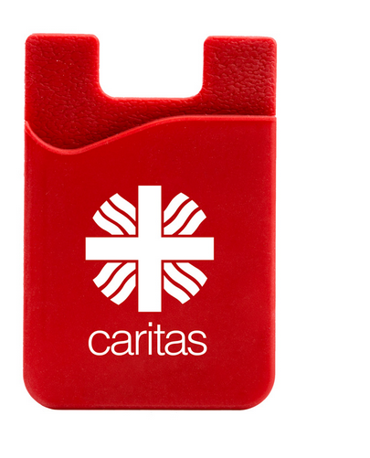
Which other products do we sell?
1. Power : Power Banks, Wireless Chargers, USB Car chargers
2. Drinkware: Water Bottles, Travel Cups, Straws
3. Audio: Bluetooth Speakers, Bluetooth Headphones, Bluetooth Earphones
4. Gadgets: USB Cables, Phone Grips, Phone Stands, Phone Wallets, Multi Tools, Bubble Pops, LED Torches, Webcam Covers, Drones
5. Face Masks: Face Masks and Face Shields
6. Gift Sets: in 3 different sizes, 5 different types
7. Bags: Tote Bags and Drawstring Bags
8. Caps: Hats and Vizors

Slide 2
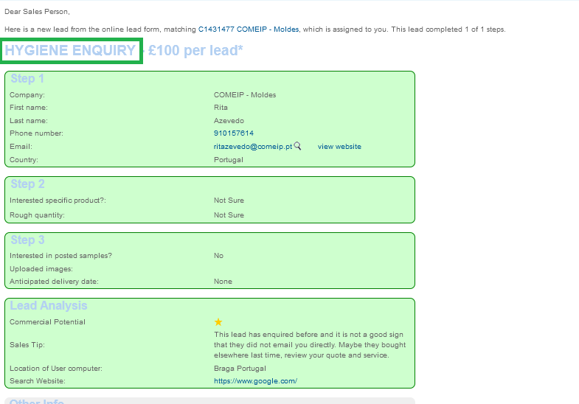
New Web Lead form
What to pay attention to :
Which product category lead is interested in
Do they want samples?
Do they have a deadline?
What quantity they are interested in?
What is the star rating?
Any other info?

Slide 3
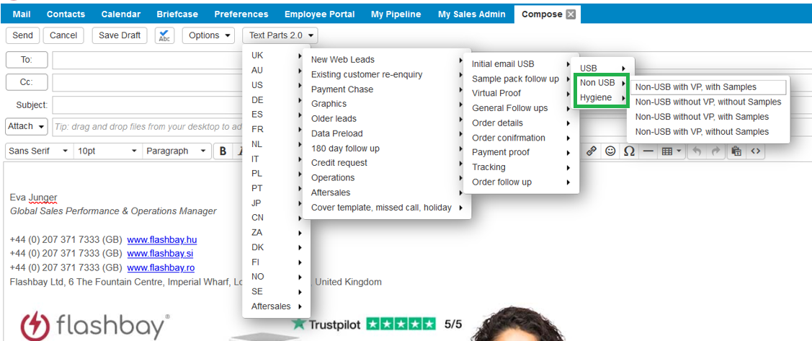
Text Parts :
Choose the correct template
Why is it important to use it?
Different lead time
Different Warranty period
Different information in the text parts

Slide 4
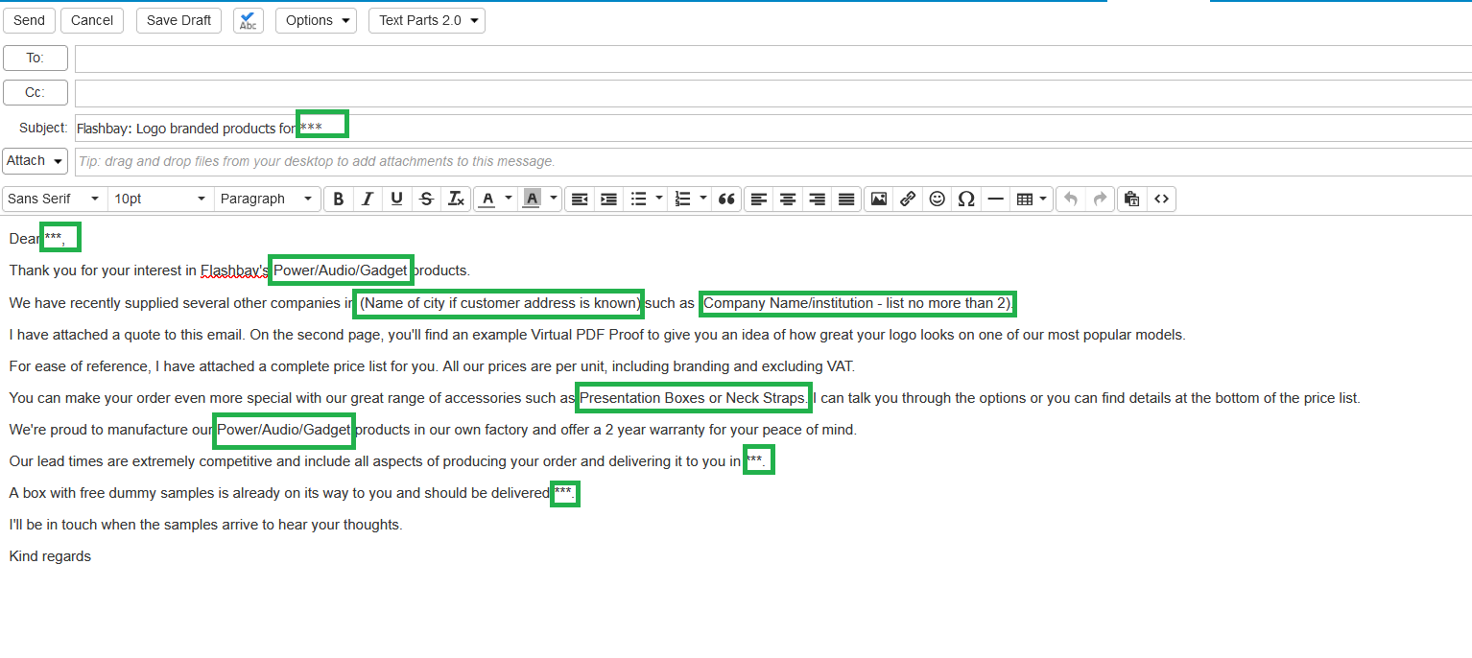
Text Parts :
Amend and proof read the text part before pressing send :

Slide 5
Power
Power Banks
How many capacities do we offer?
What is the life cycle of a Power Bank?
Do they come fully charged?
How many times a PB can charge the phone?
What are the order quantities?
Wireless chargers (USB-C)
How does the wireless chargers work?
Compatibility (QI enabled devices)
USB Car charger:
How many devices can it charge?
What is the Warranty period for all Power products?
Remember: MOQ and order quantities for Power Banks vs other sub
categories

Slide 6
Audio
What is the Bluetooth version used and what is the Bluetooth range?
How long does it take to charge:
Headphones (MO 45 mins, AC 30 mins)
Speakers (mono: 1,5 hours, stereo: 3 hours)
Earphones (1,5 hours)
Which customers are likely to buy, what’s the target audience?
Do the products come pre-charged?
Can the speaker be used as a Power Bank?
What is the Warranty period?
What are the order quantities?
When to send working sample?

Slide 7
Gadgets
Range of Gadgets is changing depending on the market trends.
What is the top seller gadget?
Why is Shield (SH) thicker than the ones sold by competitors?
What is the Warranty period?
What is the MOQ and order quantities?
Multi (MU) and Motion (MT) upsell with Power Banks

Slide 8
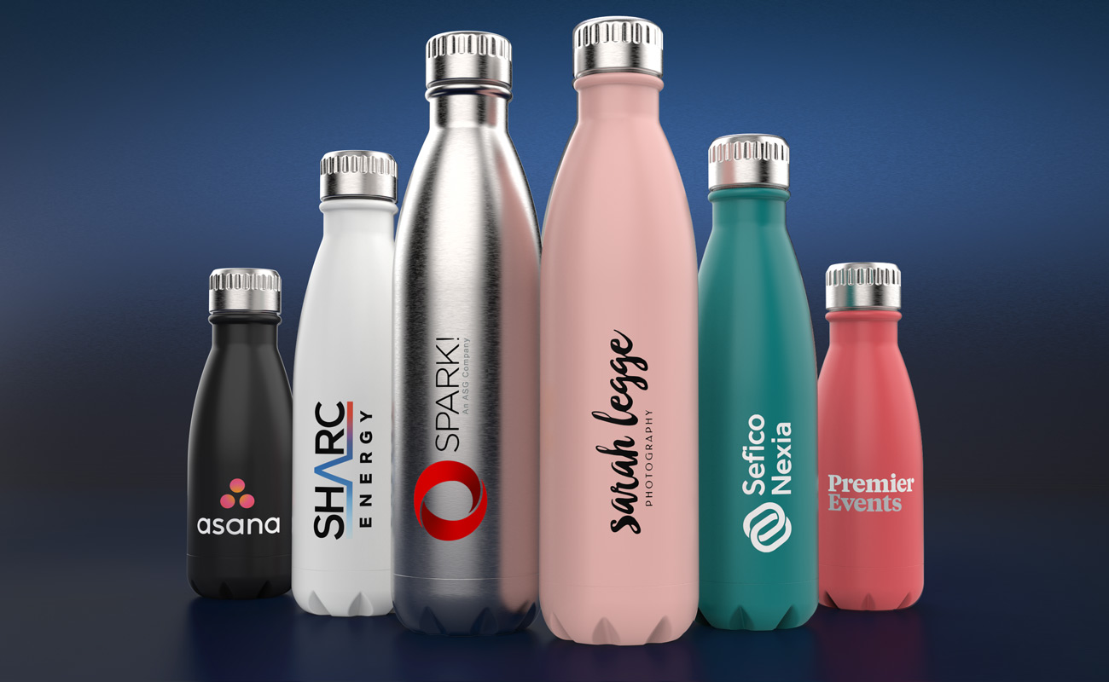
Drinkware
Which model is the top seller?
What certificates do we have for Drinkware, why are they important? - (BPA, EU Food Grade)
How many colours can we print on Drinkware?
What can you upsell?
Dishwasher?
What is the MOQ and order quantities?

Slide 9
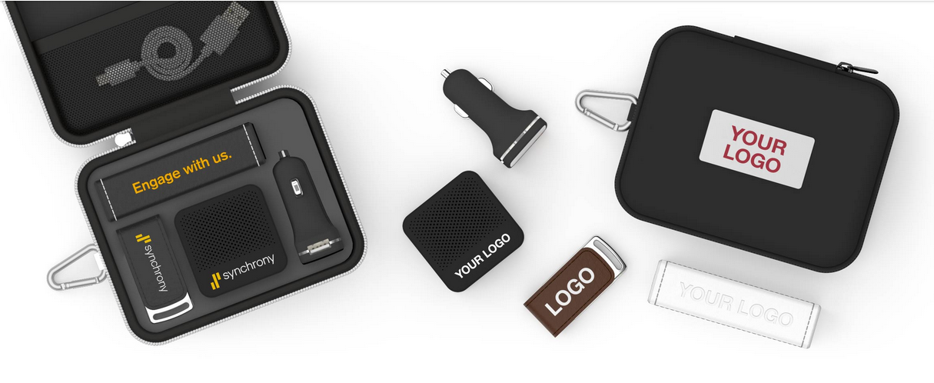
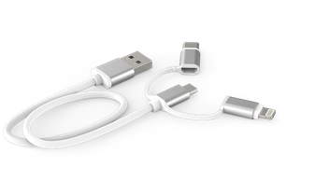
Gift sets
How many types of Gift Sets, how many sizes? (5 types, 3 sizes).
What can be sold as an upgrade for Gift Sets?
What is the warranty period?
What is the MOQ and order quantities?

Slide 10
Hygiene
Are the products re-useable?
How many times could the masks be washed?
What’s the recommended degree to wash the Face Masks?
How should the Face Shield be cleaned?
Are the Face masks medical, do we have medical certificates?
Do we sell masks for children?
Are the masks individually packed?
What is the Warranty?
What is the MOQ and order quantities?

Slide 11
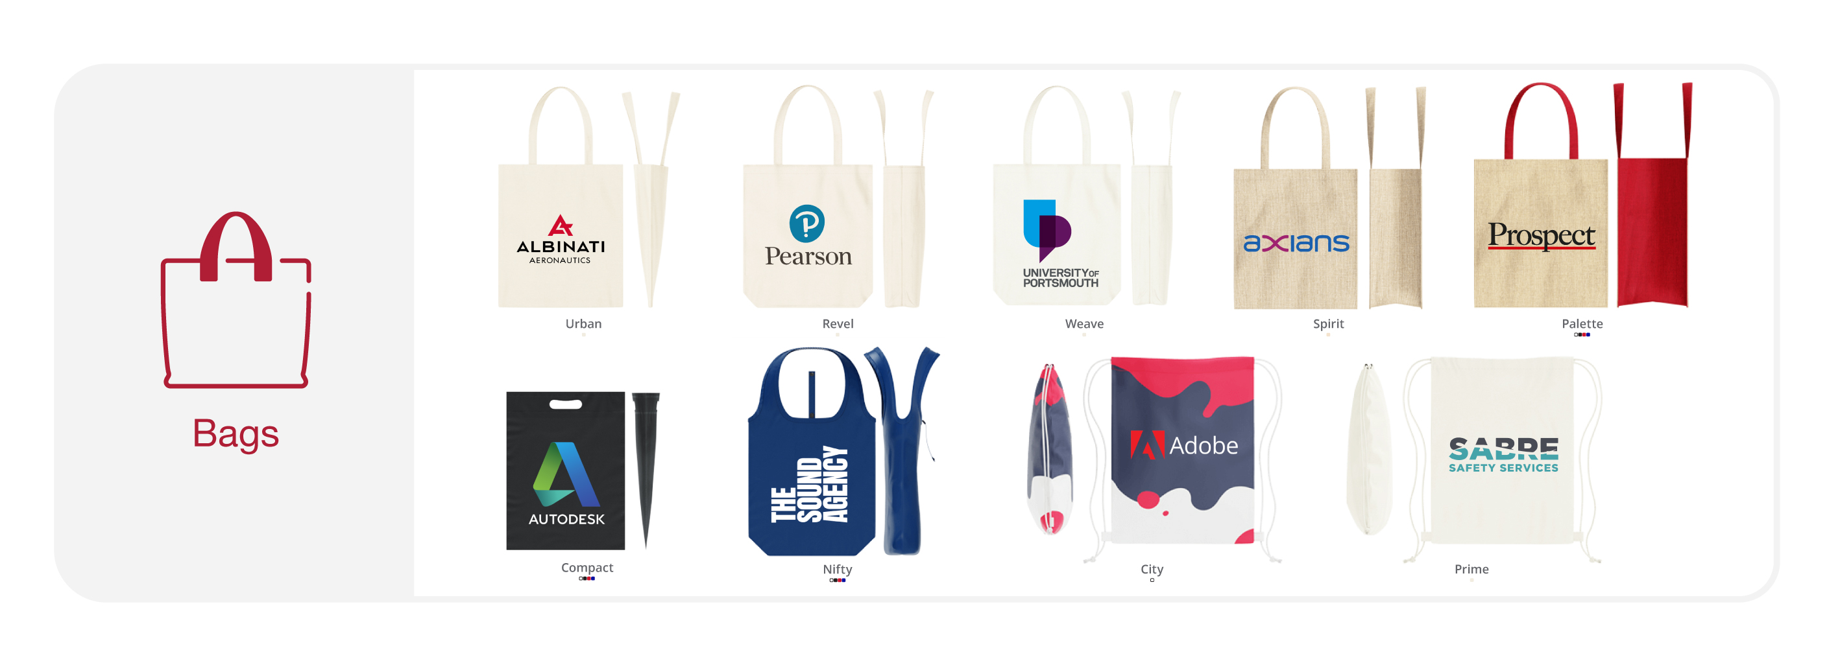
Bags
What are the printing methods?
Purpose?
How many kinds of bags?
What are the lead times?
Volume and Carrying Capacities?
Branding Area?
Environmental Friendly?
What is the Warranty?
What is the MOQ and order quantities?

Slide 12
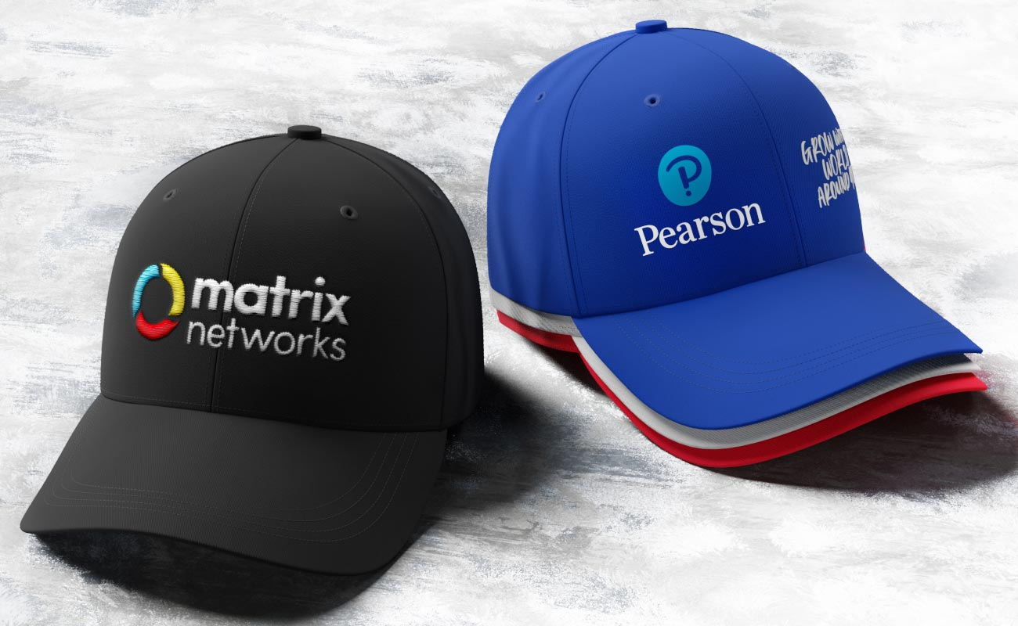
Caps
What are the printing methods?
What’s the target audience?
How many kinds of caps?
What are the lead times?
Branding Area?
Colour Limitation Embroidery
What is the Warranty?
What is the MOQ and order quantities?

Slide 13
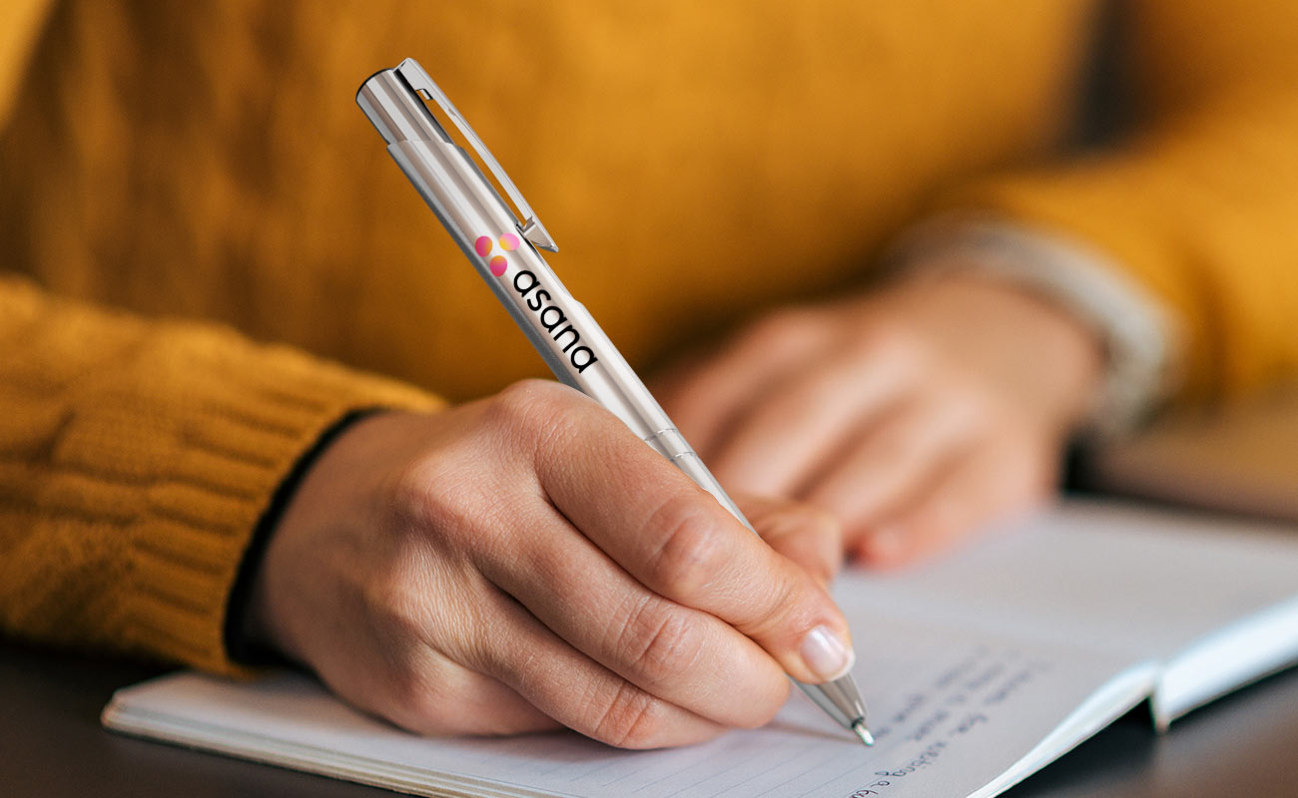
Pens
Why Pens?
What’s the target audience?
Why should leads/customers buy our Pens?
What are the lead times?
Branding Area?
Ink colour!
What is the Warranty?
What is the MOQ and order quantities?

Slide 14
Any Questions?

