Slide 1
In this course we will discuss:
1. Solving Aftersales case cycle
2. How to report cases correctly
3. Responsible parts for mistakes
4. Examples of potential mistakes
5. Case studies
6. Introduction to Aftersales and Warehouse department

Slide 2
What is Aftersales?
Aftersales refers to the service provided to handle any issues after a successful sale.
By doing this, we prove to our customers that we take even the smallest issues very seriously and we are a trustworthy company. This would hopefully give the customer confidence for future relations/business.

Slide 3
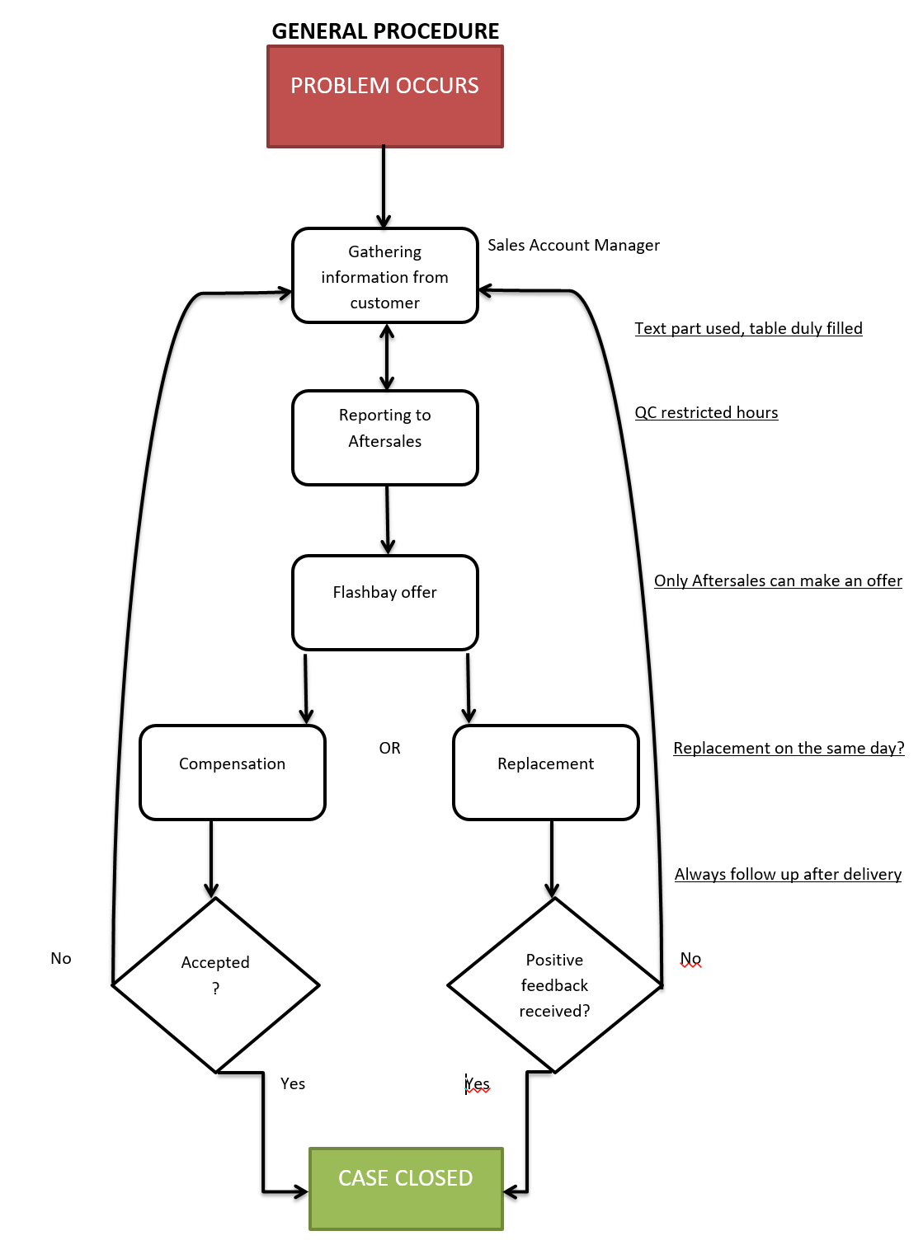
1. Solving Aftersales
The efficiency of the problem-solving process is affected by:
Deadline – “ASAP”
Information supplied in Text Parts to the Aftersales team
The factory’s Quality Control reports vs a real order?
The same day collection
Proactive follow up by Sales Account Manager

Slide 4
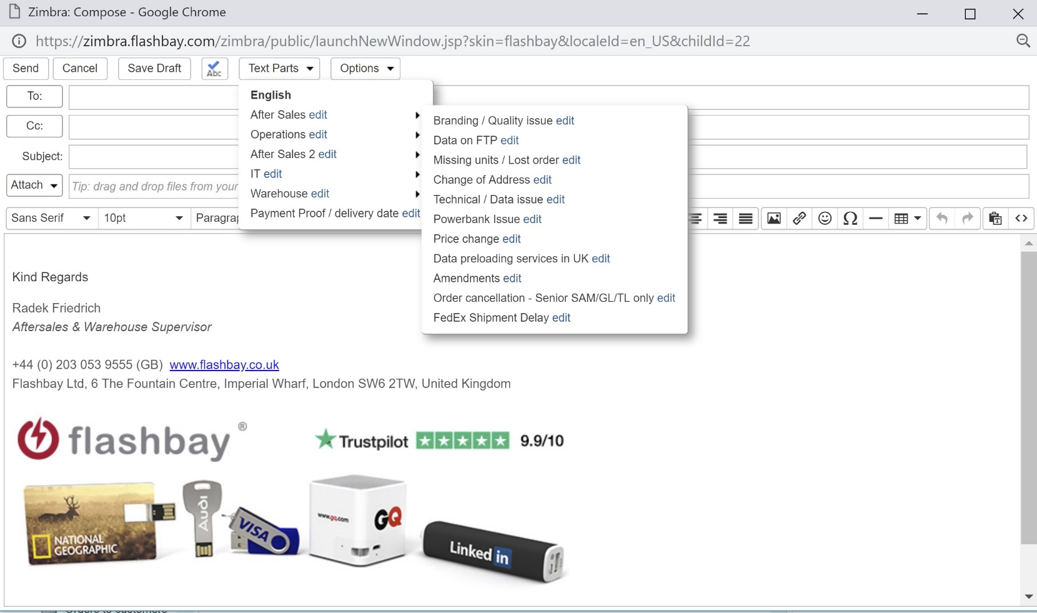
2. How to Report Cases Correctly
It is important for the Aftersales team to get all information listed in the Text Parts including relevant attachments proving a fault.
When calling your customer regarding an issue please have the Text parts opened in front of you so you know which details to discuss and double check.
The completed Text parts should be sent to: aftersales.[country code]@flashbay.com always with your Group Leader in cc.

Slide 5
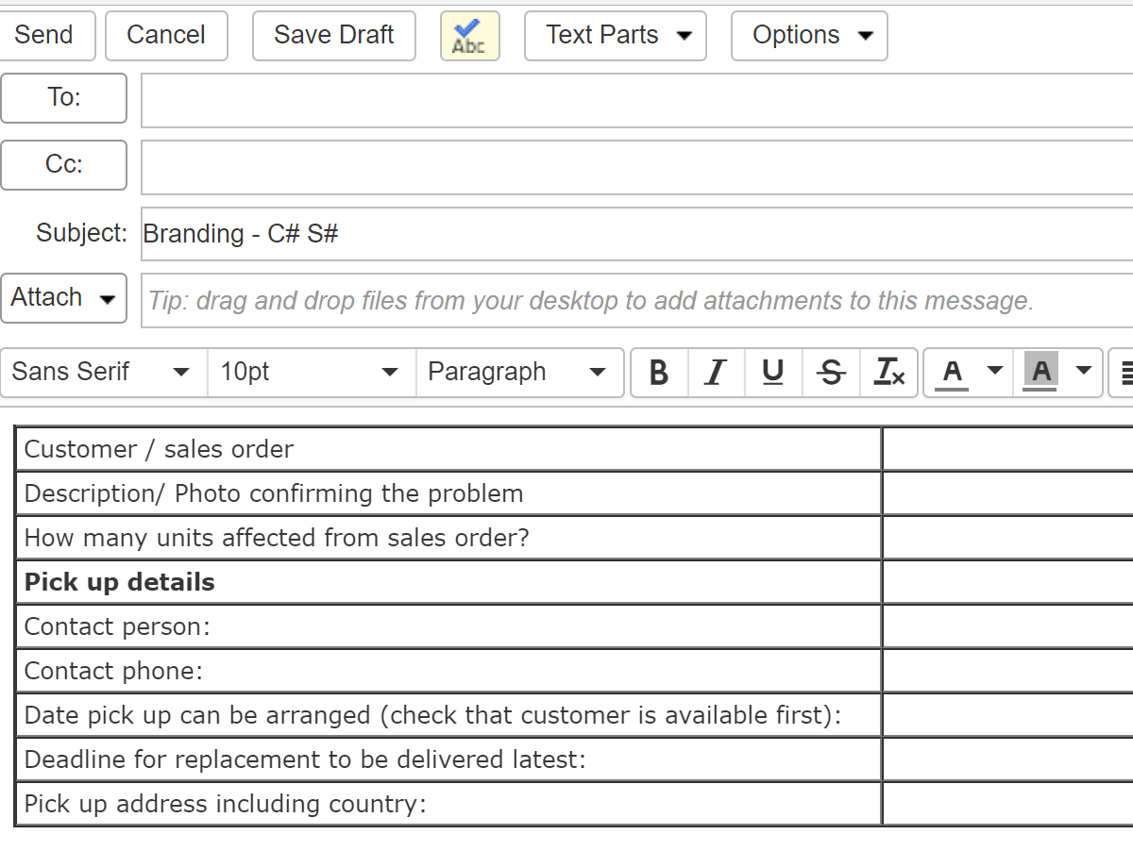
Branding/ Quality issues:
The factory always keeps one sample from each sales order.
To speed up the whole Aftersales process, please ask for a photo/ short video confirming the problem.
Branding issue e.g. what is the customer comparing the print to?
How many units left from the sales order?

Slide 6
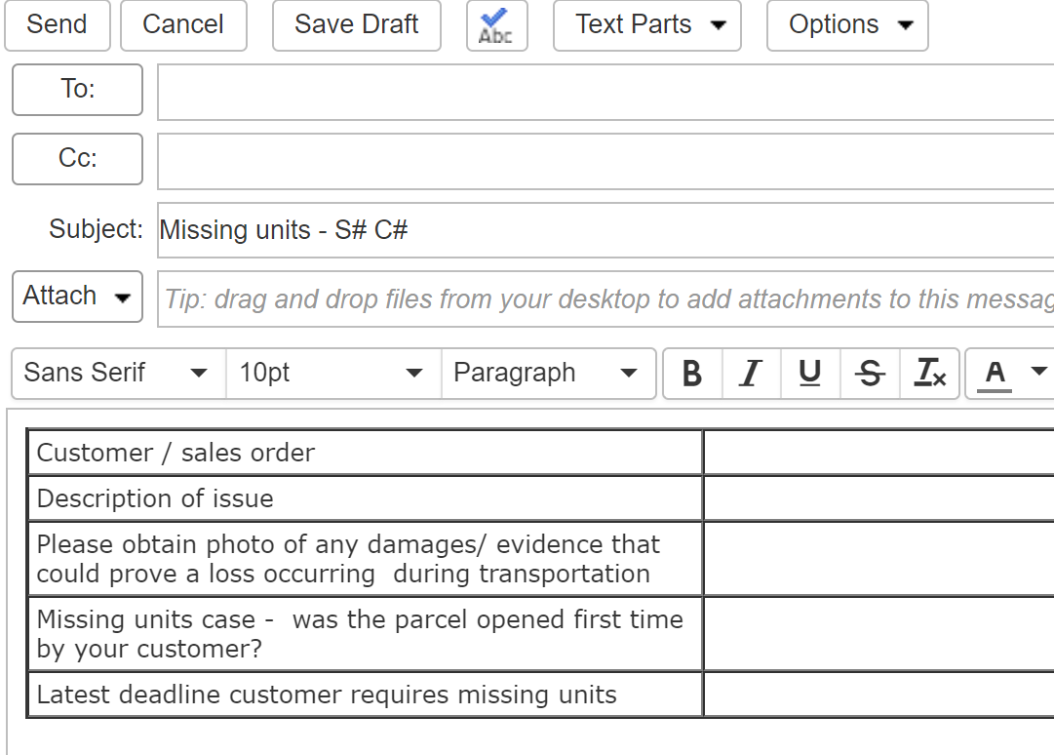
Text Parts “Missing units / Lost order” :
If box was delivered damaged, pictures are essential so we can also raise a complaint with our courier company for compensation.
DEADLINE. Is there time to investigate with TNT (they usually takes 2-3 working days to provide sufficient information on lost parcels.)

Slide 7
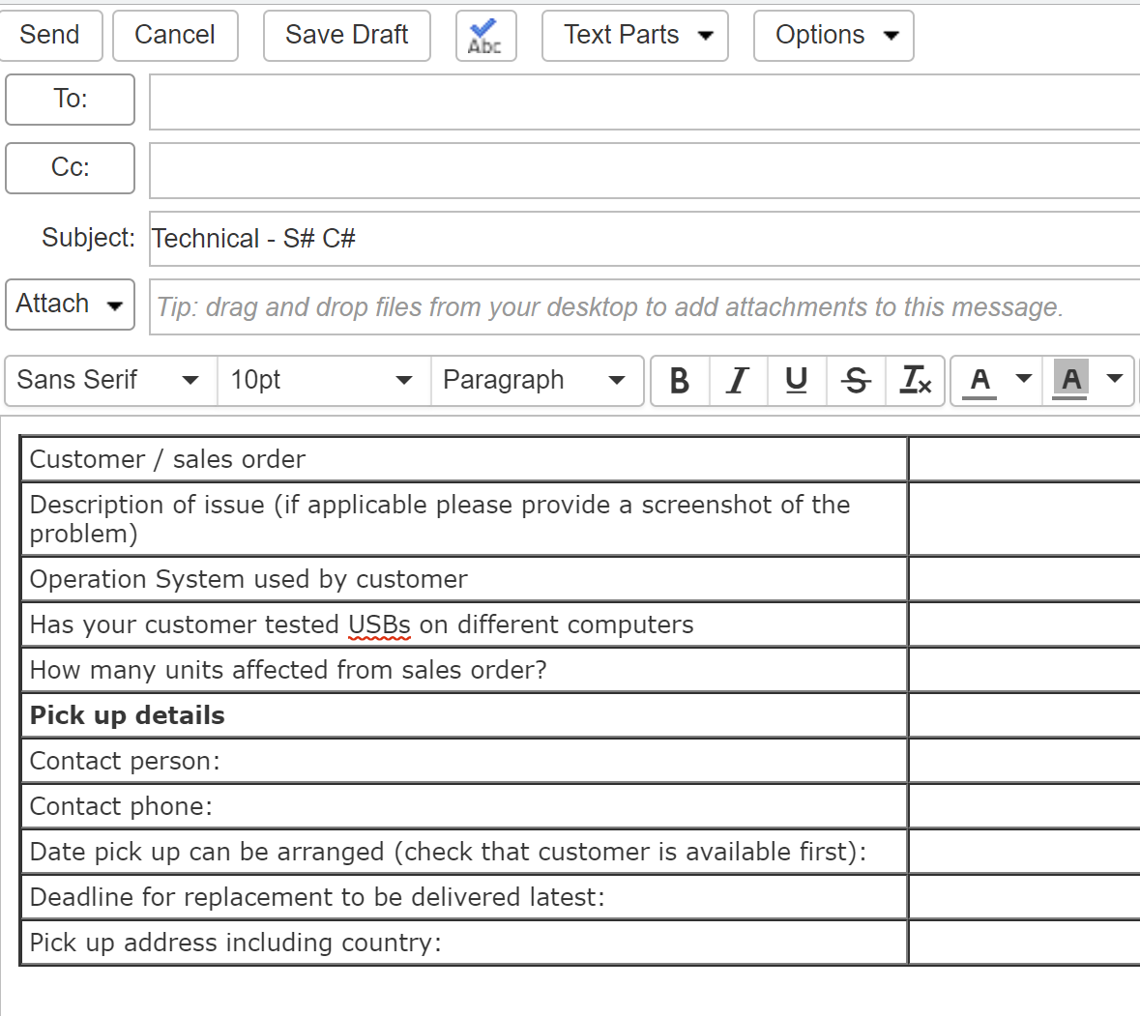
Technical / Data issues:
Data is “missing”
Given that USB is recognised and there is DP on order, is there DPUS on order?
USB flash drives are not recognised
If a thin connector supplied, USB can be potentially plugged upside down.
To see if there is any pattern the customer shall be asked to check USBs on several computers/ OS.
Any ‘Error’ message?
Please provide the screenshot of the issue and its translation.
Pre-loaded data is incomplete
Please supply screenshots of the issue plus the Root/Properties of original data that was confirmed with the customer.

Slide 8
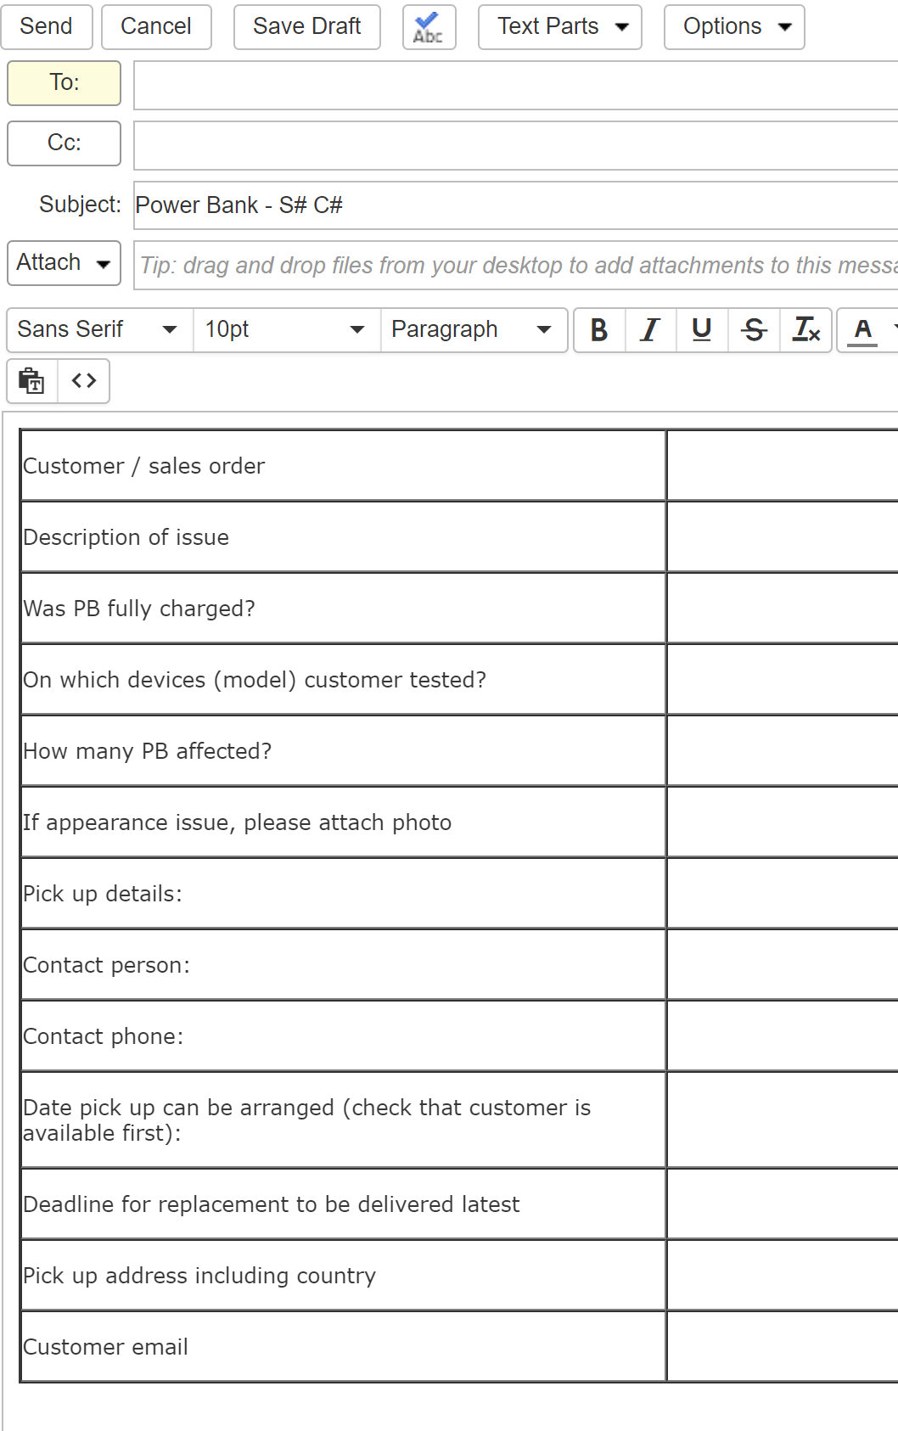
Text Parts “Powerbank Issues” :
Customer might be misled by the colour of the LED - LED turns red quickly – “why, is it empty?”:
Red LED kicks in roughly at 50% of capacity
If PB is empty, red LED starts blinking or PB switches off
PB only charges once
The battery capacity of devices/mobiles phones to be checked
Customer receives PB charged up to only a few %
According to aviation law, for safety reasons Power Banks can be only pre-charged up to 30%.

Slide 9
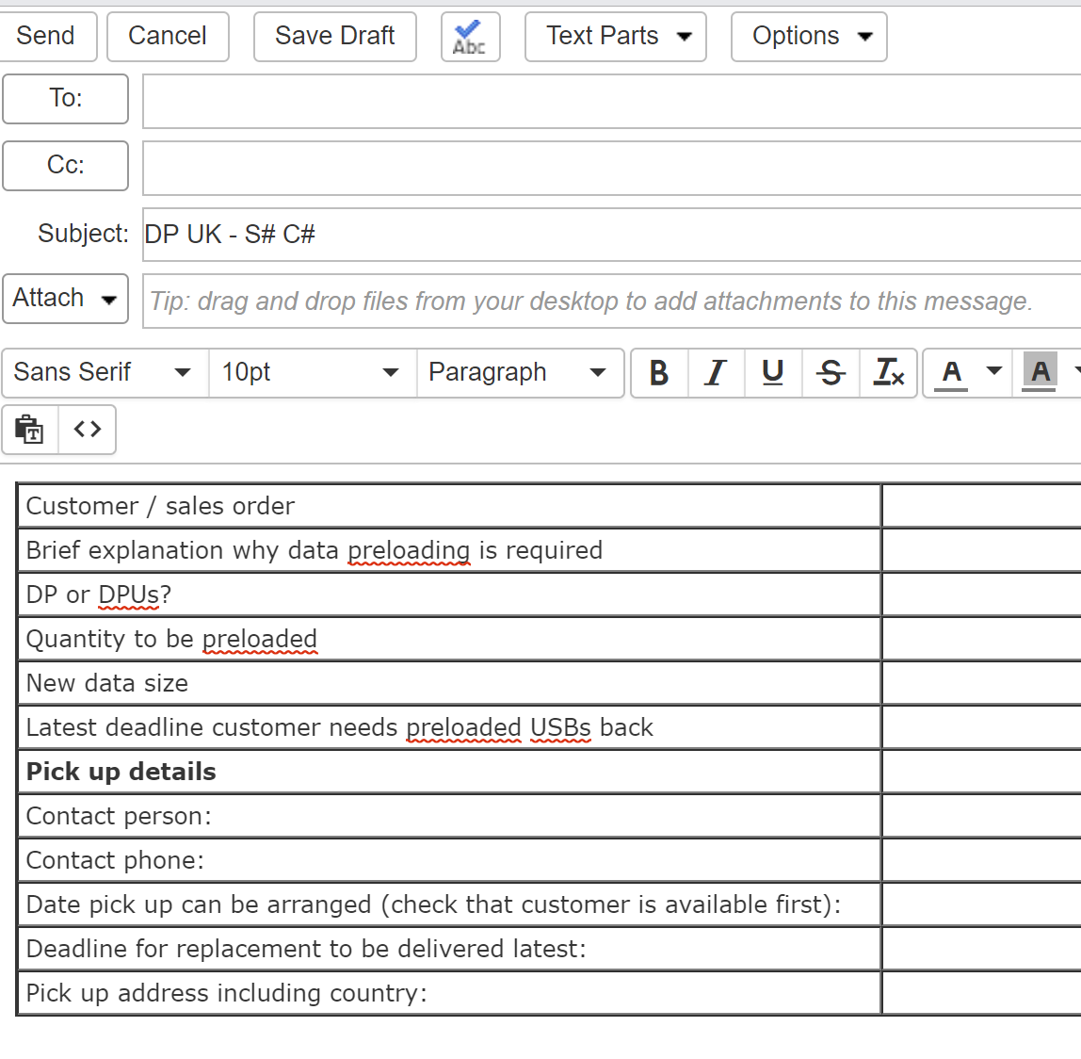
Text Parts “Data Preloading services in UK”:
Customer can ask to change DP or do a brand new pre-load after order has been shipped (especially a big demand for DPUS orders)
Only Aftersales in UK office can quote and approve DP job
To get a quote ASAP, fill in all details in the table

Slide 10
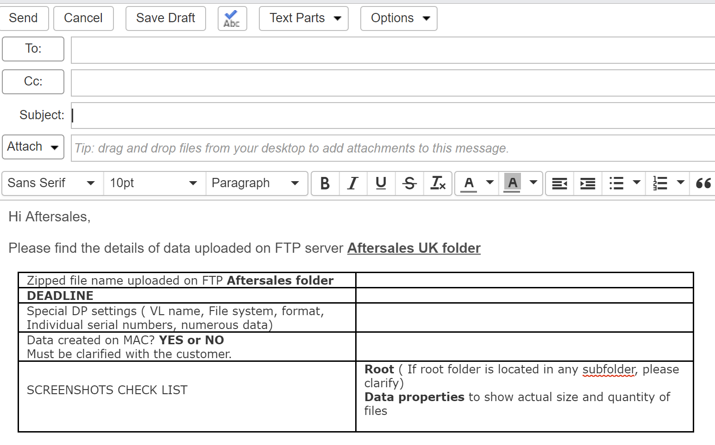
Text Parts to be used for DP confirmation with Operations and also with Aftersales team:
Aftersales to advise when to load data
Initial table with all information for the job
Uploaded to relevant location

Slide 11
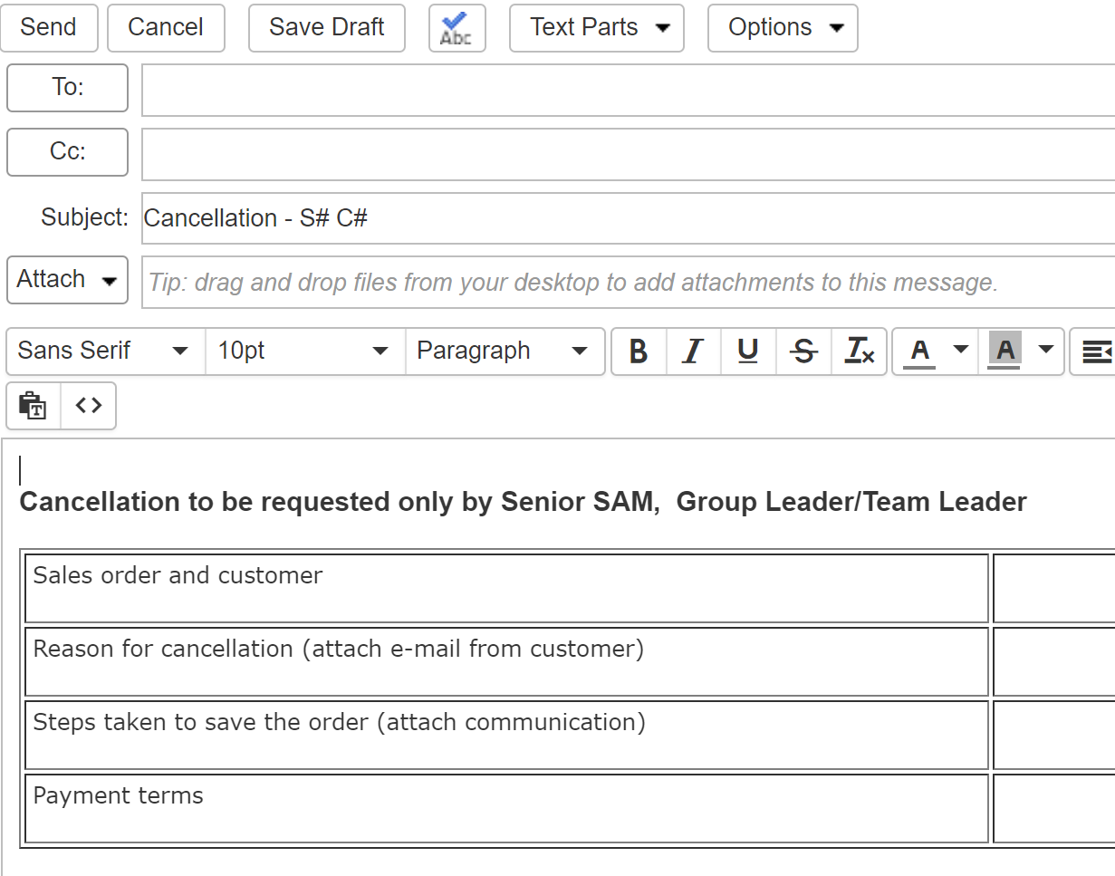
Text Parts “Order Cancellation”:
We will always try to save the order
Only Senior, Group or Team leader can request cancellation
Include description of what has been done to save the order

Slide 12
3. Responsible parts for mistakes
The most common causes of Aftersales are:
Factory error
Courier error
Completely unpreventable error (very rare)
Sales person error

Slide 13
4. Examples of potential mistakes
Sales person errors
We want to avoid mistakes and also spot mistakes made by customers.
Do not leave space for doubt or confusion: if something is unclear, ask the customer again to clarify.
The Aftersales team will have to answer the question “Was it completely unpreventable?” If the answer is “NO” then in most cases it means the SAM should have done better and the case will likely be marked as a Sales Mistake.

Slide 14
Most Common Sales Errors
Wrong VP supplied with order
Discrepancy between artwork and VP
Wrong details of order - Capacity, quantity, special requests missed in Job notes, etc. SAM often states USB 2.0 type instead of 3.0 type.
Delivery address - ALWAYS confirm delivery address. Do not suggest the address, but rather ask customer to provide it.
Wrong currency - Some customers might be based in different countries. If you know customer account is in EUR but order is in CHF, it will be marked as sales mistake.
Wrong quote sent for approval
Not taking the best care to meet deadline - There is a certain procedure to chase payments which must be followed. Customer must be informed what to do to meet deadline
DP screenshots not confirmed
Unclear communication with Operations /Graphics - Always keep communication and requests as clear as possible. Ops will reply back every time they make any changes for you - make sure they understood exactly what to do.

Slide 15
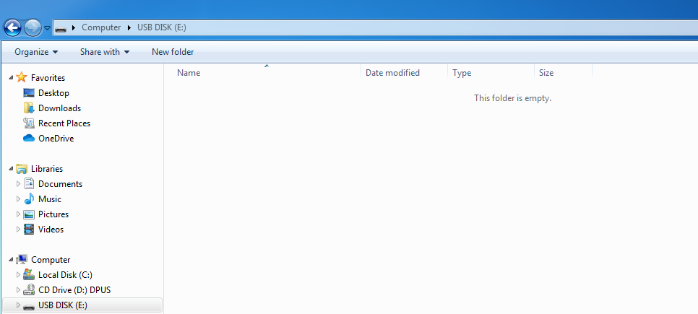
DPUS not explained

Slide 16
Completely unpreventable errors
As the name already suggests, these are errors which could not be prevented:
Names misspelled on the list provided by customer for individual engraving
Incorrect phone number is provided (or to a different branch)
Initial request from customer is wrong (perhaps their own internal miscommunication)

Slide 17
Remember!
If you ‘Save’ the order then want to change something (even if production has not yet started), it will be treated as a sales mistake – unless you can show proof it was a customer error / request.
Always check ALL details of the order BEFORE clicking ‘Save’ button!
Check that the final quote you send to the customer for confirmation includes all necessary services, product and accessories requested as well as the correct address.
Triple check all details before pressing ‘Save’ in NetSuite.
If a mistake is made, instead of panicking just reach out to your colleagues in Aftersales.
The Team / Group Leaders have the potential to re-instate commission for sales mistakes but this requires you to promptly report the issue and cooperate fully in the resolution process.

Slide 18
Further Reading
The Flashbay Wiki is an incredibly valuable resource and contains lots of information pertaining to past Aftersales cases and general product knowledge.
Good places to start are Aftersales Awareness and Product Knowledge
These resources are constantly updated so try to check and refresh your product knowledge from time to time.

Slide 19
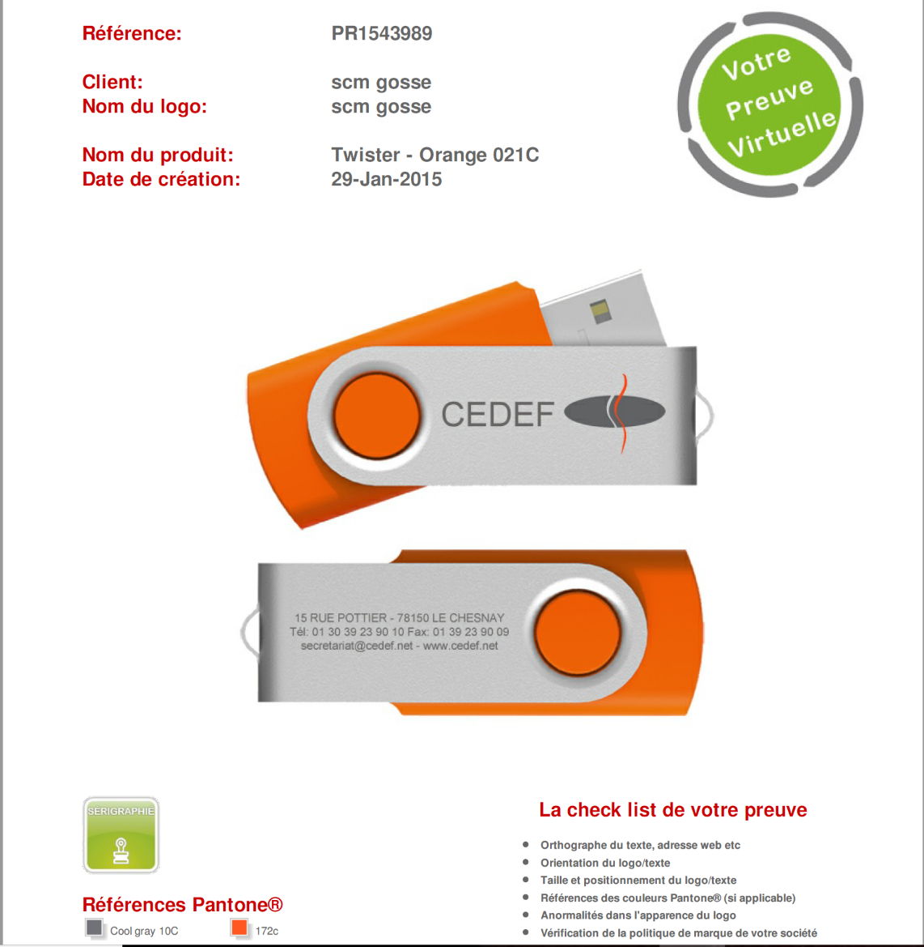
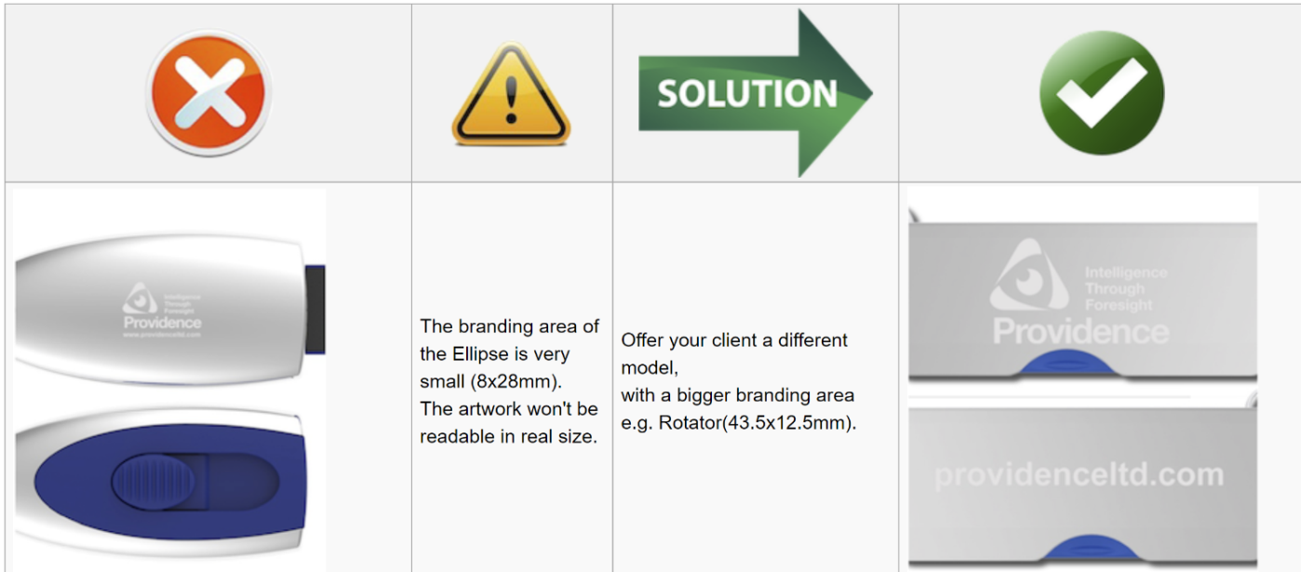
5. Case study
A) Flashbay expects our SAMs to provide full support to customers, whenever necessary. When a customer asks for a lot of print on limited space and it’s obvious print will be hard to read, the SAM should spot it and warn the customer. Perhaps a different model will do? Or change VP to have less details?

Slide 20
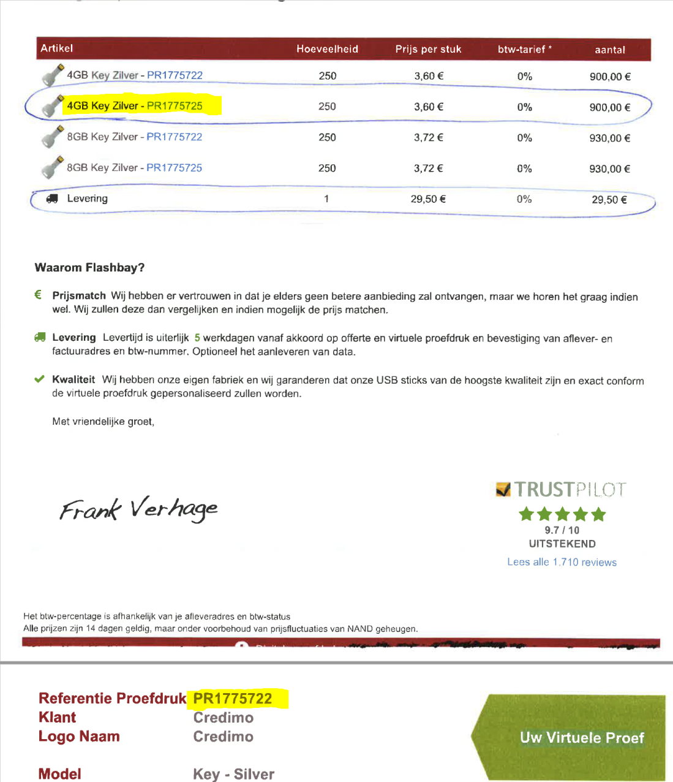
A SAM sent the customer a quote and two VPs. Customer resent a scan where they marked which VP they want, also a scan of signed VP. The problem was that they marked two different VPs.
What would you do?

Slide 21
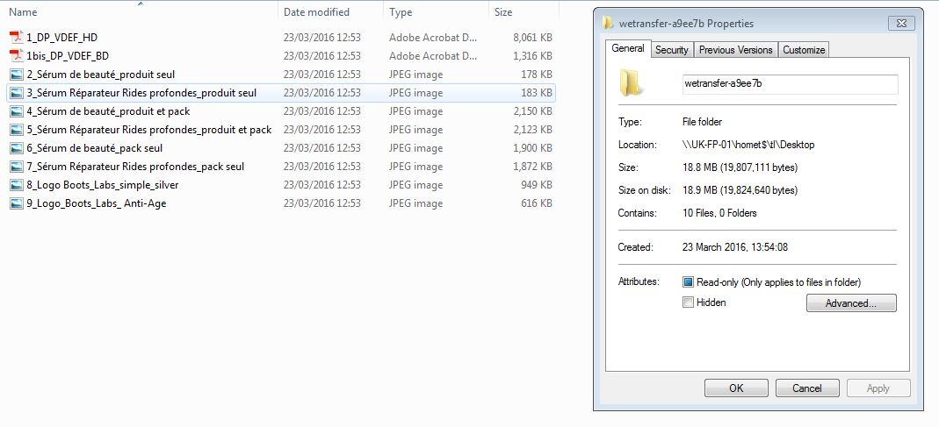
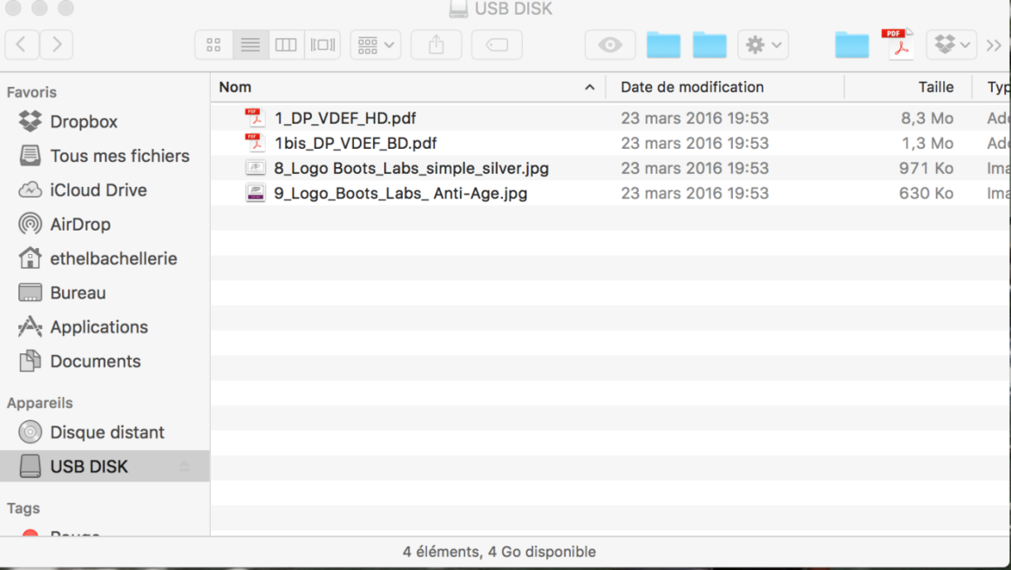
C) If customer zipped data for DP on Mac OS, it has to be unzipped on Mac as well, otherwise some files can be corrupted.
By default, all data is unzipped by Ops on Windows which is why a SAM must always check with the customer if the data was zipped on Mac and inform Ops accordingly. Below is an example where the SAM did not inform Ops about Mac data so it was unzipped on Windows.
All files worked fine on Windows, but… when you open the same USB on Mac, some files are not visible

Slide 22
D) Volume Label (VL) was required, but customer did not yet know what it would be. The SAM placed the order and in VL section wrote “TBC” - (meaning To Be Confirmed). However, the SAM did not inform Ops this “TBC” was not a real VL name so the factory produced the order and shipped to customer with VL “TBC”.
Correct procedure would be using Job Notes and ask Ops to wait for VL name to be confirmed, or even send additional e-mail to Ops asking for it.
DO NOT leave space for doubt. If you feel something might be confusing, make sure you explain clearly what needs to be done

Slide 23
GOOD LUCK!
We wish you very successful, problem-free sales!
☺

