Slide 1
DATA PRELOADING

Slide 2
Data Preloading
An additional service we provide to our customers.
Very handy if your customer’s order is quite large.
Necessary checks ensure the customer is receiving the products they ordered with the correct data.

Slide 3
Data Types
Mac Data will need to be handled by itsupport@flashbay.com
If you try to extract it yourself it will corrupt, not work properly or display incorrect data
The DP email highlights Mac data like this:
Windows data can be extracted on your desktops
If you are having trouble with unzipping data notify itsupport@flashbay.com
If you have no space on your computer you can move data into your public folder
Notes:
question 1 – Multi choice
What do you do when you receive Mac data?
1- Try and extract it yourself? 2-Tell the customer the data is incorrect and ask for windows data.
3- Send it to IT so that can extract it for you 4- Send to Operations for help
Answer
3- Send it to IT so that can extract it for you
Question 2 – multi choice
What happens if you unzip Mac data on your computer?
1- It will delete itself 2- It will corrupt the data
3- Nothing 4- it will up zip correctly
Answer
2- It will corrupt the data

Slide 4
Zipped DATA
We ask customers to zip all their data into one zipped folder before sending to us for preloading.
Makes it easy to keep related files together and makes transporting, downloading and storing data faster and more efficient.
Compresses the data into one file which we call an “Archive”.
Reduces the size of the data and also keeps data from being misplaced or lost.
Easier to transport the data as only need to send one file.
Notes:
question 1 – Multi choice
What do you do when you receive Mac data?
1- Try and extract it yourself? 2-Tell the customer the data is incorrect and ask for windows data.
3- Send it to IT so that can extract it for you 4- Send to Operations for help
Answer
3- Send it to IT so that can extract it for you
Question 2 – multi choice
What happens if you unzip Mac data on your computer?
1- It will delete itself 2- It will corrupt the data
3- Nothing 4- it will up zip correctly
Answer
2- It will corrupt the data

Slide 5
Data Preloading Guide
Step One:
Send the data preload link to the customer and request they upload their data to our FTP (our data server)
Note: Our FTP only takes up to 10GB of data, any data over that amount needs to be sent in to the office via USB
The customer should follow the steps ensuring that they have zipped the data. Note: we will only accept data in one complete zip folder
If the customer cannot upload:
Ask them to check the data for corruptions, rezip and resend the data.
If they are still experiencing issues ask them to send us the data via a USB instead.
Under very special circumstances we will accept 3rd party transfers from other sites such as WeTransfer or Filemail.
Notes:
Question 3 – multi choice Image
What are the accepted methods to acquire data from a customer?
(See images in word doc)
Answer
FTP and USB
Question 4 – multi choice question
How much data can a customer upload to our FTP?
1- 10GB 2- 20GB
3- 50GB 4- unlimited
Answer
1-10GB
Question 8 Multi Choice
What do you do if a customer has trouble uploading data to our FTP?
1- Straight away ask the customer to send in via USB 2- Straight away send to IT support
3- First ask customer to check data rezip and resend 4- Tell the customer to try again
Answer
3 First ask the customer to check data rezip and resend

Slide 6
Data Preloading Guide
Step Two:
When the customer has sent the data successfully you will receive an email with a link to the data.
If customer has sent Mac data forward to IT.
Note: If you try to download this data on your windows PC you will most likely corrupt the data.
If your customer has sent the data via USB then please hand over to IT.

Slide 7
Data Preloading Guide
Step Three:
Once you have the data on your desktop, check the data is correct.
Data from Flashbay FTP
Unzip the data on your computer
Take screenshots of the Properties and Root to confirm with the customer that the data is correct.
Data from USB
Data received via USB will already be unzipped and put in your public folder by IT.
Take screenshots of the Properties and Root to confirm with the customer that the data is correct.
Notes:
Question 5 – true or false
Before we send data to operations to be proceed we first check the properties and root with the customer.
Answer
True

Slide 8
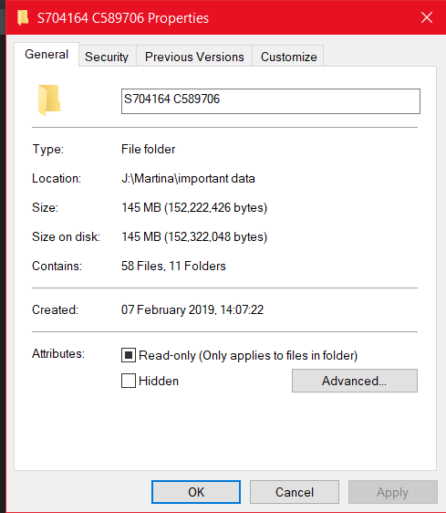
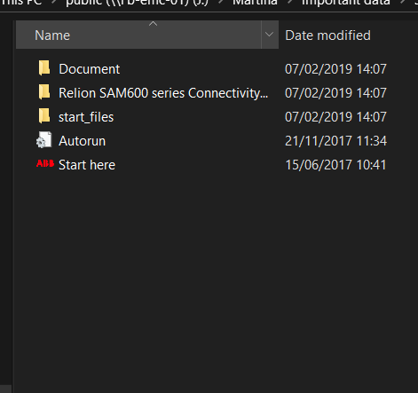
Data Preloading Guide
Properties:
Root:
Notes:
Question 7 Text Answer -
It is very important to check the properties &____________ with the customer
Answer
Root

Slide 9
Data Preloading Guide
Step Four:
Once the data has been confirmed by your customer, send it to Operations in China.
Rename the original Zip folder to the S & C number.
Send Screenshots of the Properties and Root so Operations can confirm that they have received the data correctly.
Provide any additional information to ensure Operations has all the information they need to fulfil the customer’s requirements.
Note: When emailing Ops please use the Text Parts we have provided to ensure you provide all the necessary information.

Slide 10
Data Handling Process
Send via Flashbay Website
Customer data
Data is downloaded to public folder
Extract data
Confirm Properties & Root with customer
Confirm Properties & Root with Ops
Send original data through FTP to Operations & confirm
Send in Via USB
Notes:
Question 6 – match Image with label
Below are all the steps of the data preloading process. Put them in order from first process to last process.
(see images in word doc)
Answer
1 customer data
2 send via Flashbay Website / USB
3 Data is downloaded to the public folder
4 Extract Data
5 Confirm properties and root with customer
6 Confirm properties and root with Ops
7 Send Original Data through FTP to Operations and Confirm

Slide 11
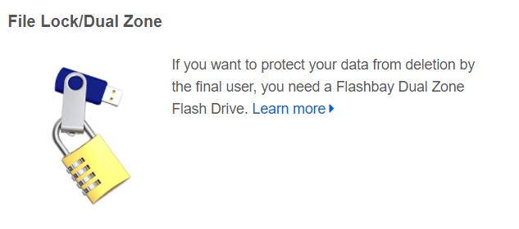
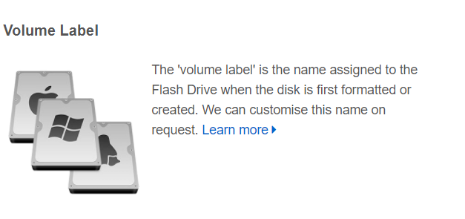
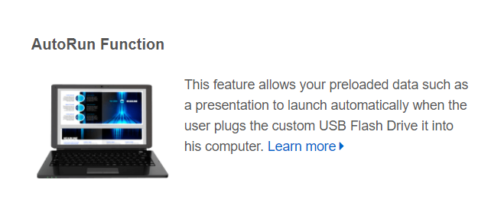
Other USB Services

Slide 12
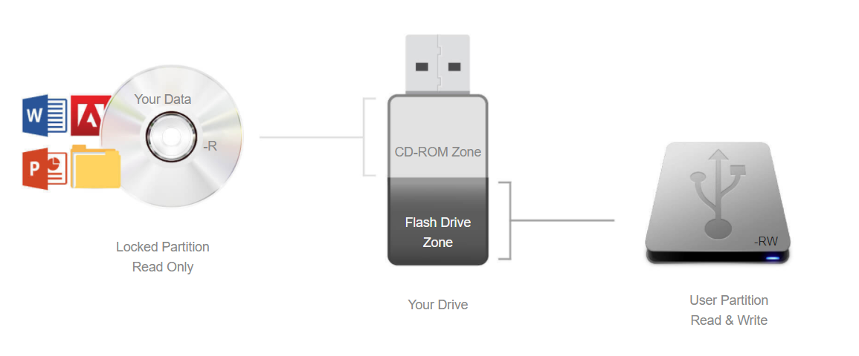
File Lock / Dual Zone
Flashbay Dual Zone Flash Drive – prevents deletion by final user.
This special Flash Drive unites the flexibility of a standard USB Flash Drive with the Read-only nature of a CD-ROM.
When you insert the Flash Drive into your USB port, two drive icons will appear: one is for the Read-only CD-ROM zone and the other for a standard removable drive (user area).
Your 'hard-coded' data is on the CD-ROM zone while still giving users the ability to use the 'Flash Drive zone' as a regular Flash Drive.
Notes:
Question 12 true or false -
When we file lock a USB the drive is split into two Partitions, a read only CD partition and a USB partition
Answer
True

Slide 13
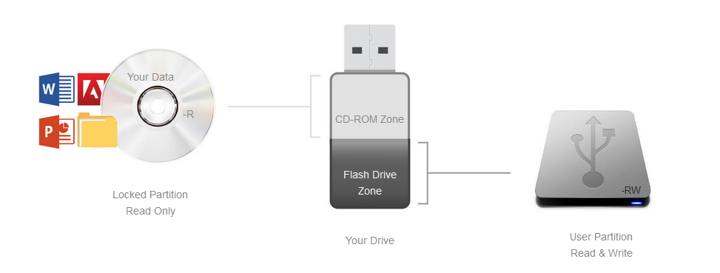
DPUS
Splits the USB into a CD partition and a USB partition
CD partition contains files that are Read only; the USB partition can either be locked or unlocked
The CD partition will not work on devices such as TVs
Need DPUS for Autorun to work
Notes:
Question 11 multi Choice-
What is DPUS?
1- The process we use to do the file locking service 2- The process we use to do Autorun
3- The process we use to do the volume labelling 4-The process we use to do Data Preloading
Answer
True

Slide 14
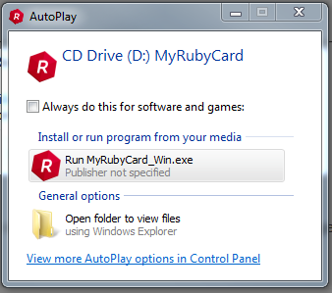
Autorun
Autorun is a Windows feature that allows programs to run automatically.
It doesn’t work for any version of Mac OS
It was taken advantage of by malware writers with instances of users plugging in a USB only to find they had infected their computer.
Modern operating systems have now disabled Autorun by default. It may work on some Windows operating systems, however, it will only launch a pop-up window and the user will still need to click to run the program.
If customers request this feature, make them aware that it is not guaranteed to work
Notes:
Question 9 True or False –
Autorun works fine on Mac Operating Systems.
Answer
False

Slide 15
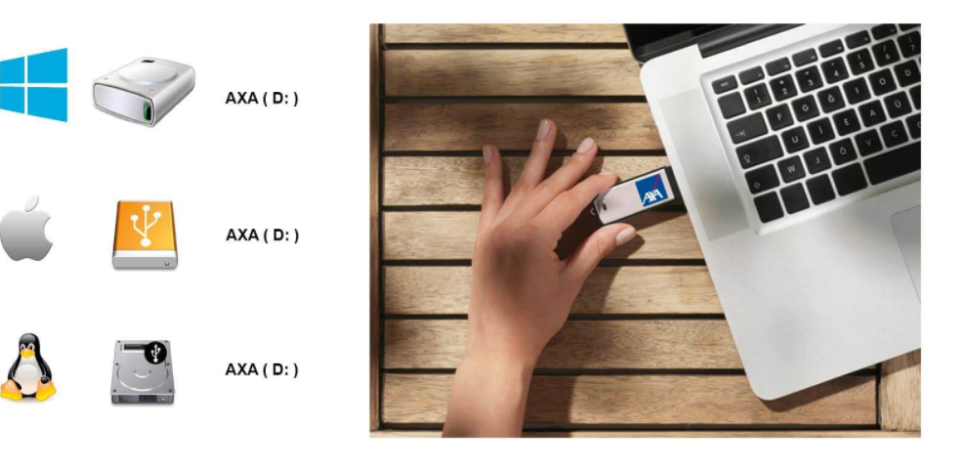
Volume Label

Slide 16
Storage Capacity
 | Photos | Music | Films
2GB (1.86GB or 1905MB) | 952 | 476 | 3.81
4GB (3.72GB or 3809MB) | 1904 | 952 | 7.62
8GB (7.44GB or 7619MB) | 3809 | 1904 | 15.24
16GB (14.88GB or 15237MB) | 7618 | 3809 | 30.47
32GB (29.76GB or 30474MB) | 15237 | 7618 | 60.95
64GB (59.52GB or 60948MB) | 30474 | 15237 | 121.90
128GB (119.04GB or 121897MB) | 60948 | 30474 | 243.79
Notes:
Question 10 true or false -
A 4GB USB can store 4GB of data on it
Answer
False

