Slide 1
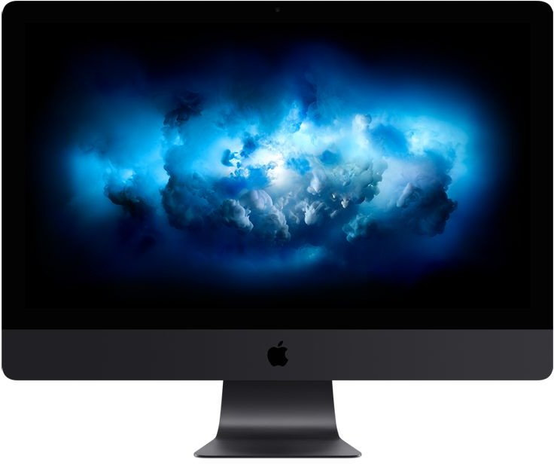
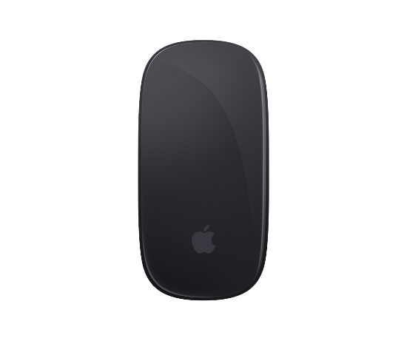
Introduction
After this training you will be able to identify basic printing techniques and terminology needed for your daily work and cooperation with Virtual Proofs, Graphics and Operations.

Slide 2
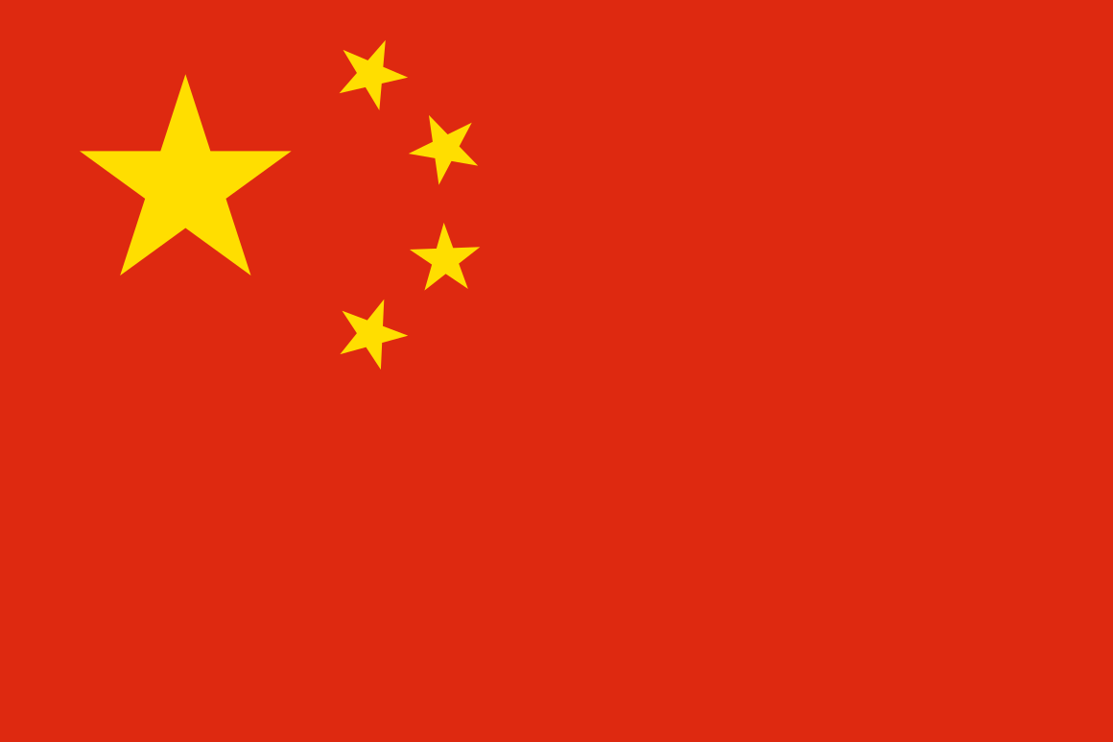
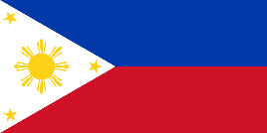
Your VP request
Virtual Proof Structure
There are a lot of Graphic Technicians behind your Virtualproof mailbox you usually sending your Virtual Proof requests daily. See on the diagram how whole structure is organised – two teams of CN VP and PH VP sharing the workload.
Whole VP making process is supervised so you can contact Bartek, bartek@flashbay.com, in order to get your VP right.
VP Mailbox
CN Team
PH Team
Bartek - supervising

Slide 3
Helping with Virtual Proofs
Fonts
All your Virtual Proof requests have to be submitted to Virtualproof Mailbox – they are your first initial contact. Those three categories listed here are major help points we can provide you with your artwork from client.
When comes to Fonts we are able to produce print ready PDF files with desired typed text or phrase (or the one client described) so it is matching main logo or artwork making your VP seamless and consistent.
Artwork is not always perfect in order to print but we can still help you with it by making it better, sharper, by redrawing it manually using skills and special software so you can use it for future orders.
Not all the time Colours are accurate since we are using PANTONEs for print hence sometimes colours are not exact – we can help you sort you all those issues.
Anything related to font types specified or requested by client or you need to match text to customer’s artwork
Artwork
Blurry logos, not sharp elements that can be redrawn manually as a last resort
Colours
Any problems related to colour spaces translations from client’s artwork or not perfectly illustrated shades on VPs

Slide 4

NO
Transparency
Things we cannot print
There a lot of element of artwork we can print using our SPR technique, but more important is to know what are limitations of this process.
Since PANTONE paint is very thick we cannot print any elements containing transparencies (like 50% of the colour), gradients (one colour seamlessly transforming into another, like for example dark blue going into light blue) and shadows (since paint is 100% opaque).
NO
NO
Gradients
Shadows

Slide 5
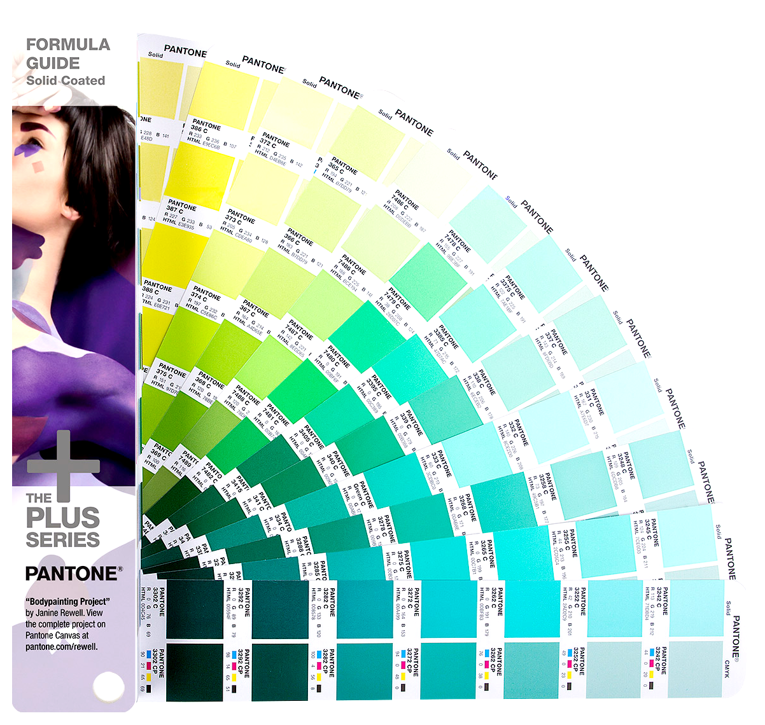
PANOTNE colours
Back in the early 1960s, Pantone was a printing company in Carlstadt, New Jersey, with a specialty in colour charts for the cosmetic, fashion, and medical industries. Lawrence Herbert joined the company in 1956 and noticed how difficult it was for designers, ad agencies, and printers to communicate—identifying exact colours from names alone is tough. Mistakes happened, there were tons of inefficiencies due to reprints. He bought Pantone in 1962 and launched the first PMS guide in 1963 with 10 colours in an effort to reduce the number of variables happening in the printing process. Creating an objective, numeric language means that any printer anywhere in the world can accurately produce a colour.
In our factory we are using one particular type of PANTONE which is called Coated (which is distinguished by letter C at the end of the name, like 485 C).
PANTONE Coated ensures & prevent wear & tear due to having oil mixed with the paint – that also adds a nice effect of shine on the print matter.

Slide 6
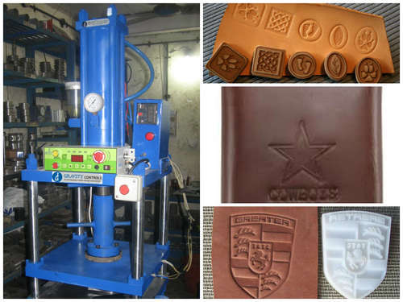
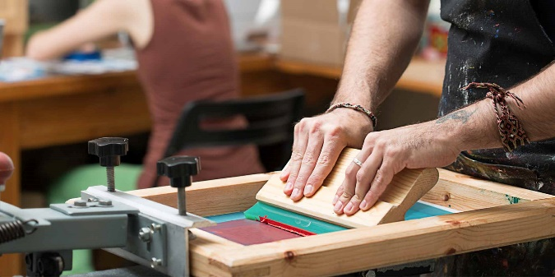
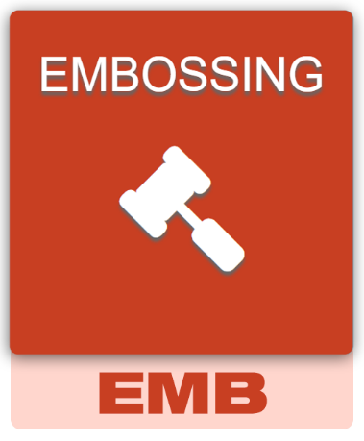
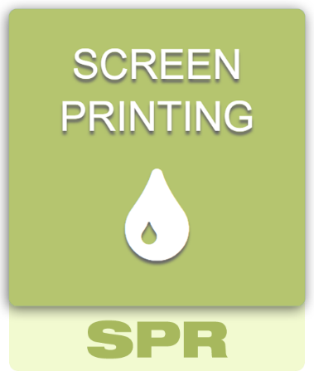
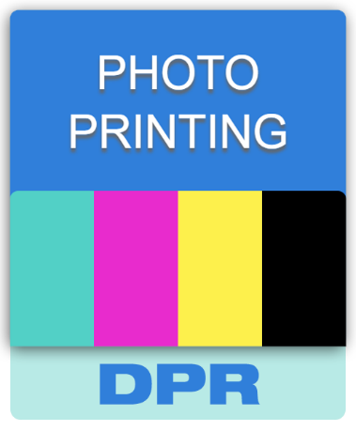
Branding Methods
Some of the branding methods got its limitations when comes to print like in SPR we cannot produce very small text (below like 4pts) or very detailed artworks, ENL cannot reproduce tiny elements (but better with detailed artworks) and EMB method will not work with small lettering or very detailed elements.
We have got main 4 branding methods that we can use on our products:
We can mixed methods on our models but only on opposing sides of the product – like for example SPR on front of the unit and ENL on the back.

Slide 7
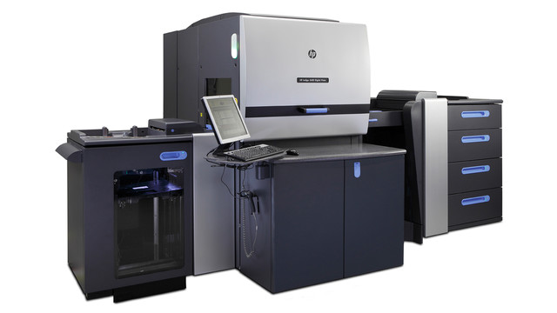
Digital print
Our DPR method is very efficient when comes to print artworks on models like Wafer or Fin models.
We are using HP Indigo machines that can utilise up to 800dpi of an artwork if needed with vibrant colours and accurate sharp print outputs.
Please make sure when obtaining digital print artworks from customers that it has to be in CMYK and at least in 300dpi resolution.

Slide 8
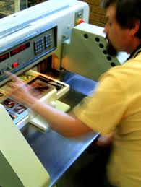
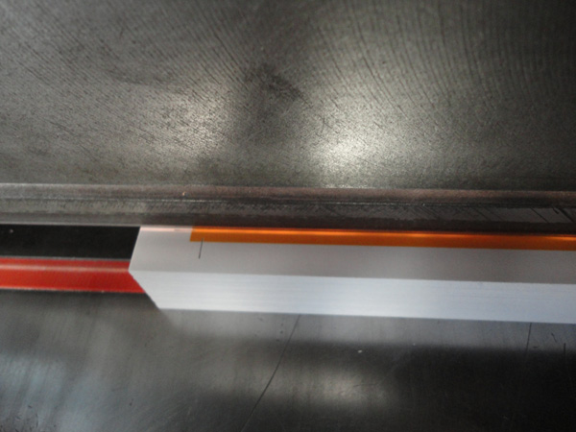
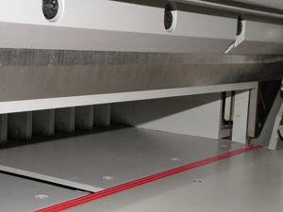
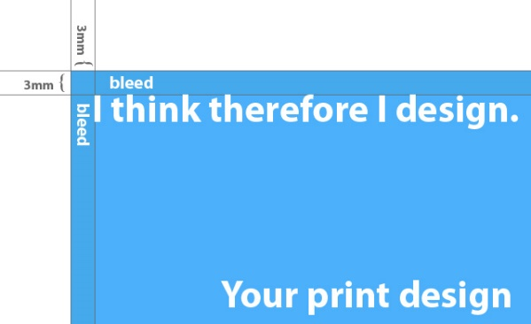
Bleeds in digital print
Due to the nature of the digital print and especially cutting the sheet of paper after print to desired size – bleeds are the invention that saves money, time and speed.
Bleeds are excessive amount of artwork (around 3mm) around desired size in order to ‘cut out’ so we do not see any white paper edges and whole print area is covered.

Slide 9
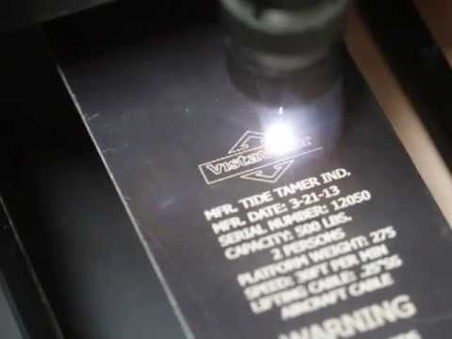
Laser engraving
This method is perfect when comes to durability and presentation effect: physically ‘damaged’ surface by powerful laser carving through metal or wood makes customer’s artworks long lasting and with interesting visuals.
Laser beam used for ENL method is very thin (like human hair in thickness) hence it can reproduce very detailed artwork elements and sometimes it can produce much more sharper and elegant look than for example screen print method – hence sometimes ENL is a good choice in oppose to SPR offered to client.
ENL method also offers special service like Individual or Personalised Engraving when you can make separate individual engraved elements on each VP, very useful for individual names or text from the given list or file.

Slide 10
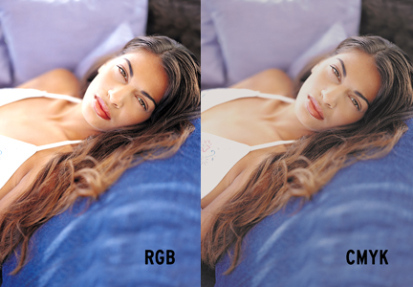
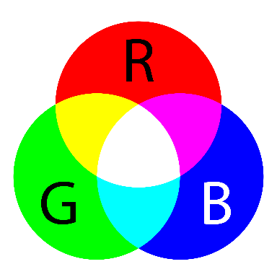
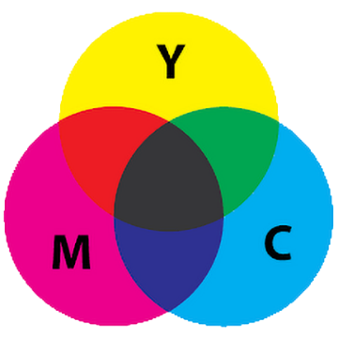
Why colours on screen are different than on print?
Those are two worlds: one is created based on emitting light and mixing three basic colours: red, green and blue in order to create vivid images, other one is build on purpose of ‘covering’ white sheet of paper with mixture of four basic print shades: cyan, magenta, yellow and black. RGB is more vibrant whether CMYK is more toned down.
For our DPR print purposes we are using pure CMYK colour palette and files for outputting.

Slide 11
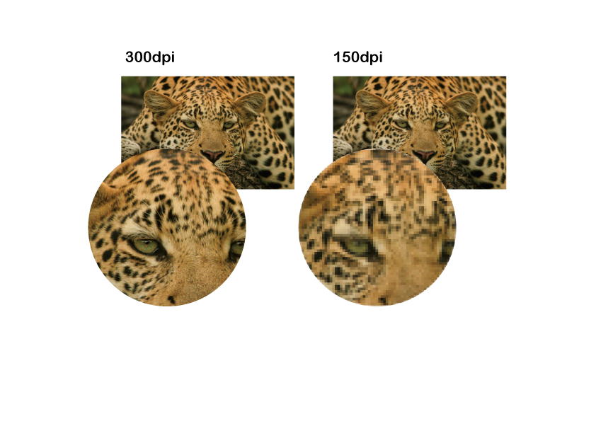
Resolutions
300dpi
150dpi
There are both worlds: world of screen images (the ones you can see on any screen like TV, mobile, laptop or tablet) and world of print (anything you can hold and see printed matter). Those both world got two different way of creating image on it.
Screen are made of squares as well as print – those dots are defining and building image. Screens got only 72dpi: 72 small dots in an area of 1 square inch – small amount since we are not sitting so close to screen. For print is a different story – 300dpi is the minimum – that amount of dots will assure that our eyes will not see separate dots that made that image.
DPI stands for Dots Per Inch where number indicate physical ‘dots’ amount in area of 2.5 x 2.5cm (1x1inch).

Slide 12
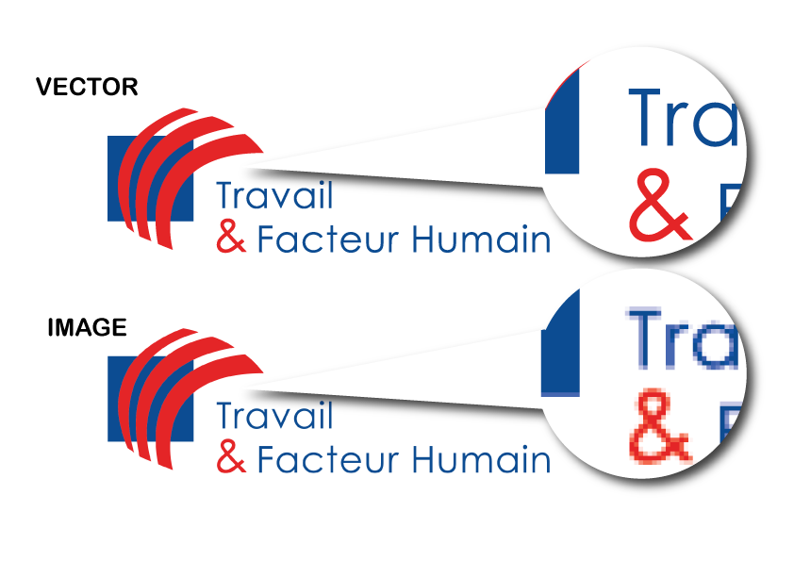
VECTORS
Sharp or not?
Most of the artwork obtain from customers are vector or rasters (images). Vectors are the best solutions when comes to logo and graphic elements like letters or shapes – they are mathematical formulas created by software hence they always will be fine and sharp (they build on the spot, while you looking on it).
Rasters (or images) are built from small squares (pixels) which are fixed in size hence they quality are defined – they cannot be enlarged without loosing quality – when you can do this with vectors.
Hence vectors are more desirable.
RASTER

Slide 13
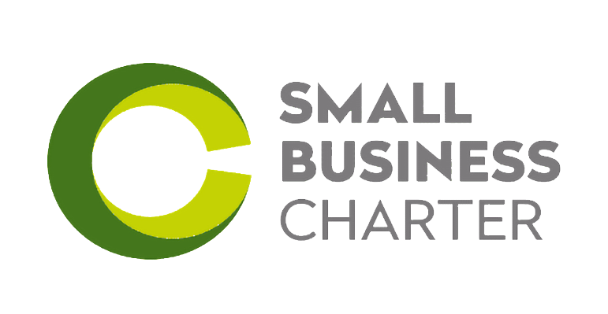




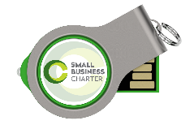
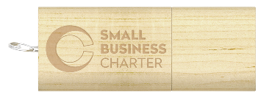



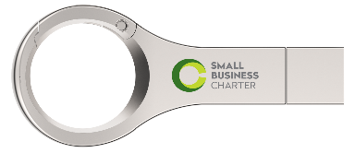



3 colour logo
Make it better!
Logo shown here is a good example of clean and sharp shapes that will need all those three conditions below fulfilled to make it look nicely!
This showcase will indicate good and bad sides of placing Customer’s artworks on our units as well how to make them stand out from the crowd to achieve almost instant orders!
MODEL CHOICE
COLOUR CHOICE
LAYOUT CHOICE
Changed colour
for better visuals
Good contrast and visibility for whole artwork
Good model choice is perfect relation of size of the artwork to the unit
Analyse artwork colours carefully and match to the model to create seamless look
Observe the layout of the artwork and model print area. Good choice of print area makes artwork eligible
For more ‘rectangle’ shaped artwork choose more ‘rectangle’ shaped print areas
Engraved (ENL) models also make a nice change like this wooden unit
Sometimes artwork can be presented in condensed form
Also background can be done like this
Logo can be adjusted to be engraved by combining colours and shapes
Always pay attention to print areas: sometimes different layout will help increase visibility greatly
Be aware that on small models artwork will be proportionally smaller as well
Similar and too contrast colours create unclear and not visual strong appearance
Those colours are not a good combination (creates contrast and ‘eye-tiring’ effect after print)
This artwork will might not work nicely apart from logo being small on it – artwork is ‘tall’ where you can still utilise whole print area
Too small to see it clearly

Slide 14
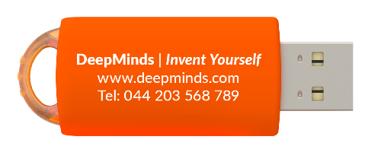
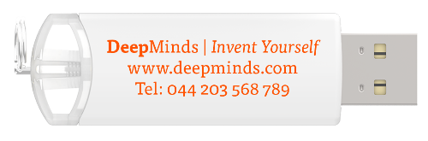
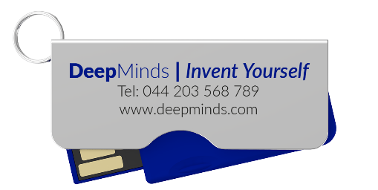
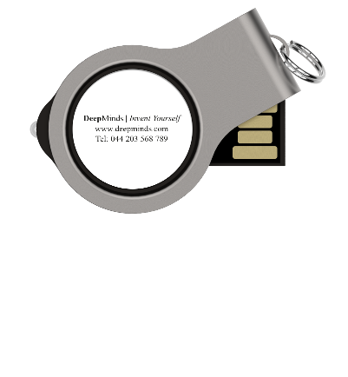
Simple artwork made out of text (popular font Times New Roman)
Make it work!
Artwork shown here is a example of only text and simple elements combinations in case your Customer has no defined logo / artwork options.
This showcase will indicate good and bad sides of placing Customer’s artworks on our units as well how to make them stand out from the crowd to achieve almost instant orders!
MODEL CHOICE
FONT CHOICE
LAYOUT CHOICE
Please consider using whole available brand areas to promote your brand better
If Customer have not defined specific font type or model – nothing stops you to make it look better!
Font: Tisa
Observe the layout of the artwork and model print area. Good choice of print area makes artwork eligible
Try to avoid putting logo or artwork on its own where we have big print areas like DPR models – otherwise we are wasting potential of our units and brand areas
Always pay attention to print areas: sometimes different layout will help increase visibility greatly
Font: Lato

Slide 15
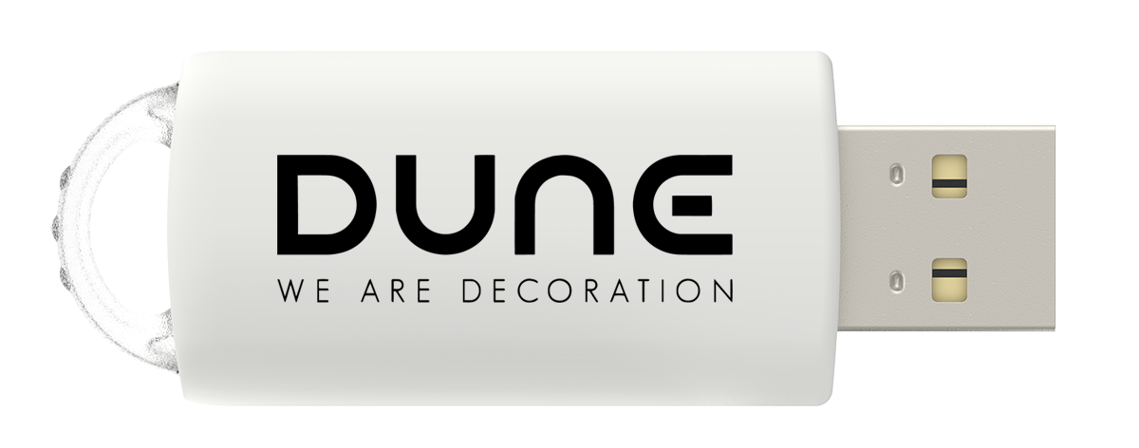
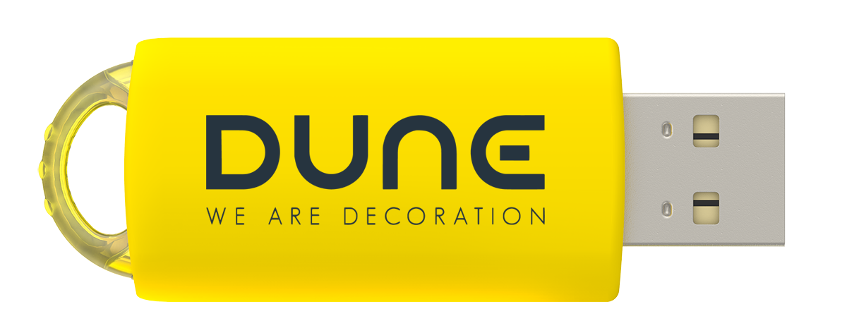
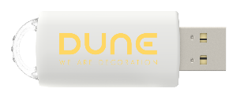
What customer sent:
We like your idea!
How easy is to make simple change to make everything looks much better? See below on attached examples:
What customer sent:
Nice usage of contrast: yellow drive and off-blue shade of logo makes it stand out!
Looks boring a bit, putting yellow on white will render logo almost invisible like this:
We’ve used standard Yellow PANTONE shell (not matched one) to reduce unnecessary costs and dark blue colour setup to create perfect contrast!

Slide 16
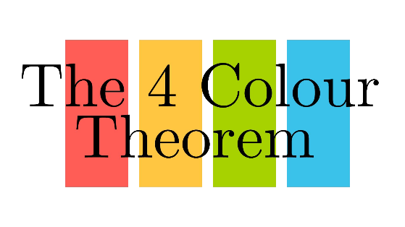
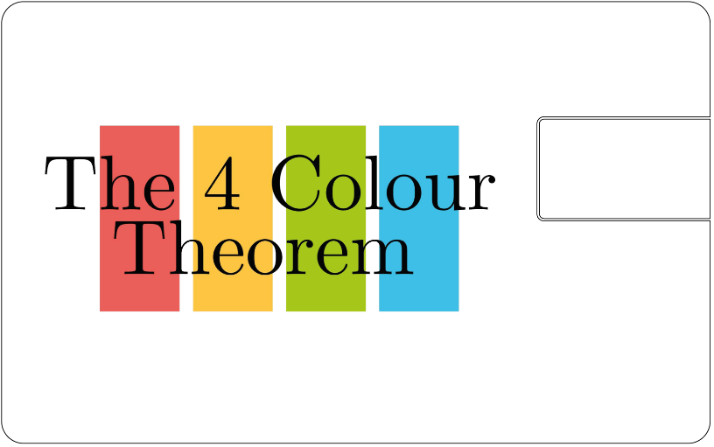
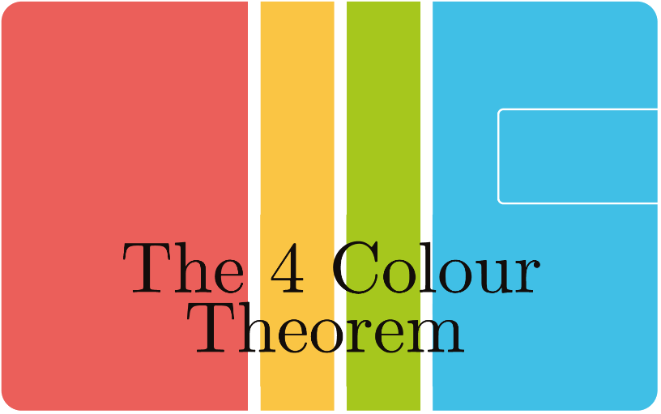
What customer sent:
We like your idea!
How easy is to make simple change to make everything looks much better? See below on attached examples:
Don’t be afraid to experiment with colours and layout – few ideas and creative touches makes this almost an instant Sales Order!
What customer sent:
By just putting logo on the WA for example there is no ‘wow’ impact created with such nice branding area provided!
This 5 colour logo will be hard and costly to put on SPR mode hence digital print choice is the best effective way of displaying Customer’s artwork in full!

