Slide 1
Welcome to Flashbay

Slide 2
It all started in a flat in 2003

Slide 3
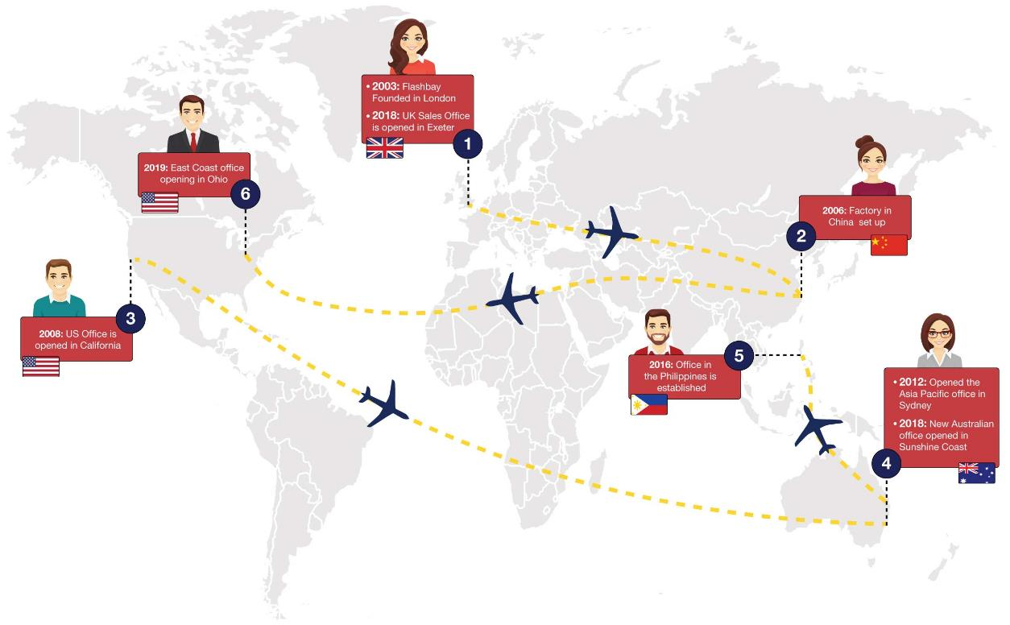
The Development of our Worldwide Presence

Slide 4
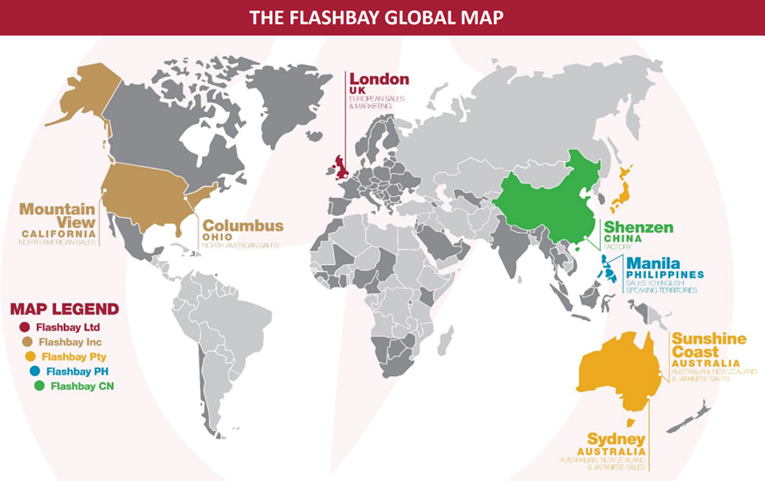

Slide 5
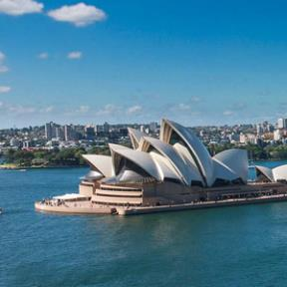
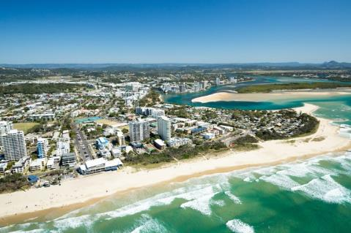
Our Global Offices

Slide 6
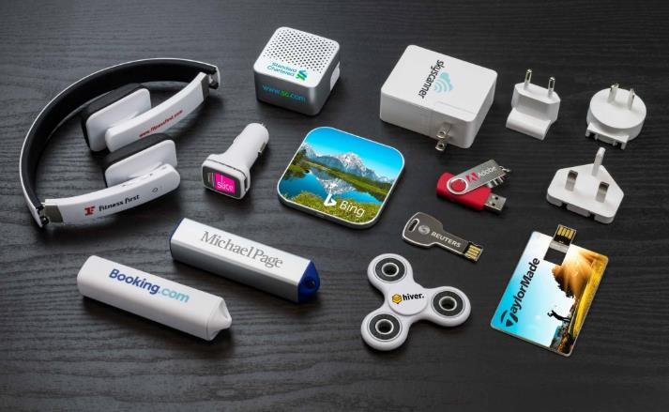
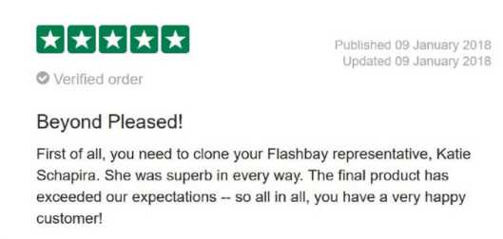
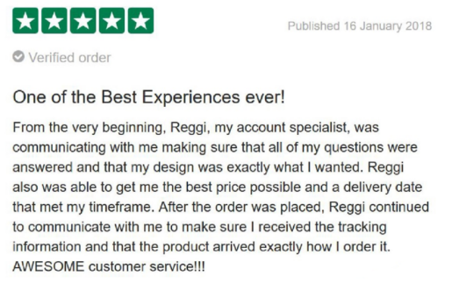
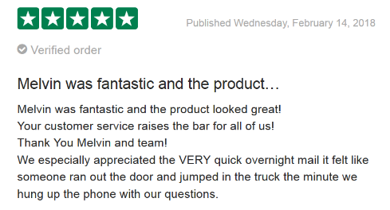
Flashbay Today
+2,000,000 products manufactured and sold every month
+800 employees worldwide
7 International offices
15 Languages spoken
9.9/10 Average rating on TrustPilot

Slide 8
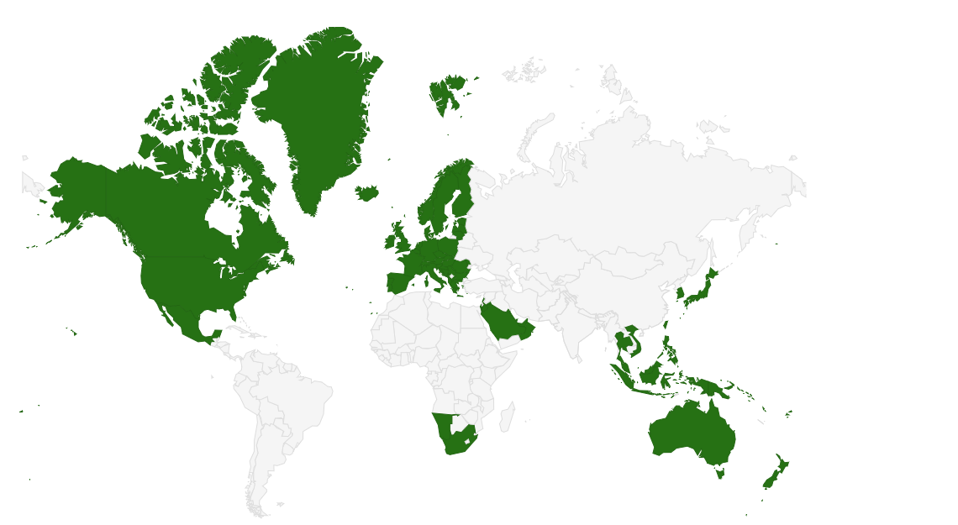
Countries We Sell To

Slide 9
15 Sales Languages

Slide 10
Nationalities in our Global Offices

Slide 11
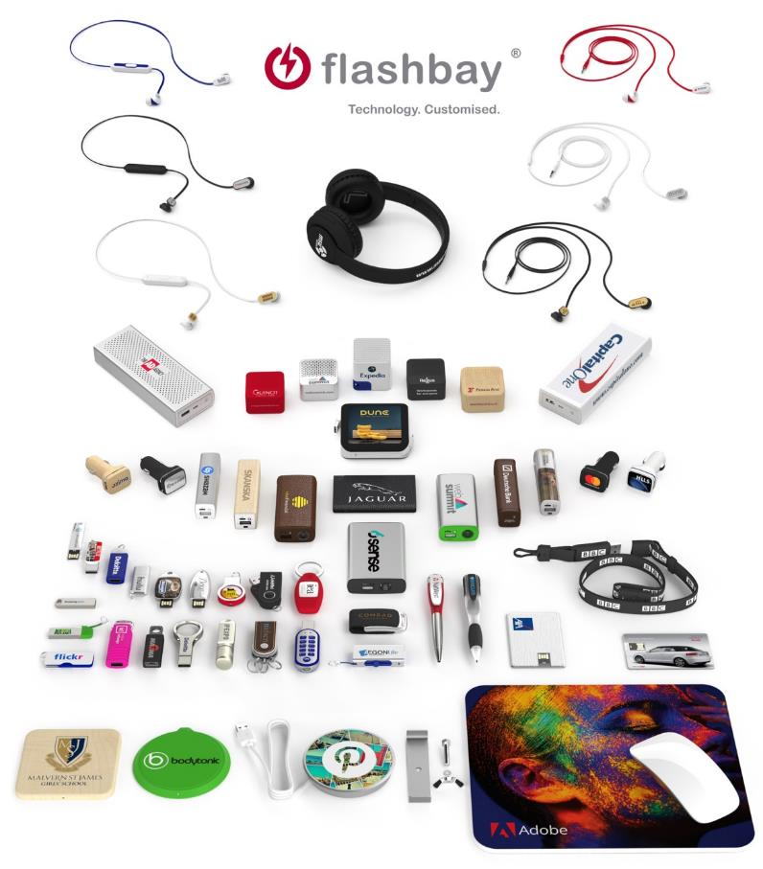
Our Products

Slide 12
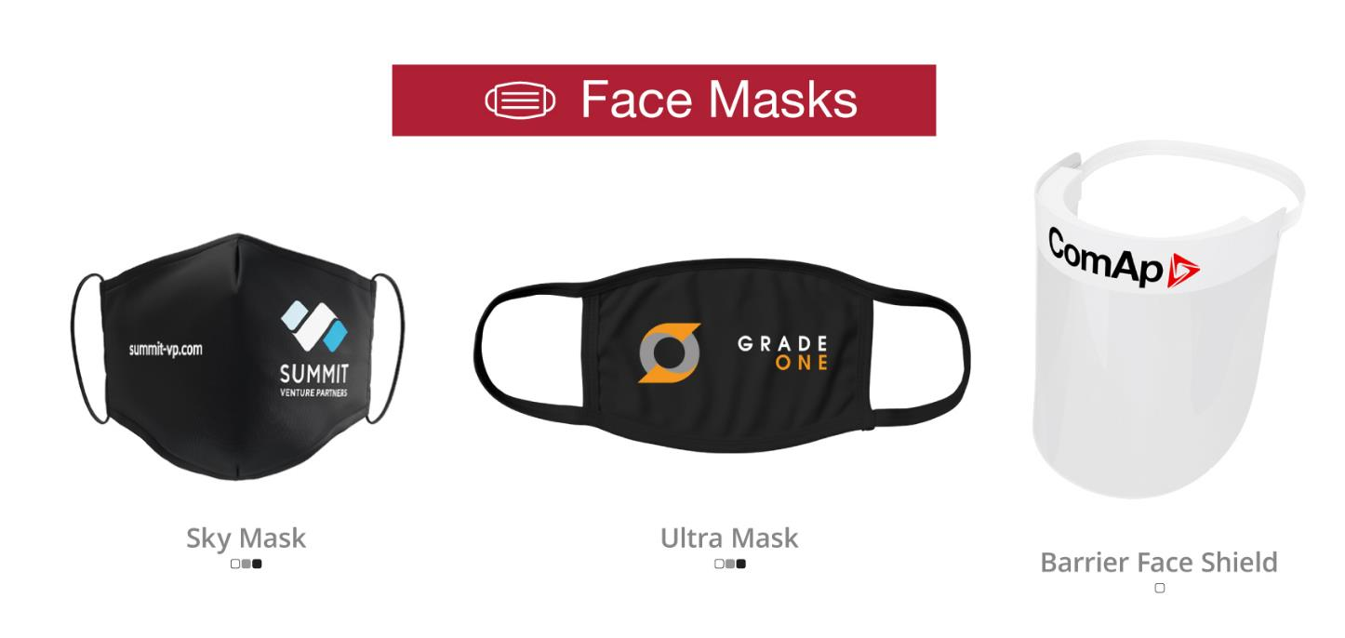
Latest Products

Slide 13
A Handful of our Clients

Slide 14
Logo Club!
What is it?
Our website and marketing materials feature many logos to advertise the variety and calibre of companies we work with, as well to showcase our most attractive products and designs. We are looking for Sales to secure the express permission of customers to utilise their logo on our website and marketing materials. For each successful email permitting logo use receive, the responsible salesperson will get a bonus amount as advised, provided the logo is accepted into the Logo Club.
Have a look at the #logo_club channel on Slack! - £10 per successful submission !

Slide 15
Flashbay Office layout
LIFT
SUITE 1
SUITE 2
SUITE 3
STAIRCASE
MAIN DOOR
One Way System
CORRIDOR
RECEPTION
STAIRCASE
SUITE 6
Sales Teams
SUITE 5
SUITE 4
SUITE 7

Slide 16
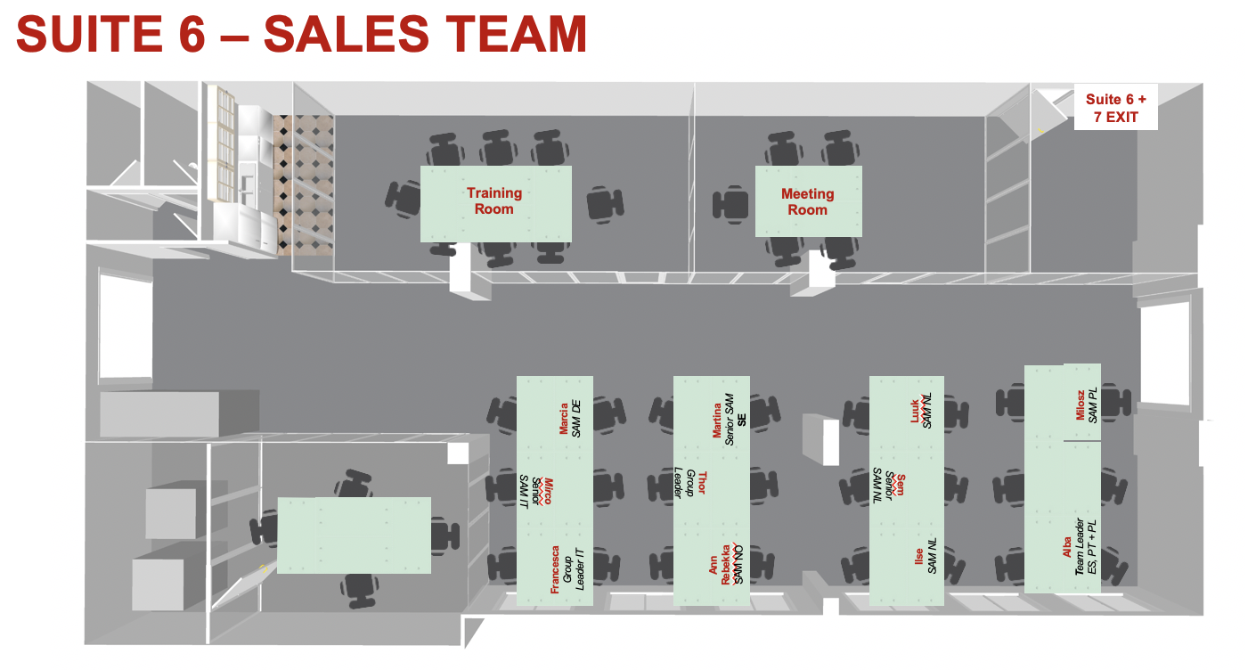

Slide 17
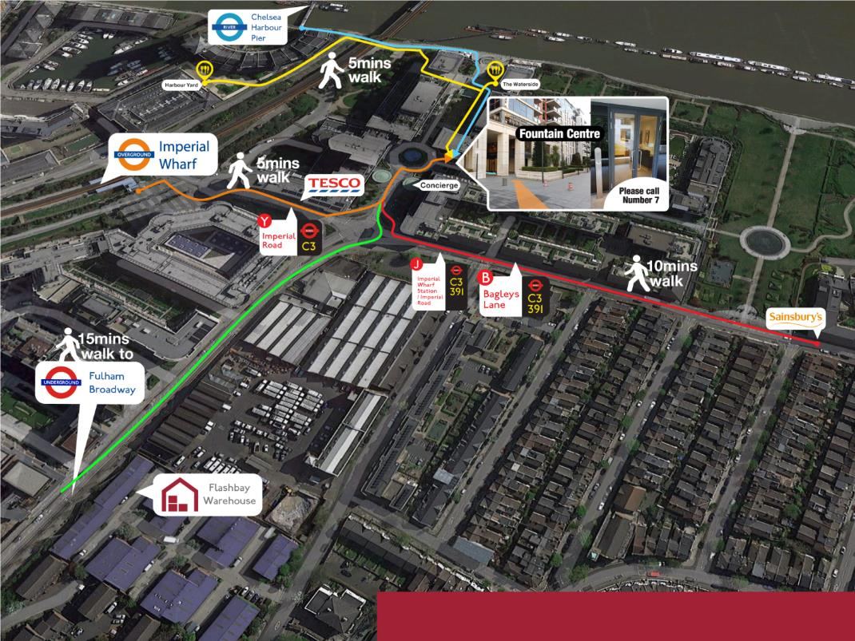
What’s in the area?

Slide 18
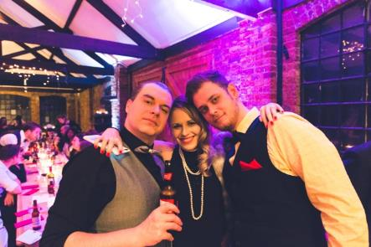
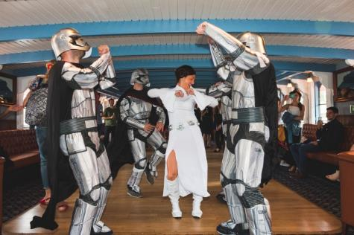
Social events

