Slide 1
Sales Mistake Awareness
When going through this learning pack we advise you take notes in order to really solidify this content. It is imperative you know our product range off by heart when dealing with customers.

Slide 2
What are the most common sales mistakes?
Data Handling Error
Miscommunication
Sales Order Entry Error
Virtual Proof Error
During the training we will be looking into how you can avoid the most common sales mistakes and keep your customers happy.

Slide 3
1. Sales Order Entry Errors

Slide 4
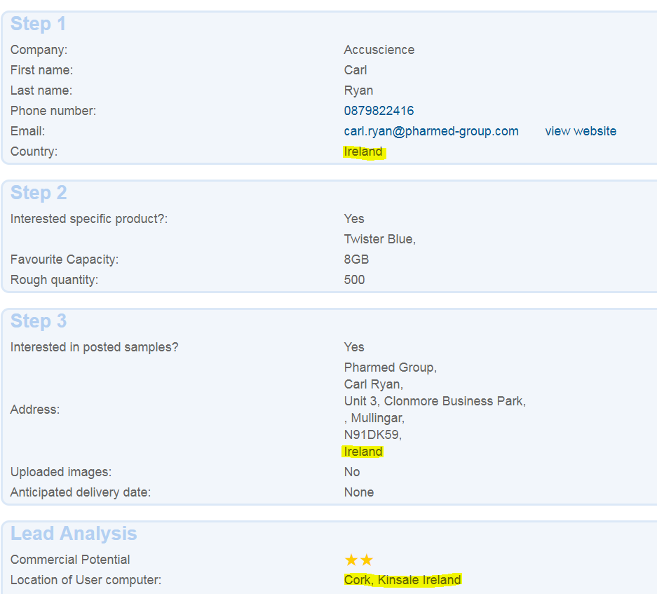
1.1 Wrong Currency for New Leads
Territories most commonly affected:
Switzerland – preferable currency CHF
Ireland - EUR
Northern Ireland - GBP
Solution: When you receive a New Web Lead you should check ‘Location of User Computer’ in the online form so you can tick the correct Primary Currency on NetSuite and in the quote.

Slide 5
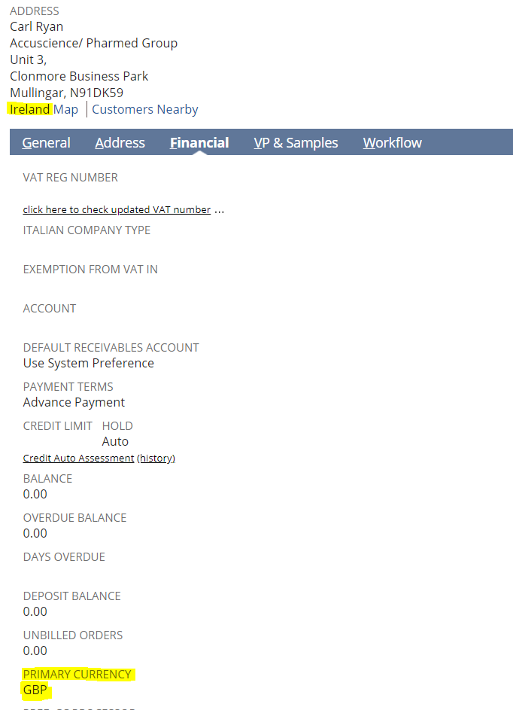
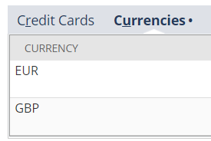
1.2 Wrong Currency for old Leads/Customers
Scenario: The Lead was by mistake saved in NetSuite with GBP as Primary currency under the Finance tab. The quote was created correctly in EUR.
When uploading the quote to a NetSuite Sales Order the unit price will automatically switch to the Primary currency, in this case GBP.
Solution: If the lead is already in NetSuite or it’s an existing customer you should always double check the currency before quoting or placing the order.
Exception: In some rare cases your customer might request to be billed in different currencies for each order, there is an option to add several currencies in the Financial tab.

Slide 6
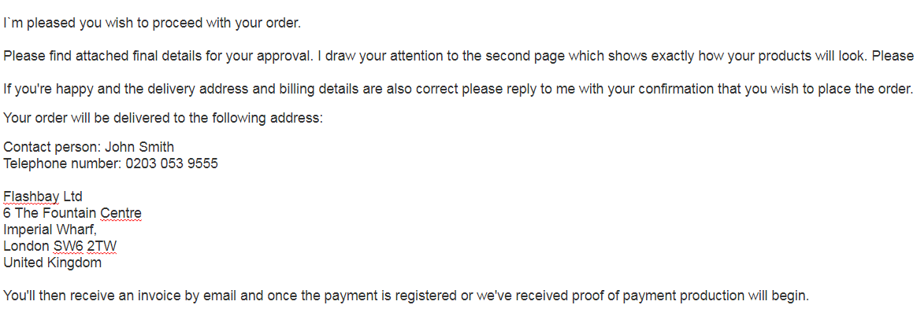
1.3 Incorrect Shipping Address
Scenario: Order from a returning customer is placed in NetSuite with the same shipping address as their previous order. However the customer has moved or wishes to have it delivered to a different location. SAM did not double check the delivery address with the customer.
Solution: Order details confirmation email should without exception be sent to both new and returning customers. The email should include the shipping address and a complete quote of the order the customer needs to confirm prior to you placing the order in NetSuite. For repeat enquiries it is better to outline the delivery address in the email body.

Slide 7
1.4 Replacement order entry error: Incorrect format
Scenario: The order was delivered with an incorrect Virtual Proof and a replacement order has to be placed.
Below instructions were provided by Aftersales for the new order with correct Virtual Proof.
Replacement: When placing the replacement order the SAM did not check the original Job Notes and the important formatting request from the customer was missed resulting in another aftersales mistake.
Solution: When placing a replacement order you should always double check the original order to make sure valuable information isn’t missed.

Slide 8
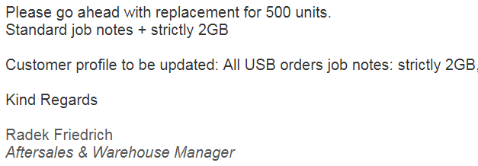
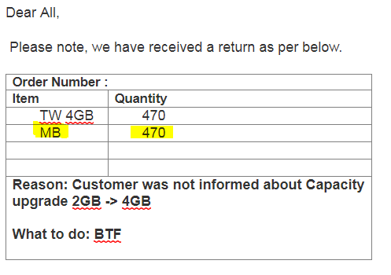
1.5 Replacement order entry error – Missing accessories
Scenario: The order was upgraded to 4GB, however the customer could not accept an order larger than 2GB and returned the order to us.
Solution: The original aftersales case could have been avoided if SAM double checked the Excel list provided by operations on a daily basis on #sales_global.
The second mistake was done when SAM didn’t verify if the customer returned the accessories along with the USB Flash Drives and the replacement order was placed without Magnet Boxes (MB).
Aftersales provided the following instructions for the replacement order:

Slide 9
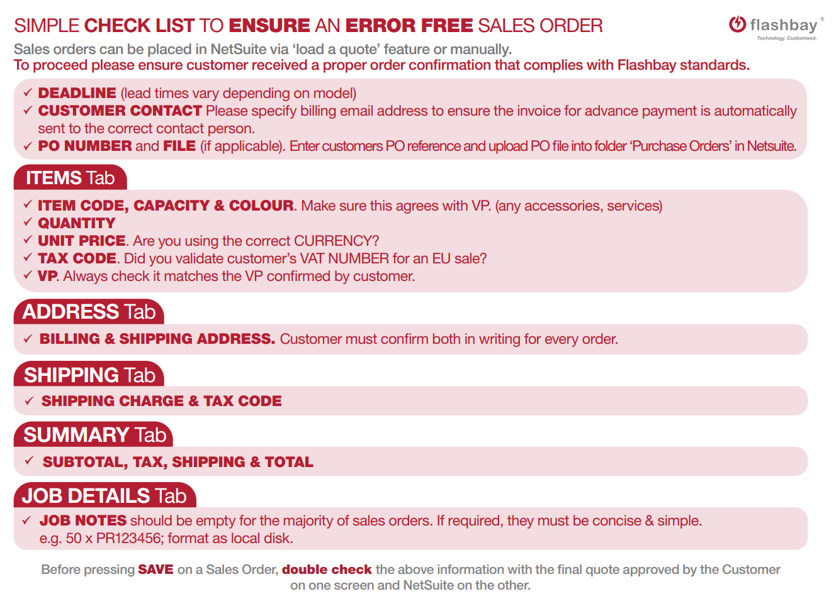
1.6 Replacement order
Sales Order Check List should also be used when placing an order for an existing customer, in addition to looking up the previous order in NetSuite please double check:
Quantity
Capacity
OTG Connector type
Service
Accessories
Shipping address
Job Notes
The same rule applies for replacement orders.
The aftersales team will only provide instructions sufficient to resolve the original issue for the replacement order.

Slide 10
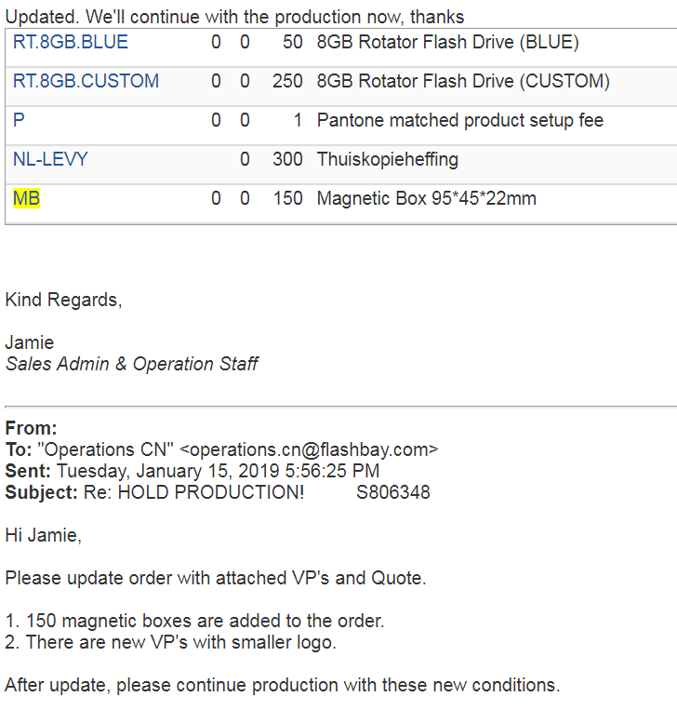
1.7. Wrong item line convention
Scenario: After the sales order is placed the customer made a change asking for 150 Magnet Boxes to be added to the order of 300 USB Flash Drives with 2 different Virtual Proofs
Solution: Before you contact Operations you need to clarify the following with your customer:
Is it correct that they only want Magnet Boxes for 150 of the 300 USB Flash Drives?
How many units of each Virtual Proof do they want to be delivered in the Magnet Boxes?
Now Operations need to be informed in an email with your Group Leader and aftersales team cc how exactly your customer wishes the order to be delivered.

Slide 11
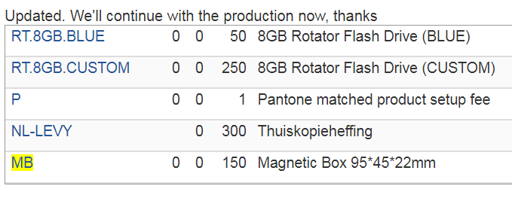
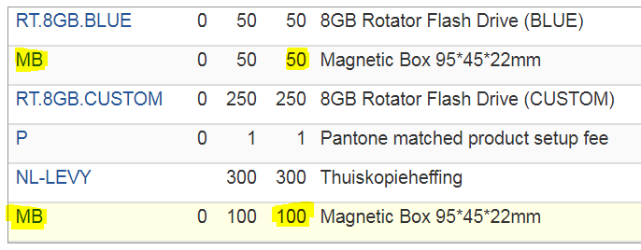
1.7 Wrong item line convention
What Operations understood: Based on the information SAM provided to Operations 150 units of the 250 units with the same Virtual Proof will be delivered in Magnet Boxes.
What the customer wanted: However the customer actually wished to order the 50 units in one Virtual Proof and 100 units of the other Virtual Proof delivered in Magnet Boxes.
50 RT.8GB.Blue in MB
100 RT.8GB.CUSTOM in MB
150 RT.8GB.CUSTOM packed individually in the polybag.

Slide 12
2. Virtual Proof Errors

Slide 13
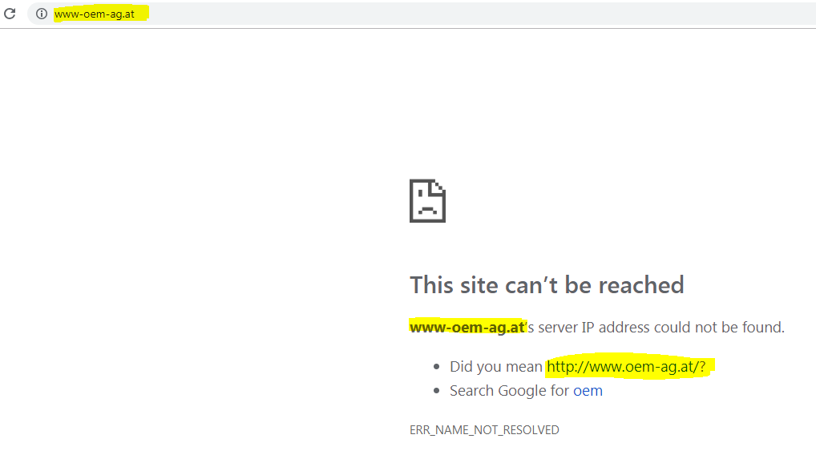
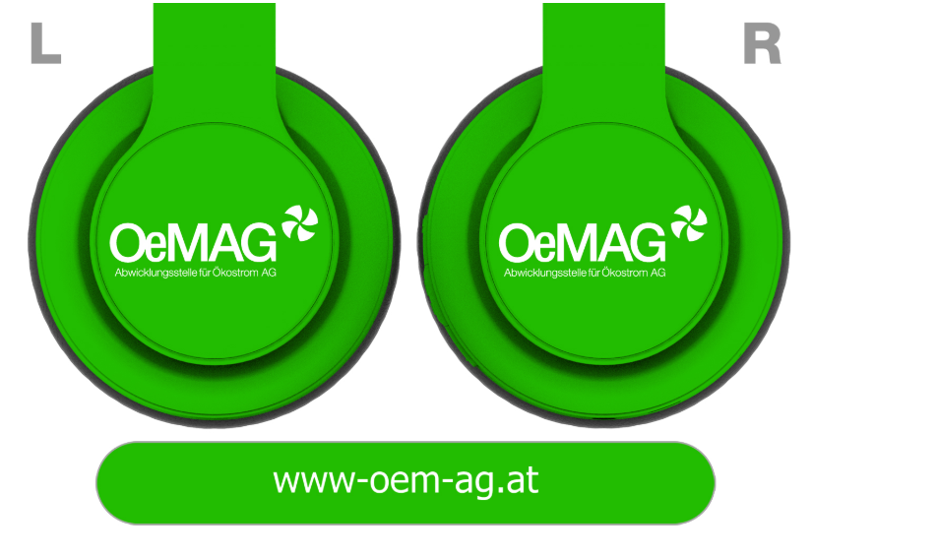
2.1 Spelling mistake
Solution:
‘Copy and paste’ the text from the customers email
In some cases customer misspell their own website so always look it up in a browser.
Can the customer provide you the text they’d like printed?
Compare the text on the Virtual Proof with the text provided before sending it to your customer.
Can you spot the error?

Slide 14
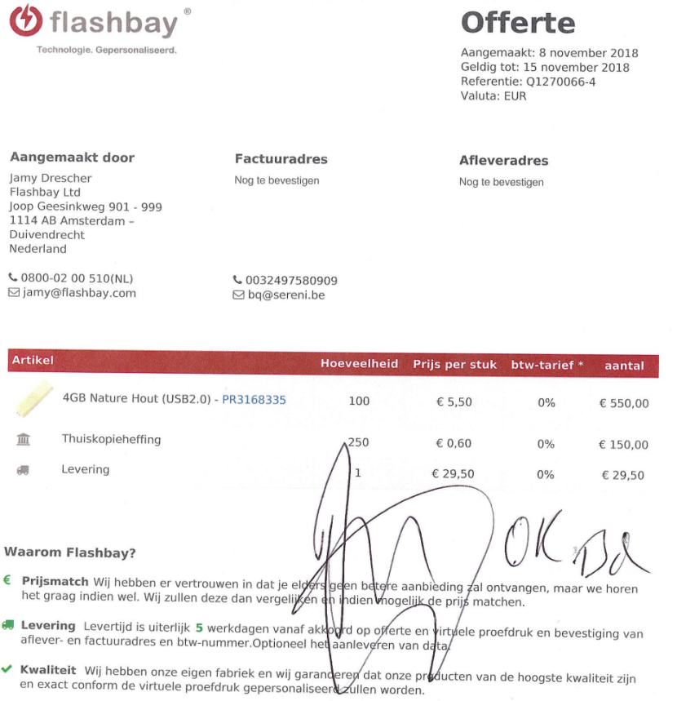
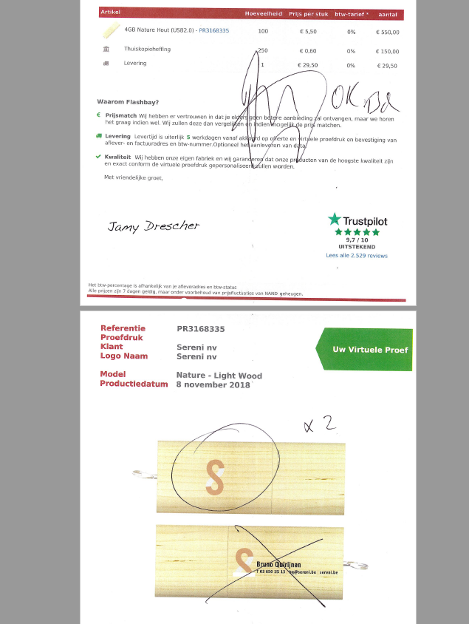
2.2 Wrong Virtual Proof processed
Scenario: The Customer confirmed the order in a short sentence ‘approved as attached’. The SAM did not open the attachment and placed the order based on the quote he sent to the customer.
Issue: On the second page the customer had made changes to the Virtual Proof.
Solution: Always double check all attachments provided by the customer.

Slide 15
3. Miscommunication

Slide 16
3.1 OTG USB Flash Drives - Customer cannot access the locked partition on their mobile
Scenario: Customer requests for parts of the data to be locked (DPUS) on the OTG USB Flash Drive.
Issue: Smart Phones, Smart TV, Printer and Car radios won’t recognize the locked partition (CD-Rom partition) preloaded with the customers data.
Solution: Inform the customer of this limitation before placing the order. In some cases the customer will be fine with the limitation. If the customer tells you the data absolutely have to be accessible on a mobile phone you can recommend doing a standard Data Preloading in addition to the DPUS.

Slide 17
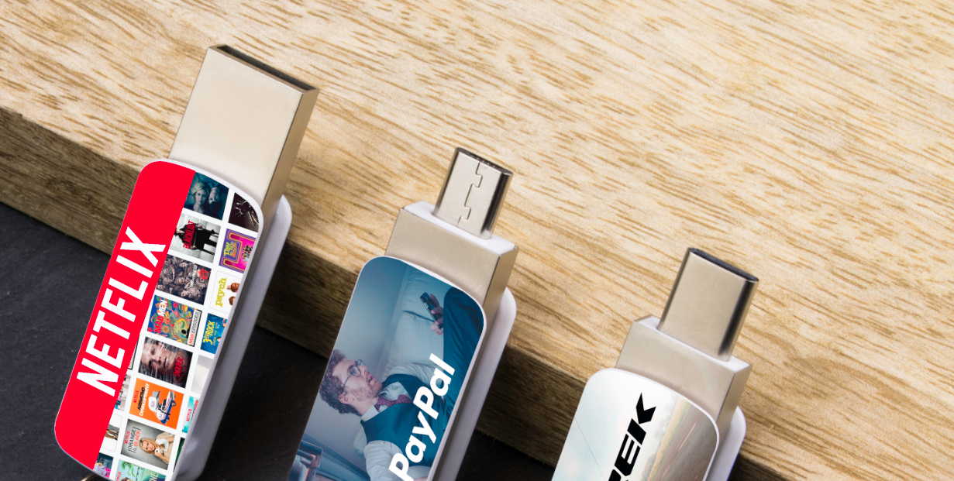
3.2 OTG Connector type
Scenario: Customer thought they ordered OTG Flash Drives with a USB-C connector not Micro-B.
USB-A
Solution: Don’t assume what connector the customer wants but rather ask some questions regarding the use of the USB Flash Drive so you can better advise.
Micro-B
USB-C
We offer 4 OTG USB Flash Drives that have a choice of 2 Connectors: Lynx – Orbit – Twister Go – Active.
*ABC* puzzle
A – USB Type A – Standard USB Flash Drive Connector.
B – Micro-B – The oldest version and widely used at the moment.
C – USB Type C – Compatible with most modern Android system mobile phones and it is on track to replace all cables in the future. Compatible with the newest Apple MacBooks (Thunderbolt 3 ports).

Slide 18
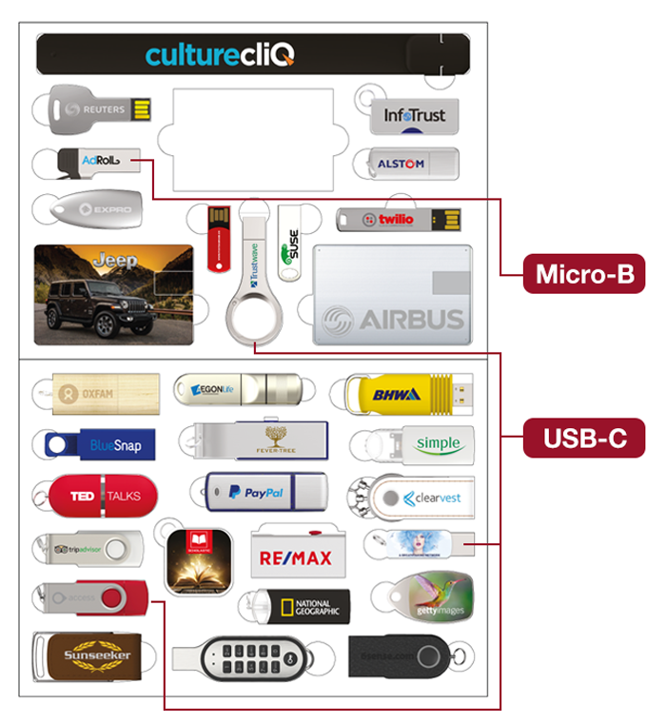
Solution: Please explain the different types of OTG Connector to your customer as it might be the first time they use OTG USB Flash Drive on a mobile phone:
What mobile phone is the customer using? You can find an up to date list of compatible mobile phones with OTG on Wiki.
If the customer is giving them away to customers with different types of phones you can recommend an upgrade to one of our OTG models with all 3 connectors in one, Slide and Bounce.
Highlight in your email the type of Connector you are quoting. Avoid quoting both options – it can be misleading.
Have you sent correct samples? OTG varies in the USB Flash Drive Sample pack – OTG types are displayed in the ‘View’ option.
In the current Price List all of the OTG models have USB-C connector except Lynx.

Slide 19
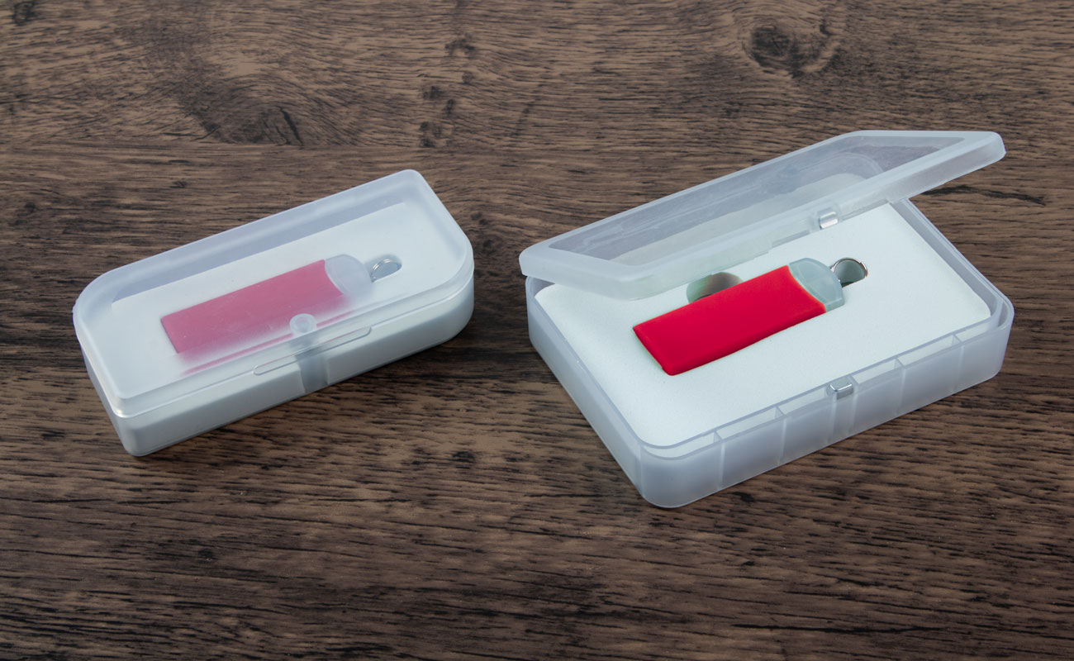
3.3 MB or MBM?
The Magnet Box and Magnet Box Medium start with the same word, so it can be easy for a customer to mix both names up.
In the below example the customer asked for an order with ‘boxes’ referring to MBM (Magnet Box Medium).
Solution:
Ask the customer whether they are interested in a small or medium sized Magnet Box. The picture in the quote is small so it can be difficult for the customer to see the actual difference between the two, however you can find a picture of the two in the Briefcase.
ii) When a customer asks for a repeat order with Magnet Boxes always double check if the customer has previously ordered MB or MBM.

Slide 20
Any Questions or perhaps an example of your aftersales case you would like to share?

