Slide 1
Negotiations

Slide 2
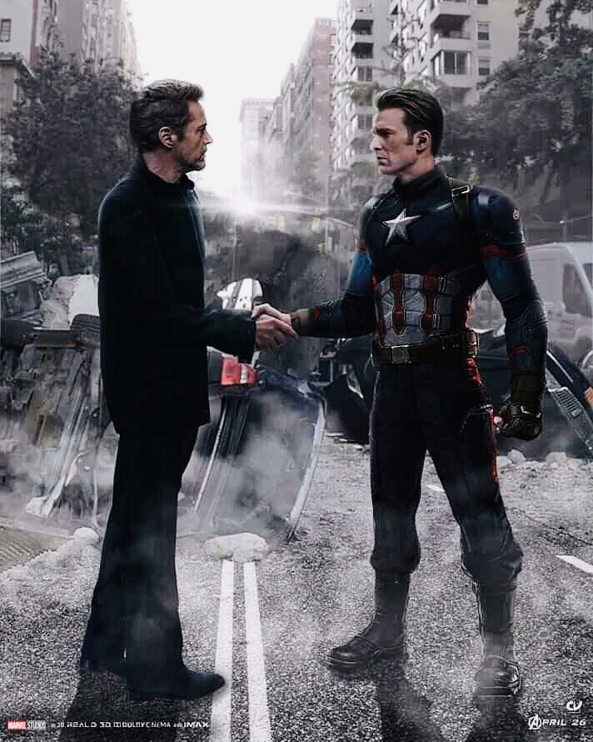
What is negotiation?
A bargaining process between two or more parties seeking to discover common ground and reach an agreement.

Slide 3
Where do we encounter negotiation?

Slide 4
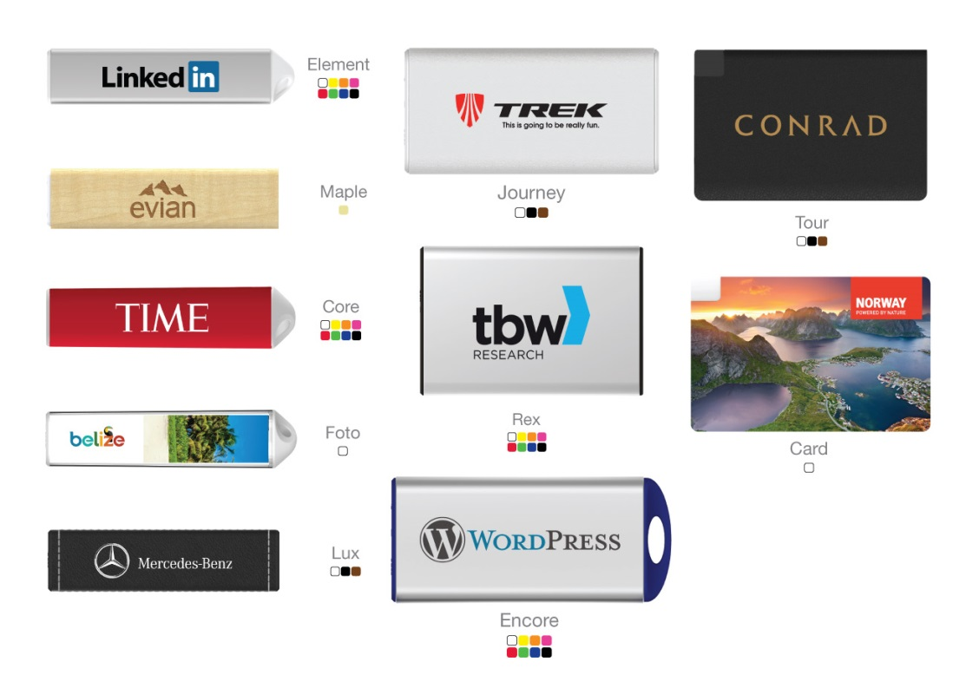
Flashbay Benefits
Fast delivery
Our own factory
Free Samples (Next day)
Instant Quote (15 min)
Factory Direct Prices
10 Units Minimum Order
10 Year Warranty/2 Year Warranty
No Hidden Cost
Free Virtual Proof
Trustpilot
Unique Design
Printing included on all printable sides
Original NAND Flash
Aftersales department
Our Sales Staff

Slide 5
How to negotiate on the phone?
The phone is your best tool in a negotiation.
Explain why Flashbay is more expensive - discuss the benefits of a Flashbay order vs a competitor.
Be sure to mention all the benefits relevant to the customer i.e. if they don’t have a firm deadline, do not mention a five day delivery.
Never mention price on the phone.
Confirm when the customer will be able to make a decision.

Slide 6
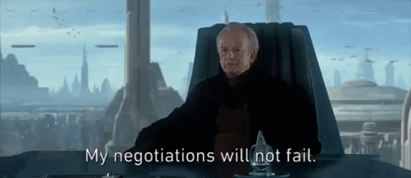
How to negotiate by email?
Be aware of who will be reading your email i.e. a decision-maker more senior than the person you originally spoke to - keep it professional.
Explain why you are lowering the price.
Include the Flashbay benefits you’ve mentioned on the phone.
Are they ready to order? Why not send order details straight away!
Send a Quote not a new Price List.
Follow up on your lower quote before it expires.

Slide 7
#Price_Check
A channel on Slack for price checks - to be used for new business if you need approval for a price that is below Level 0.
#Price_Check_Existing
For existing customers - if you need to offer a price that is 20% or more below the price the customer previously paid for the same product.

Slide 8
#Price_Check & #Price_Check_Existing
Prior to posting on the Price Check channels you should first try to negotiate with your Lead. (Remember negotiation is not always about price)
When using the channels, be sure to @mention your line manager.
Upload the competitor quote if you have it.
Example of a template:
i) Capacity:
ii) Quantity:
iii) Flashbay Quoted Unit Price:
iv) Competitor Quoted Unit Price:
v) Date Received:
vi) Competitor:
vii) Website:
viii) Product:
ix) C#:
x) Samples received: YES/NO
xi) Profit: (important to complete this field)
Based on your conversations with your customer, now how do you want to play it?
Update the thread with news on the order and add a tick when you have won the order.
Remember - sometimes more than one round of negotiation is needed.
This means you won the order!
This means your manager is
looking into it…

Slide 9
What is NAND Flash?
NAND Flash is like the engine in a car and drives the USB – it determines the speed of the flash drive and the length of the warranty.
"NAND flash" is the memory chip used in USB flash drives and other electrical items including smartphones. NAND flash memory chips are manufactured by just a few hi-tech giants - Samsung, Intel and Hynix - in a variety of capacities and levels of performance.
Prices change daily in accordance with laws of supply and demand much like commodities i.e. coffee and gold.
It determines the R/W speed as well as the warranty of the USB Flash Drive.
We cannot expect our customers to understand the detailed technology inside a USB Flash Drive.

Slide 10
Scenario
A lead has emailed you the information below:
1GB
Classic USB Flash Drive
50p/unit lower price from competitor (still above cost price)
No firm deadline
What do you do?

