Slide 1
Explorer Part 1

Slide 2
Slack
Slack is the tool you will be using every day to communicate and keep up with the latest updates from Flashbay.

Slide 3
Slack Profile
To edit your profile click on the square in the top right hand corner of the window.
Select ‘edit profile’ and a pop up window will appear with your profile details.
Please enter your first name and surname in both the ‘full name’ and ’display name’ fields.
Please enter your job title in the ‘What I do’ field. Sales team members should also include their territory code e.g. Sales Account Manager DE
There is no need to enter a phone number and the time zone will be pre-set to the correct time zone for London.
Please upload a selfie style photograph by clicking ‘upload an image’. Please ensure your face is clearly visible in the photograph – please do not use group photographs.

Slide 4
Types of conversations
Public Channels
Free to join, posts are visible for anyone. You can identify a public channel by the # before the channel name. Country specific and General channels for Sales People (e.g. #Sales_global, #Sales_fr)
Private Channels
You can only join if you receive an invitation, messages care only visible to members of the channel. You can identify a private channel with the lock symbol before the channel name. To see who is part of a channel simply click the ‘i’ icon in the top right hand corner of the channel and then click ‘members’.
Direct Messages
To start a direct message you click the ‘+’ symbol beside ‘direct message’ on the left hand side of the slack window. You can have up to 8 people in one direct message. Messages are not visible to anyone not part of the group. @ mentioning a non-member in the chat will not add the person to it nor will they be able to view the message.

Slide 5
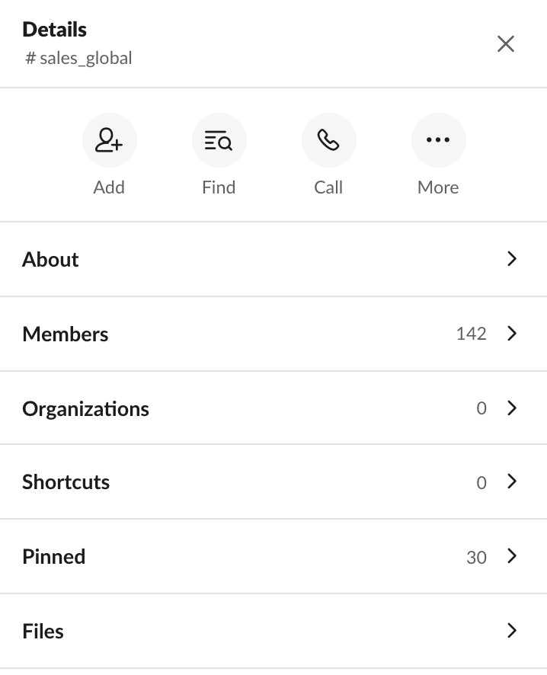
Slack Channels
On the right hand side of the channel there are lots of useful features that are explained below.
About
All channels have an ‘About’ which includes useful information explaining what the channel is used for and what information you will find in this channel.
Members
You can view all members who are part of any channel here.
Pinned
The most important announcements will be ‘pinned’ to a channel so you can easily find them at any time. They are pinned in order of date.
Files
Any files that have been shared within a channel can be easily found by clicking ‘files’.

Slide 6
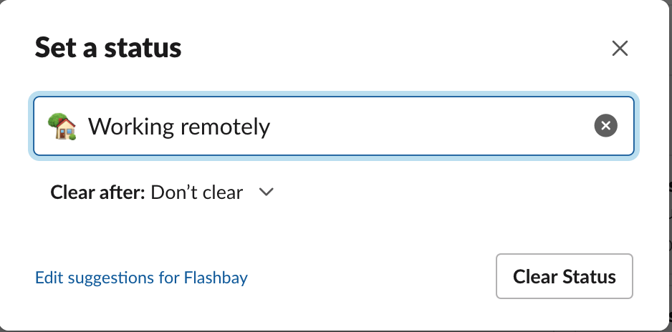
Slack Messaging Guidelines
Sign in to Slack
Every morning same time when you sign in to Zimbra/NetSuite. Remember to use the Desktop version of Slack as opposed to the browser – it will already be downloaded on your PC.
2. Set your Status
To set your status click your profile photograph on the top right hand corner. Then click
You can now select one of the pre programmed statuses.
3. Keep your status up to date
If you are based in the office you do not need to update your status to state this. If you are working remotely you should update your status to ’Working Remotely’. For the duration of your lunch break set yourself as ‘Away’ so your colleagues know not to expect a reply immediately and before going on holiday set status to ‘Vacationing’.
4. Acknowledging a post in a channel
Once you have read and understood the post, always acknowledge it with an emoji (e.g. country flag or thumbs up).

Slide 7
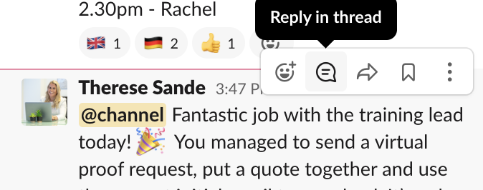
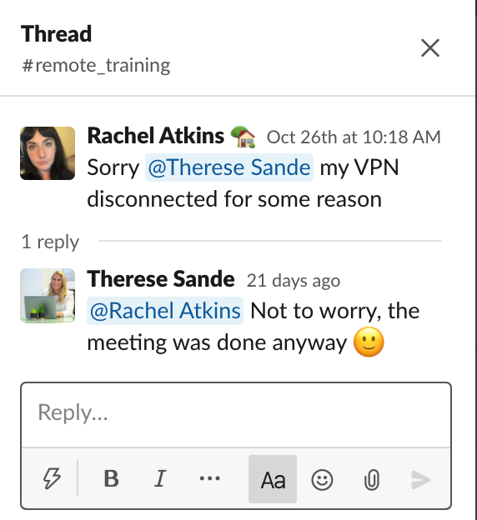
Slack Messaging Guidelines Contd.
5. Asking a question in a channel or direct message
Always @mention the person you are asking a question to or replying to. If you are asking a general question then you can @mention the channel ’@channel’ meaning everyone who is part of that channel
will be notified and one can respond. When asking a question please give as much
detail as possible to make the communication as efficient as possible. If the question
relates to a customer or lead you must always include the C number and if it
related to an order you must include the s number both of which are found on NetSuite.
6. Replying to messages in a channel or direct message
Reply to messages in channels by starting a thread instead of replying to all on the main
channel. Hover over the message you wish to reply to and you will see the 5 icons and
can then click ‘reply in a thread’. Always @mention the person you are replying to so
they are notified of your message.
The thread will open in a pane of the right hand side of
the Slack window and ensures all replies on that topic are
kept together so you can easily find them in future.

Slide 8
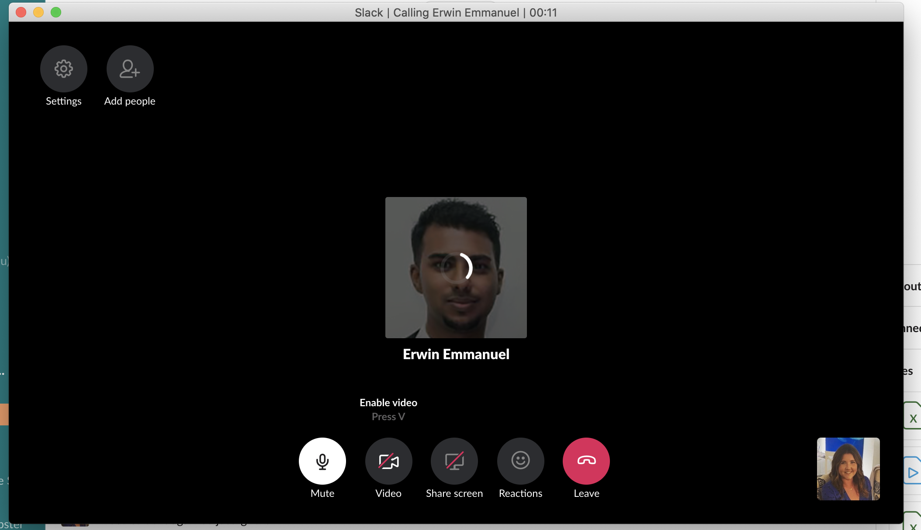
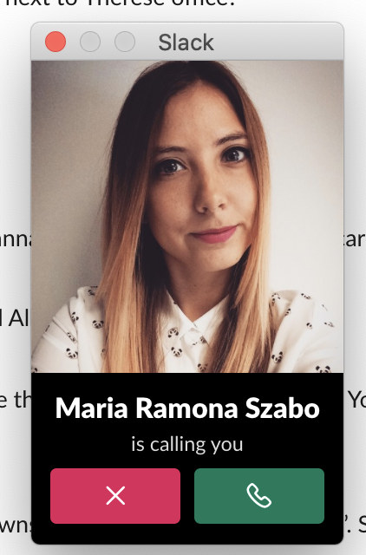
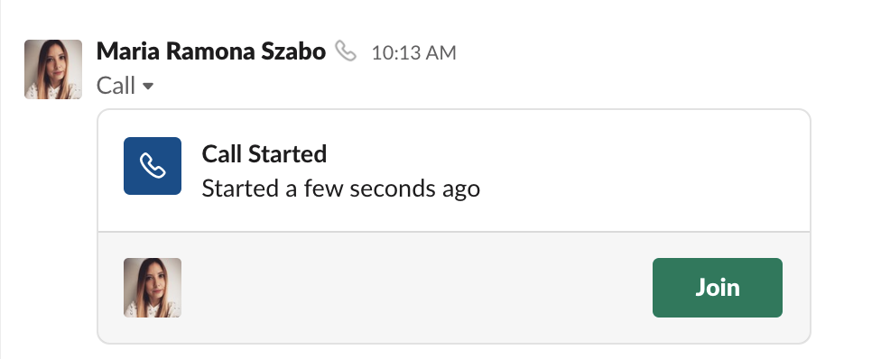
Slack Audio and Video Call Guidelines
1. Make an Individual audio or video call
If you’d like to call an individual or group on slack then you open a direct message with the individual or group of people and then click the phone symbol in the top right
hand corner of the screen and it will immediately start calling that
person/people. A pop up window will then appear which gives you
the option to make it a video call by clicking ‘video’.
2. Receive an Individual audio or video call
If you receive a call from an individual slack member, you will receive a pop up on your screen
and you simply click the green phone symbol to accept the call or click the red ‘x’ to decline the
call. Once you’ve accepted the call you can then click ‘video’ to turn on the video.
3. Conference audio or video call
Conference (group/channel) calls will always be pre-arranged and you should
receive a Zimbra calendar item regarding the call. No pop up will appear for
this call therefore a couple of minutes before the call is due to begin you
must go to the channel/group message that includes the other members
taking part in the call. Once the host starts the call you will see a ‘join call’
option on the channel that you must click on. Please mute yourself when not speaking.

Slide 9
Slack Audio and Video Call Guidelines
4. Audio or video?
The host will set whether the call is audio or video. As a general guide, calls planned in advance will normal be video calls and ad-hoc calls are more likely to be video however you should always be prepared for both.
5. Confirming you have joined the call
In conference/group calls, it’s important to confirm with the host that you have joined therefore please quickly say hello and confirm you are ready to begin. If on video you can also give a wave!

Slide 10
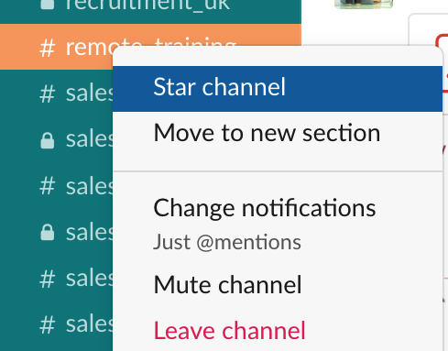
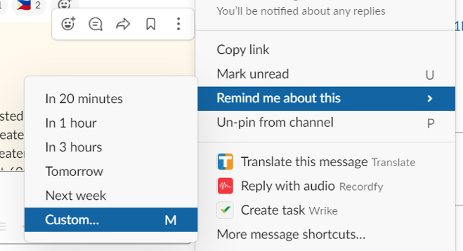
Organizing your Slack
1. Star
We suggest ‘starring’ the channels and direct conversations you use most often as these will be grouped together and appear on the top of your Slack panel. To ‘star’ a channel or conversation, right click it and then click ‘star channel/conversation’. You can ‘unstar’ a channel or conversation you no longer use regularly by following the same process.
2. Save items
Mark your to-dos or save something for later. These messages or documents will appear under tab in you Slack panel.
3. Reminders
You can set a if you want to re-read a
message in a few hours or on a specific date.

Slide 11
Searching on Slack
There is a lot of useful information available on Slack. As a new employee you will receive lots of new information and it can sometimes feel a little overwhelming however don’t panic as if you do forget something it’s easy to search on Slack and find what you are looking for!
General Search
At the top of the Slack window you will see the main search function
You can type a word or phrase here and it will search for it in all the channels you are part of and any direct messages.
Search in Channel
Ctrl+F if you want to search for messages or files in a conversation.

Slide 12
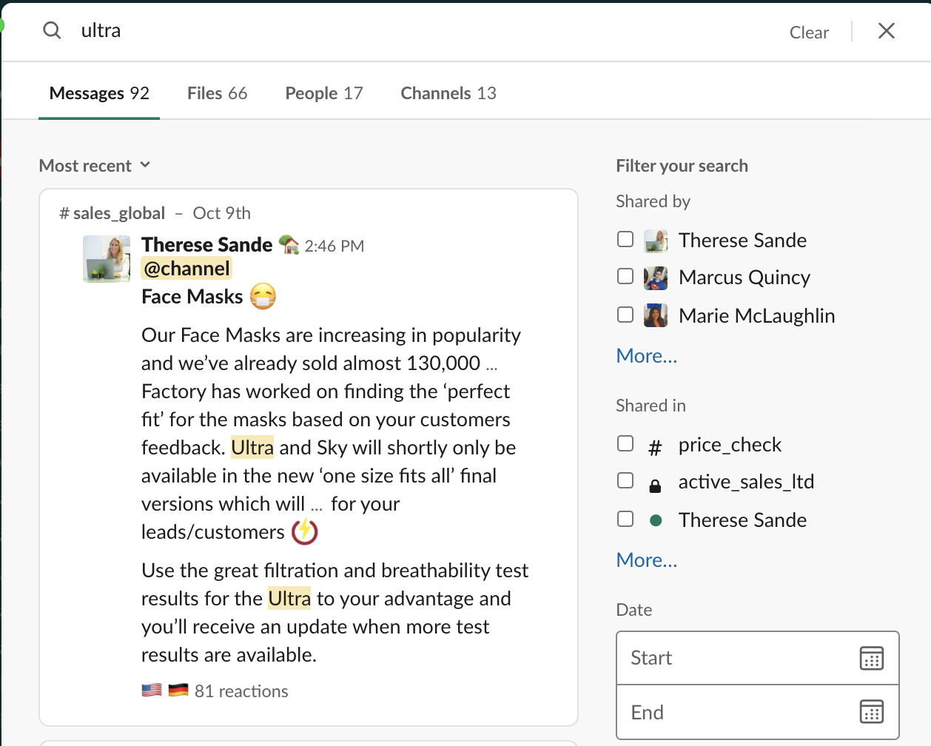
Searching on Slack
Filtering your Search
Depending on the word or phrase you search on, you will receive a different number of results. Often you will receive a large number of results and in order to find the information you require as quickly as possible you need to make the most of the filtering options.
All messages wit the key word or phrase will appear however you can then tick the filters on the right hand side of the window to narrow down the results
If you remember a rough time period when the information was shared, for example, update lead times – then you can enter the date range and it will only show you information during that time period
If you remember the information was sent to you by a specific person or posted in a specific channel then you can select those on the right hand side of the window to narrow down the results

Slide 13
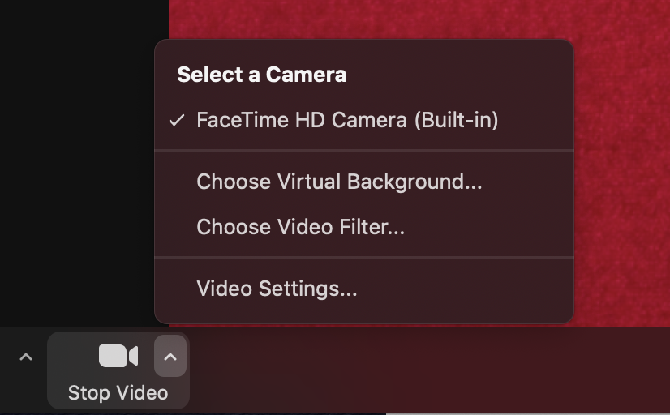
Zoom
Zoom is primarily used for external meetings, interviews and internal training sessions. It’s a relatively new tool for Flashbay and so moving forward there may be new uses.
How to Join a Meeting
You will receive a link for the meeting and also a pass code. A couple of minutes before the scheduled meeting time please set up zoom so you can test your audio and/or video in advance.
Zoom Guidelines
A few things to remember when using Zoom:
Join the meeting on time
Ensure your microphone and video are both on
When you are not speaking place yourself on mute to avoid unnecessary background noise
You can use your actual background (e.g. office, bedroom) or you
can select a suitable virtual background such as a plain colour. To
do this you click the right arrow beside ‘stop video’ and then ’choose
virtual background’.

Slide 14
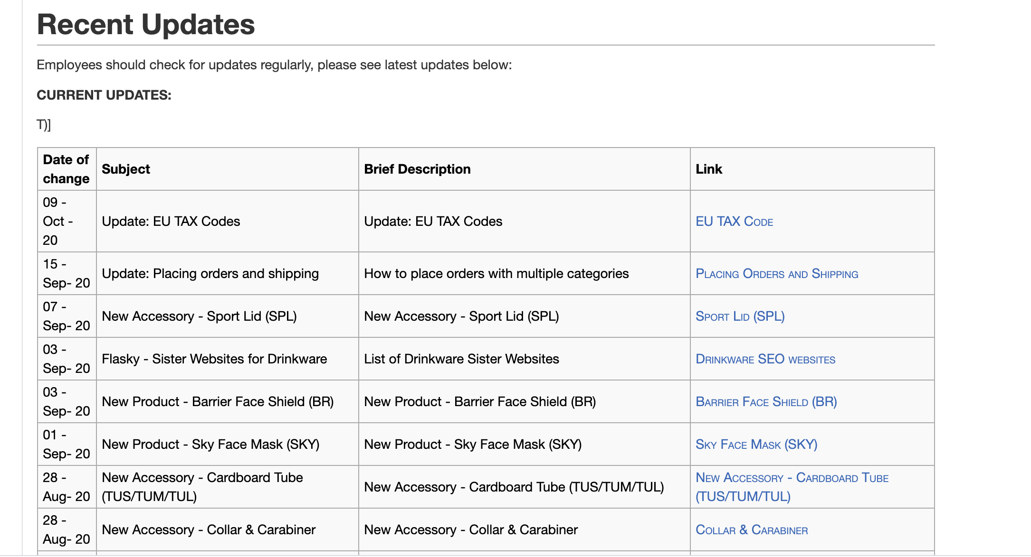
Wiki
We have an internal wiki that is packed with lots of information on everything related to Flashbay - Sales, HR, IT and Aftersales topics.
To access the wiki go to Zimbra>Employee Portal>Flashbay Wiki
The wiki is split into different sections and you can find the contents on the left hand side of the page making it easy to navigate.
You should check regularly at least once per week for updates.
If you scroll to the bottom of the main page you will find a table
with all of the recent updates for you to easy identify them and
read the relevant information.
Before you ask your Group Leader a Sales or Product related question, check wiki first.
In Explorer 2 we will look at the wiki in more detail, however between now and then please start exploring the wiki for yourself!

Slide 15
Questions?

