Slide 1
Sales Cycle

Slide 2
9. Customer Follow up
1. Receiving Lead
Sales Cycle
8. TrustPilot Feedback
2. Analysing & Qualifying
3. Response
7. Order
4. Virtual Proof
6. Negotiation
5. Dummies

Slide 3
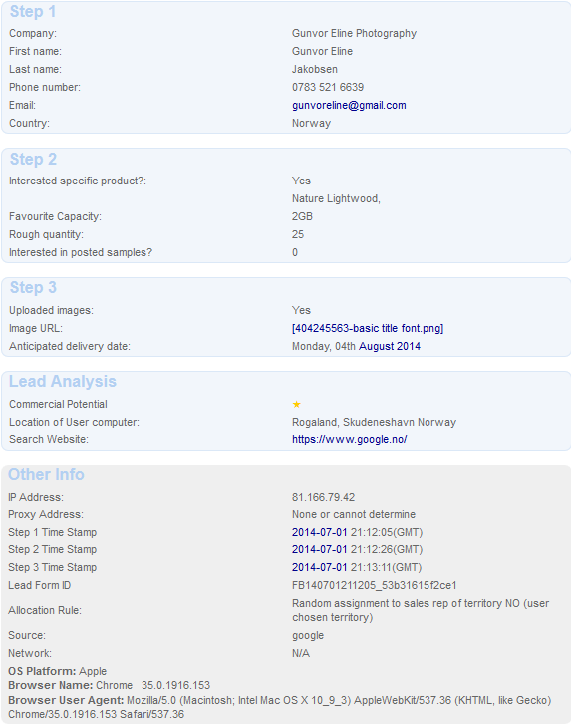
1. Receiving a Lead
Web (different webpages)
www.flashbay.com
www.flash-drives.com
www.expressusbdrives.com
www.usb-business-cards.com
Phone
Cross Selling
Check Netsuite for Duplicates
Email Ending
Company Name
Reseller/Competitor

Slide 4
2. Analyzing & Qualifying (5min)
Check all information in the lead
Company/name/phone/email/website
Model/Capacity/Quantity/Dummies/Address – can you find it yourself?
Logo/Delivery Date
How hot is the lead? /Domain free/ Country of PC, Fraud?/ Search website/ Key word
DP or dummies?
Any additional information the lead has given

Slide 5
3. Response (10min)
Prepare your questions
Always keep your promises e.g. “I will send you an email within 5 minutes”
Prepare your email template before calling, use a template, and fill in the information you already have
Remember to offer accessories and data preloading to your customer both on the phone and in the email quote.
PHONE
Do you have all the information you need?
YES – Summarise the information you have and explain the next step.
E.g. “Thank you for your inquiry regarding 100 units KN with your logo. I can confirm that we can
meet your deadline in 6 working days”
NO – Ask for the missing information and explain the next step
EMAIL
Polite - “Thank you for your inquiry”
Pricelist
VP/PDF
Next Step
Delivery Time

Slide 6
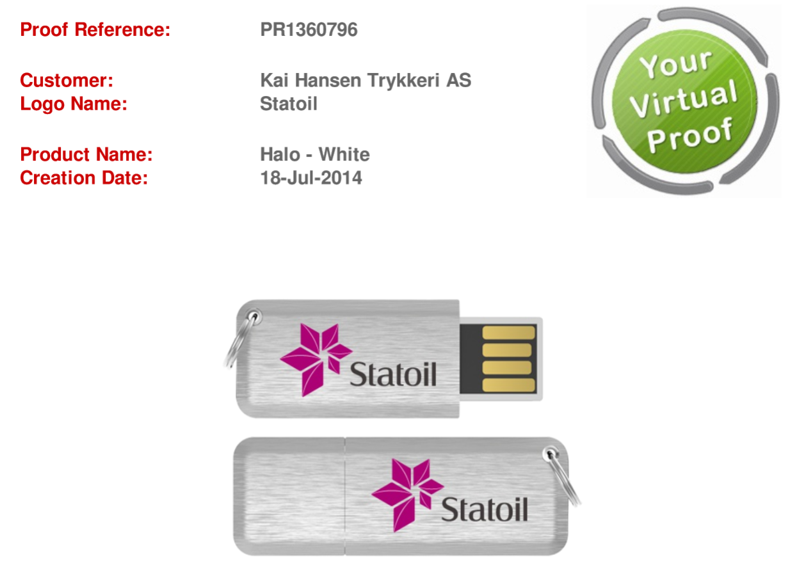
4. Virtual Proof
What model do they want?
Did the customer provide you with a logo?
If not, can you find one on their webpage?
Or make a VP with the company name/webpage
Be creative if you don’t have a logo or model:
“The Key model has been very popular with
other building companies before”
“Kinetic model is in our lowest price class and
it has been sold to many different schools
before”
“It is a great alternative to the Twister model”
Flashbay models are always better to sell
END 15 min!

Slide 7
5. Dummies
Follow up when dummies have arrived.
Did they find a few favourites?
If you already have the logo a new VP will be generated quickly. If not, ask again for a logo.
When will a decision be made? Do they need anymore information from you?

Slide 8
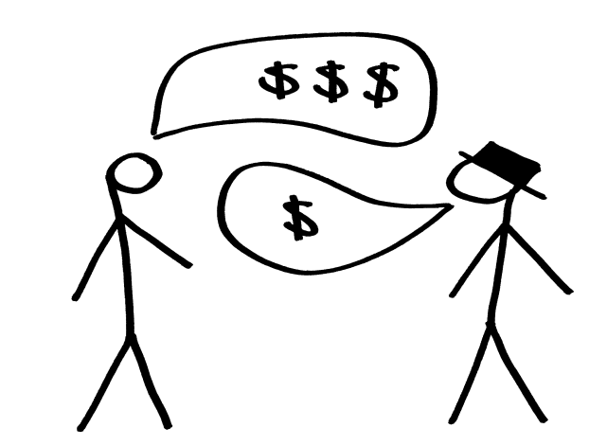
6. Negotiation
What are the best arguments to buy from Flashbay?
10 year warranty
Original NAND Flash from companies like Samsung, Toshiba and Intel
Printing included on all printable sides
No hidden cost
6 days delivery
Free Virtual Proof
Free next day dummies
Our own factory
TrustPilot link
When you`ve made your case:
“I will speak to my manager and see if we can offer you a special price”
Don`t just drop the price without describing the benefits of ordering with Flashbay

Slide 9
7. Order
Send order details with VP, billing/shipping address, model, capacity, colour of model, payment terms and expected delivery date
Ask your customer again if they would like some accessories or DP
Get a written confirmation, not only a ok on the phone
Place the order (always use your check list)
Send an email to your customer confirming the flash drives are in production and the expected delivery date
Triple check before pressing save to avoid Aftersales

Slide 10
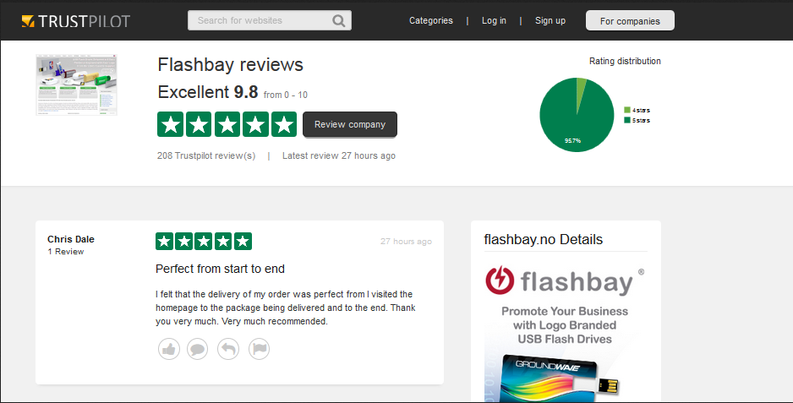
8. TrustPilot Feedback
Always call your customer to make sure they are happy with the delivery.
If your customer is 100% happy you can send them a link to TrustPilot and mention if they want to refer us to other companies.
Email memo after the call.

Slide 11
9. Customer Follow up
90 days personal follow ups – the majority of the customers should hear from us once every 3 months with the phone call (no voicemails follow ups)
Automatic follow-ups from the Marketing team (Friendly reminder)
Marketing emails (Marketing team)

