Slide 1
Memory

Slide 2
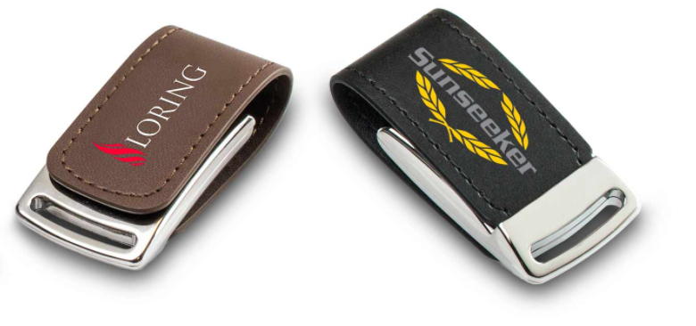
What is a USB Flash Drive?
A USB Flash Drive holds incredibly large amounts of information and is small enough to slip easily into your pocket, conveniently around your neck like a necklace, or on your key chain.
For what our customers use the USBs for?
To store data
To transfer/share data
To give them away (promotional products)

Slide 3
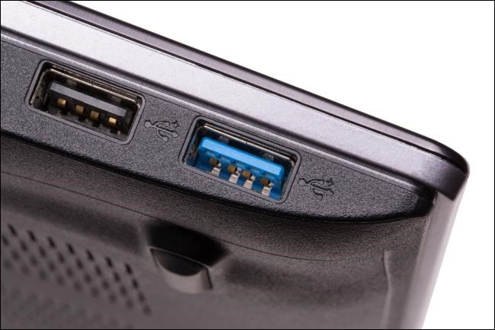
USB 2.0 vs USB 3.0?
USB 3.0 is a new generation of USB 2.0 and delivers a significantly higher reading/writing speed.
USBs 3.0 that we offer start from 16GB capacity
USB 2.0:
Sequential write speed range = 3~10 MB/s
Sequential read speed range = 10~25 MB/s
USB 3.0:
Sequential write speed range = 10~45 MB/s
Sequential read speed range = 60~150 MB/s
We offer USB 3.0 from 16GB capacity

Slide 4
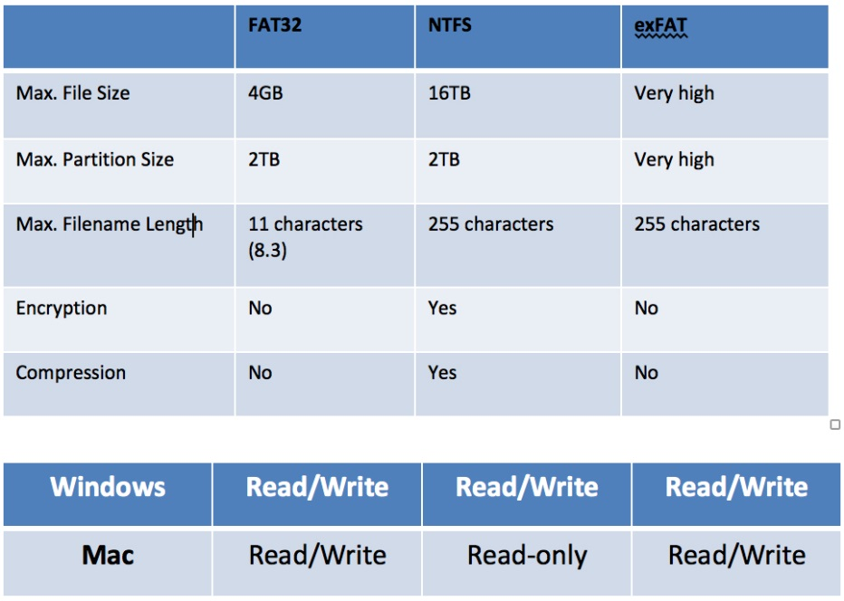
Formats on the USB Flash Drive

Slide 5
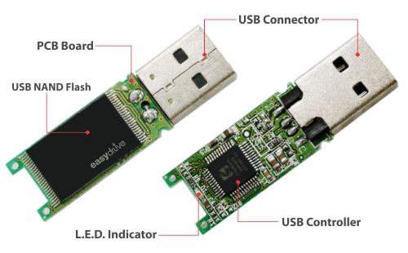
Why choose Flashbay?
Flashbay currently uses the SMI 324 controller
NAND Flash – memory chip
Supplied by: Samsung, Toshiba, Hynix, Intel and SanDisk.

Slide 6
What to do when customer has special chip requirements?
Pre-Production Working sample (PPWS)

Slide 7
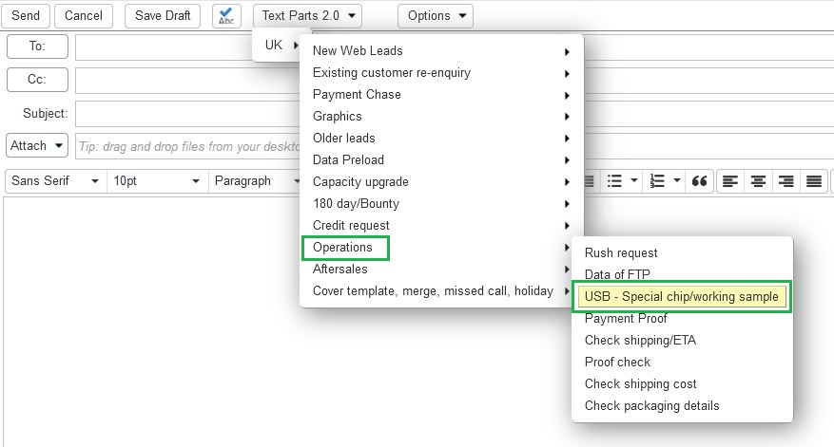
Pre-Production Working sample (PPWS)
Gather as much information as possible from the customer
Model, quantity, capacity?
What are they being used for? (Special devices, TVs, etc.)
Any special technical requirements? (W&R speed, format, individual serial number, Data preloading, etc.)
Deadline?
2. Contact operations to get information on the chips we have in
stock for the model and capacity the customer is looking for
Use correct text par and fill in the info you gathered form the customer
Add your group leader in cc’

Slide 8
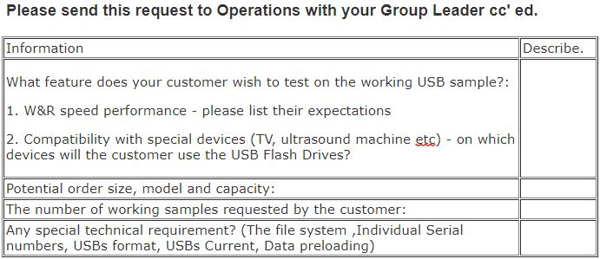
Pre-Production Working samples (PPWS) c.d.
3. Send the customer a working sample from the Factory
Place an order for one unit
(E.g., TW.4GB.BLACK - 1 unit - PPWS price from our price list)
specify components and any technical requirements in job notes when you are placing the sales order for the working sample and the number of units Operations should reserve for 2 weeks
Ops will only hold the units for 2 weeks, any longer must have special approval and be mentioned in the job notes
Customer should be charged for the working sample, but the price can then be deducted from the final order.
4. When placing the final order, you must add the S# of the test sample and information for ops to use the same chip
5. Make a note on the customers NetSuite account for future orders

Slide 9
Flash drives

Slide 10
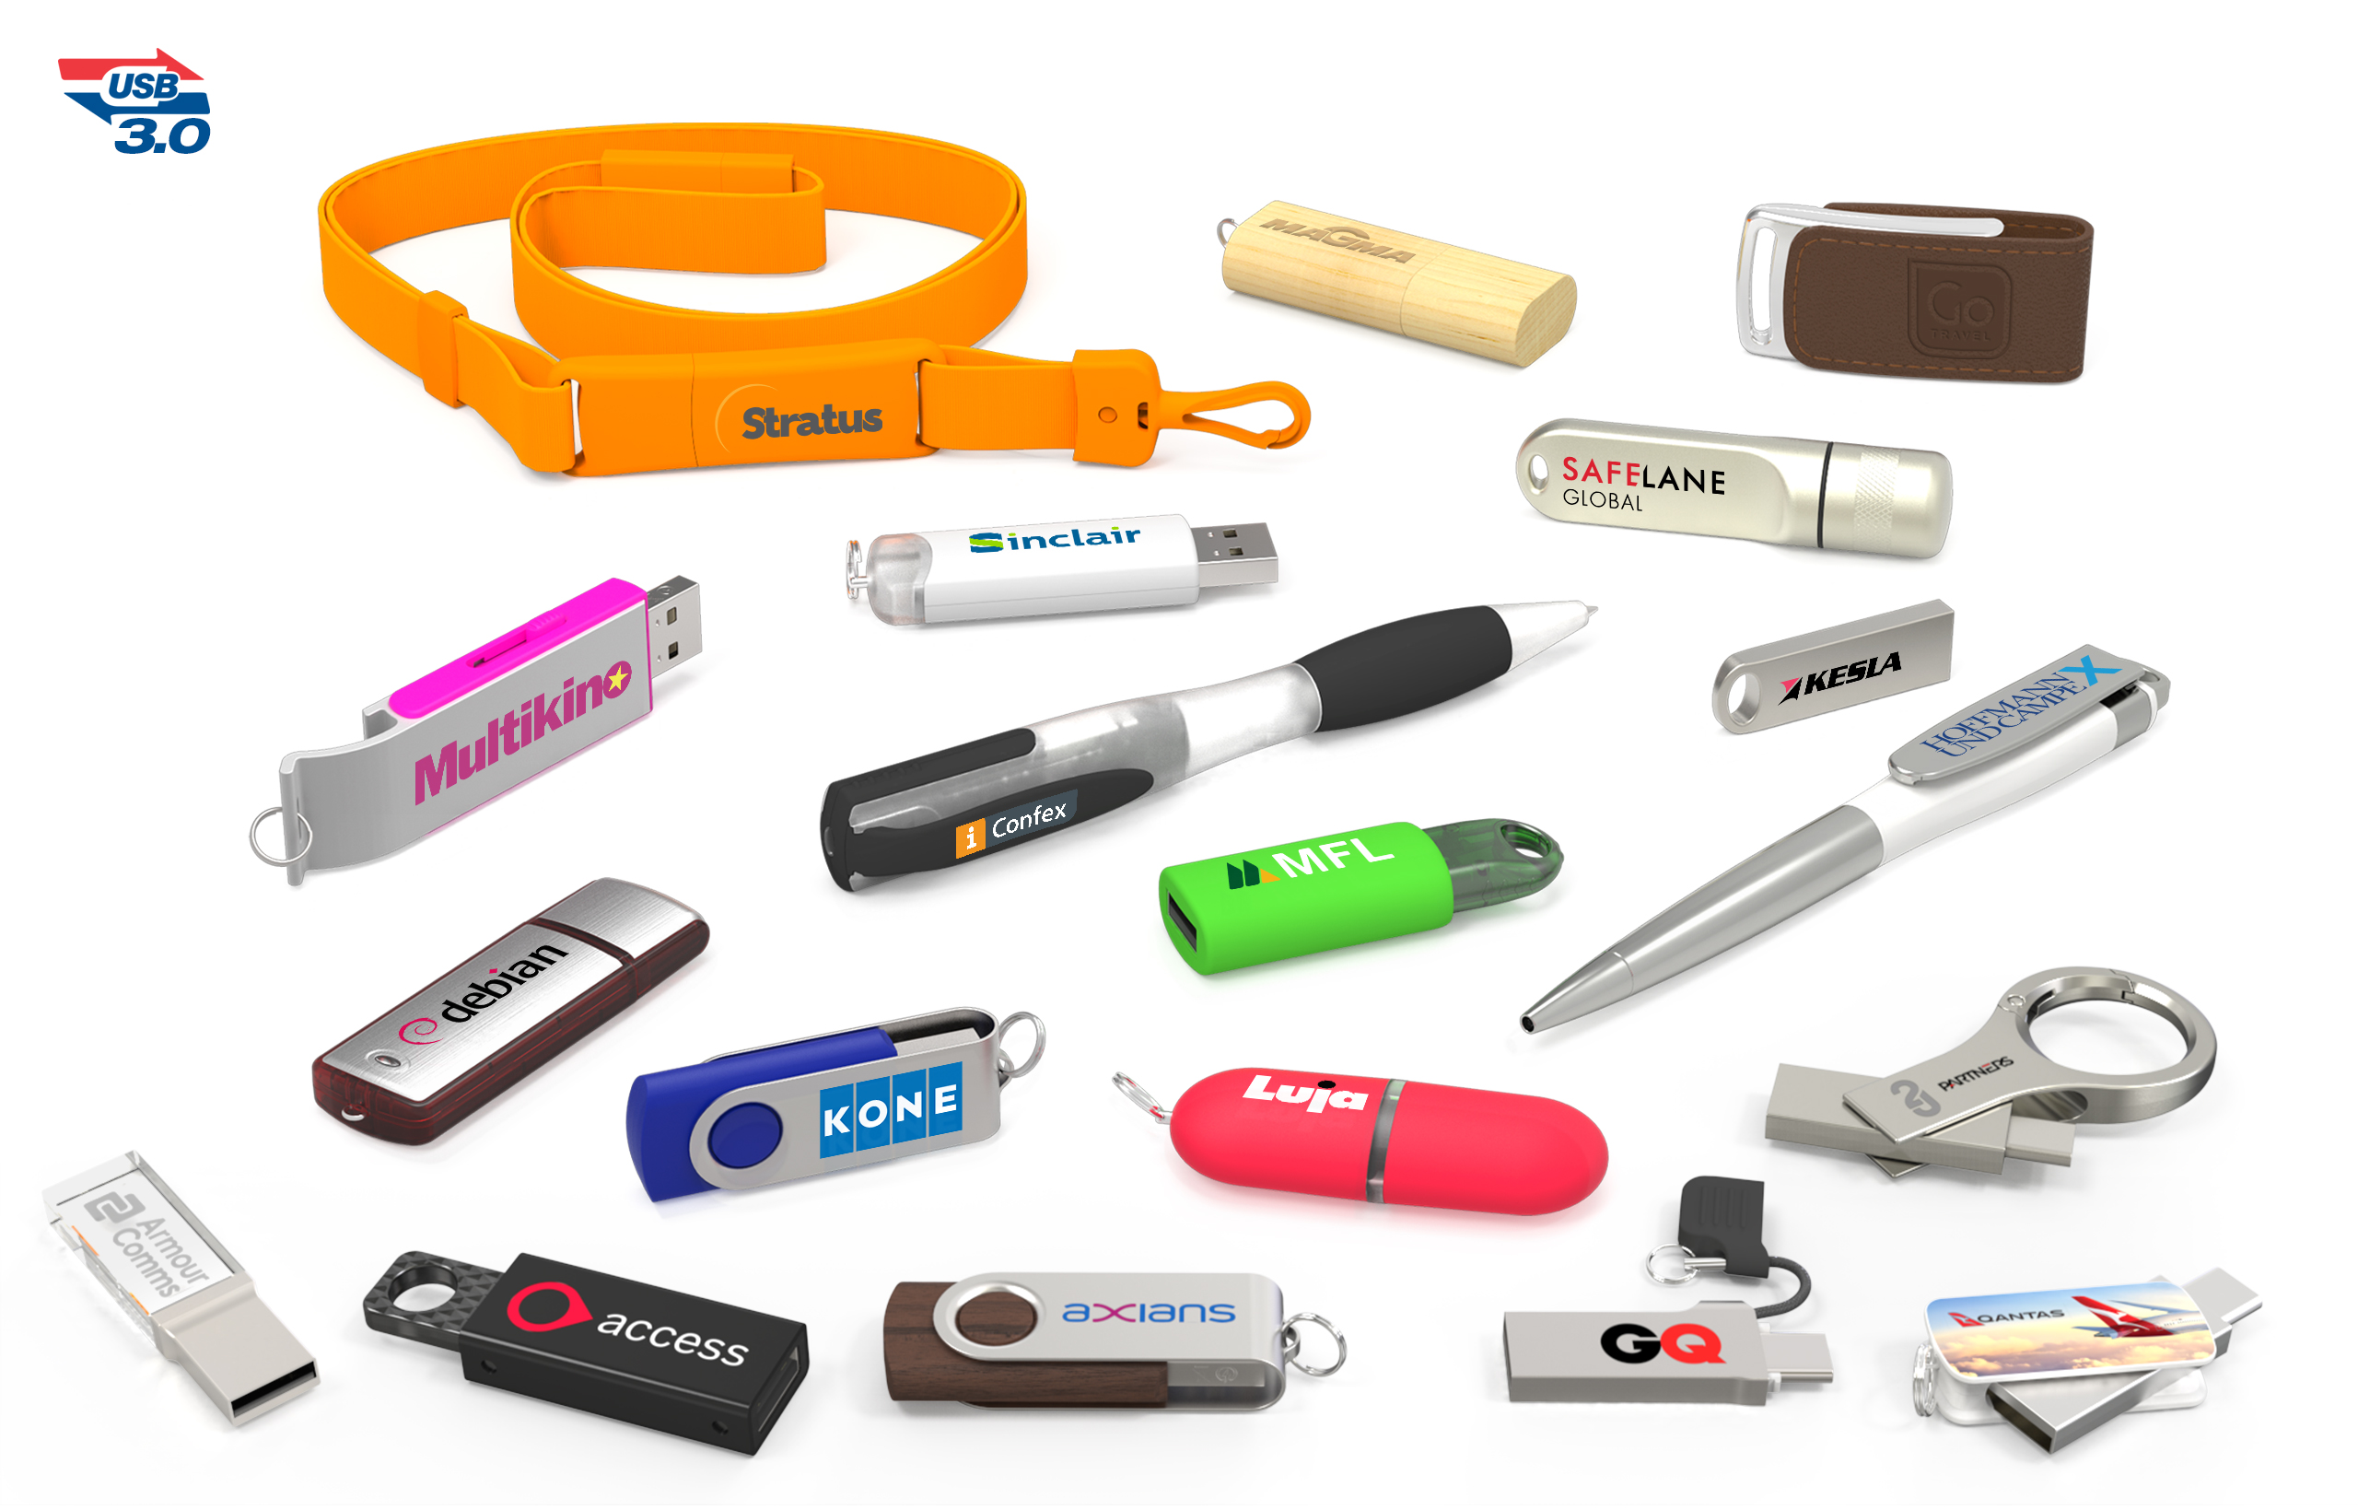
Memory
What types of USBs do we offer?
What does OTG mean?
Do we offer USBs 3.0 for all models?
What is the warranty period?
Is branding included in the price?
What capacities do we offer?
What are our top seller capacities?
What are our top seller models?

Slide 11
USB Models

Slide 12
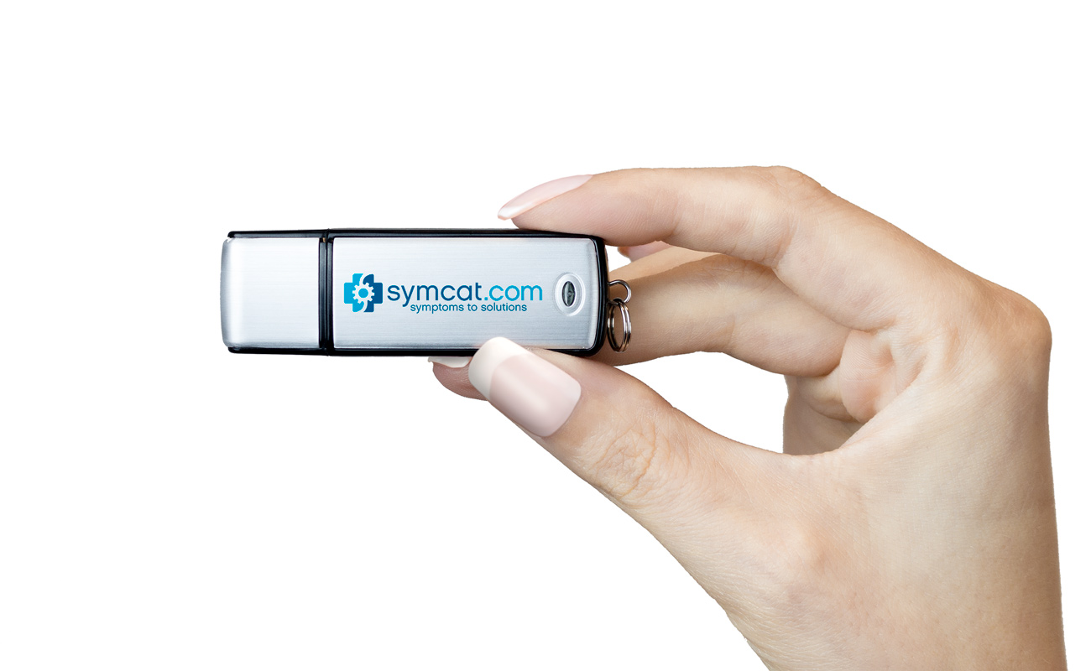
Non Flashbay design USB Drives
These models are available from our competitors – we still make these products in our factory

Slide 13
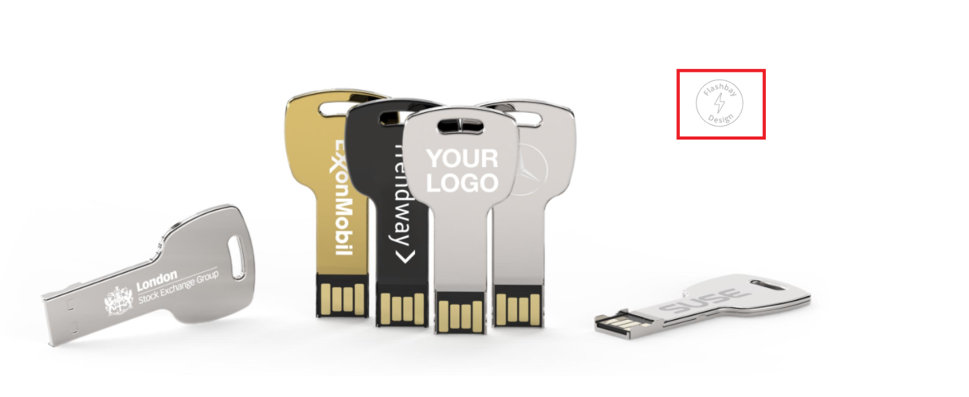
Flashbay Exclusive USB Drives
All other USBs are designed by Flashbay!

Slide 14
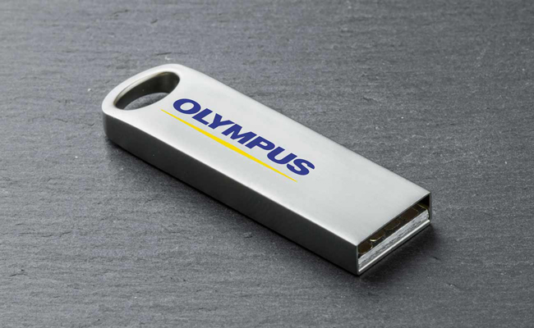
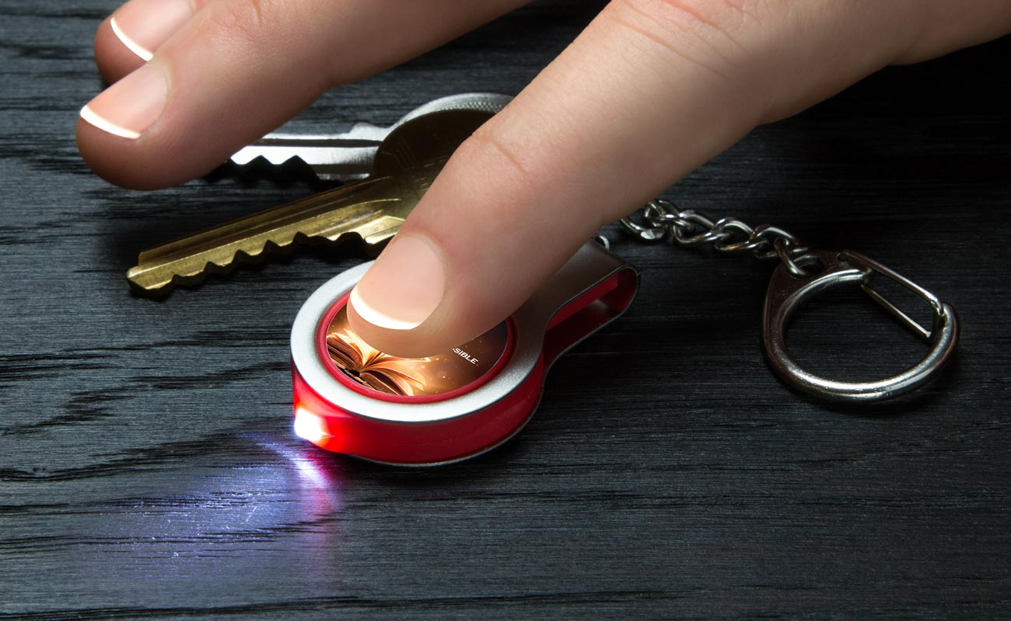
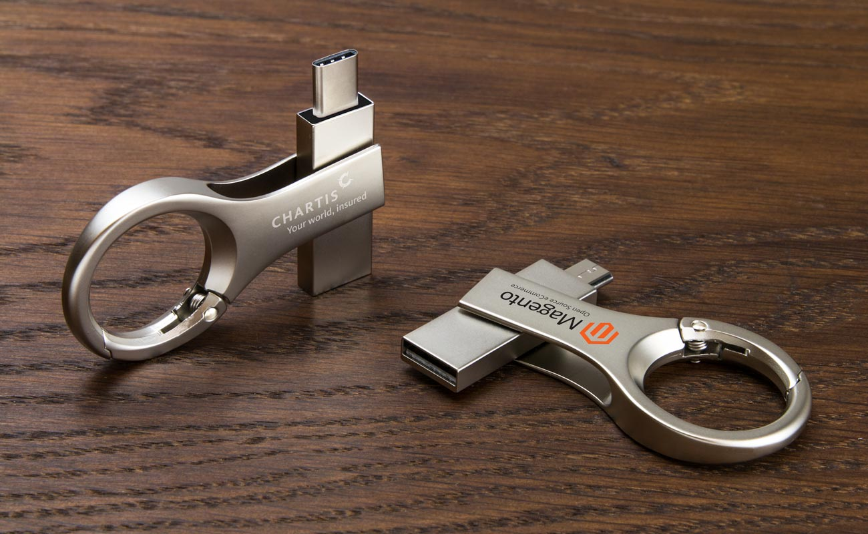
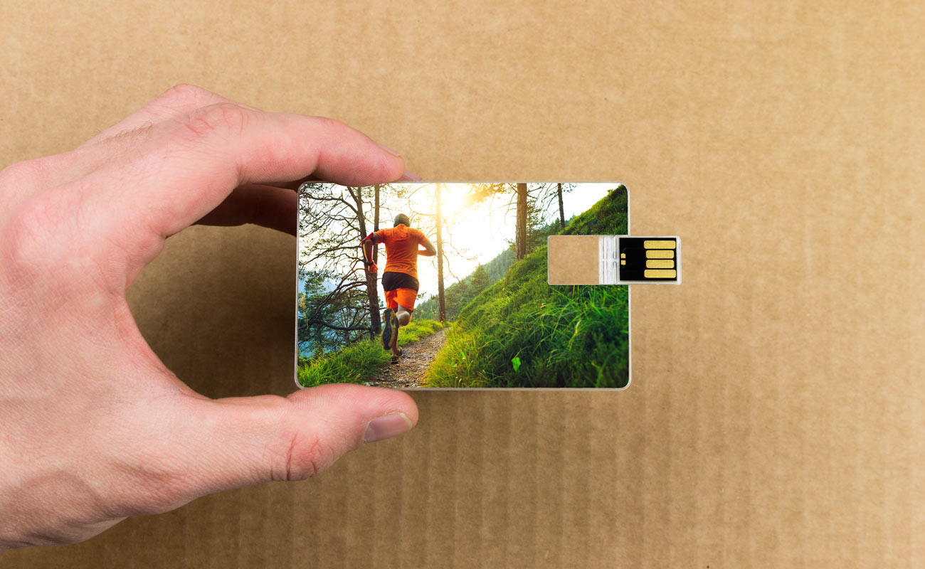
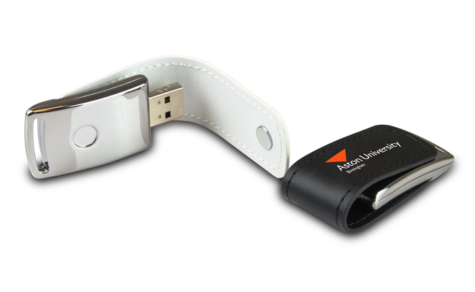
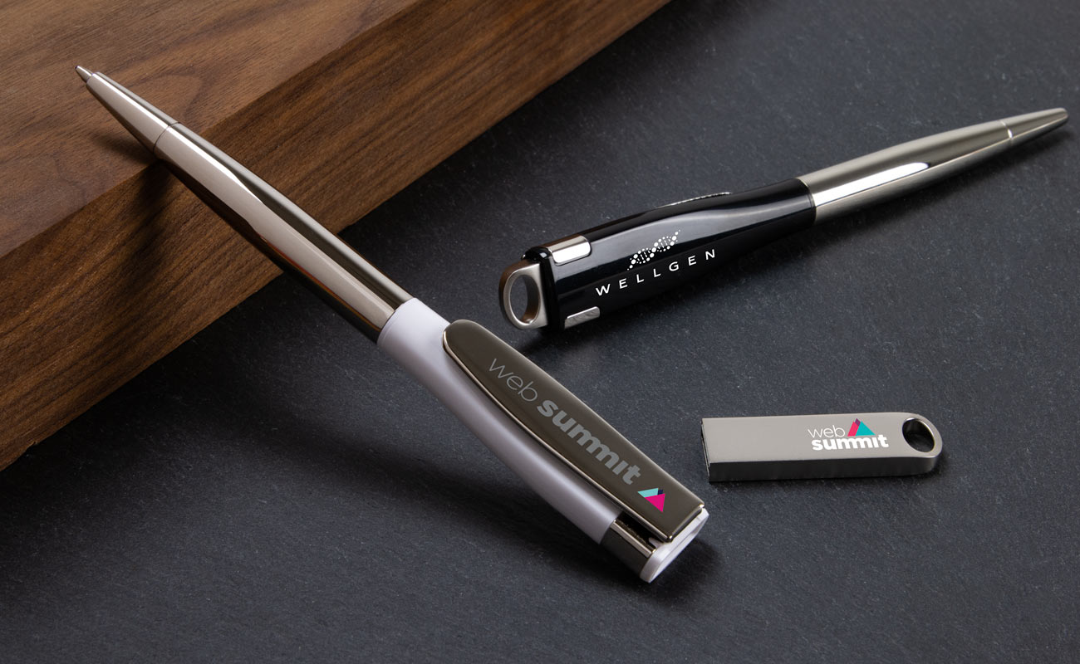
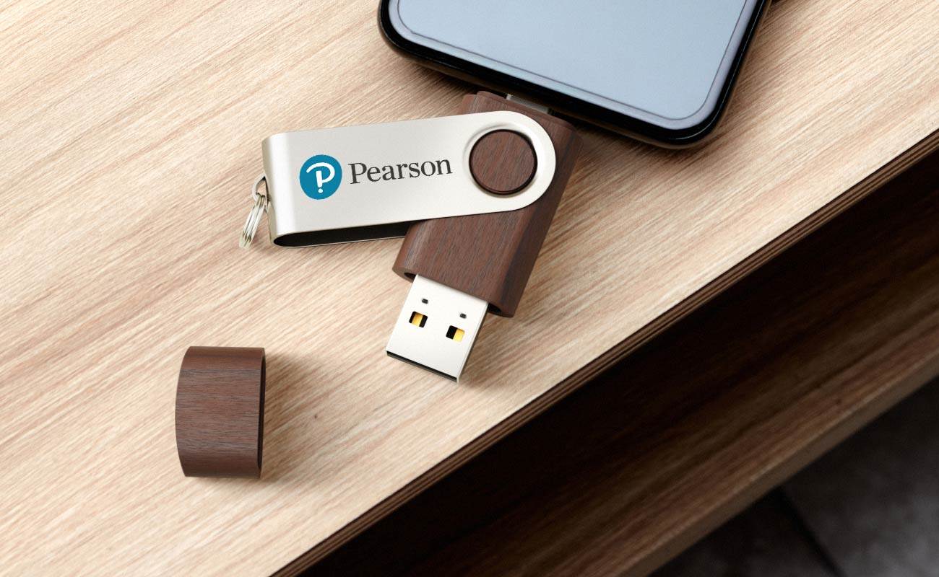
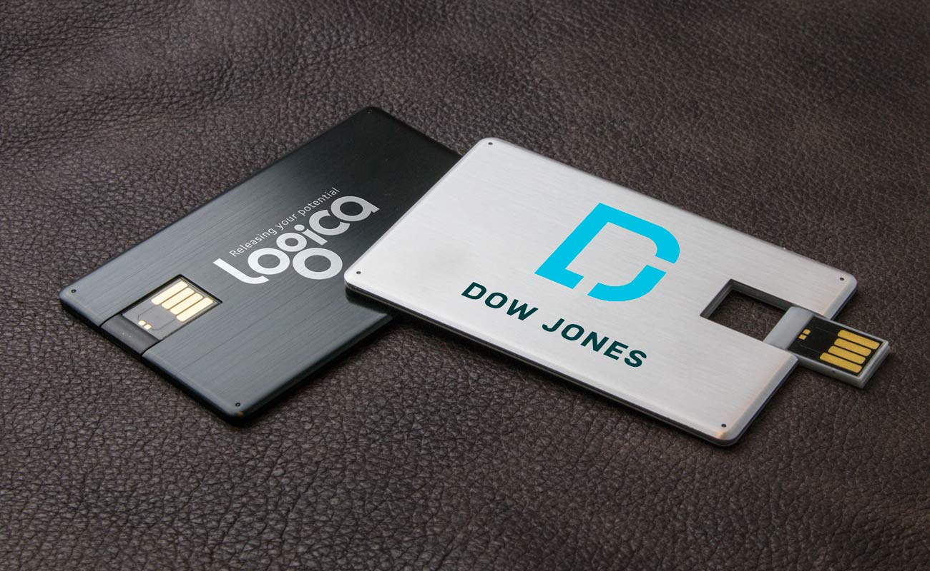
Categories
Standard models
Multifunctional
On The Go (OTG)
Cards

Slide 15
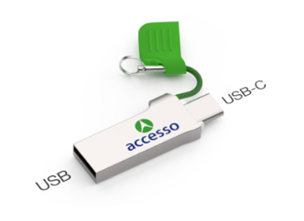
OTG (On The Go) USBs
Are they compatible with iPhones?
Will they work on all devices?
Are they compatible with DP and DPUS?
Lynx, Orbit, Active are available in 3.0 generation (from 32GB up)

Slide 16
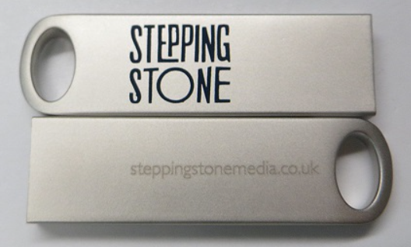
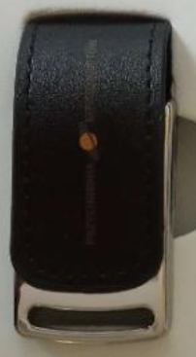
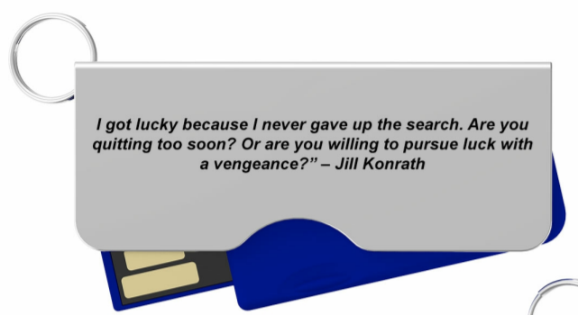
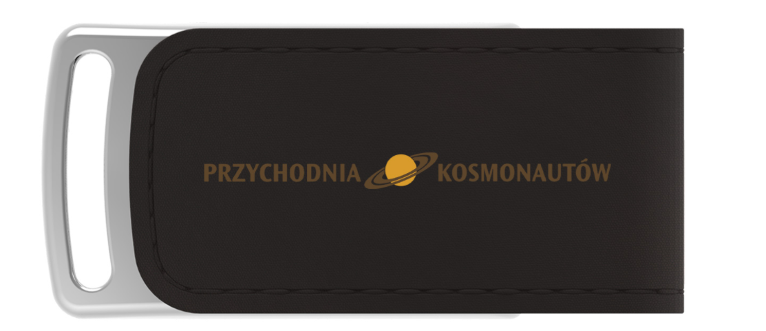
What to look out for?
Small text on small models – FC, HA
Dark print on a dark surface
Too many text on one branding area

Slide 17
Where to look for information?
Flashbay Wiki
Price list
Flashbay Website

Slide 18
Scenario #1
Company: Photographer
Logo:
Model: USBs need to be fast
Deadline 15th Sep

Slide 19
Scenario #2
Company: Software development
Logo:
Model: they consider to store sensitive data on the USBs
Deadline: 11th Sep

Slide 20
Logo #1:
Scenario #3
Company: Travel company
Logo: 2 logos
Model: wants a small USB model
Deadline: non
Logo #2:

Slide 21
Thank you for your attention ☺

