Slide 1
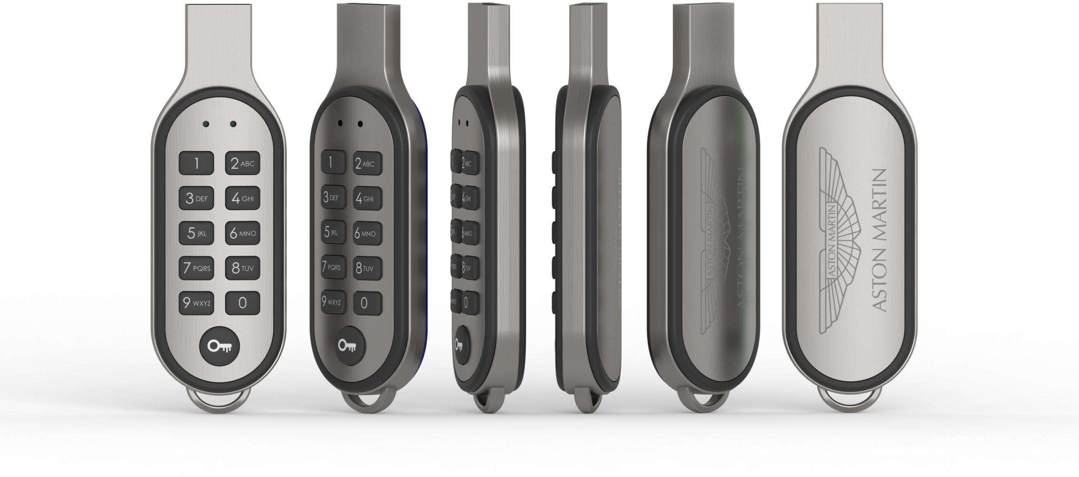
Product Design | ‘Code’ – secure flash drive

Slide 2
Product Design | ‘Code’ – secure flash drive
Important things to note:
This product is NOT an encrypted flash drive. It is a “secure PIN-protected flash drive”. However, if a customer has already encrypted data we can preload that onto the drive.
Resistant to tampering – hard to access the internals and the NAND flash cannot be accessed without the PIN.
Currently only available in USB 2.0 - 16GB
Uses a 20mAh NiMH battery which charges each time the drive is plugged in. Fully-charged in 3 hrs and will last for 1 year.
Default PIN is 1234 – user can change the PIN to anything between 4-15 digits.
A bank card has 10,000 possible combinations. ‘Code’ has 1 quadrillion (1000 trillion) possible combinations.
Letters on the buttons are designed to help remember longer PIN codes (explanation later).
If the wrong PIN code is entered 10 times in a row, the drive will reset to the default number and wipe all data.
We cannot retrieve data if the user has forgotten the PIN code.
Volume Label (VL) Service is available for this product.

Slide 3
Product Design | ‘Code’ – secure flash drive
UNLOCKING THE FLASH DRIVE
The default PIN is 1234. We cannot change this for the customer.
If the wrong PIN is entered 10 times, the drive will reset to this default and destroy all data.

Slide 4
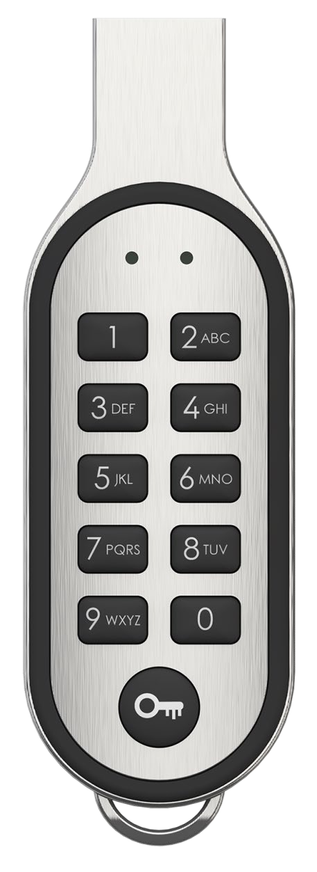
Product Design | ‘Code’ – secure flash drive
Sleep mode
No lights are visible

Slide 5
Product Design | ‘Code’ – secure flash drive
Locked mode
Press any number and the red light will flash quickly 5 times.

Slide 6
Product Design | ‘Code’ – secure flash drive
Unlocking sequence
Press the KEY button to begin unlocking sequence. Red light will flash slowly for 30 seconds. After this time the drive goes back to sleep.

Slide 7
Product Design | ‘Code’ – secure flash drive
Incorrect PIN entered
Once a PIN has been entered and the KEY button pressed to confirm, if the PIN is incorrect the red light will flash quickly 5 times then will turn off indicating it is back in sleep mode.

Slide 8
Product Design | ‘Code’ – secure flash drive
Correct PIN entered and unlocked If the PIN is correct, the red light will disappear and the green light flash quickly 5 times then will remain on. If the drive is not connected to a PC within 30 seconds the drive will auto-lock and the green light will go out.

Slide 9
Product Design | ‘Code’ – secure flash drive
Lock drive from unlocked state If the user wants to lock the drive quicker than waiting the 30 second time-out, they can press the KEY button instead. The green light will turn off and the red light will turn on for 5 seconds. After this the drive will go into sleep mode.

Slide 10
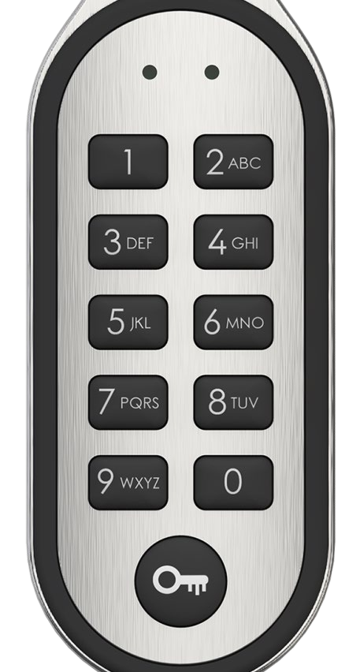
Product Design | ‘Code’ – secure flash drive
CHANGING THE PIN
Any combination of numbers can be used between 4-15 digits.
The new PIN will need to be entered twice to confirm it.
To remember longer PIN numbers, letters have been added to the buttons so that the user can remember a word and then enter the corresponding numbers.
e.g. ‘Flashbay’ would be entered as 35274229.
Please note that this is not done in the same way as classic texting i.e. a number button does not need to be pressed multiple times to cycle though the letters. Only press the number with the corresponding letter once.

Slide 11
Product Design | ‘Code’ – secure flash drive
PIN change sequence
Only when the drive is unlocked, press and hold the KEY button for 3 seconds to begin PIN change sequence. Both the red and green lights will flash synchronously slowly for 30 seconds.
After this time the drive goes back to sleep.

Slide 12
Product Design | ‘Code’ – secure flash drive
Invalid PIN change
Once a PIN has been entered and the KEY button pressed to confirm, if the new PIN is invalid the red light will flash quickly 5 times before returning to it’s unlocked state.

Slide 13
Product Design | ‘Code’ – secure flash drive
Successful PIN change
Once a valid PIN has been entered and the KEY button pressed to confirm, the green light will flash slowly until the user re-confirms the PIN. If the PINs match then the green light will flash quickly and will return to it’s unlocked state.

Slide 14
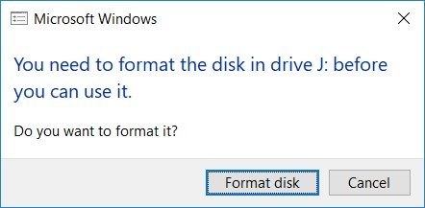
Product Design | ‘Code’ – secure flash drive
RESETTING THE FLASH DRIVE
Resetting the drive will return the PIN to the default which is always 1234.
Resetting the drive will destroy all data saved on the locked partition.
After a reset, when the drive is next unlocked and plugged in, the user will be prompted to format the drive.
It is extremely unlikely that the user will accidentally reset the drive as it requires a combination of buttons to be pressed.

Slide 15
Product Design | ‘Code’ – secure flash drive
Ready to reset
Press and hold the KEY button and ‘9’ for 10 seconds to enter the reset sequence. The red and green lights will flash rapidly. If the KEY button is not pressed within 10 seconds the operation will be cancelled and the drive will go back to sleep.

Slide 16
Product Design | ‘Code’ – secure flash drive
Reset confirmed
Press the KEY button to confirm the reset. The red and green lights will stop flashing to confirm the reset then both lights will turn off, indicating the drive is back in sleep mode.

Slide 17
Product Design | ‘Code’ – secure flash drive
FAQs:
Are there any services that we do not offer with Code?
DPUS and Autorun.
Can we offer Volume Label (VL) service?
Yes.
Is there a paper manual that comes with each drive?
Yes.
Is there a prompt that appears on PC/Mac to enter the PIN?
No, the locked data will just remain inaccessible until the PIN is entered.

Slide 18
Product Design | ‘Code’ – secure Flash Drive
FAQs:
Can the 10x wrong entry countdown be restarted/cancelled?
The counter will only reset if the correct PIN is entered. After that, the counter restarts.
If the user presses the KEY button before entering a PIN will it count towards the automatic reset 10x?
No, only if a PIN is entered will it count.
What if the user types in a wrong PIN and they want to cancel it?
If they do not press the KEY button to confirm it will time-out after 30 seconds and the drive will go back to sleep.

