Slide 1
Sales Cycle

Slide 2
1. Receiving Lead
2. Analysing & Qualifying
3. Response
4. Virtual Proof
5. Dummies
6. Negotiation
7. Order
8. TrustPilot Feedback
9. Customer Follow Up
Sales Cycle

Slide 3
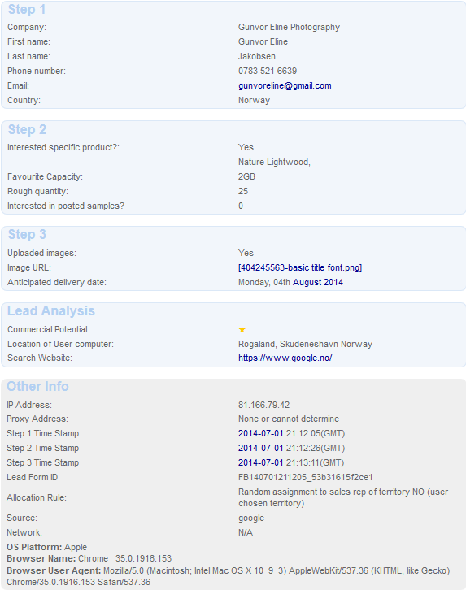
Receiving a Lead
Web
www.flashbay.com
www.flash-drives.com
www.expressusbdrives.com
www.usb-business-cards.com
Note:
If a lead is received from one or more of these sites,
it means the customers is shopping around!
Phone
By a new lead calling in asking for information.

Slide 4
Analysing & Qualifying (first 5 minutes)
Check the information the lead provided. Is anything missing?
Have they chosen a favourite model?
Have they mentioned a deadline?
Have they uploaded a logo?
Make Notes
Before calling your lead, make notes so you can ask the right questions.

Slide 5
Response (10 minutes)
Call your lead – first impression is everything
Phone
E-mail

Slide 6
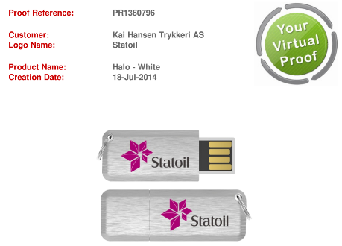
Virtual Proof
When should you make a Virtual Proof?
Has the lead provided you with a logo?
Has your lead mentioned what they would like printed on the back?
Flashbay exclusive models or standard models?

Slide 7
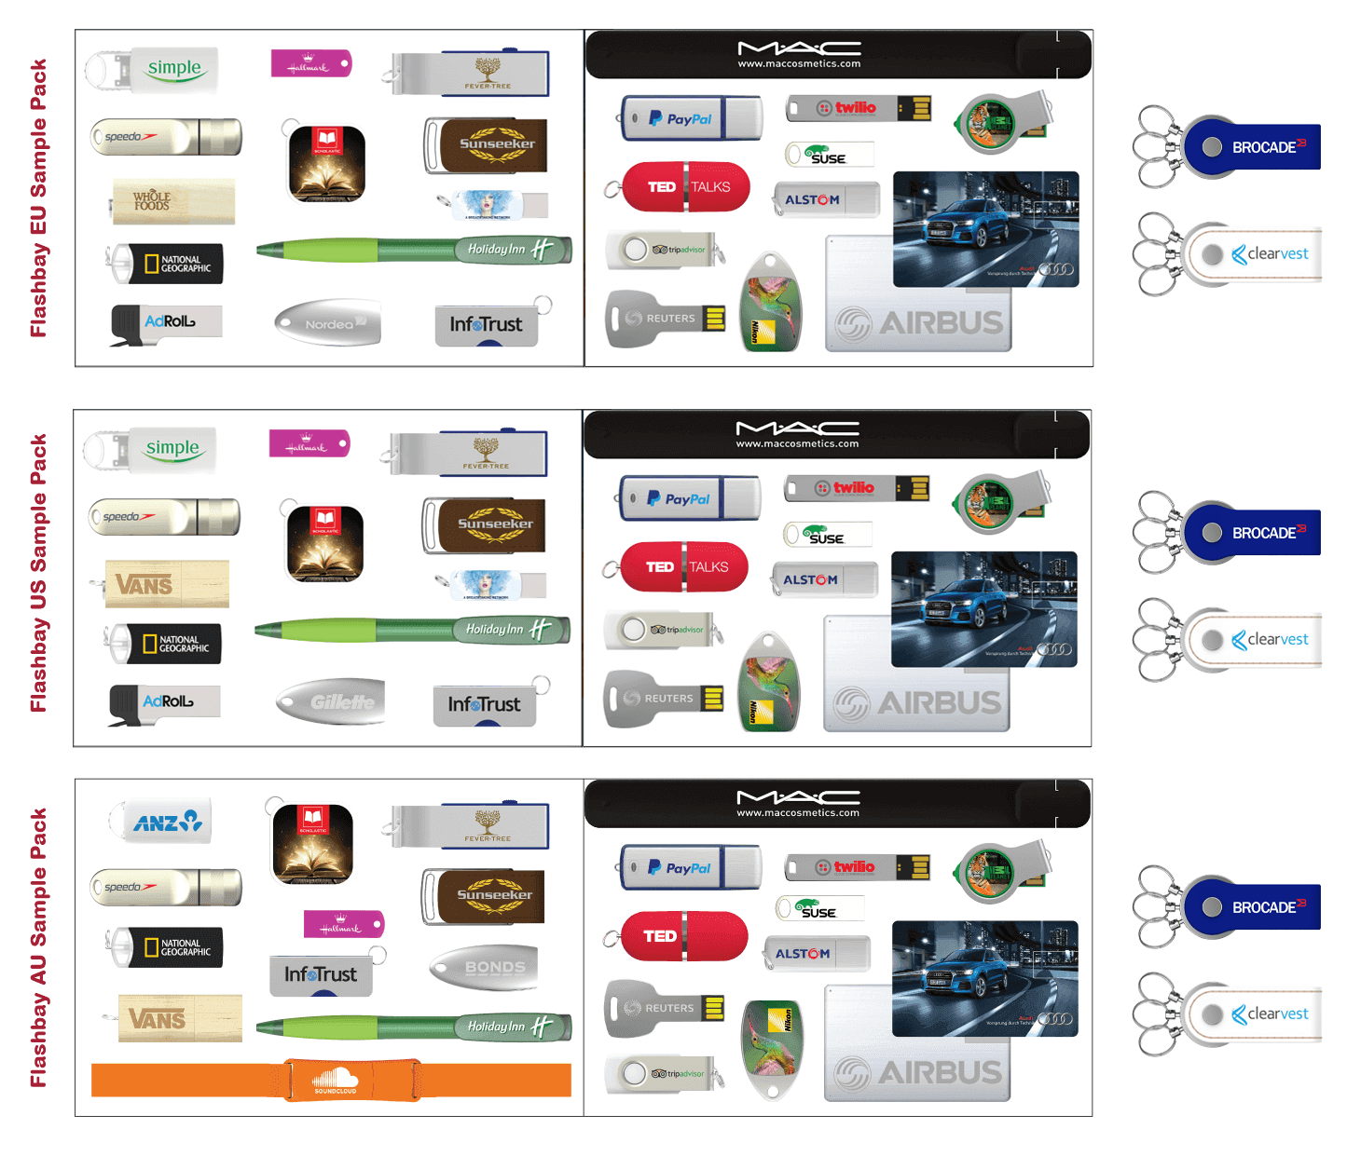
Samples
USB Flash Drives, Power and Future. What fits in a UPS bag?
Can I use my whole Sample budget?
How long does it normally take for samples to arrive?
What do I do when the samples arrive?

Slide 8
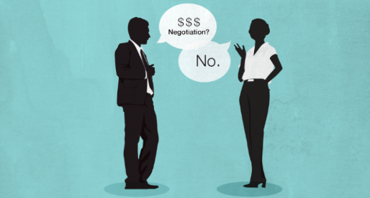
Negotiation
What are the benefits of Flashbay?
Fast delivery
Our own factory
Free Samples (Next day)
Instant Quote (15 mins)
Factory Direct Prices
10 Units Minimum Order
10 Year Warranty/2 Year Warranty
No Hidden Cost
Free Virtual Proof
TrustPilot
Unique Design
Printing included on all printable sides
Original NAND Flash
Aftersales department
Our Sales Staff

Slide 9
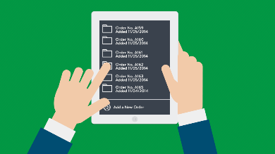
Order
Use our Quote Tool to send order details to your customer including all the relevant information: Shipping/Billing Address, Virtual Proof, Units, Capacity, Lead time, Accessories/Services.
Offer Accessories and Services again - better to ask one time too many than miss an opportunity to up-sell.
Only accept written confirmation from customers.
When placing the order, use the Sales Order Check List. If you are unsure, please ask a colleague to look it over before clicking ‘Save’. Better to triple check now than deal with Aftersales mistakes later.
E-mail your customer confirmation of when their order can be expected.
If the order is on Advanced Payment, please remind your customer that we need payment prior to shipping.

Slide 10
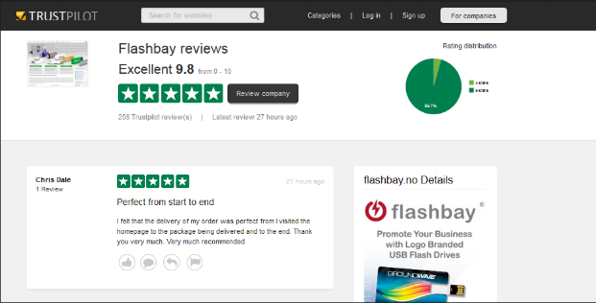
TrustPilot Feedback
Always follow up once a customer has received the order to confirm they are 100% satisfied.
(If not, contact Aftersales.)

Slide 11
C.3.10 Customer Follow Up
All our customers should hear from their Sales Account Manager a minimum of every 180 days. These calls should be around the same time of year as the previous order and then six months after that.
Our Marketing team sends out automatic follow-ups called Friendly Reminders.
Our Marketing team also sends quarterly Marketing emails to all leads and customers the same day.

